Slide 1
Challenges to address for distributed systems
  Yvon Kermarrec
  Télécom Bretagne
  Institut Mines Télécom

Slide 2
Challenges in Distributed System Design
Distributed systems are great … but we need a change in considering a system :
  From centralized to distributed
  From a programming and admin perspectives
  A New way to develop applications that target not one PC but thousands of them…
  New paradigms to deal with difficulties related to DS : faults, network, coordination, ….

Slide 3
Challenges in Distributed System Design
Heterogeneity
Openess
Security
Scalability
Failure handling
Transparencies

Slide 4
Challenge 1 : heterogeneity
  networks (protocols),
  operating systems (APIs) and hardware
  programming languages (data structures, data types)
  implementations by different developers (lack of standards)
  Solution : Middleware
    can mask heterogeneity
    Provides an augmented machine for the users :more services
    provides a uniform computational model for use by the programmers of servers and distributed applications

Slide 5
Challenge 2 : Openness
  The degree to which new resource-sharing services can be added and be made available for use by a variety of client programs
    Specification and documentation of the key software interfaces of the components can be published, discovered and then used
    Extension may be at the hardware level by introducing additional computers

Slide 6
Challenge 3 : security
  Classic security issues in an open world …
    Confidentiality
    Integrity
    Origin and trust
  Continued challenges
    Denial of service attacks
    Security of mobile code

Slide 7
Challenge 4 : scalability (1/2)
  Scalability : system remains effective when there is a significant increase in the number of resources and the number of users
  controlling the cost of performance loss
  preventing software resources from running out
  avoiding performance bottlenecks

Slide 8
Challenge 4 : scalability (2/2)
  Example of a DNS organization
  Performance must not degrade with growth of the system. Generally, any form of centralized resources become performance bottlenecks:
    components (single server),
    tables (directories), or
    algorithms (based on complete information).

Slide 9
Challenge 5 : failure handling
  In distributed systems, some components fail while others continue executing
    Detected failures can be hidden, made less severe, or tolerated
      messages can be retransmitted
      data can be written to multiple disks to minimize the chance of corruption
      Data can be recovered when computation is “rolled back”
      Redundant components or computations tolerate failure
    Failures might result in loss of data and services

Slide 10
Challenge 6 : concurrency
  Several clients may attempt to access a shared resource at the same time
    ebay bids
  Generally multiple requests are handled concurrently rather than sequentially
  All shared resources must be responsible for ensuring that they operate correctly in a concurrent environment
  Thread, synchronization, dead lock …

Slide 11
Transparency ?
It is the concealment from the user and the application program of the separation of the components of a distributed system (single image view).
It is a strong property that often is difficult to achieve.
There are a number of different forms of transparency
Transparency : the system is perceived as a whole rather than as a collection of independent components

Slide 12
Different forms of transparencies
Location: Users are unaware of location of resources
Migration: Resources can migrate without name change
Replication: Users are unaware of the existence of multiple copies
Failure: Users are unaware of the failure of individual components
Concurrency: Users are unaware of sharing resources with others
Parallelism: Users are unaware of parallel execution of activities

Slide 13
How to deal with these transparencies ?
  For each of the transparency level, indicate how you would implement them ?

Slide 14
How to develop a distributed application
A sequential application + communication calls (similar to C + Thread library)
A middleware + an application
A specific language
See next course….

Slide 15
One approach to ease the development of an application
Client-server model
  client processes interact with individual server processes
      servers processes are in separate host computers
      clients access the resources the servers manage
      servers may be clients of other servers
  Examples
      Web servers are clients of the DNS service

Slide 16
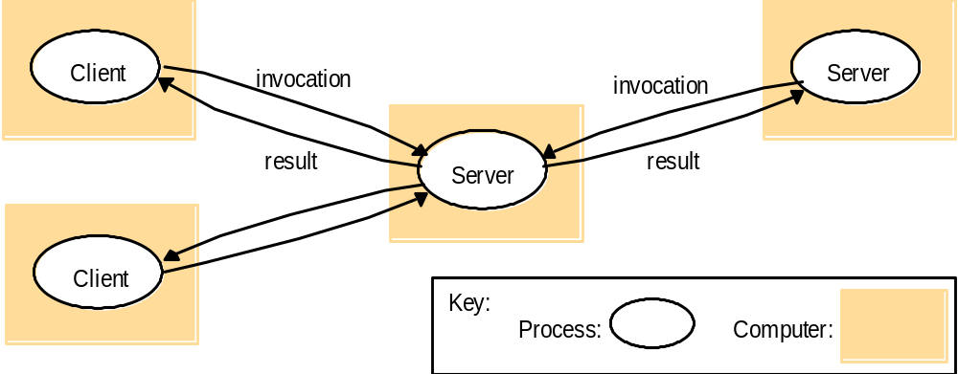
Client-Server

Slide 17
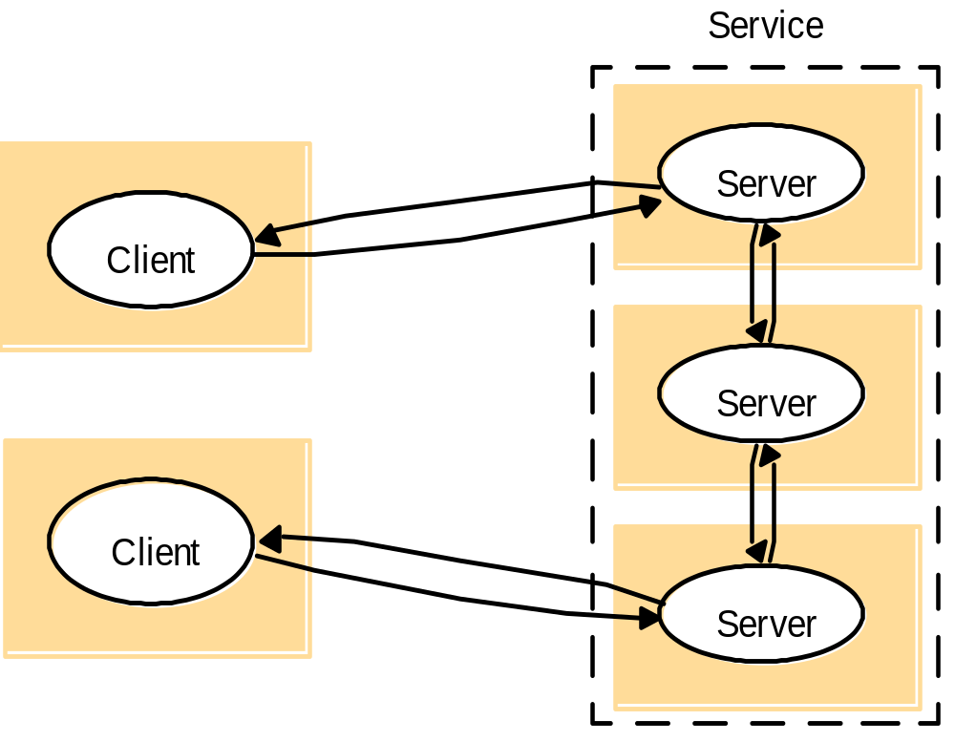
Multiple Servers
Separate processors interact to provide a service

Slide 18
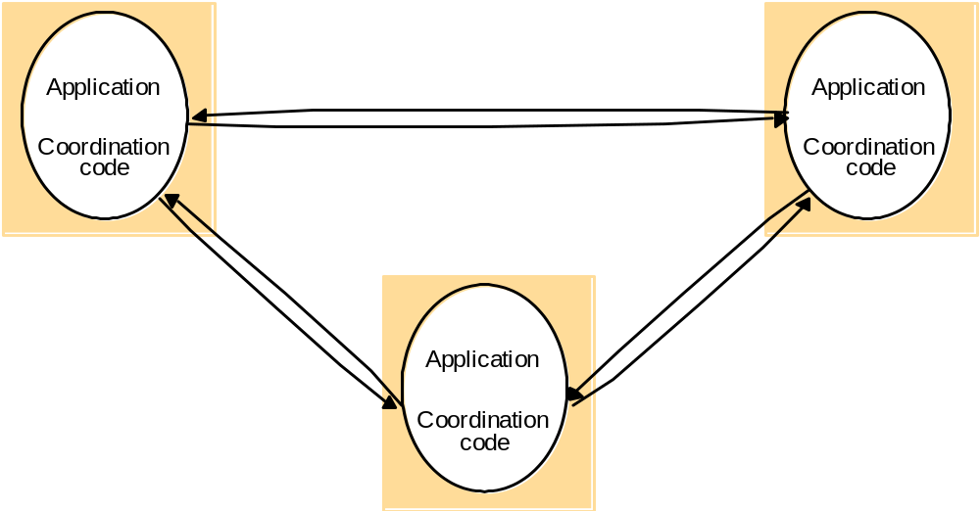
Peer Processes
All processors play a similar role - eliminate servers

Slide 19
Distributed Algorithms
A definition of the steps to be taken by each of the processes of which the system is composed, including the messages transmitted between them
Types of distributed algorithms
  Interprocess Communication (IPC)
  Timing Model
  Failure Model

Slide 20
Distributed Algorithms
Address problems of
      resource allocation -- deadlock detection
      communication -- global snapshots
      consensus -- synchronization
      concurrency control -- object implementation
Have a high degree of
    uncertainty and independence of activities
      unknown # of processes & network topology
      independent inputs at different locations
      several programs executing at once, starting at different times, operating at different speeds
      processor non-determinism
      uncertain message ordering & delivery times
      processor & communication failures

Slide 21
Interprocess Communication
Distributed algorithms run on a collection of processors
    communication methods may be shared memory, point-point or broadcast messages, and RPC
    Communication is important even for the system
      Multiple server processes may cooperate with one another to provide a service
        DNS partitioning and replicating its data at multiple servers throughout the Internet
      Peer processes may cooperate with one another to achieve a common goal

Slide 22
Difficulties and algorithms
For sequential programs
  An algorithm consists in a a set of successive steps
  Execution rate is immaterial
For distributed algorithms
  Processor execute at unpredictable and all different rates
  Communication delays and latencies
  Errors and failure may happen
  A global state (ie, memory …) does not exist
  Debug is difficult

Slide 23
3 major difficulties
Time issues
Interaction model
failures

Slide 24
Time issues
Each processor has an internal clock
  Used to date local events
  Clock may drift
  Different time values when reading the clock at the « same time »
Issues
  Local time is not enough to time stamp events
  Difficulties to order events and compare them
  Necessities to resynchronize the clocks

Slide 25
Time issues
Events order
  MSC : Message Sequence Chart – a way to present interactions and communications
X
Y
Z
A
X site broadcasts a message to all sites – the other broadcast
Their response. Due to different network speed / latencies
Node A, receives the response of Z before the question from X.
Idea : be able to order the events / to compare them

Slide 26
Time issues
In the MSC presented earlier, all processes see different order of the messages / events
How to order them (resconstruct a logic) so that processes can take coherent decisions

Slide 27
Synchronization model
Synchronous model
  Simple model
  Lower and upper bounds for execution times and communication are known
  No clock drift
Asynchronous
  Execution speed are ‘random’ / comm
  Universal model in LAN + WAN
    Routers introduce delays
    Servers may be loaded / the CPU may be shared
    Errors and faults may occur

Slide 28
Timing Model
Different assumptions can be made about the timing of the events in the system
  Synchronous
    processor communication and computation are done in lock-step
  Asynchronous
    processors run at arbitrary speeds and in arbitrary order
  Partially synchronous
    processors have partial information about timing

Slide 29
Synchronous Model (1/2)
Simplest to describe, program, and reason about
  components take steps simultaneously
    not what actually happens, but used as a foundation for more complexity
      intermediate comprehension step
      impossibility results care over
Very difficult to implement
  Synchronous language for specialized purposes

Slide 30
Synchronous Model (2/2)
2 armies – one leader : the 1rst to attack – the 2 armies must attack together or not
Message transmission (min, max) is known and there is no fault
1 sends « attack ! » and wait for min and then attacks
2 receives « attack ! » and wait for one TU.
1 is the leader and 2 charges within max-min+1

Slide 31
Asynchronous Model (1/2)
Separate components take steps arbitrarily
Reasonably simple to describe - with the exception of liveness guarantees
Harder to accurately program
Allows ignorance to timing considerations
May not provide enough power to solve problems efficiently

Slide 32
Asynchronous Model (2/2)
Coordination is more difficult for the armies
Select a sufficient large T
1 sends « attack ! » and wait for T and then attacks
2 receives « attack ! » and wait for one TU.
Cannot guarantee 1 is the leader

Slide 33
Partially Synchronous Model
Some restrictions on the timing of events, but not exactly lock-step
Most realistic model
Trade-offs must be considered when deciding the balance of the efficiency with portability

Slide 34
Failure Model (1/6)
The algorithm might need to tolerate failures
  processors
    might stop
    degrade gracefully
    exhibit Byzantine failures
  may also be failures of
    communication mechanisms

Slide 35
Failure Model (2/6)
Various types of failure
  Message may not arrive : omission failure
  Processes may stop and the other may detect this situation (stopping failure)
  Processes may crash and the others may not be warned (crash failure)
  For real time, deadline may not be met
    Timing failure

Slide 36
Failure Model (3/6)
Failure type
  Benign : omission, stopping, timing failures
  Severe : Altered message, bad results, Byzantine failures

Slide 37
Failure Model (4/6)
Crash failure
  Processes crash and do not respond anymore
  Crash detection
    Use time out
    Difficulties with asynchronous model
      Slow processes
      Non arrived message
      Stopped process, etc.

Slide 38
Failure Model (5/6)
Stopping failure
  Processes stop their execution and can be observed
  Synchronous model
    Time out
    Asynchronous model
      Hard to distinguish between a slow message and if a stopping failure has occurred

Slide 39
Failure Model (6/6)
Byzantine failure
  The most difficult to deal with
  3 processes cannot resolve the situation in presence of one faute
  Need n > 3 * f (f number of faulty processes and n number of processes)
  Complex algorithms which monitor all the messages exchanged between the nodes / processes

Slide 40
Conclusions
Distributed algorithm are sensitive to
  The interaction model
  Failure type
  Timing issues
Design issues
  Control timing issues with time outs
  Introduce fault tolerance and recovery

Slide 41
Conclusions
Quality of a distributed algorithm
  Local state vs. Global state
  Distribution degree
  Fault tolerance
  Assumptions on the network
  Traffic and number of messages required

Slide 42
Design issues
Use direct call to the O/S
  Simple and complex
Use a middleware to ensure portability and ease of use
  PVM, MPI, Posix
  CORBA, DCE, SOA and web services
Use a specific distributed language
  Linda, Occam, Java RMI, Ada 95

Slide 43
Various forms of communications
Communication paradigms
  Message passing : send + receive
  Shared memory : rd / write
  Distributed object : remote invocation
  Service invocation
Communication patterns
  Unicast
  Multicast and broadcast
  RPC

