Slide 1
Distributed Computing Paradigms
Yvon Kermarrec
Based on ML Liu’s transparencies
“Distributed computing : principles and applications” published by Addison-Wesley

Slide 2
Paradigms for Distributed Applications
Paradigm means “a pattern, example, or model.” In the study of any subject of great complexity, it is useful to identify the basic patterns or models, and classify the detail according to these models.
Characteristics that distinguish distributed applications from conventional applications which run on a single machine.
  Existence of multiple processing elements
  Interprocess communication to cooperate and communicate (exchange data and results)
  Event synchronization: In a distributed application, the sending and receiving of data among the participants of a distributed application must be synchronized.

Slide 3
Abstractions
“We often use abstraction when it is not necessary to know the exact details of how something works or is represented, because we can still make use of it in its simplified form. Getting involved with the detail often tends to obscure what we are trying to understand, rather than illuminate it … Abstraction plays a very important role in programming because we often want to model, in software, simplified versions of things that exist in the real world … without having to build the real things.” D Barnes
In software engineering, abstraction is realized with the provision of tools or facilities which allow software to be built without the developer having to be aware of some of the underlying complexities.

Slide 4
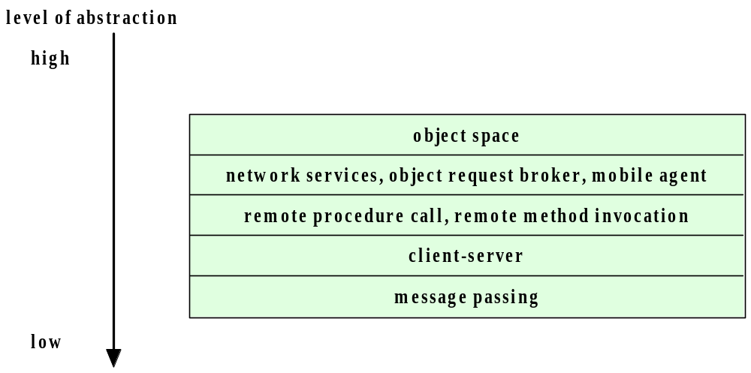
Distributed Application Paradigms

Slide 5
The message passing paradigm (1/13)
Message passing is very flexible, universal, can be highly efficient, and is absolutely ghastly to use
Straightforward to use with the OS facilities and the network layers
Notes:
Message passing parallel programming paradigm is very flexible, universal, can be highly efficient, and is absolutely ghastly to use. But since the former three outweigh the latter, message passing wins and is currently used by most parallel production codes.
As was the case with data parallel programming, message passing programming is a paradigm and can be implemented on systems with various architectures. You can use message passing on clusters, on SMPs, even on single CPU machines and on fancy supercomputers like Cray T3E and Cray X1.
In message passing paradigm your computer program can be logically split into as many different processes as you need. You can even have more processes than you have CPUs, but usually you try to match these two numbers together. The processes can all run quite different codes and they can run on CPUs that are geographically distant. For example you can have one process run in Bloomington and another one run in Gary.
The processes exchange data with one another by sending messages. A process can send a message in such a way that it doesn't care if the message has been received by anybody. So the messages that have been sent, don't need to be received. But usually they are and there are special function calls for receiving messages too.
The most commonly used library for message passing is called the Message Passing Interface . Two popular freeware implementations of it exist, one developed by the Argonne National Laboratory, called MPICH , and another one developed by the Ohio Supercomputer Center , but currently maintained by the LAM organization and the LAM team at Indiana University .
MPI is huge. There are hundreds of functions in it for doing various things. We are going to study and use some of them in this course, with special emphasis on functions for doing parallel IO.
Because MPI is so flexible and universal, data parallel languages for clusters are often implemented on top of MPI, i.e., the compiler automatically converts a data parallel code to an MPI code. This is how the Portland Group HPF compiler works and this is how the IBM HPF compiler for SP works too.

Slide 6
The message passing paradigm (2/13)
A p p l i c a t i o n
T r a n s p o r t
N e t w o r k
T r a n s p o r t
A p p l i c a t i o n / S e r v e r
N e t w o r k
MOM (With Message Queue)
MOM (With Message Queue)
Application
Specific
or
Proprietary
Message

Slide 7
The message passing paradigm (3/13)
Message passing is the most fundamental paradigm for distributed applications.
  A process sends a message representing a request.
  The message is delivered to a receiver, which processes the request, and sends a message in response.
  In turn, the reply may trigger a further request, which leads to a subsequent reply, and so forth. The message-

Slide 8
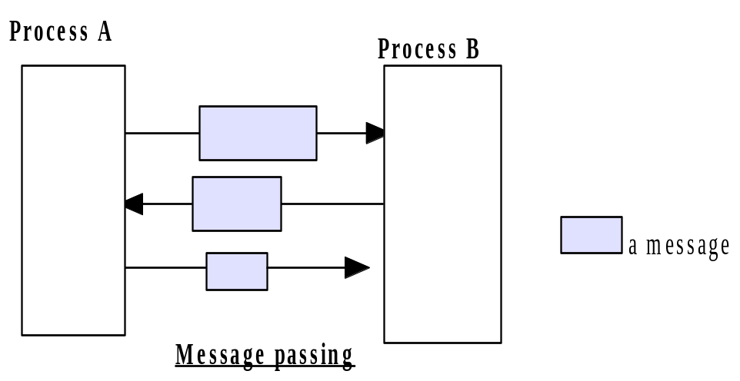
The message passing paradigm (4/13)

Slide 9
The message passing paradigm (5/13)
The basic operations required to support the basic message passing paradigm are send, and receive.
For connection-oriented communication, the operations connect and disconnect are also required.
With the abstraction provided by this model, the interconnected processes perform input and output to each other, in a manner similar to file I/O.
The I/O operations encapsulate the detail of network communication at the operating-system level.
The socket application programming interface is based on this paradigm.
  http://www.sockets.com/

Slide 10
The message passing paradigm (6/13)
Synchronous communication
  Communication and synchronization are tightly coupled.
  To send a message, a process must establish a channel and then send message.
  Process sending a message delays until the other process is ready to receive the message.

Slide 11
The message passing paradigm (7/13)
Asynchronous communication
  send primitive does not cause a process to block
  a message might be received arbitrarily long after it has been sent.
  communication channel has unbounded capacity
  receive is a blocked call

Slide 12
The message passing paradigm (8/13)
The Message System or Message-Oriented Middleware (MOM) paradigm is an elaboration of the basic message-passing paradigm.
In this paradigm, a message system serves as an intermediary among separate, independent processes.
The message system acts as a switch for messages, through which processes exchange messages asynchronously, in a decoupled manner.
A sender deposits a message with the message system, which forwards it to a message queue associated with each receiver. Once a message is sent, the sender is free to move on to other tasks.

Slide 13
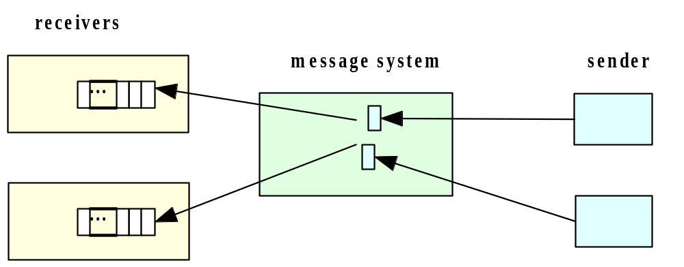
The message passing paradigm (9/13)

Slide 14
The message passing paradigm (10/13)
The Point-To-Point Message Model
  In this model, a message system forwards a message from the sender to the receiver’s message queue.
  The middleware provides a message depository, and allows the sending and the receiving to be decoupled.
  Via the middleware, a sender deposits a message in the message queue of the receiving process. A receiving process extracts the messages from its message queue, and handles each one accordingly.
  Compared to the basic message-passing model, this paradigm provides the additional abstraction for asynchronous operations. To achieve the same effect with basic message-passing, a developer will have to make use of threads or child processes.

Slide 15
The message passing paradigm (11/13)
The Publish/Subscribe Message Model
  In this model, each message is associated with a specific topic or event. Applications interested in he occurrence of a specific event may subscribe to messages for that event. When the awaited event occurs, the process publishes a message announcing the event or topic. The middleware message system distributes the message to all its subscribers.
  The publish/subscribe message model offers a powerful abstraction for multicasting or group communication. The publish operation allows a process to multicast to a group of processes, and the subscribe operation allows a process to listen for such multicast.

Slide 16
The message passing paradigm (12/13)
The MOM paradigm has had a long history in distributed applications.
Message Queue Services (MQS) have been in use since the 1980’s.
  PVM and now MPI
  Java’s Message Service
  http://developer.java.sun.com/developer/technicalArticles/Networking/messaging/

Slide 17
The message passing paradigm (13/13)
Questions
  Difficulties with the message passing approach ?
  How to reference its communication counter-part?
  Direct naming vs. Indirect naming

Slide 18
The client / server paradigm (1/4)
Perhaps the best known paradigm for network applications, the client-server model assigns asymmetric roles to two collaborating processes.
One process, the server, plays the role of a service provider which waits passively for the arrival of requests. The other, the client, issues specific requests to the server and awaits its response.
Well known at the OS level

Slide 19
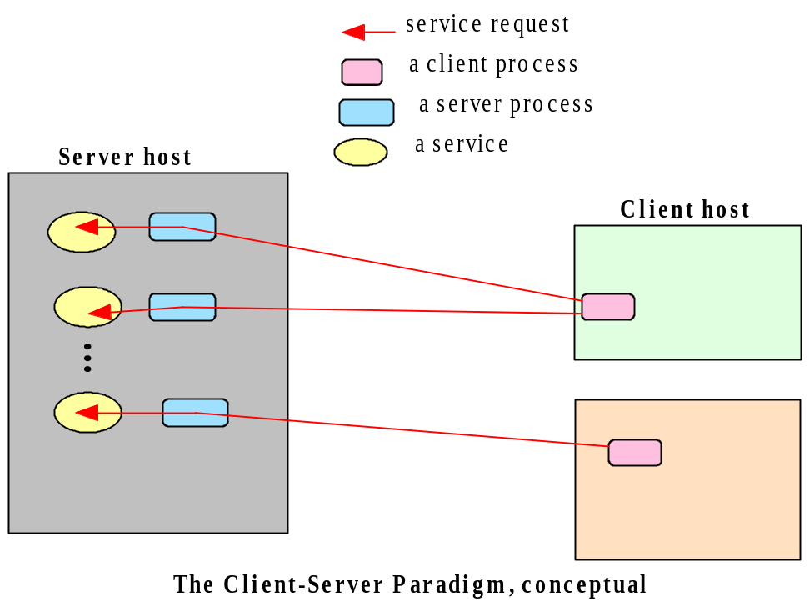
The client / server paradigm (2/4)

Slide 20
The client / server paradigm (3/4)
Simple in concept, the client-server model provides an efficient abstraction for the delivery of network services.
Operations required include those for a server process to listen and to accept requests, and for a client process to issue requests and accept responses.

Slide 21
The client / server paradigm (4/4)
By assigning asymmetric roles to the two sides, event synchronization is simplified: the server process waits for requests, and the client in turn waits for responses.
Many Internet services are client-server applications. These services are often known by the protocol that the application implements.
Well known Internet services include HTTP, FTP, DNS, finger, gopher, etc.

Slide 22
Remote Procedure Call (1/5)
As applications grew increasingly complex, it became desirable to have a paradigm which allows distributed software to be programmed in a manner similar to conventional applications which run on a single processor.
The Remote Procedure Call (RPC) model provides such an abstraction.
Using this model, interprocess communications proceed as procedure, or function, calls, which are familiar to application programmers.
  Notion of parameters and call

Slide 23
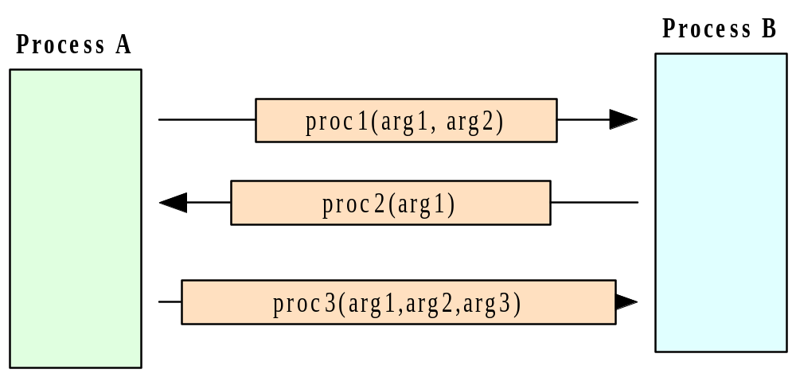
Remote Procedure Call (2/5)

Slide 24
Remote Procedure Call (3/5)
RPC allows programmers to build network applications using a programming construct similar to the local procedure call, providing a convenient abstraction for both interprocess communication and event synchronization.
Since its introduction in the early 1980s, the Remote Procedure Call model has been widely in use in network applications and is used at system level

Slide 25
Remote Procedure Call (4/5)
There are two prevalent APIs for Remote Procedure Calls.
  The Open Network Computing Remote Procedure Call, evolved from the RPC API originated from Sun Microsystems in the early 1980s.
  The OSF Group - Distributed Computing Environment (DCE) RPC.
Both APIs provide a tool, rpcgen, for transforming remote procedure calls to local procedure calls to the stub.

Slide 26
Remote Procedure Call (5/5)
Questions
  RPC vs. Message passing ?

Slide 27
The Peer-to-Peer System Architecture (1/5)
In system architecture and networks, peer-to-peer is an architecture where computer resources and services are directly exchanged between computer systems.
These resources and services include the exchange of information, processing cycles, cache storage, and disk storage for files.
In such an architecture, computers that have traditionally been used solely as clients communicate directly among themselves and can act as both clients and servers, assuming whatever role is most efficient for the network.

Slide 28
The Peer-to-Peer System Architecture (2/5)
In the peer-to-peer paradigm, the participating processes play equal roles, with equivalent capabilities and responsibilities (hence the term “peer”). Each participant may issue a request to another participant and receive a response.

Slide 29
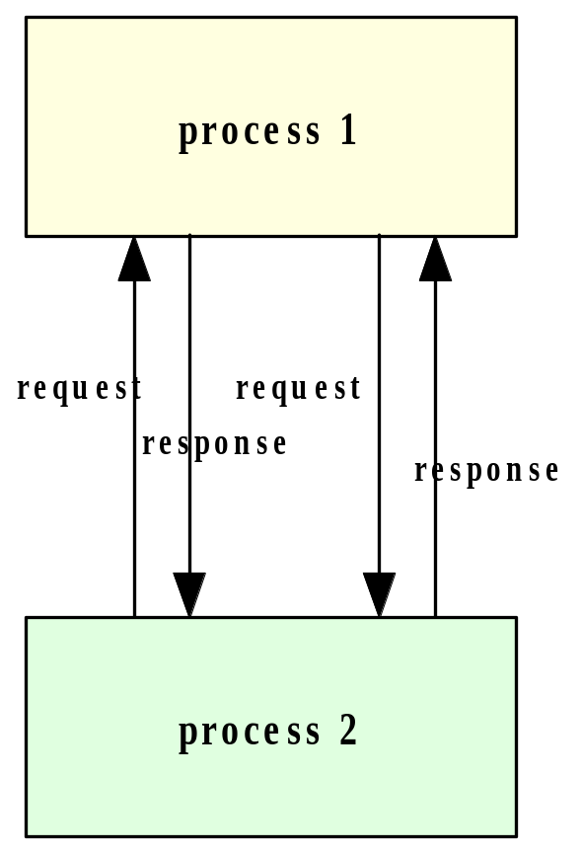
The Peer-to-Peer System Architecture (3/5)

Slide 30
The Peer-to-Peer System Architecture (4/5)
Whereas the client-server paradigm is an ideal model for a centralized network service, the peer-to-peer paradigm is more appropriate for applications such as instant messaging, peer-to-peer file transfers, video conferencing, and collaborative work. It is also possible for an application to be based on both the client-server model and the peer-to-peer model.
A well-known example of a peer-to-peer file transfer service is Napster.com or similar sites which allow files (primarily audio files) to be transmitted among computers on the Internet. It makes use of a server for directory in addition to the peer-to-peer computing.

Slide 31
The Peer-to-Peer System Architecture (1/5)
The peer-to-peer paradigm can be implemented with facilities using any tool that provide message-passing, or with a higher-level tool such as one that supports the point-to-point model of the Message System paradigm.
http://www.jxta.org/
http://www.jabber.org/

Slide 32
The Peer-to-Peer System Architecture (1/5)
http://www.jxta.org/
“Project JXTA is a set of open, generalized peer-to-peer protocols that allow any connected device (cell phone, to PDA, PC to server) on the network to communicate and collaborate. JXTA is short for Juxtapose, as in side by side. It is a recognition that peer to peer is juxtapose to client server or Web based computing -- what is considered today's traditional computing model. “
JXTA peers create a virtual network where any peer can interact with other peers and resources directly

Slide 33
The distributed object paradigm (1/3)
The idea of applying object orientation to distributed applications is a natural extension of object-oriented software development.
Applications access objects distributed over a network.
Objects provide methods, through the invocation of which an application obtains access to services.
Object-oriented paradigms include:
  Remote method invocation (RMI)
  Network services
  Object request broker
  Object spaces

Slide 34
The distributed object paradigm (2/3)
Java RMI
  Remote method invocation is the object-oriented equivalent of remote method calls.
  In this model, a process invokes the methods in an object, which may reside in a remote host.
  As with RPC, arguments may be passed with the invocation.

Slide 35
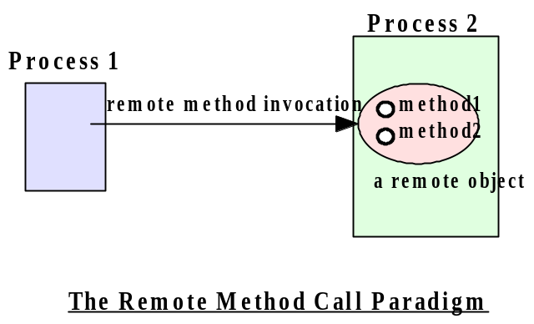
The distributed object paradigm (3/3)

Slide 36
The network service paradigm (1/5)
Service providers register themselves with directory servers on a network.
A process desiring a particular service contacts the directory server at run time, and, if the service is available, will be provided a reference to the service.
Using the reference, the process interacts with the service.
This paradigm is essentially an extension of the remote method call paradigm. The difference is that service objects are registered with a global directory service, allowing them to be look up and accessed by service requestors on a federated network.
Java’s Jini technology is based on this paradigm.

Slide 37
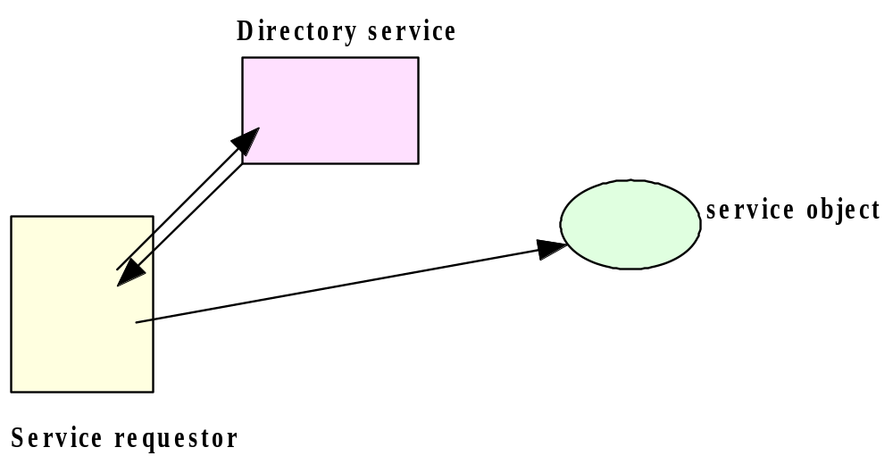
The network service paradigm (2/2)

Slide 38
The object broker paradigm (1/3)
An application issues requests to an object request broker (ORB), which directs the request to an appropriate object that provides the desired service.
The paradigm closely resembles the remote method invocation model in its support for remote object access. The difference is that the object request broker functions as a middleware which allows an application, as an object requestor, to potentially access multiple remote (or local) objects.
The request broker may also function as an mediator for heterogeneous objects, allowing interactions among objects implemented using different APIs and /or running on different platforms.

Slide 39
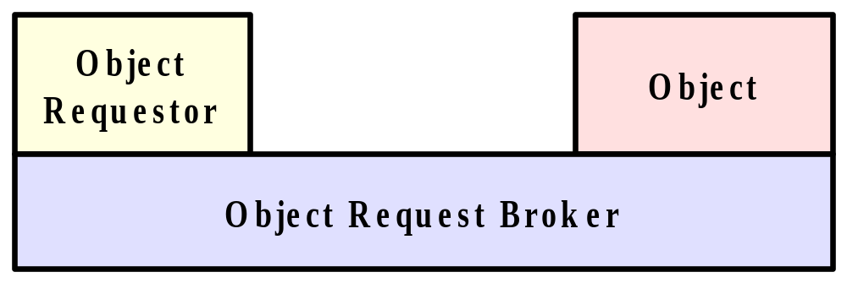
The object broker paradigm (2/3)

Slide 40
The object broker paradigm (3/3)
This paradigm is the basis of the Object Management Group’s CORBA (Common Object Request Broker Architecture) architecture.
http://www.corba.org/
Tool kits based on the architecture include:
  Orbix’s IONA
  TAO from the Object Computing, Inc.
  JacORB

Slide 41
The Object Space Paradigm (1/3)
Perhaps the most abstract of the object-oriented paradigms, the object space paradigm assumes the existence of logical entities known as object spaces.
The participants of an application converge in a common object space.
A provider places objects as entries into an object space, and requesters who subscribe to the space access the entries.

Slide 42
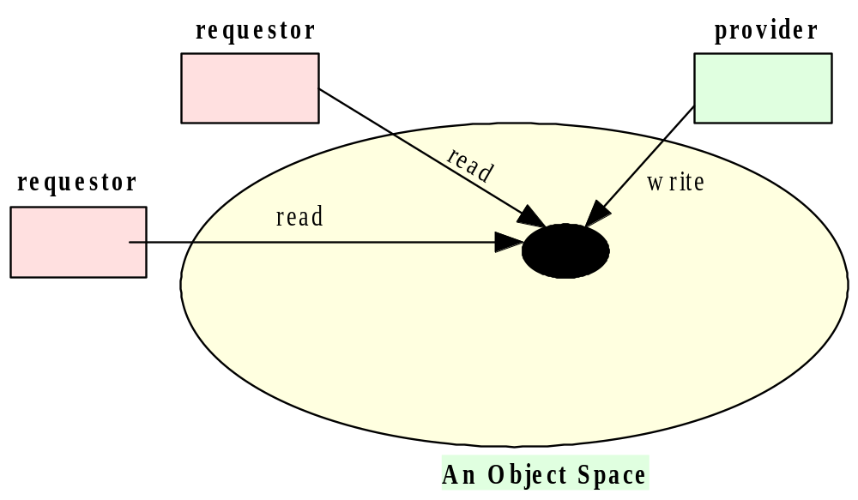
The Object Space Paradigm (2/3)

Slide 43
The Object Space Paradigm (3/3)
In addition to the abstractions provided by other paradigms, the object space paradigm provides a virtual space for providers and requesters of network resources or objects.
This abstraction hides the detail involved in resource or object lookup needed in paradigms such as remote method invocation, object request broker, or network services.
Linda and its tuple space (University of Yale)
JavaSpaces
http://java.sun.com/products/javaspaces/

Slide 44
Component based paradigms
Component-based technologies such as Microsoft’s COM, Microsoft DCOM, Java Bean, and Enterprise Java Bean are also based on distributed-object paradigms, as components are essentially specialized, packaged objects designed to interact with each other through standardized interfaces.
In addition, application servers, popular for enterprise applications, are middleware facilities which provide access to objects or components.
IBM’s WebSphere,

Slide 45
The mobile agent paradigm (1/3)
A mobile agent is a transportable program or object.
In this model, an agent is launched from an originating host.
The agent travels from host to host according to an itinerary that it carries.
At each stop, the agent accesses the necessary resources or services, and performs the necessary tasks to accomplish its mission.

Slide 46
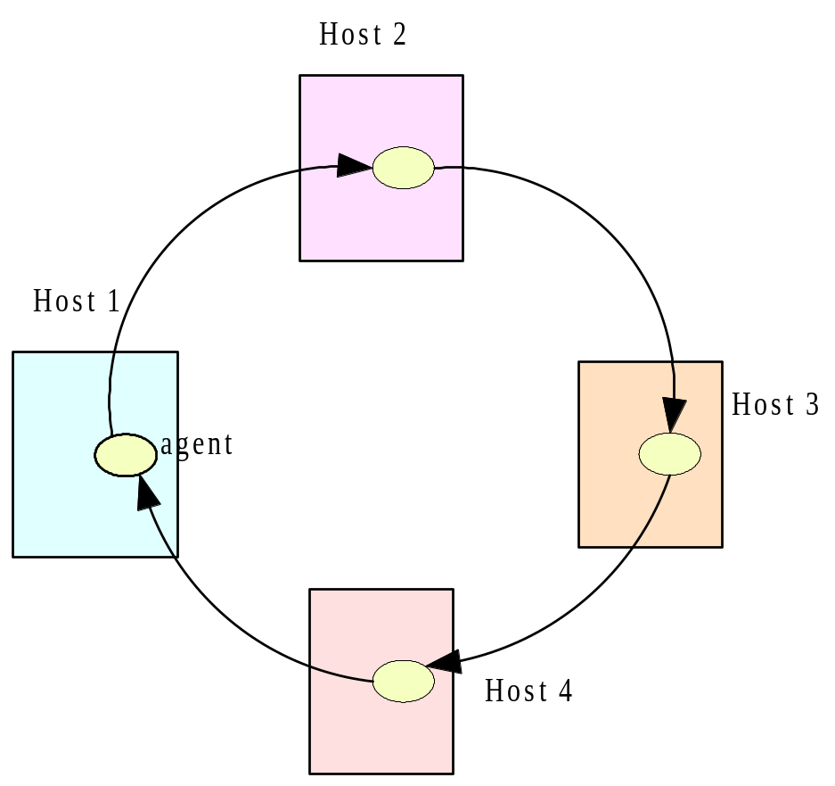
The mobile agent paradigm (2/3)

Slide 47
The mobile agent paradigm (3/3)
The paradigm offers the abstraction for a transportable program or object.
In lieu of message exchanges, data is carried by the program/object as the program is transported among the participants.
Commercial packages which support the mobile agent paradigm include:
  Mitsubishi Electric ITA’s Concordia system http://www.meitca.com/HSL/Projects/Concordia/Welcome.html
  IBM’s Aglet system.
http://www.trl.ibm.co.jp/aglets/

Slide 48
The groupware paradigm (1/2)
In this model, processes participate in a collaborative session as a group. Each participating process may contribute input to part or all of the group.
Processes may do so using:
  multicasting to send data to all or part of the group, or they may use a
  virtual sketchpads or whiteboards which allows each participant to read and write data to a shared display.

Slide 49
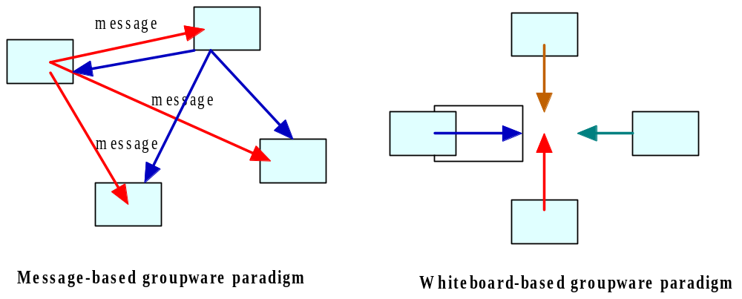
The groupware paradigm (2/2)

Slide 50
Summary
We have looked at a wide range of paradigms for distributed applications.
The paradigms presented were:
  Message passing
  Client-server
  Message system: Point-to-point; Publish/Subscribe
  Distributed objects:
    Remote method invocation
    Object request broker
    Object space
  Mobile agents
  Network services
  Collaborative applications

Slide 51
Summary
To varying degrees, these paradigm provide abstractions that insulate the developers from the detail of interprocess communication and event synchronization, allowing the programmer to concentrate on the bigger picture of the application itself.
In choosing a paradigm or a tool for an application, there are tradeoffs that should be considered, including overheads, scalability, cross-platform support, and software engineering issues.

Slide 52
Summary
Questions
  Level of abstraction vs. Overhead ?
  Scalability issues
  Cross platform support
  Middleware and implementation of the facilities:
    How to implement asynchronous communication ? How to deal with cross platform issues ? How to implement the publish / subscribe model ?

Slide 53
Shared memory paradigm
Communicating through shared memory can be very fast, but it can be also quite troublesome
  Race condition
  Page default
  A process that wants to write on a shared memory location or that wants to read from it, can lock it, so that no other process can access it for writing at the same time.

