Slide 1


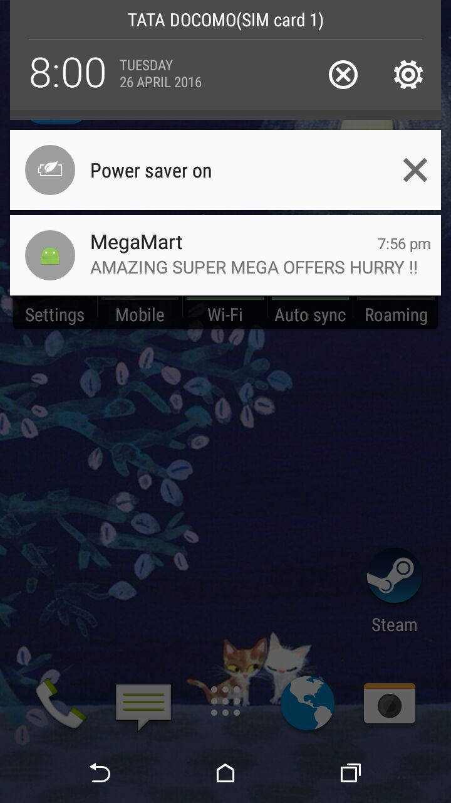
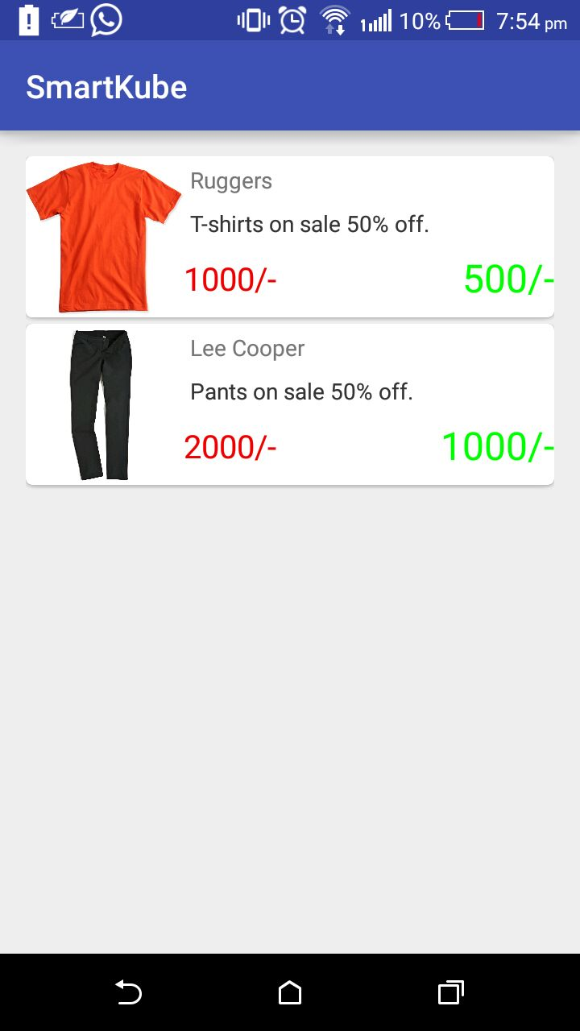
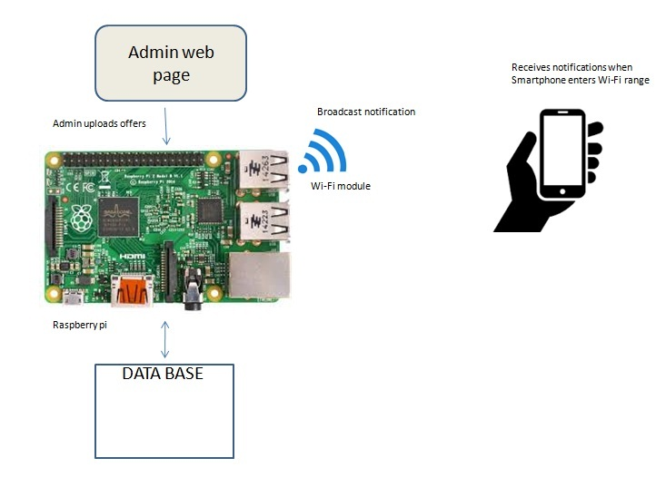
Smart advertising platform using Raspberry pi and push notifications
JSS ACADEMY OF TECHNICAL EDUCATION
DEPARTMENT OF INFORMATION SCIENCE ENGINEERING
Abstract
The data got is populated into Recycler Views in android with custom adapters and getters and setters.
RecyclerView is an Android widget that displays a collection of items in a list or a grid, enabling the user to scroll through the collection.
The shopkeeper has to upload the offers using the admin page or the dashboard in the raspberry pi. The raspberry pi contains a sql database where all the offers are stored.
A Wi-Fi module connected to the raspberry pi is used to broadcast the offers to the customer’s smartphones.
Whenever the customers come into the Wi-Fi range of the shop the customer’s smartphones gets the notification of the offers.
The following code describes the insertion into the database on the raspberry pi.
<?php
$dateTime=$_POST['dateTime'];$name=$_POST['name'];
$description=$_POST['description'];$header=$_POST['header'];
$oldprice=$_POST['oldprice'];$newprice=$_POST['newprice'];
$url=$_POST['url'];
$con = mysqli_connect("localhost", "root", "sqlmy" ,"roleDb");
$sql="insert into offersAvailable values('$dateTime','$name','$header‘
,'$description’,'$oldprice','$newprice','$url')";
$result = mysqli_query($con,$sql);
if($mysqli_affected_rows() >0)
echo "<strong>Success!</strong> your data is updated successfully."; else echo "<strong>failed</strong> your data is not updated, check for errors and try again";
?>
This proposed model is based on an advertising platform. Our proposed idea digitizes the advertisements of products.
A php server is running on the raspberry pi which contains the database that includes all the offers uploaded. These offers are uploaded by the individual shop keepers. A dashboard is created which is used by the shop keeper to upload the offers to the database in the raspberry pi.
A Wi-Fi module connected to the raspberry pi is used to broadcast the offers to the customer’s Smartphone. Whenever the customers come into the Wi-Fi range of the shop, the customer’s smartphone gets the notification of the offers.
An android application is installed in the customer’s Smartphone to get offers broadcasted through the Wi-Fi. This application does not use the internet nor is GPS, only the Wi-Fi connection sufficient.
Introduction
Advertising is a means by which communication with the users of a product or service occurs. Advertising is always present, even though people may not be aware of it.
In present world, using every possible media advertising get’s its message through. It may do this via television, print (newspapers, magazines, journals etc), radio, press, internet, events, direct selling, hoardings, posters, mailers, contests, clothes, sounds, visuals sponsorships, and even people (endorsements).
However today’s advertising platforms are relatively expensive in terms of creative, production and airtime costs making it difficult for targeting your market.
Our proposed idea helps in making the advertising more efficient and cost effective. This helps in the targeted marketing strategy.
This model describes how this proposed idea is more effective than the traditional advertising methods
Results
Whenever the customer’s smartphone comes into the Wi-Fi range of the shop the customer gets a notification on his smartphone when the app is off. The following figure 2 shows the notification got on the customers smartphone.
When the notification is received by the customer, he can go into the app to check for the details about the offer. An image of the product can also be broadcasted along with the offers details. The following figure 3 shows the content present inside the app when the offers is got from the shop.
SYSTEM DESIGN AND DESCRIPTION
An effective advertising platform helps in effective marketing of the products. It should be cost effective and more responsive than the traditional methods. The following fig.1 shows the design of the proposed model for the effective advertising platform.
Fig.1 design of the proposed advertising platform.
The android studio is used for the development of the app for the customer’s smartphone. The raspbian OS is uploaded onto the raspberry pi.
Php and mysql is used for designing the backend. The database which is used to store the information about offers is placed in the raspberry pi and php is used to upload and retrieve the data from it.
HTML, CSS, bootstrap is used for designing the front end of the model. An admin page is used to upload the data.
The raspberry pi is used as a medium for storage and sending of the offer details. A mysql database is created on the raspberry pi to store the offer’s list.
An admin web page or dashboard is used by the shop keeper to upload the data to the database.
A Wi-Fi module is present in the raspberry pi which is used to broadcast the offers to the customer’s smartphone.
An android app is installed in the customer’s smartphone and whenever the smartphone comes into the range of the shop keeper’s Wi-Fi, he gets a notification about the offers present.
Fig.2 notification about offers
Fig.3 example output of offers
Conclusions
The proposed advertising model has been designed for immediate notification of offers to the customers through Wi-Fi connection.
This model helps in providing a very efficient and effective advertising platform. It overcomes disadvantages of the traditional advertising platform.
One of the biggest concerns of advertising is the cost, this proposed model is very cost effective and also the usage of the neither internet nor GPS is not necessary. Only the Wi-Fi connectivity is sufficient.
References
Advance Flood Detection and Notification System based on Sensor Technology and Machine Learning Algorithm --Mohammed Khalaf, Abir Jaafar Hussain, Dhiya Al-Jumeily, Paul Fergus, Ibrahim Olatunji Idowu Applied Computing Research Group, School of Computing and Mathematical Sciences Liverpool John Moores University.
https://en.wikipedia.org/wiki/Android
http://www.developer.android.com/training/volley .– volley libraries for asynchronous task.
http://www.developer.android.com/reference/org/json/JSONObject. – JSON for sending data and receiving data to server.
http://www.javatechig.com/android/android-recyclervie. – recycler view for view list.
http://www.raspbian.org-- OS for raspberry pi.
Implementation
An android app is created and is to be installed by the customer in his smartphone to get the notification about the offers.
The data (offers) in the raspberry pi is broadcasted through the Wi-Fi module. In the android phone a Broadcast Receiver is used to check the Wi-Fi state.
Whenever a Wi-Fi connection is detected, a service is made to run on the background to pick up the data from the raspberry pi. This data is in the form of JSONs.
PRESENTED BY:
PAVAN V
AKASH N G
PUNITH B M
GUIDED BY:
Mrs NAGAMANI N P
Asst. Professor
Dept. of ISE,JSSATE

