Slide 1
ExpEyes
Computer Interfaced Physics Experiments

Slide 2
About the device
A tool for learning science by exploring and experimenting.
It is an open source hardware & software framework for developing science experiments.
expEYES-17 is interfaced and powered by the USB port of the computer, and it is programmable in Python.
It can function as a low frequency oscilloscope, function generator, programable voltage source, frequency counter and data logger etc.,

Slide 3
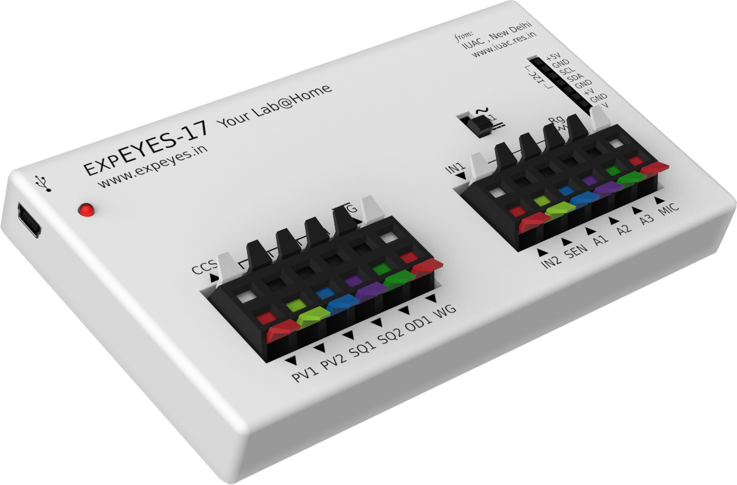
EXP EYES-17

Slide 4
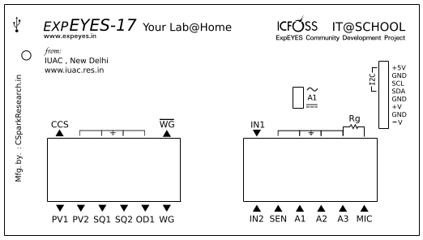
Block Diagram

Slide 5
External Connections
Constant Current Source (CCS) :The nominal value is 1.1 mA . To measure the exact value, connect an ammeter from CCS to GND.
Programmable Voltage (PV1) :Can be set, from software, to any value in the -5V to +5V range.
Programmable Voltage (PV2) :Can be set, from software, to any value in the -3.3V to +3.3V range.
Square Wave SQ1:Output swings from 0 to 5 volts and frequency can be varied 4Hz to 100kHz.

Slide 6
Square Wave SQ2:Output swings from 0 to 5 volts and frequency can be varied 4Hz to 100kHz. The duty cycle of the output is programmable. SQR2 is not available when WG is active.
Digital Output (OD1) :The voltage at OD1 can be set to 0 or 5 volts, using software.
Sine/Triangular Wave WG: Frequency can be varied from 5Hz to 5kHz. The peak value of the amplitude can be set to 3 volts, 1.0 volt or 80 mV. Shape of the output waveform is programmable. Using the GUI sine or triangular can be selected. WG bar is inverted WG.

Slide 7
Capacitance meter IN1:Capacitance connected between IN1 and Ground can be measured. It works better for lower capacitance values, upto 10 nanoFarads.
Frequency Counter IN2:Capable of measuring frequencies upto several Mhz.
Resistive Sensor Input (SEN):This is mainly meant for sensors like Light Dependent Resistor, Thermistor, Photo-transistor etc. SEN is internally connected to 3.3 volts through a 5.1kohm resistor.

Slide 8
Analog Inputs, A1 & A2: Can measure voltage within the A±16 volts range. The input voltage range can be selected from .5V to 16V fulls cale. Voltage at these terminals can be displayed as a function of time, giving the functionality of a low frequency oscilloscope. The maximum sampling rate is 1 Msps /channel.
A±3.3V Analog Input A3:Can measure voltage within the Â± 3.3 volts range. The input can be amplified by connecting a resistor from Rg to Ground.This enables displaying very small amplitude signals.

Slide 9
Microphone input MIC: This enables displaying very small amplitude signals.
I2C Sensor Interface:The four connections (+5V, Ground, SCL and SDA) of the 8 terminal berg strip supports I2C sensors.The software is capable of recognizing a large number of commercially available I2C sensors.
Â±6V /10mA Power supply:The VR+ and VR- are regulated power outputs. They can supply very little current, but good enough to power an Op-Amp.

Slide 10


How to Use the device
Step1: Connect the device through a USB port and Click on the expEYES icon on the desktop.
Step2:Graphical User Interface for various experiments can be selected from the pull down menu. In that user should browse the RVCE tab and select the Physics 1st Sem experiments.
Step 3:Now by default, it will go to NPN transistor Characteristics window screen of 1st sem Physics experiments. Click on the check box for the help window to get the explanation of the experiment.
.

Slide 11
Physics 1st Sem experiments
Transistor Characteristics
Diode Characteristics
RL Transient Response
RC Transient Response
LC and RLC Transient Response
RLC Steady State Response

Slide 12
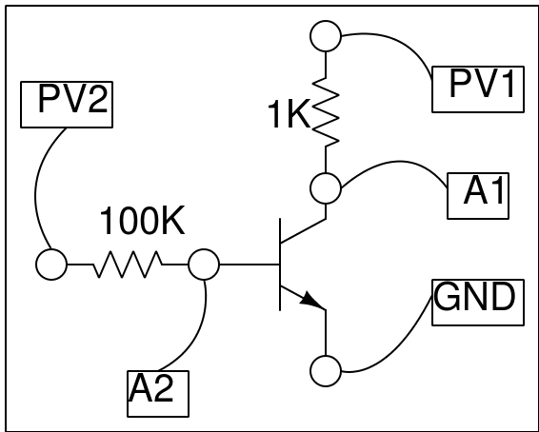
Transistor characteristics (CE)
Objective: Study the input and output characteristics of a transistor.
Circuit Diagram

Slide 13
Instructions
Input Characteristics:
Make the connections of NPN transistor provided with the kit as shown in the schematic diagram.
Make sure the "Use Defaults" checkbox is ticked
Run the experiment by clicking the Start button.
Once the trial is completed, you will see a "Completed graph plotting" message on the bottom left side of the window
You can save the data values by using the "Save Data" button
Now uncheck the "Use Defaults" box and run the experiment using your custom values of V_{CE}.
Output Characteristics:
The output characteristic curve of an NPN transistor at different base currents is plotted.
The base current is set by the voltage at PV2.
Press START to get a plot for a particular Ib.
You can save the data value by using the "Save Data" button
Repeat the same by changing base current I_{b} by changing PV2 voltage.

Slide 14
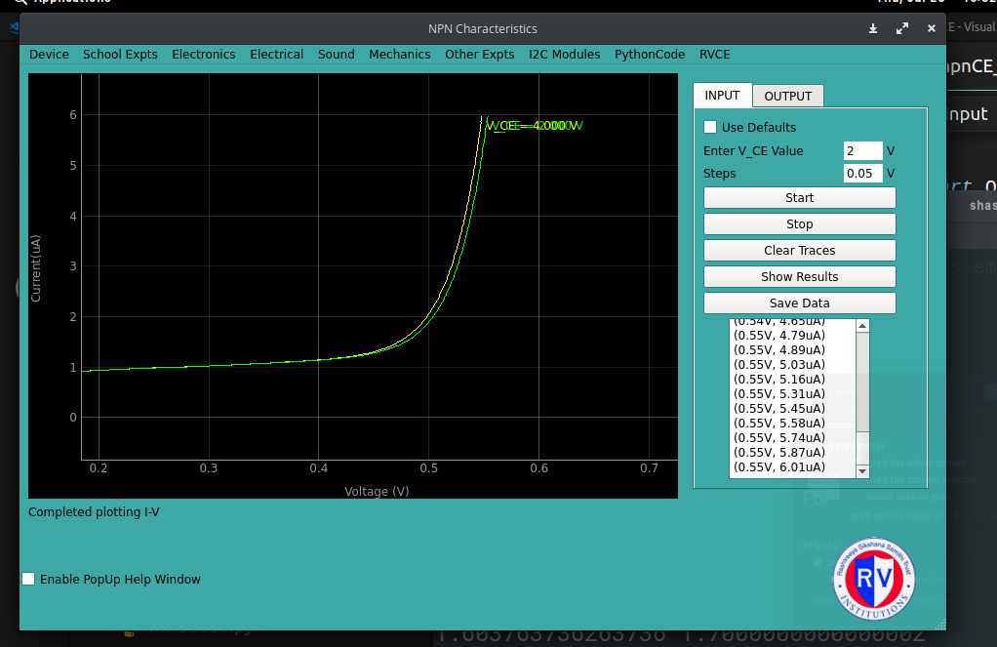
Input Characteristics

Slide 15
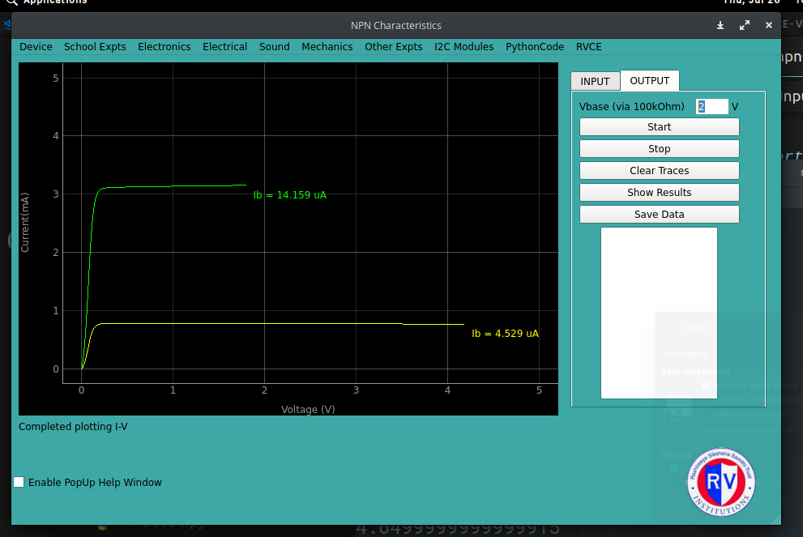
Output Characteristics

Slide 16
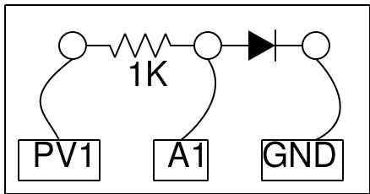
Diode Characteristics
Objective: Study the I-V Characteristics of a diode and Zener diode.
Circuit Diagram

Slide 17
Instructions
Ordinary diode/LED in forward bias
Make connections using given diode and press START button.
The graph represents the characteristics for forward biased mode.
Use the save data button to export plot points.
Use different color LEDs / ordinary diodes and repeat the experiment.
Zener diode in forward bias and reverse bias
Make connections according the schematic and follow the same procedure as you did for ordinary diode or LEDs and press START button.
The graph represents the characteristics for forward biased mode.
Use the save data button to export plot points.
For reverse bias, flip the diode in circuit board, such as the black notch should be at the positive terminal (attached to A1) and the other end should be attached to GND.
Click the start button and follow the procedure as before.

Slide 18
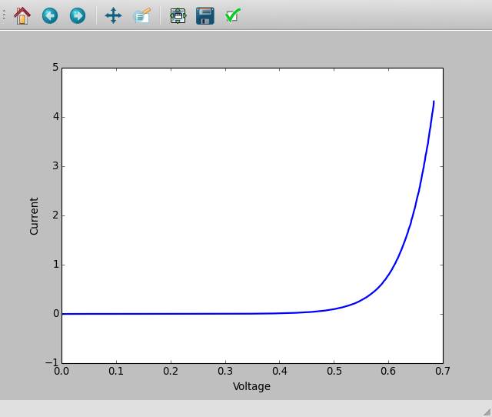
Diode Characteristics

Slide 19
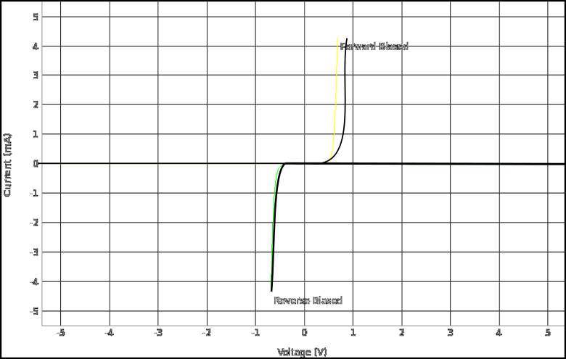
Zener Diode Characteristics

Slide 20
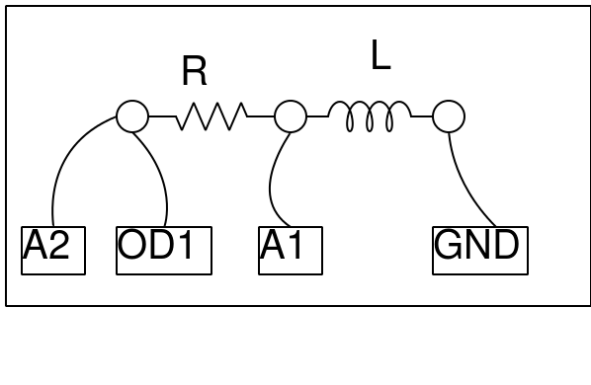
RL Transient Response
Objective: Explore the nature of current and voltage when a voltage is applied across the resistor and inductor in series and calculate its inductance.
Circuit Diagram

Slide 21
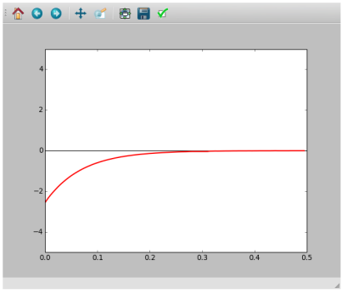
Instructions
Make connections as shown in the figure.
Press "0 to 5V STEP" and capture the resulting voltage variation
Press "5 to 0V STEP" and capture the resulting voltage variation
"Calculate R/L" fits the data with V = Vo exp(-tR/L)
Repeat with different R and L values.
Expected Graph

Slide 22
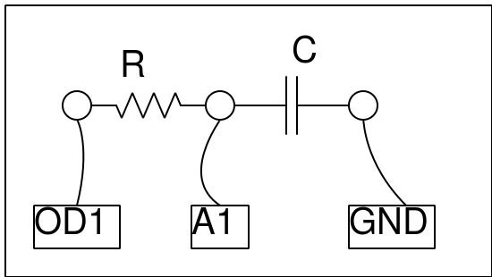
RC Transient Response
Objective: Study the nature of graph, when the voltage across a capacitor when is charged/discharged. Calculate the value of the capacitance from the graph.
Circuit Diagram

Slide 23
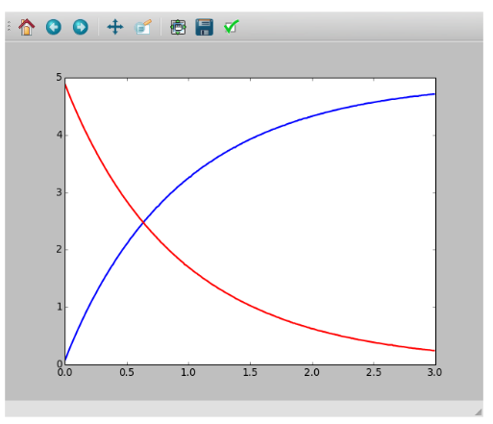
Instructions
Make connections as shown in the figure.
Pressing "0 to 5V STEP" or "5 to 0V STEP" switches OD1 and captures the resulting voltage variation at A1
Calculate RC fits the data with V = Vo exp(-t/RC)
Repeat with different RC values.
Expected Graph

Slide 24
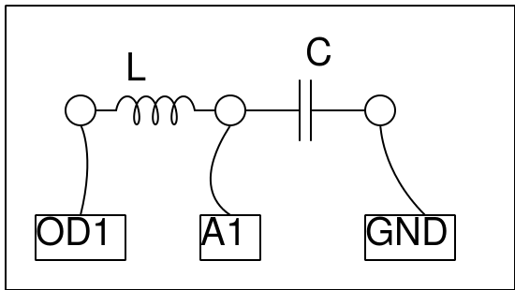
LC and RLC Transient Response
Objective: Explore the oscillatory nature of L and C in series, identify the nature of response whether it is under-damped, critically-damped or over-damped.
Circuit Diagram

Slide 25
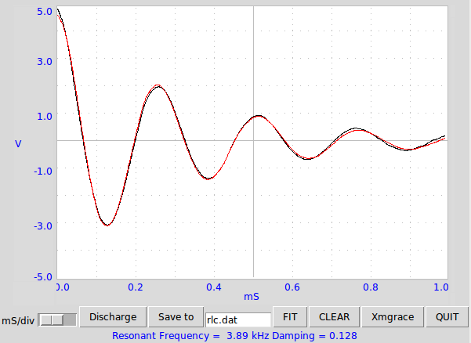
Instructions
Make the connections as shown in schematic diagram.
Click on 0->5V STEP on OD1. Observe the wave pattern
and note down the resonance frequency and damping factor.
Repeat with a resistor between OD1 and the inductor.
Repeat the experiment with different values of L, C and R
FIT the graph to find the resonant frequency & Damping.
Expected Graph

Slide 26
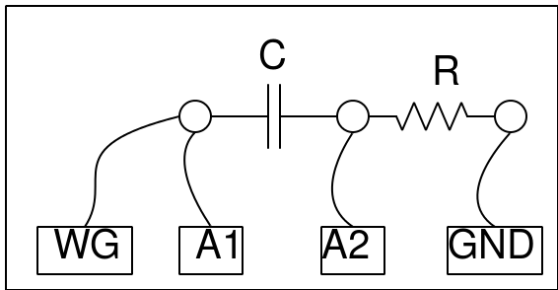
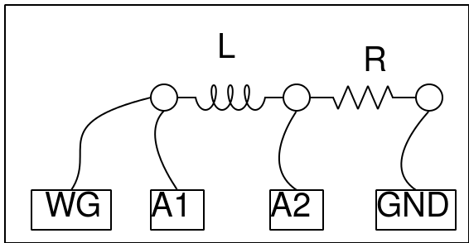
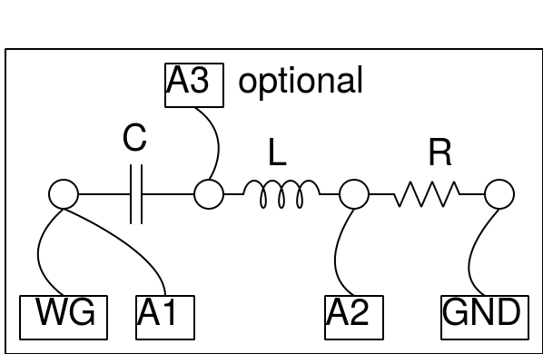
RLC Steady State Response
Objective: Study the amplitude and phase across the circuit elements as a function of frequency.
The three different circuit combinations are as shown below.

Slide 27
Instructions
Make connections one by one, as per the drawing
In each case note down the amplitude and phase measurements.
Repeat the measurements by changing the frequency.
For RLC series circuit, the junction of L and C is monitored by A3
For resonance select C = 1uF, L = 10mH and F= 1600 Hz, adjust F to make phase shift zero.
To observe resonance, adjust the frequency to make the phase difference across LC goes almost to zero, the voltage across them are out of phase at resonance.

Slide 28
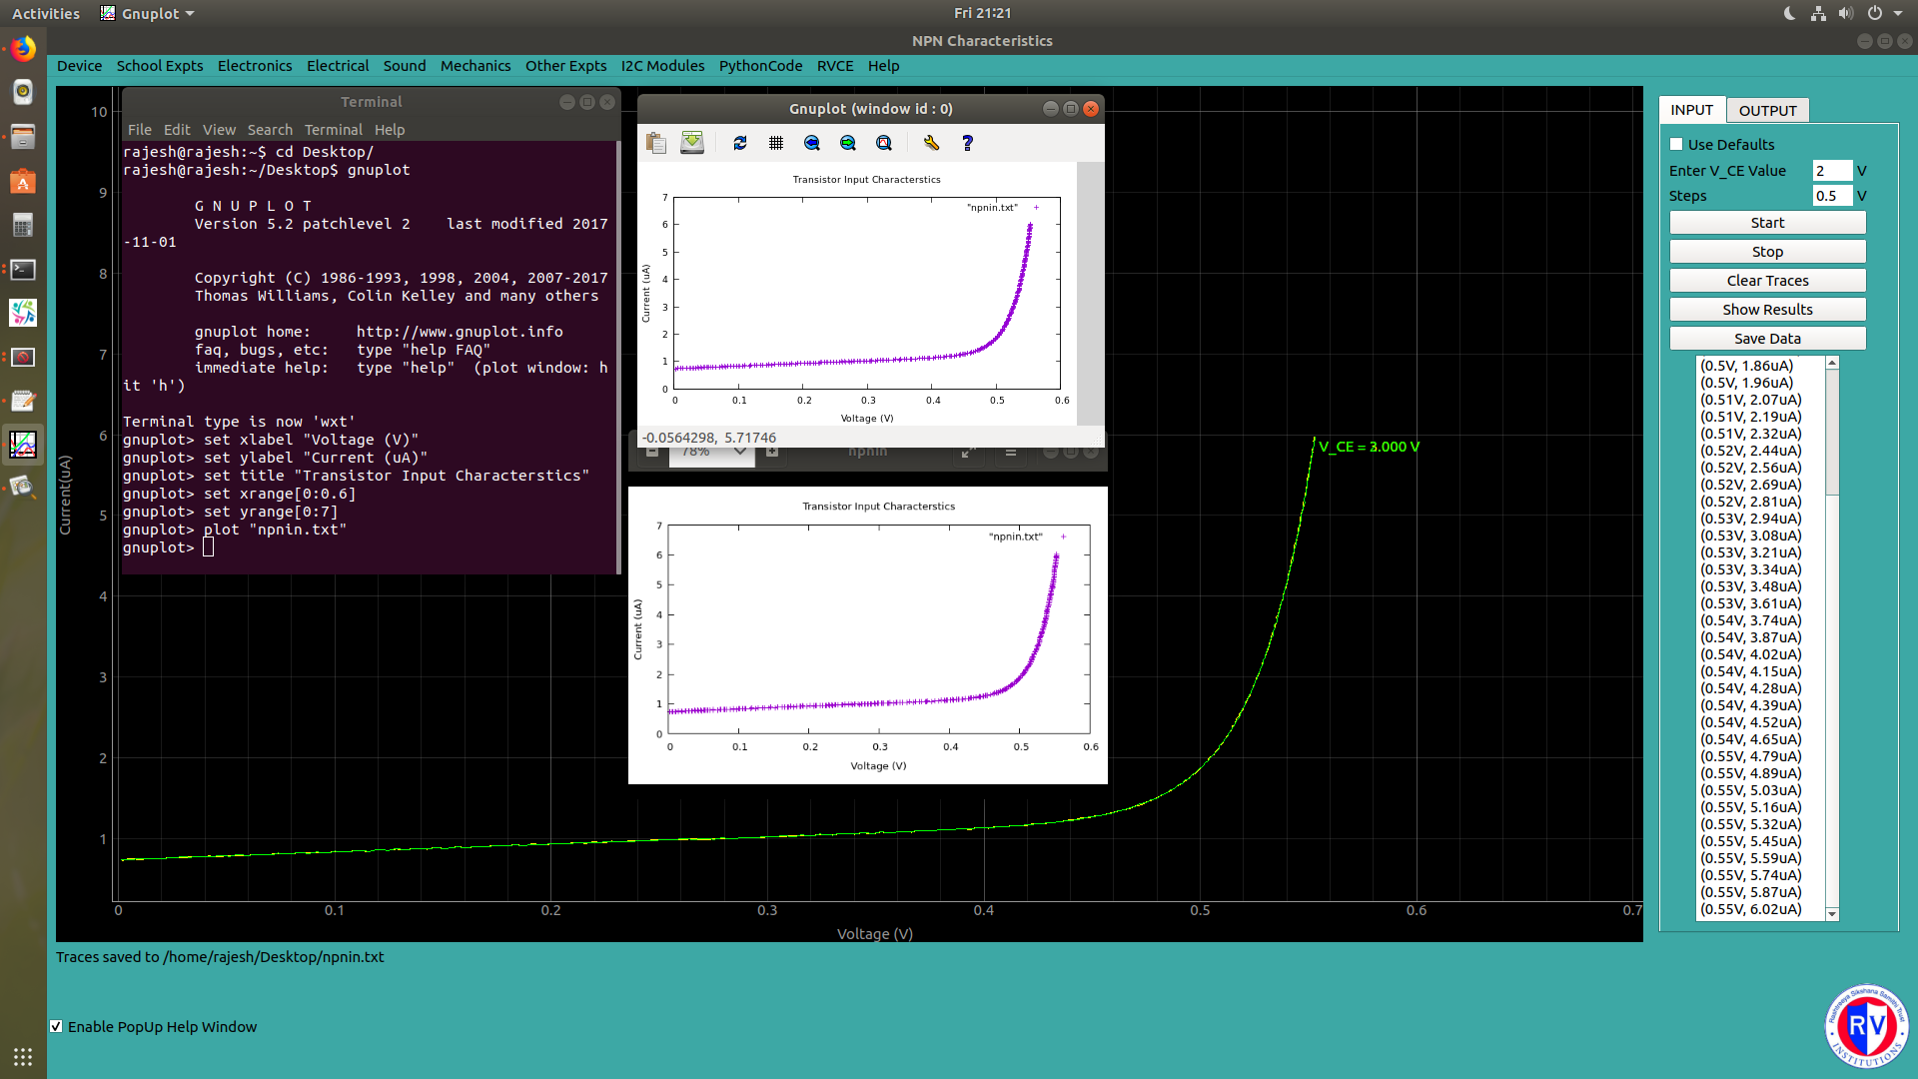
Gnuplot

Slide 29
Note: If you happen to receive a Error. Try Device-Reconnect message, it means either your device is not properly connected to your computer or the drivers for expeyes are missing.
Try clicking the Device option on the top left corner and click the Reconnect submenu and try the experiment.

