Slide 1
An Introduction to Ansible
ben robinson
5am Solutions

Slide 2

What is Ansible?
Agentless configuration management and task execution software
No agents installed on nodes
Uses SSH
Requires Python
Notes:
Term “ansible” coined in 60’s science fiction literature and is a device used for almost instantaneous interstellar communication between devices.
“Agentless”
Ansible has no agents installed on remote machines in your deployment
Uses SSH (or alternatively a python implementation of SSH2) to interact with nodes
No background daemons or installed software running on target machines (besides python). This eliminates the need for polling
“Python”
Requires 2.6 or 2.7 on the machine executing commands (‘controlling machine’)
Windows currently not supported as controlling machine
Requires ssh and Python 2.5 or higher on remote machine

Slide 3
How does it work?
Uses SSH to connect to remote machines and executes instructions read from YAML files
Authentication via SSH
Idempotency, not state
JSON requests/responses
Notes:
“Modules”
These are the “tasks”, “plugins”, “libraries”, etc that do the work on a remote machine
“Authentication”
Because authentication is done via SSH, this means that you can (and should) use your existing SSH key setup to control the authentication from controlling machine to the remote machines
Authentication can be done with passwords but this is not advised
Because we use SSH keys, we don’t have to worry about having a certificate signing component like with Puppet
“Idempotency”
Instead of storing/caching a representation of a server’s state at execution time (puppet/chef), ansible playbooks are written such that they can be executed multiple times without having an ill effect
“JSON”
- Under the hood, JSON requests and responses are sent and received telling the server what to do and responding to the controlling machine with the stdout/stderr

Slide 4
Components
Inventory
Like /etc/hosts files
Uses INI-style format
Allow for pattern matching, grouping, variable declaration, and more
Playbook
YAML file consisting of tasks to execute on a given member of the inventory
Notes:
“hosts” files
Refers to specific hosts that plays will be executed against

Slide 5
Inventory Hierarchy
[app-servers] # group name 1
app-server-01 # hostname in group
10.250.0.115 # IP in group
[db-servers] # group name 2
db-server-01 port=3306 # host in group with variable
db-server-02.myapp.com # FQDN in group
[backups:children] # group of groups
app-servers # group 1 in group
db-servers # group 2 in group
Notes:
Potential to diversify environments here and combine functionality where possible

Slide 6
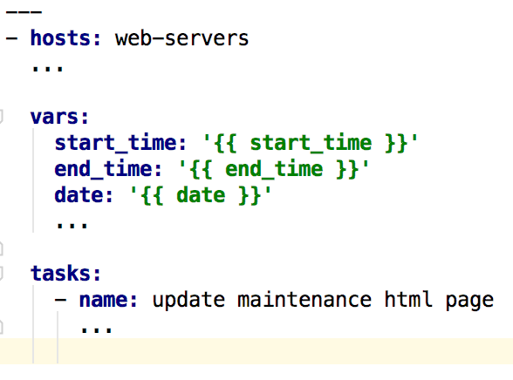
Playbook overview
Host Execution
Variables
Tasks
http://docs.ansible.com/ansible/modules_by_category.html
Notes:
“tasks”
- Are modules

Slide 7
Common Uses Cases
Fetching Logs
Performing Application Upgrades
Configuration Management
Ad-hoc task execution

Slide 8
Fetching Logs
--- - hosts: engine-servers become: yes # allow privilege escalation become_user: root # escalate to user ‘root' any_errors_fatal: true # playbook dies if errors encountered vars: design_path: /srv/engine/data/ tasks: - name: find log files
find: paths: "{{ design_path }}" patterns: "*{{ uuid }}*" recurse: yes file_type: directory register: output failed_when: uuid is undefined - name: fetch log files fetch: src: "{{ item.path }}/design.log" flat: yes dest: "../logs/{{ item.path }}/design.log" with_items: "{{ output.files }}"
Notes:
- Given an input UUID (param passed on CLI), recursively search through a path on the server looking for directories that have the UUID in the name
- If UUID is not passed in, fail
If no results found, exit (this is because of the handler “output” registered that we loop over)
- For anything found, download the file to local folder

Slide 9
Configuration Management
Define a group in the inventory
E.g., “database servers”
Define a new host in the group
Apply playbook for group
Install PostgreSQL
Copy custom pg_hba.conf
Run any other config
Etc…
Notes:
Reiterate idempotency here as a boon for configuration management.
Ansible’s modules leverage this by having parameters like “unless”, etc.
(postgresql has their own ansible module)

Slide 10
Playbook of Playbooks
--- - vars: app_version: '{{ version }}' enable_backups: true notify_team: false - include: enter-maintenance-mode.yaml - include: stop-app.yaml - include: backup-db.yaml enable_backups={{ enable_backups }} - include: deploy.yaml version={{ app_version }} - include: start-app.yaml - include: exit-maintenance-mode.yaml notify={{ notify_team }}

Slide 11
--- - hosts: proxy become: yes become_user: root vars: start_time: '{{ start_time }}' end_time: '{{ end_time }}' date: '{{ date }}' tasks: - name: update maintenance html page template:
src=../templates/maintenance.html
dest=/var/www/maintenance.html force=yes - name: enter maintenance mode file: path=/var/www/maintenance.enable state=touch # Variables are referenced in the template HTML file like {{ start_time }}

Slide 12
Don’t see what you need?
Write your own Module
Just need JSON!
Notes:
Ansible modules can be written in any language that returns JSON (ruby, python, perl,

Slide 13
Demo

Slide 14
Helpful Resources
Getting Started
Best Practices
Ansible as compared to other similar tools (opinionated)
Intro to Ansible Commands
Variables in Playbooks
Demo source code

