Slide 1
Company’s new branch in Bangalore

Slide 2
Business Problem:
This project is for a company which is already established where there headquarters is located. Now they want to expand their business by constructing a new unit in Bangalore, INDIA for which they need to find a plot which is reasonable but also surrounded by venues which will attract more talented employees and keeps the productivity high.
Finding a plot in a populated city like Bangalore is not an easy job. Locality average prices, its basic features needs to be considered. This project will help them in zeroing out the probable locations and then they may get into further details based on their specific needs.

Slide 3
Data description:
Firstly, we extracted data for area names in Bangalore, INDIA with its average price per sqft in rupees. ( https://www.makaan.com/price-trends/property-rates-for-buy-inbangalore) We used plot section from this site as our project is about constructing new company.
Secondly, we used foursquare api for extracting neighbourhood venues.
And finally we used a json file for boundaries of each area in Bangalore from here- (https://raw.githubusercontent.com/datameet/PincodeBoundary/master/Bangalore/bou ndary.geojson).

Slide 4
Methodology:
Data extraction for average price per sqft in rupees for plots in each locality of Bangalore.
Extracting Longitudes and Latitudes for localities mentioned in the data frame. For this we have used geopy and Nominatim.
Plotting each column data on map and bar plot for average price in INR with respect to locality name.
Collection of venues for each locality using Foursquare and creating a table for venue categories.
Kmeans Modelling.

Slide 5
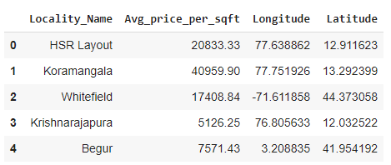
Data extraction for average price per sqft in rupees for plots in each locality of Bangalore.

Slide 6
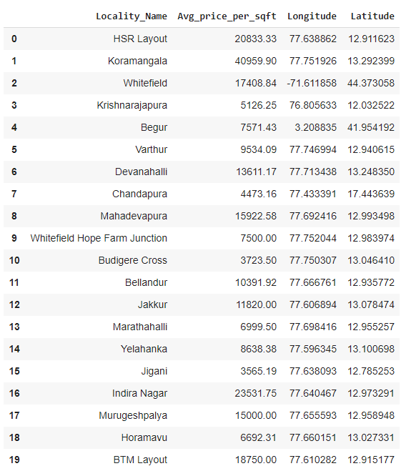
Extracting Longitudes and Latitudes for localities mentioned in the data frame. For this we have used geopy and Nominatim.

Slide 7
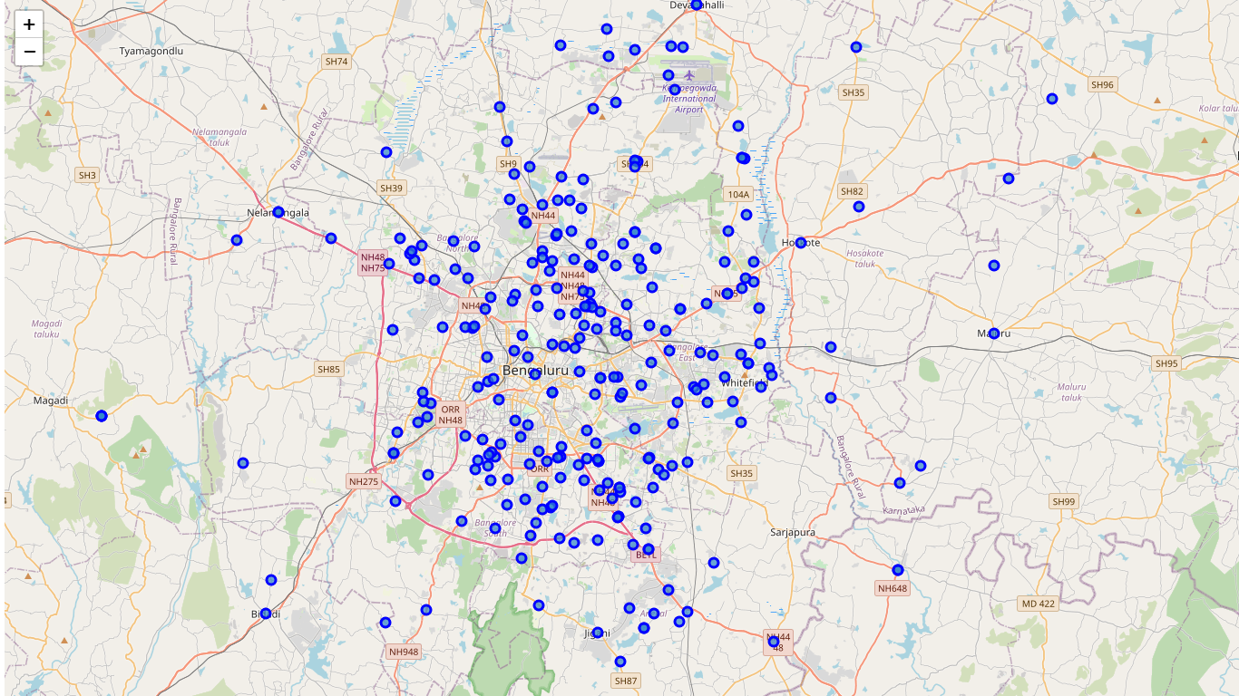
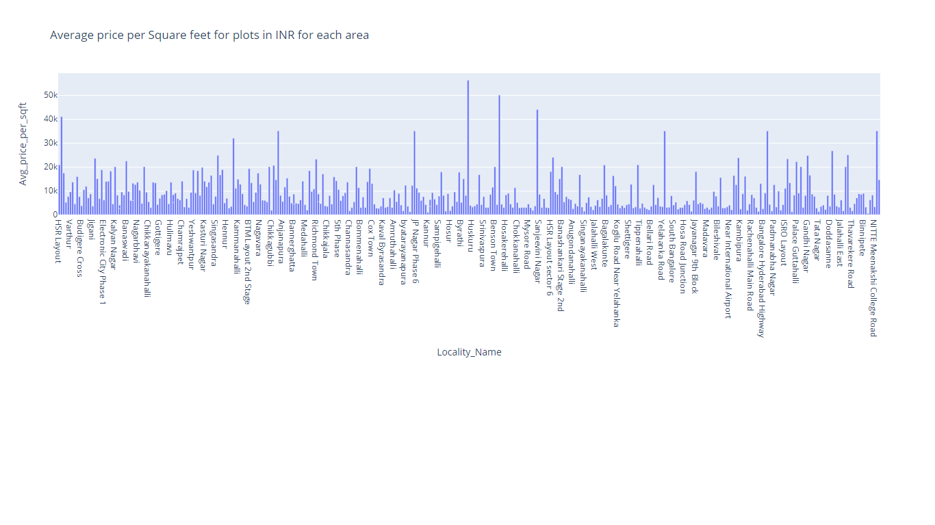
Plotting each column data on map and bar plot for average price in INR with respect to locality name.

Slide 8
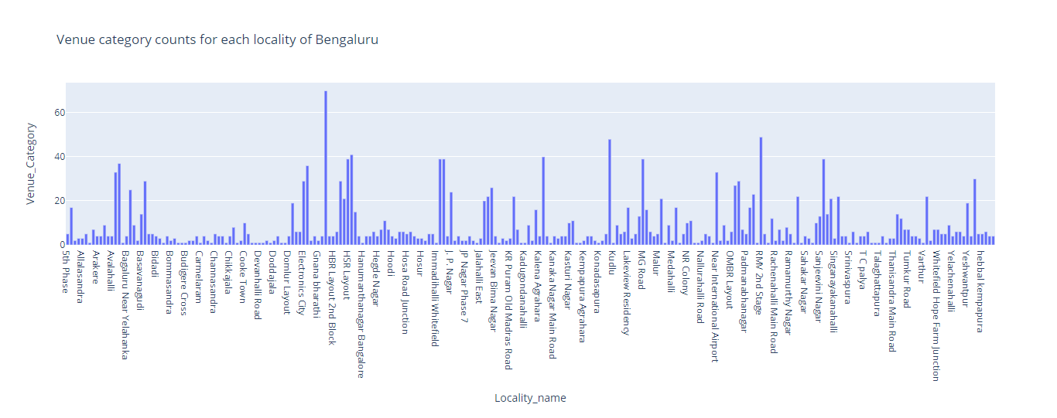
Collection of venues for each locality using Foursquare and creating a table for venue categories.

Slide 9
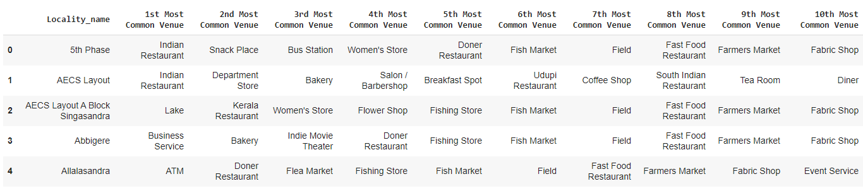
Placing the top ten venues of each locality, converted into columns and placed it as a table with locality name column.

Slide 10
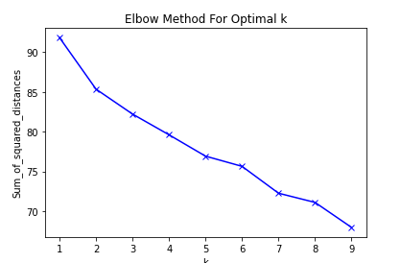
Kmeans Modelling.
We used one hot coded data to use it for kmeans modelling for which first we found the best k using elbow curve method and chose k as 5 and modelled.

Slide 11
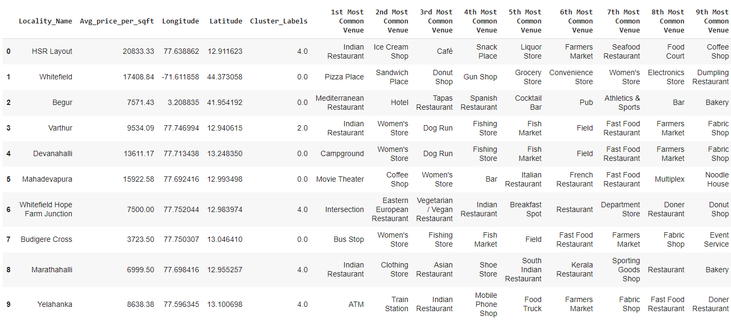
Then we merged all the data for including columns with Locality_Name, average price, Longitudes, latitudes and top ten venues associated.

Slide 12
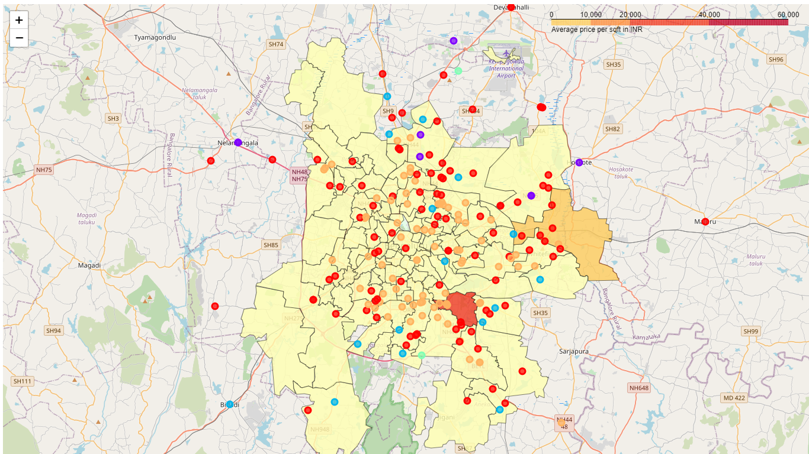
Plotting the clusters on map using json data for boundaries of locality in Bangalore and choropleth for Average price per sqft of plots.

Slide 13
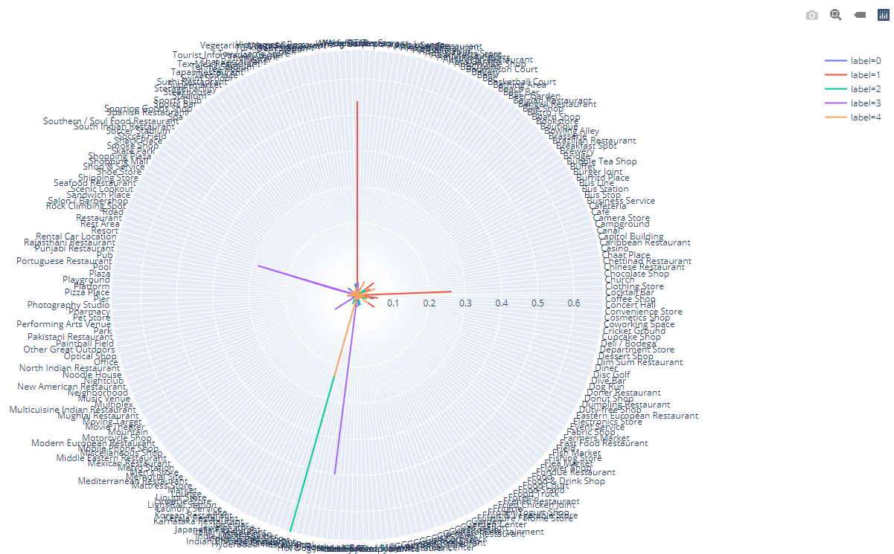
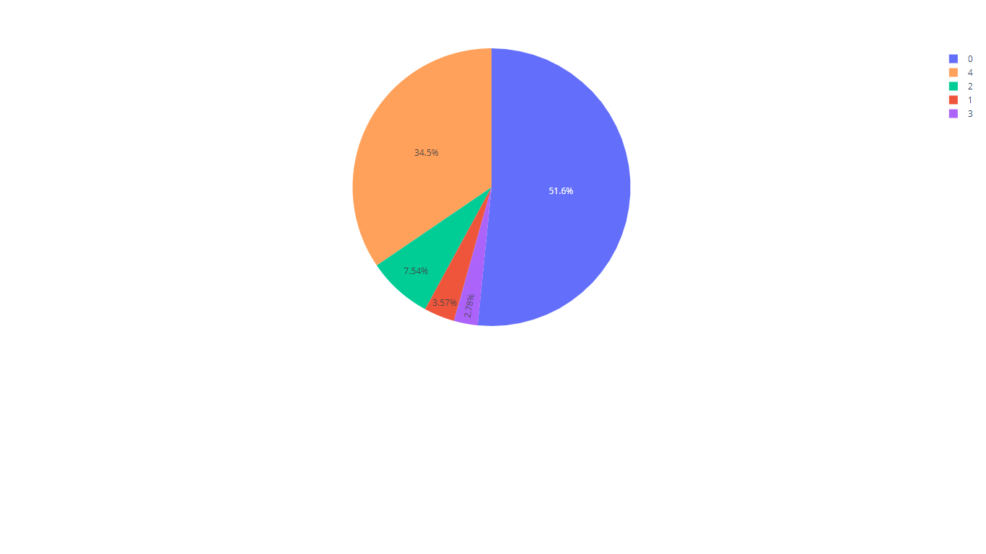
Lastly, we used Line polar for visualizing which cluster has the maximum frequency per venue and also used a pie chart to check the number of localities in each cluster.

Slide 14
Results discussion:
Finally we will conclude with results in this section:
We need to consider two facts here: Average price per sqft in INR for each locality and Number of venues available at each locality
With respect to above observations we may say that prices are almost equal around the city other than couple of locality where prices are at peak. We can also say that cluster 4 considers the highest venues with help of line polar and pie plots. Cluster 4 can be seen in the maximum around south, east and central-north Bangalore.
Any of these places might be suitable for new office space considering many other established companies and start-ups are also set up here. Please note that plot selection of different companies may depend on many other factors, so other deep research is also required based on company requirements

Slide 15
Conclusion:
In this project we have searched data available from all possible sources available and selected the best suitable data for analysing results.
Here we have identified locality names, average price per sqft, its longitudes, latitudes, best possible general venues. Then used this data to plot on map with both heat map of average prices and marking clusters based on venues.
Finally discussed about the possible results. This project as used for a company to open their new branch office in best possible location of Bangalore, we can say that this project may also be used with similar scenarios when required

