Slide 1
Time to Roclet
admiral’s use of custom roclets to enhance and extend examples in function documentation. Ben Straub (GSK, Philadelphia, United States)

Slide 2
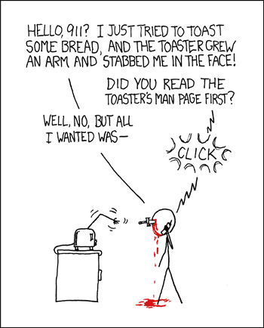
Required xkcd comic
Do you read the manual first? Show of Hands
Do you just dive in and read the manual afterwards? Show of Hands
I am a dive in and then read the manual later.

Slide 3
The next 20 minutes…
Brief intro to the problem. Hint: documentation
Infrastructure behind R package documentation
admiral R package and its documentation
How admiral extended roxygen2 abilities to solve its problem

Slide 4
So at the end of 20 minutes…
I hope you walk away with:
How R documentation is created.
How admiral enhanced its documentation to help its users.
Better documentation means users are happy but also also AI/LLMs to easier understand and harvest information from your R package.

Slide 5
Introduction: The Challenge of R Package Documentation
Detailed argument definitions and inline examples aid understanding complex functions.
In admiral, top-notch documentation is a priority.
Problem: As number of functions and complexity of functions grew, documentation became unwieldy and hard to navigate.
Solution: Extended roxygen package’s roclets to better display and curate examples.
This presentation explores the technical details and positive impact on admiral’s function examples.

Slide 6
R Packages: The Foundation of the R Ecosystem
R packages bundle code, data, documentation, and tests in a standardized format.
They facilitate code sharing and reuse, expanding R’s functionality.
Key components:
R functions in R/ directory. Documentation in man/
Documentation using roxygen2 comments in .R prodce the .Rd files.
Dependencies in DESCRIPTION file.
Few other folders and needed files - Check out: https://r-pkgs.org/

Slide 7
roxygen2: Streamlining R Docs
The roxygen2 R package simplifies documentation within R packages.
Developers write documentation directly alongside function definitions using #' comments.
Benefits:
Keeps code and documentation co-located, making updates efficient.
Automatically generates .Rd files (standard R documentation) from comments.
This system significantly reduces effort, enhancing user understanding of functions.
Check out: https://roxygen2.r-lib.org/

Slide 8
Roxygen in an .R file
Here’s a brief example of a function add_numbers() with its roxygen documentation:
#| echo: TRUE #| code-line-numbers: “1-13|1|2|3|4|5|6|7|8|9|10|11-13” #’ Add two numbers together. #’ #’ This function takes two numeric inputs and returns their sum. #’ #’ @param x A numeric value, the first number. #’ @param y A numeric value, the second number. #’ @return The sum of x and y. #’ @examples #’ add_numbers(5, 3) #’ add_numbers(10, -2) add_numbers <- function(x, y) { x + y }

