Slide 1


DELEA: Distributed Ensemble Learning for Energy-Efficient IoT Applications
Benjamin Scott^{1,2}, Kaila Rosing^{1,2}, Yi-Yang Chen¹, Flavio Ponzina²
UC San Diego¹, San Diego State University²
bmscott@ucsd.edu

Slide 2

Federated Learning on Wide-Area IoT
Federated learning (FL) using
single-instance models
Server
Clients train on private data; server averages weights (FedAvg [AISTATS'17])
Target: wide-area IoT over LPWAN (LoRa/LoRaWAN)
  Low bandwidth, battery-powered nodes
Every round ships the full model up and down
Client data is non-IID: one global model fits each client poorly
Full model
every round
Client 1
Client 2
Client 3

Slide 3
The Energy Cost of FL on IoT Clients
Either training or communication can dominate FL energy
Raspberry Pi 5 client, LoRa link, 10 local epochs
Communication: 13–90% of client energy
The split depends on the model architecture (layer types, connectivity), not just size
Goal: cut both costs
Client energy per FL round, % (training vs. communication)

Slide 4
Prior Work Leaves a Gap
Energy-efficient FL
Federated ensemble learning
Treat the model as one block
Use ensembles for accuracy, not energy
Client selection: FedCS [ICC'19], ETEDS [WF-IoT'23]
Compression: FedPAQ [AISTATS'20], GWEP [IoT-J'22]
Topology: hierarchical FL [SBRC'25]
Early stopping: FLRCE [TMC'24]
Non-IID data: Fed-Ensemble [T-ASE'24], FedEL [ESWA'24]
Concept drift: ECFL [ML'23]
Hierarchical IoT fusion: CDF [IoT-J'24]
DELEA: use the ensemble's structure to cut energy
Orthogonal to, and composable with, energy-efficient FL

Slide 5
Constrained Ensembles Add No Overhead
A standard ensemble multiplies cost; a constrained one stays at 1×
Standard ensemble: N full CNNs
N× cost
memory, compute, payload
Replicate ×N
Baseline CNN (S)
Ensemble (N × S)
Constrained ensemble: E2CNN [TC'21], E-QUARTIC [ASP-DAC'25]
1× cost
+2.6% accuracy
Prune filters ÷N
Replicate ×N
Baseline CNN (S)
One learner (S/N)
Ensemble (~S total)
+2.6%: centralized accuracy of the constrained ensemble vs. the single CNN

Slide 6
Key Idea: Share Only Part of the Ensemble
Share only a few learners each round; the rest never leave the client
Server
Server
Full model
100% per round
Shared learners only
e.g., 2 of 4 = 50%
Global (shared)
Local (never sent)
Single-instance FL
DELEA client: 4 learners, 2 shared

Slide 7
DELEA at a Glance
Distributed Ensemble Learning for Energy-efficient Applications
2.0×
energy efficiency vs. single-instance CNNs
−28.4%
energy saved by sharing fewer learners
−21.2%
energy saved by early stopping
+43%
client accuracy in personalized FL
Accuracy within 1% of baseline · Raspberry Pi 5 + LoRa · ResNet8/18, MobileNetV2, VGG16 on CIFAR-10/100

Slide 8
DELEA Overview
1 Generate
2 Distribute & partition
3 Train locally
4 Share & aggregate
Cloud, offline (once)
Server
index-wise FedAvg
4
deploy structure
1
Only global
learners move
Baseline CNN
Ensemble, N = 4
same size
2
3
Global learner: trained, shared
Local learner: trained, kept
Random G/L split per client,
fixed across rounds
Client 1
Client 2
Client 3

Slide 9


Step 1: Generate a Constrained Ensemble
1 Generate
2 Distribute & partition
3 Train locally
4 Share & aggregate
Prune filters $÷$N
Replicate $×$N
+2.6%
accuracy
Baseline CNN (size S)
One learner (S/N)
Ensemble (~S total)
Structured pruning + replication [TC'21, ASP-DAC'25]
Same memory, compute, and payload as the baseline
N = 2–4: more learners need heavier pruning and lose accuracy
Done once, offline in the cloud; +2.6% is centralized accuracy vs. single CNN

Slide 10

Step 2: Distribute and Partition
1 Generate
2 Distribute & partition
3 Train locally
4 Share & aggregate
Server
Server sends one learner structure; clients replicate it
Each client randomly picks G global learners; the rest stay local
Split is fixed across rounds
Payload per round: ρ = G/N of the baseline
replicate $×$N
on each client
1 learner, round 1 only
#1
#2
#3
#4
Client 1
Client 2
Client 3
global (G)
local (L)

Slide 11
Step 3: Train Locally with Bagging
1 Generate
2 Distribute & partition
3 Train locally
4 Share & aggregate
Inside one client
Static bagging: each learner keeps its own bootstrap sample
  More diversity, stable aggregation targets
Local learners converge faster (no cross-client updates)
Early stop: freeze a local learner once its accuracy gain < 30% of its first-5-round average
B1
trains every round
Local data
B2
trains every round
B3
early stop
B4
early stop
fixed bootstrap samples

Slide 12
Step 4: Share and Aggregate
1 Generate
2 Distribute & partition
3 Train locally
4 Share & aggregate
Server: average per learner index
Upload only global learners
Server averages by learner index (FedAvg)
  Index match keeps updates coherent
Send back each client's global learners only
Local learners never leave the device
#1
#2
#3
#4
C1, C3
C1, C2
C2
C3
Client 1
Client 2
Client 3
#3, #4 get only one update: too few clients

Slide 13
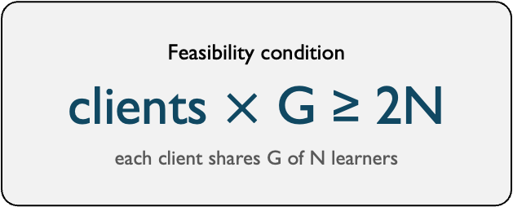
How Many Clients Are Enough?
1 Generate
2 Distribute & partition
3 Train locally
4 Share & aggregate
Every learner index needs at least 2 client updates per round
Feasibility condition
clients $×$ G ≥ 2N
each client shares G of N learners
N = 4, G = 2 → ≥ 4 clients
N = 4, G = 1 → ≥ 8 clients
Index counts per learner ~ Binomial(clients, G/N); more clients make every index aggregatable
Experiments use 10 and 50 clients: condition met with margin

Slide 14
Experimental Setup
Workloads
Federated setup
Energy measurement
CNNs: ResNet8/18, MobileNetV2, VGG16
Data: CIFAR-10/100
Ensembles: N = 2–4 learners, as in SOTA [TC'21, ASP-DAC'25]
  Larger N needs aggressive pruning, so accuracy drops
Baseline: single-instance CNN
Simulator: Flower [arXiv'20]
Clients: 10 and 50
Data split: IID and non-IID (Dirichlet α = 0.1)
Training: 15 rounds, batch 64
Device: Raspberry Pi 5 (Cortex-A76)
Training: on-board PMIC at 1 Hz, minus idle
Radio: LoRa SX1262, DR6, 235 B packets
Comm. energy is a lower bound [arXiv'25]

Slide 15
Sharing Less Barely Hurts Accuracy
Sharing 1 of N learners costs only 0.66 points of accuracy
Global accuracy vs. fully shared DELEA (G = N), average over 8 benchmarks
DELEA global accuracy matches single-instance FL
Payload drops linearly with G; accuracy barely moves
Energy results use the smallest G within 1% of fully shared
Learners shared | Payload (N = 4) | Accuracy change
All (G = N) | 100% | 0.00 pts
G = 2 | 50% | −0.36 pts
G = 1 | 25% | −0.66 pts

Slide 16
Personalized FL: Local Learners Pay Off
Non-IID clients: DELEA client model vs. fully-global model
Accuracy gain on each client's own test data, points (non-IID, α = 0.1)
+43 pts
average client accuracy gain
+1.15 pts over fully-local ensembles
Global model quality preserved
Early stop has negligible effect
Notes:
Paper table 1

Slide 17
Local Learners Converge Early
Local learners plateau within 3 rounds, so DELEA stops training them
Validation accuracy by FL round, %, one CIFAR-100 benchmark
Local: small, client-specific data
Global: keeps improving through cross-client aggregation
Stopping locals early matches training them every round
43% Global
35% Local
Notes:
Fig 4.

Slide 18
DELEA Halves Client Energy
2.0× energy efficiency vs. single-instance CNNs, accuracy within 1%
Client energy to convergence, % of single-instance baseline, average of 4 CNNs
Cuts both training (54%) and communication (46%) energy
ResNet8: 14 kJ → 7 kJ
Largest gain: ResNet18, 36% of baseline energy
Notes:
Fig 5. reduced.

Slide 19
DELEA Composes with Prior Methods
Up to 3.97× efficiency when combined with client selection
Client energy to convergence, % of baseline
Training
Communication
FedPAQ [AISTATS'20]: quantizes updates; 1.52× → 2.67×
FedCS [ICC'19]: selects clients; 2.00× → 3.97×
Accuracy within 2.5 pts of DELEA alone
Notes:
Fig 5.

Slide 20
Conclusion
Global accuracy
Client accuracy
Within 1% of single-instance FL
+43 pts on local data (non-IID)
2.0×
energy gain
up to 3.97× composed
Communication
Training
Share fewer learners: −28.4% energy
Local learners stop early: −21.2% energy
Next: adaptive G per client, larger ensembles, and measured LoRa deployments
bmscott@ucsd.edu

Slide 21
Thank You. Questions?
DELEA: share only a few ensemble learners for energy-efficient FL
Scott, Rosing, Chen, Ponzina
"DELEA: Distributed Ensemble Learning for Energy-Efficient IoT Applications" [MSWiM'26]
bmscott@ucsd.edu

Slide 22
Backup
Notes:
Aggregation bound · Personalized FL by benchmark · Energy per model

Slide 23
Backup: Aggregation Probability Bound
Upper bound on P(every index gets 2+ updates), %, N = 4, by number of clients
X_{i} ~ Binomial(clients, ρ), ρ = G/N
q = 1 − (1−ρ)^{C} − Cρ(1−ρ)^{C−1}
P(all N indices) at most q^{N} if C·G ≥ 2N, else 0
G = 2 reaches 96% at 10 clients
Source: paper Eqs. (7)–(10)

Slide 24
Backup: Personalized FL by Benchmark
Benchmark | DELEA client model | Fully-global model | Gain
ResNet8 / CIFAR-10 | 86.6% | 40.7% | +45.9 pts
ResNet18 / CIFAR-10 | 89.6% | 56.5% | +33.1 pts
MobileNetV2 / CIFAR-10 | 83.9% | 31.9% | +52.0 pts
VGG16 / CIFAR-10 | 91.6% | 61.1% | +30.5 pts
ResNet8 / CIFAR-100 | 57.5% | 17.8% | +39.7 pts
ResNet18 / CIFAR-100 | 65.6% | 22.8% | +42.8 pts
MobileNetV2 / CIFAR-100 | 57.3% | 13.5% | +43.8 pts
VGG16 / CIFAR-100 | 91.7% | 33.9% | +57.8 pts
Average | 78.0% | 34.8% | +43.2 pts
Source: paper Table I. Accuracy on each client's local test set, non-IID (Dirichlet α = 0.1)

Slide 25
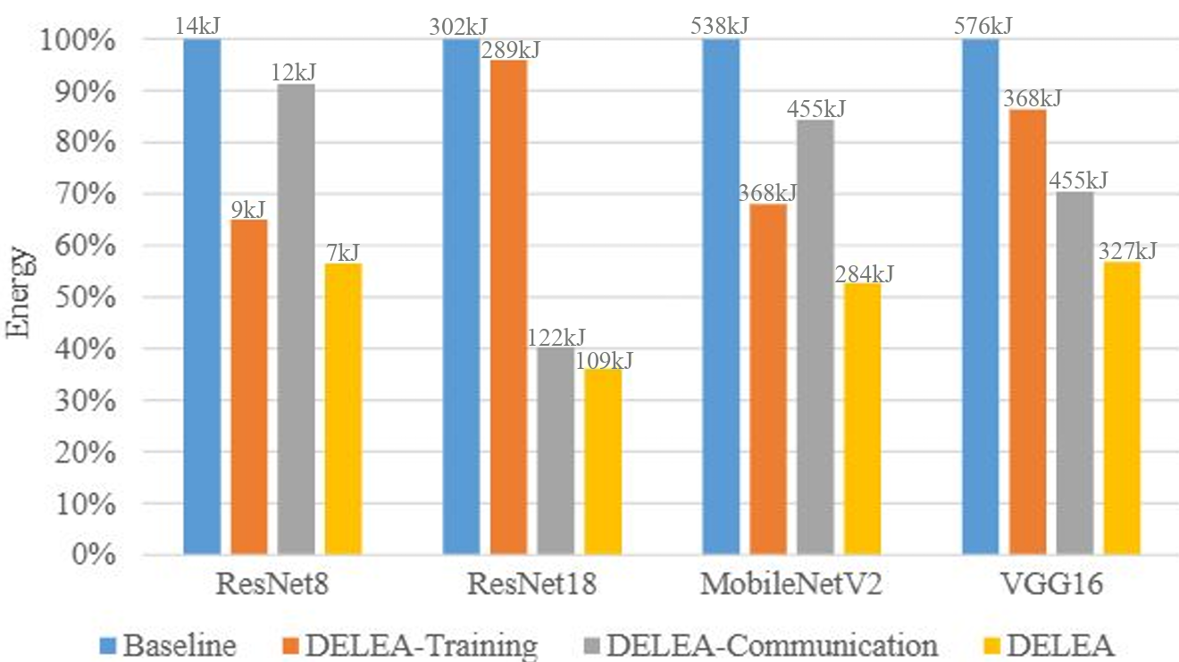
Backup: Energy per Model
Source: paper Fig. 5. Bars normalized to the single-instance baseline; labels show absolute energy

