Slide 1

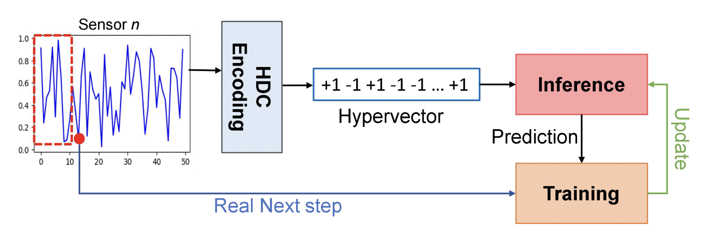
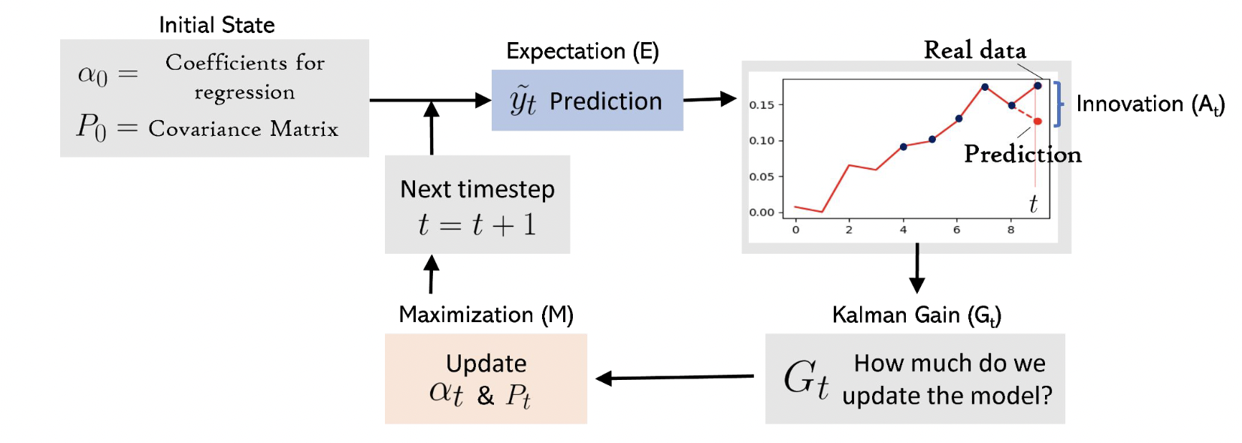


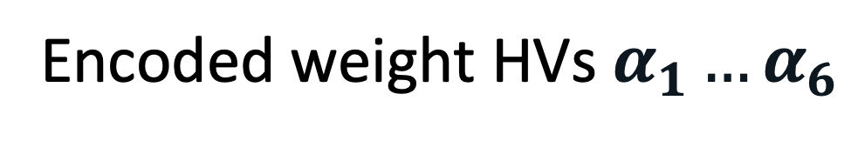
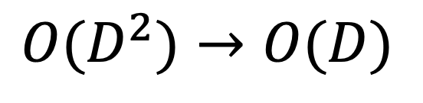
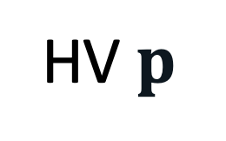
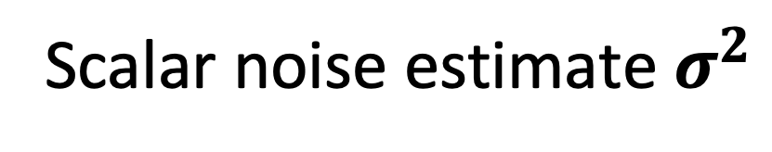


SatAnomHD: Early Detection of Satellite Telemetry Data Anomalies
using Hyperdimensional Computing
Benjamin Scott^{1,2}, Tajana Rosing², and Flavio Ponzina¹
¹San Diego State University (SDSU), ²University of California, San Diego (UCSD)
Background and Related Work
Anomaly Detection in Space
State-of-the-Art Anomaly Detection
+ NNs most precise: Telemanom-ESA [SIGKDD’18], 0.875 alarm precision
+ Statistical fast: Global-STD [PVLDB’22]
- Statistical imprecise: 0.035 alarm precision
- NNs costly: 12.5 ms infer / 55 ms train
- NNs energy-heavy: up to 56×/206× vs. HDC
- All reactive: No lead time
KEY RESEARCH QUESTION
Can we forecast multivariate telemetry and flag anomalies before they are sampled, matching NN alarm precision at a fraction of NN compute?
Mostly reactive: alarms only after anomalous samples
Per-sensor vs. multi-modal analysis
High-frequency sensor streams
Tight on-board power & memory
Hyperdimensional Computing
KalmanHD [ASP-DAC’24]
Kalman Filter Algorithm
+ Efficient, highly parallel vs. NNs
+ Gradient-free, single-pass training
+ On-board fine-tuning, small memory
HDC-based regression using Kalman Filters
 | Multi- variate | Multi- step | Kalman updates | Lead time
RegHD [DAC’21] | – | – | – | –
GlucoseHD [IEEE D&T’24] | – | ✓ | – | –
KalmanHD [ASP-DAC’24] | – | – | ✓ D×D | –
SatAnomHD (ours) | ✓ | ✓ | ✓ O(D) | ✓
Train a forecasting regressor hypervector (HV)
- Limit error amplification
- Find a hidden state through various observed states
Noise-resilient forecasting basis
→ SatAnomHD: multivariate, multi-step, O(D)
- Requirements: present state & uncertainty matrix
- Consider variance of samples ➔ single-pass approach
Continuous monitoring on-board
Hardware efficiency
Autoregressive HD-based Forecasting
Kalman-style state overhead
Hardware-friendly online adaptation
HD Regressor
HD Classifier
Encoded weight HVs $α_{1}…α_{6}$
Full Kalman covariance matrix
[6,D]
D $×$ D
HEAVY
Single shared variance HV $p$
Diagonalize
$$O(D^{2})→O(D)$$
[1,D]
Scalar noise estimate $σ^{2}$
HV $p$
D
LIGHT
[1,1]
Bipolar sign flips ➔ parallel sums ➔ 1 scalar normalization ➔ vector MACs
Shared update across channels
Skip quiet samples
No gradients
No replay buffer
Single-pass updates
Experimental Results
Experimental Setup: ESA-ADB Mission 1 [SpaceOps’25] · ARM Cortex-M MCU · D = 3000 (bipolar) · horizons S = 1, 5, 10 samples
Baselines: Global-STD [PVLDB’22], DC-VAE-ESA [IEEE TNSM’24], Telemanom-ESA [SIGKDD’18]
Autoregressor 30 s ahead predictions (S = 1)
Z-score sensor values over 500 timesteps, 6 channels; blue = true, red = predicted
Alarm precision matches Telemanom-ESA (0.875) with 5 min lead time
Alarm precision by warning horizon (event recall 0.055; full metrics in paper)
5 min
early warning (SOTA: No lead time)
~25×
alarm precision vs. Global-STD, DC-VAE
24–60× / 94–231×
faster inference / training
up to 56× / 206×
less energy, inference / training
Acknowledgments
Configurable threshold τ: choose earlier warnings or fewer false alarms, without retraining
This work was supported in part by PRISM and CoCoSys, centers in JUMP 2.0, a Semiconductor Research Corporation (SRC) program sponsored by DARPA; the U.S. DOE DeCoDe project #84245 at PNNL; and the Minderoo eDNAID project.
Notes:
SatAnomHD Characteristics:
1. Multivaraite permutation-level encoding
2. predict long term samples
3. Approximated Kalman style updates
4. on-board continual model fine-tuning

