Slide 1
U.S. Consumer:
Finance Complaints
Analysing Data with SQL
Bruno M. Serafim
01/12/2021

Slide 2
Table of Contents
Brief Introduction
Objectives
Results
Conclusions
Appendix (Queries)

Slide 3
Brief Introduction

Slide 4
Data
Data from Consumer Financial Protection Bureau (CFPB), U.S.
(Downloaded from Kaggle*)
Collection of complaints about consumer financial products and services, sent from CFPB to companies for response
SQLite database, with 18 columns and 555,957 rows
Date range: 01/12/2011 - 25/04/2016
*https://www.kaggle.com/kaggle/us-consumer-finance-complaints

Slide 5
Context
Solid economic recovery after 2008 sub-prime crisis*
Heated credit market, consumer base expanding**
Interest rates near 0%*
U$ 4 trillion boost from Federal Reserve (FED)*
Expansionary fiscal policy*
(continuous budget deficit)
*https://commonslibrary.parliament.uk/research-briefings/sn06901/
**https://www.mortgagecalculator.org/helpful-advice/mortgage-statistics.php
5

Slide 6
Objectives

Slide 7
Objectives
To analyse and bring insights about filed complaints, by category:
Products (and sub-products)
Companies
States
Consumer disputes
To investigate complaints evolution throughout time
Analysing possible trends and seasonality

Slide 8
Results

Slide 9
Results
Complaints by product (2011 - 2016), ranked
Rank | Product | Number of Complaints | Percentage of Total
1 | Mortgage | 186,475 | 33.54%
2 | Debt collection | 101,052 | 18.18%
3 | Credit reporting | 91,854 | 16.52%
4 | Credit card | 66,468 | 11.96%
5 | Bank account or service | 62,563 | 11.25%
6 | Consumer Loan | 20,990 | 3.78%
7 | Student loan | 15,839 | 2.85%
8 | Payday loan | 3,877 | 0.70%
9 | Money transfers | 3,812 | 0.69%
10 | Prepaid card | 2,470 | 0.44%
11 | Other financial service | 557 | 0.10%
91.45%
of total

Slide 10
Results
Mortgage complains, ranked by issue (2011 - 2016)
Category: Mortages
Rank | Issue | Number of Complaints | Percentage of Total
1 | Loan modification, collection, foreclosure | 97,191 | 52.12%
2 | Loan servicing, payments, escrow account | 60,375 | 32.38%
3 | Application, originator, mortgage broker | 13,306 | 7.14%
4 | Settlement process and costs | 6,888 | 3.69%
5 | Credit decision / Underwriting | 4,418 | 2.37%
6 | Other | 4,297 | 2.30%
Most mortage complaints (84.50%) related to post-aquisition issues
Access to mortage loans doesn’t seem to be a major problem

Slide 11
Results
Complaints by sub-product (2011 - 2016), ranked
Rank | Sub-product | Number of Complaints | Percentage of Total
1 | Non-specified | 158,322 | 28.48%
2 | Other mortgage | 74,319 | 13.37%
3 | Conventional fixed mortgage | 57,182 | 10.29%
4 | Checking account | 44,369 | 7.98%
5 | Other (i.e. phone, health club, etc.) | 29,617 | 5.33%
6 | I do not know | 21,634 | 3.89%
7 | Conventional adjustable mortgage (ARM) | 20,941 | 3.77%
8 | Credit card | 20,825 | 3.75%
9 | FHA mortgage | 19,152 | 3.44%
10 | Non-federal student loan | 17,969 | 3.23%
11 | Medical | 13,297 | 2.39%
12 | Vehicle loan | 12,168 | 2.19%
13 | Other than previously specified | 66,162 | 11.90%
Messy data input
Unrealiable
data

Slide 12
Results
Complaints by company (2011 - 2016), ranked - Top 10
Rank | Company | Number of Complaints | Percentage of Total
1 | Bank of America | 55,998 | 10.07%
2 | Wells Fargo & Company | 42,024 | 7.56%
3 | JPMorgan Chase & Co. | 33,881 | 6.09%
4 | Equifax | 31,828 | 5.72%
5 | Experian | 30,905 | 5.56%
6 | Citibank | 25,540 | 4.59%
7 | TransUnion Intermediate Holdings, Inc. | 25,534 | 4.59%
8 | Ocwen | 20,978 | 3.77%
9 | Capital One | 15,628 | 2.81%
10 | Nationstar Mortgage | 13,250 | 2.38%
2th largest bank by assets (2016)*
Largest bank by assets (2016)*
Bank of America:
disproportionally high number of complaints, when compared to assets size
Top 10 (2011 - 2016):
6 Banks
4 Credit agencies
53.14% of total
*https://www.relbanks.com/top-us-banks/assets-2016

Slide 13
Results
Complaints of Bank of America (2011 - 2016), ranked by product - Top 10
Bank of America
Rank | Product | Number of Complaints | Percentage of Total
1 | Mortgage | 36,228 | 64.70%
2 | Bank account or service | 10,440 | 18.64%
3 | Credit card | 7,224 | 12.90%
4 | Debt collection | 1,173 | 2.09%
5 | Consumer Loan | 541 | 0.97%
6 | Money transfers | 200 | 0.36%
7 | Student loan | 70 | 0.13%
8 | Other financial service | 44 | 0.08%
9 | Credit reporting | 37 | 0.07%
10 | Prepaid card | 33 | 0.06%
96.24%
of all complaints of Bank of America

Slide 14
Results
Complaints by state (2011 - 2016), ranked - Top 10
State | Number of Complaints | Percentage of Total | Rank (complaints)
California (CA) | 81,700 | 14.70% | 1
Florida (FL) | 53,673 | 9.65% | 2
Texas (TX) | 41,352 | 7.44% | 3
New York (NY) | 38,266 | 6.88% | 4
Georgia (GA) | 24,548 | 4.42% | 5
New Jersey (NJ) | 22,408 | 4.03% | 6
Pennsylvania (PA) | 20,015 | 3.60% | 7
Illinois (IL) | 19,624 | 3.53% | 8
Virginia (VA) | 18,150 | 3.26% | 9
Maryland (MD) | 17,703 | 3.18% | 10
Rank (population - 2019)*
1
3
2
4
8
11
5
6
12
19
Number of complaints in New Jersey and Maryland are disproportionally high (when compared to population size)
An analysis within these states is needed
*https://www.census.gov/data/tables/time-series/demo/popest/2010s-state-total.html

Slide 15
Results
Complaints comparison between states, ranked - Top 5
California
Rank | Product | Number of Complaints | Percentage of Total
1 | Mortgage | 32,988 | 40.38%
2 | Debt collection | 13,568 | 16.61%
3 | Credit reporting | 11,965 | 14.65%
4 | Credit card | 9,078 | 11.11%
5 | Bank account or service | 8,519 | 10.43%
New Jersey
Rank | Product | Number of Complaints | Percentage of Total
1 | Mortgage | 8,411 | 37.54%
2 | Debt collection | 3,304 | 14.74%
3 | Bank account or service | 3,046 | 13.59%
4 | Credit reporting | 2,881 | 12.86%
5 | Credit card | 2,870 | 12.81%
Maryland
Rank | Product | Number of Complaints | Percentage of Total
1 | Mortgage | 7,000 | 39.54%
2 | Debt collection | 2,617 | 14.78%
3 | Credit reporting | 2,551 | 14.41%
4 | Bank account or service | 2,026 | 11.44%
5 | Credit card | 1,999 | 11.29%
‘Complaints distribution’ nearly exactly the same
Further investigation is necessary to understand why New Jersey and Maryland had disproportional high number of complaints (compared to population size)

Slide 16
Results - Complaints over Time and Seasonality
Monthly av: 53,057 complaints
(14.5% above total average)
Monthly av: 42,966
complaints
(7.3% bellow total average)
+132.5% (2012 to 2015)
First trimester (and quarter) accrued more complains than rest of the year
Relevant?
Sharp increase in number of complaints

Slide 17
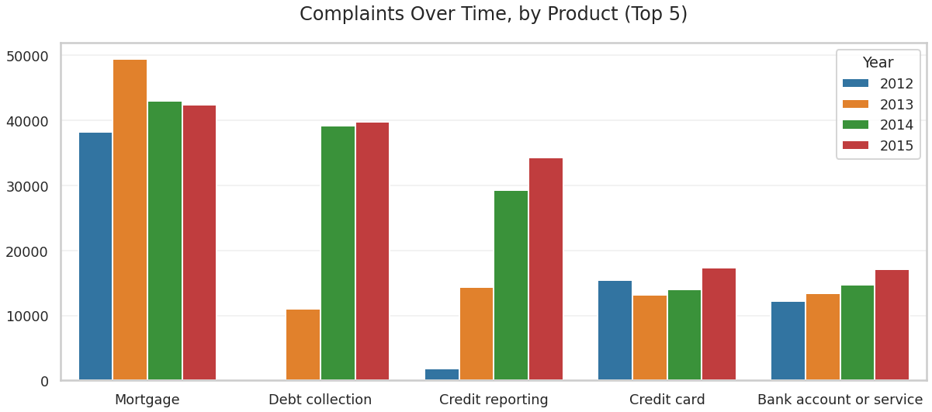
Results - Complaints over Time, by Product
Debt collection complaints
increased...
...but credit delinquency decreased*
(same period)
Further investigation needed
Largest increase in complaints number
*https://fred.stlouisfed.org/series/DRCLACBS

Slide 18
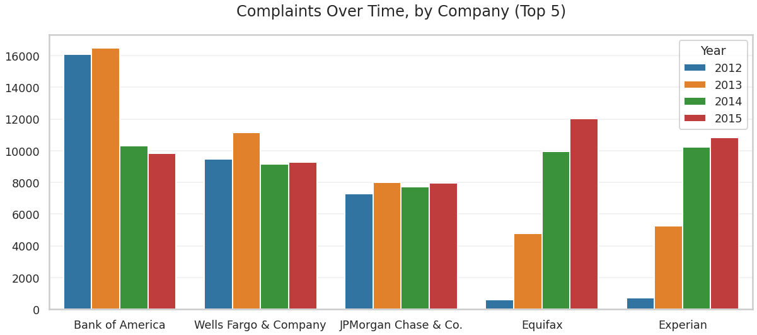
Results - Complaints over Time, by Company
Change in number of complaints (2012 to 2015)
- 38.85%
- 2.01%
+ 9.09%
+ 1832.85%
+ 1393.52%

Slide 19
Results - Complaints Comparison between Equifax and Experian
Equifax
Rank | Issue | Number of Complaints | Percentage of Total (from Equifax)
1 | Incorrect information on credit report | 22,538 | 70.81%
2 | Credit reporting company's investigation | 3,762 | 11.82%
3 | Unable to get credit report/credit score | 3,404 | 10.69%
4 | Improper use of my credit report | 1,050 | 3.30%
5 | Credit monitoring or identity protection | 940 | 2.95%
Experian
Rank | Issue | Number of Complaints | Percentage of Total (from Experian)
1 | Incorrect information on credit report | 21,933 | 70.97%
2 | Credit reporting company's investigation | 3,913 | 12.66%
3 | Unable to get credit report/credit score | 2,609 | 8.44%
4 | Credit monitoring or identity protection | 1,204 | 3.90%
5 | Improper use of my credit report | 1,109 | 3.59%
‘Issues distribution’ nearly identical in both companies
It might suggest that the problem is within the sector (credit reporting), not necessarily with specific companies

Slide 20
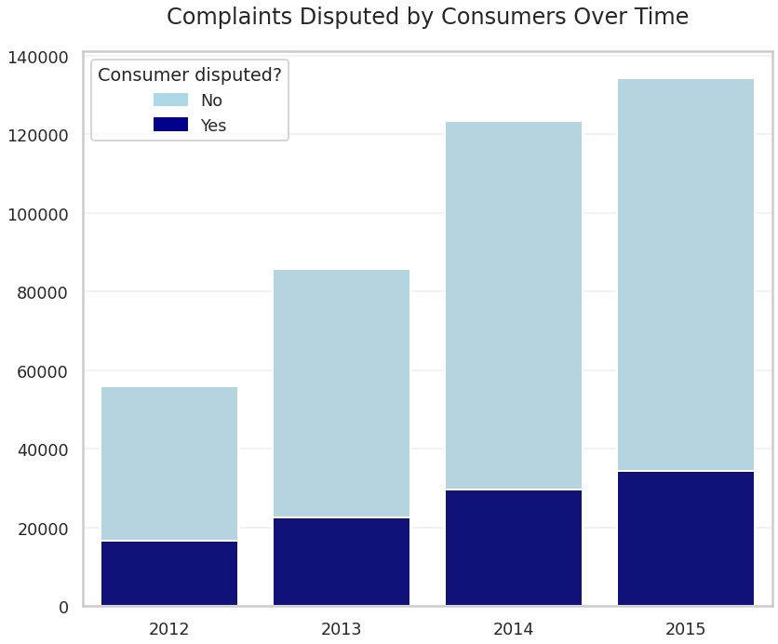
Results - Complaints over Time
From 2012 to 2015:
Complaints
+ 132.5%
Consumer disputes
+ 107.5%
Further understanding of dispute process is necessary to investigate this difference
It might be related to the fact that number of complains of credit reporting agencies grew over time

Slide 21
Conclusions

Slide 22
Conclusions
Full data range (01/12/2011 – 25/04/2016)
Mortagage was the product with more complaints (33.54%)
With loan modification (collection, foreclosure) and loan servicing (payments, escrow account) representing 84.50% of it
Bank of America was the company with more complaints received (10.07%)
Mortgage was their most complained product (64.70%)
California was the state with more complaints (14.70%), but also the one with largest population in U.S, though
New Jersey and Maryland, when compared to population sizes, were disproportionally high in number of complaints (4.03% and 3.18% respectively)
When compared to California, complaints distributions were nearly identical, though
Evolution throughout time (From 2012 to 2015)
Number of complaints increased 132.50%
Monthly average between January and April was 14.5% larger than total monthly average
“Small” seasonality effect, causes not clear
Debt collection and Credit reporting had the largest increases
Led by Equifax (+1833%) and Experian (+1394%)
Both nearly identical in issues distribution

Slide 23
Appendix

Slide 24
Appendix - Queries
-- Complaints by product (2011 - 2016), ranked
select distinct RANK() over (
order by count(*) desc
) as 'Rank',
product,
count(*) as 'number of complaints',
round(1.0 * count(*) / sum(count(*)) over (
order by 3), 4) as 'percent. of total'
from consumer_complaints
group by product
order by 3 desc;
-- Mortgage complains, ranked by issue (2011 - 2016)
select distinct RANK() over (
order by count(*) desc
) as 'Rank',
issue,
count(*) as 'number of complaints',
round(1.0 * count(*) / sum(count(*)) over (
order by 3), 4) as 'percent. of total'
from consumer_complaints
where product = 'Mortgage'
group by issue
order by 3 desc
limit 10;
-- Complaints by sub-product (2011 - 2016), ranked
select distinct RANK() over (
order by count(*) desc
) as 'Rank',
sub_product,
count(*) as 'number of complaints',
round(1.0 * count(*) / sum(count(*)) over (
order by 3), 4) as 'percent. of total'
from consumer_complaints
group by sub_product
order by 3 desc;
-- Complaints by company (2011 - 2016), ranked - Top 10
select distinct RANK() over (
order by count(*) desc
) as 'Rank',
company,
count(*) as 'number of complaints',
round(1.0 * count(*) / sum(count(*)) over (
order by 3), 4) as 'percent. of total'
from consumer_complaints
group by company
order by 3 desc
limit 10;
-- Complaints of Bank of America (2011 - 2016), ranked by product - Top 10
select distinct RANK() over (
order by count(*) desc
) as 'Rank',
product,
count(*) as 'number of complaints',
round(1.0 * count(*) / sum(count(*)) over (
order by 3), 4) as 'percent. of total'
from consumer_complaints
where company = 'Bank of America'
group by product
order by 3 desc
limit 10;
-- Complaints by state (2011 - 2016), ranked - Top 10
select distinct RANK() over (
order by count(*) desc
) as 'Rank',
state,
count(*) as 'number of complaints',
round(1.0 * count(*) / sum(count(*)) over (
order by 3), 4) as 'percent. of total'
from consumer_complaints
group by state
order by 3 desc
limit 10;
(1)
(2)

Slide 25
-- Finding most common products, and how much of total each one represents, in California
select distinct RANK() over (
order by count(*) desc
) as 'Rank',
product,
count(*) as 'number of complaints',
round(1.0 * count(*) / sum(count(*)) over (
order by 3), 4) as 'percent. of total'
from consumer_complaints
where state = 'CA'
group by product
order by 3 desc
limit 10;
-- Finding most common products, and how much of total each one represents, in New Jersey
select distinct RANK() over (
order by count(*) desc
) as 'Rank',
product,
count(*) as 'number of complaints',
round(1.0 * count(*) / sum(count(*)) over (
order by 3), 4) as 'percent. of total'
from consumer_complaints
where state = 'NJ'
group by product
order by 3 desc
limit 10;
-- Finding most common products, and how much of total each one represents, in Maryland
select distinct RANK() over (
order by count(*) desc
) as 'Rank',
product,
count(*) as 'number of complaints',
round(1.0 * count(*) / sum(count(*)) over (
order by 3), 4) as 'percent. of total'
from consumer_complaints
where state = 'MD'
group by product
order by 3 desc
limit 10;
-- Finding the complaints distribuition over the years, between 2012 and 2015
select cast(substr(date_received, 7, 10) as integer) as 'Year',
count(*) as 'number of complaints',
round(1.0 * count(*) / sum(count(*)) over (
order by 1), 4) as 'percent. of total'
from consumer_complaints
where Year between 2012 and 2015
group by 1
order by 1;
-- Complaints by month (2012 - 2015) - Seasonality
select substr(date_received, 1, 2),
count(*) as 'number of complaints',
round(1.0 * count(*) / sum(count(*)) over (
order by 3), 4) as 'percent. of total'
from consumer_complaints
group by 1
order by 1;
-- Complaints over time, by product (Top 5) from 2012 to 2015
select distinct row_number() over (
partition by substr(date_received, 7, 10)
order by count(*) desc
) as 'Rank',
product,
count(*) as 'number of complaints',
round(1.0 * count(*) / sum(count(*)) over (
order by 3), 4) as 'percent. of total',
substr(date_received, 7, 10) as 'Year'
from consumer_complaints
group by Year, product
order by Year, 3 desc;
(3)
(4)

Slide 26
-- Complaints over time, by company (Top 5) from 2012 to 2015
select cast(substr(date_received, 7, 10) as integer) as 'Year',
company,
count(*) as 'number of complaints',
1.0 * (LEAD(count(*)) over(
partition by company
order by company) - count(*))/count(*) 'Change (in dec. points)'
from consumer_complaints
where (company = 'Equifax' or
company = 'Experian’ or
company = 'Bank of America’ or
company = 'JPMorgan Chase & Co.' or
company = 'Wells Fargo & Company’) and
(Year = 2012 or
Year = 2015)
group by Year, company
order by 2;
-- Complains by issue (2011 - 2016), from 'Equifax'
select distinct issue,
count(*) as 'number of complaints',
round(1.0 * count(*) / sum(count(*)) over (
order by 3), 4) as 'percent. of total'
from consumer_complaints
where company = 'Equifax'
group by issue
order by 3 desc
limit 10;
-- Complains by issue (2011 - 2016), from 'Experian'
select distinct issue,
count(*) as 'number of complaints',
round(1.0 * count(*) / sum(count(*)) over (
order by 3), 4) as 'percent. of total'
from consumer_complaints
where company = 'Experian'
group by issue
order by 3 desc
limit 10;
-- Complaints disputed by consumers over time, between 2012 and 2015
select cast(substr(date_received, 7, 10) as integer) as 'Year',
count(*) as 'number of complaints',
"consumer_disputed?"
from consumer_complaints
where Year between 2012 and 2015
group by 1, 3
order by 1;
(5)

