Slide 1

Restaurant Analysis
By : B M Sourava Raj

Slide 2
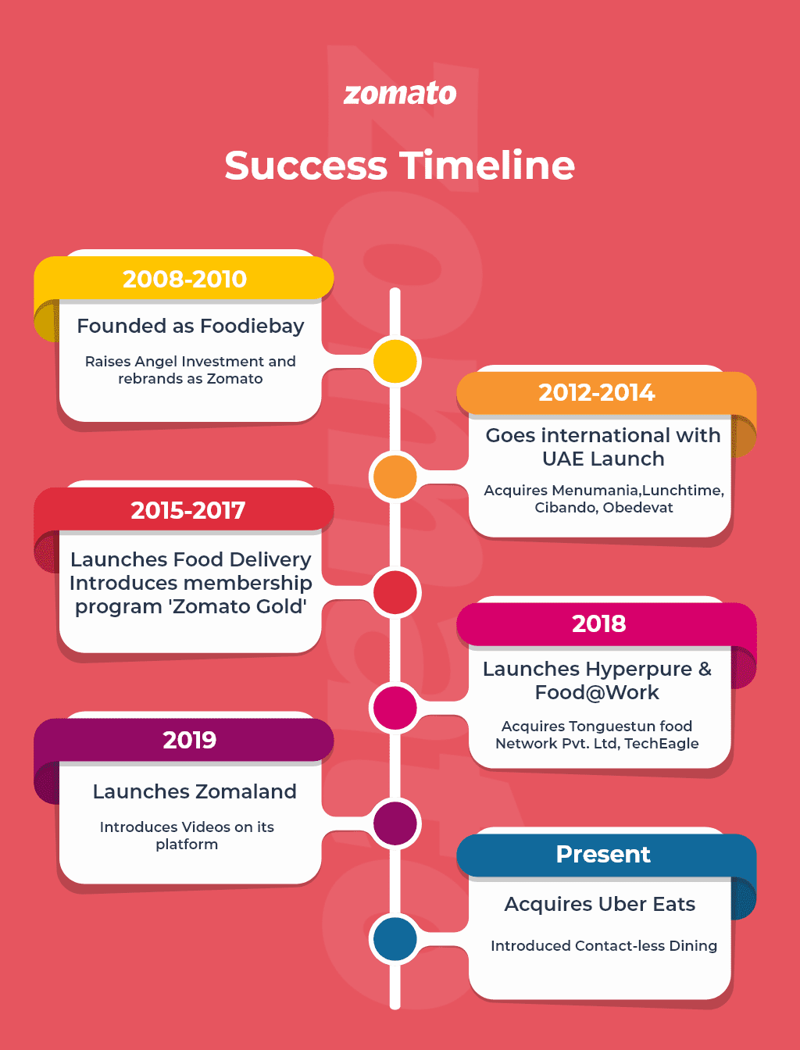
Project Objective:
Zomato is exploring new opportunities for global restaurant expansion.
The key challenge is to determine:
🌍 Markets with low competition but high customer satisfaction.
🍽️ Cuisines, price ranges, and services (online delivery, table booking) that drive ratings and engagement..
Goal: Deliver data-backed insights to guide management in making smarter expansion and customer strategy decisions.

Slide 3
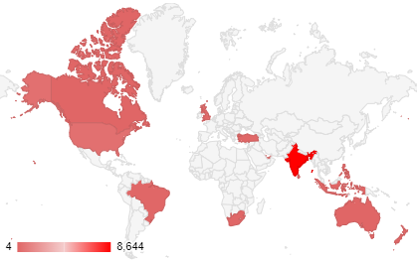
Zomato Data Overview:
Dataset Overview
Countries: 15
Cities: 142
Restaurants: 9,543
Cuisines: 1,825
Active Voters: 14,986
Data Cleaning Steps
Addressed and cleaned the date column
Cleaned the “average cost for two” column
Standardized data using country codes
Extracted and added country names from another sheet

Slide 4
Methodology
Data Cleaning & Preparation
Filled missing values in “average cost for two” using each country’s mode
Formatted the date column; extracted date and month for further analysis
Feature Creation
Created a new column combining currency symbols with “average cost for two” using IF and CONCAT formulas
Extracted year from the cleaned date column to enable future analysis with a year-based slicer

Slide 5
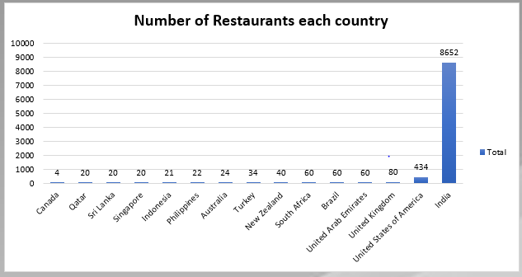
Number of Restaurants per Country
Insights
India dominates with 8,652 restaurants, far higher than all other countries.
The second highest is UAE with just 434 restaurants, showing a large gap.
All other countries have less than 300 restaurants each.
Recommendations
Focus new restaurant openings in countries with fewer restaurants but stable markets
Leverage learnings from India to scale operations in these under-served countries.
Conduct feasibility studies for high-potential cities in these markets.

Slide 6
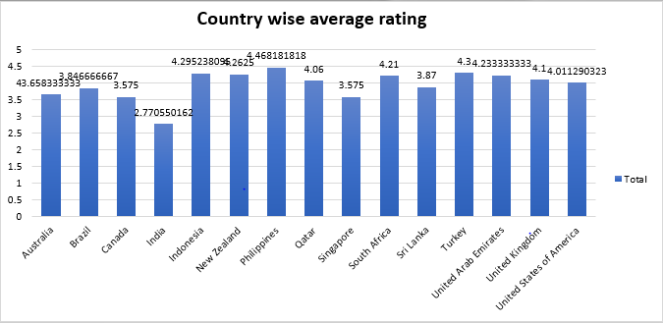
Country-wise Average Rating
Insights
Average ratings range from 2.77 to 4.46 across countries.
Philippines and Turkey show highest ratings (~4.3+)
Some countries have lower average ratings indicating quality/expectation gaps.
Recommendations
Prioritize countries with high ratings but few restaurants
Offer premium or unique menus to match customer expectations.
Choose cities carefully using data on ratings and restaurant density.

Slide 7
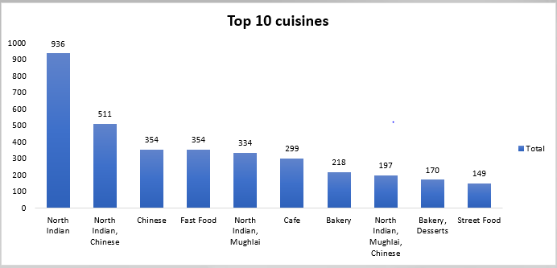
Top 10 Cuisines
Insights
North Indian dominates (936 restaurants) followed by North Indian-Chinese (511).
Fast food, Café, and Bakery are also significant.
Dessert and Street Food have a small share but exist.
Recommendations
Prioritize North Indian and Chinese for expansion and promotions.
Develop targeted campaigns for emerging cuisines (Dessert, Street Food).
Consider adding innovative fusion cuisines to attract new customers.

Slide 8
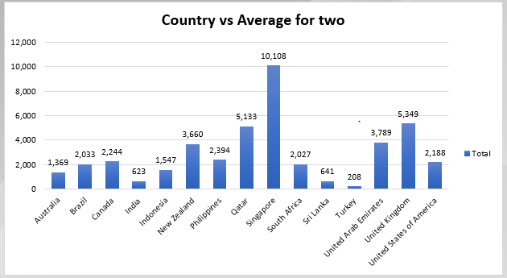
Country vs Average Cost for Two
Insights
Huge cost variation — Singapore peaks at 10,108, many countries around 2,000–4,000.
Some countries (India, Philippines) much more affordable.
Recommendations
Adjust pricing strategy per market; avoid one-size-fits-all.
Promote premium offerings in high-cost countries; budget-friendly bundles in low-cost ones.
Use insights to guide country-specific promotions.

Slide 9
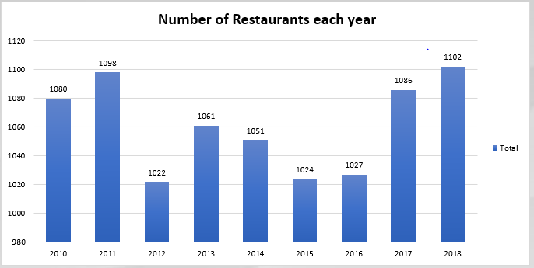
Number of Restaurants Each Year
Insights
Steady growth from 2010 (1080) to 2018 (1102), with dips in some years.
Significant jump in 2011 and 2018.
Recommendations
Analyze factors behind growth spikes (2011, 2018) to replicate in future.
Plan marketing pushes during historically strong years.
Prepare operations to handle more restaurants in the future.

Slide 10
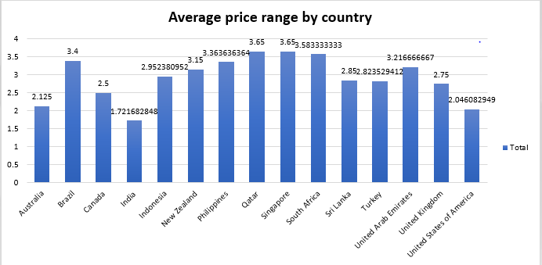
Average Price Range by Country
Insights
Average price varies widely — highest in Qatar & South Africa (~3.6–3.5), lowest in Australia (~2.1).
India shows low pricing (~1.7).
Recommendations
Adjust menu pricing to local affordability levels.
Offer tiered pricing in high-price countries to attract budget customers.
Use low-cost countries as test beds for value-based offerings.

Slide 11
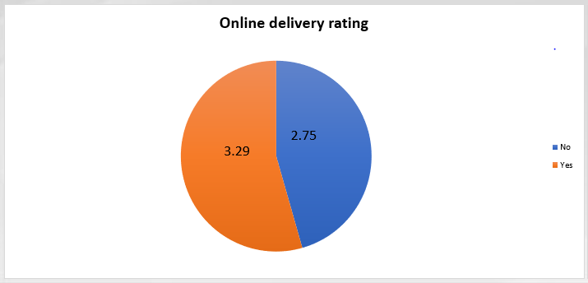
Online Delivery Rating
Insights
Ratings for “Yes” (3.29) higher than “No” (2.75).
Indicates positive customer response to online delivery options.
Recommendations
Expand online delivery services in all countries.
Improve digital experience (app UX, delivery speed) to sustain higher ratings.
Promote restaurants with strong delivery scores.

Slide 12
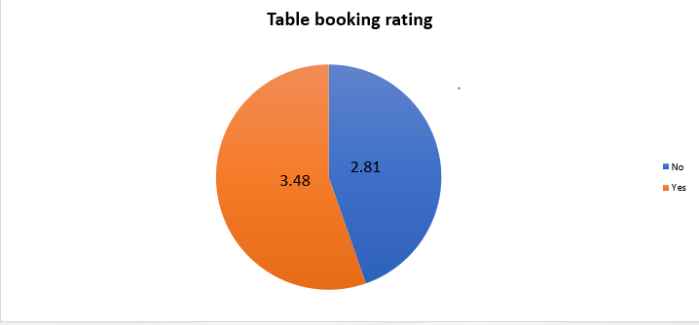
Table Booking Rating
Insights
Ratings for “Yes” (3.48) slightly higher than “No” (2.81).
Suggests table booking enhances customer satisfaction.
Recommendations
Encourage restaurants to enable table booking via Zomato.
Highlight table-booking restaurants in the app.
Analyze why some restaurants don’t support booking to remove barriers.

Slide 13
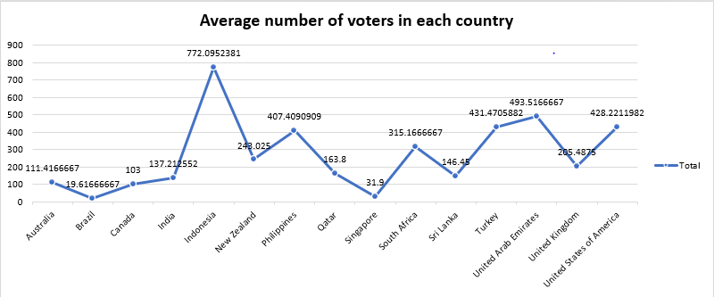
Average Number of Voters in Each Country
Insights
India has the highest voter participation (~772).
Other countries vary widely with much lower averages.
Recommendations
Use India as a model for customer engagement campaigns.
Incentivize reviews/votes in low-engagement countries.
Leverage high voter base to launch loyalty or feedback programs.

Slide 14
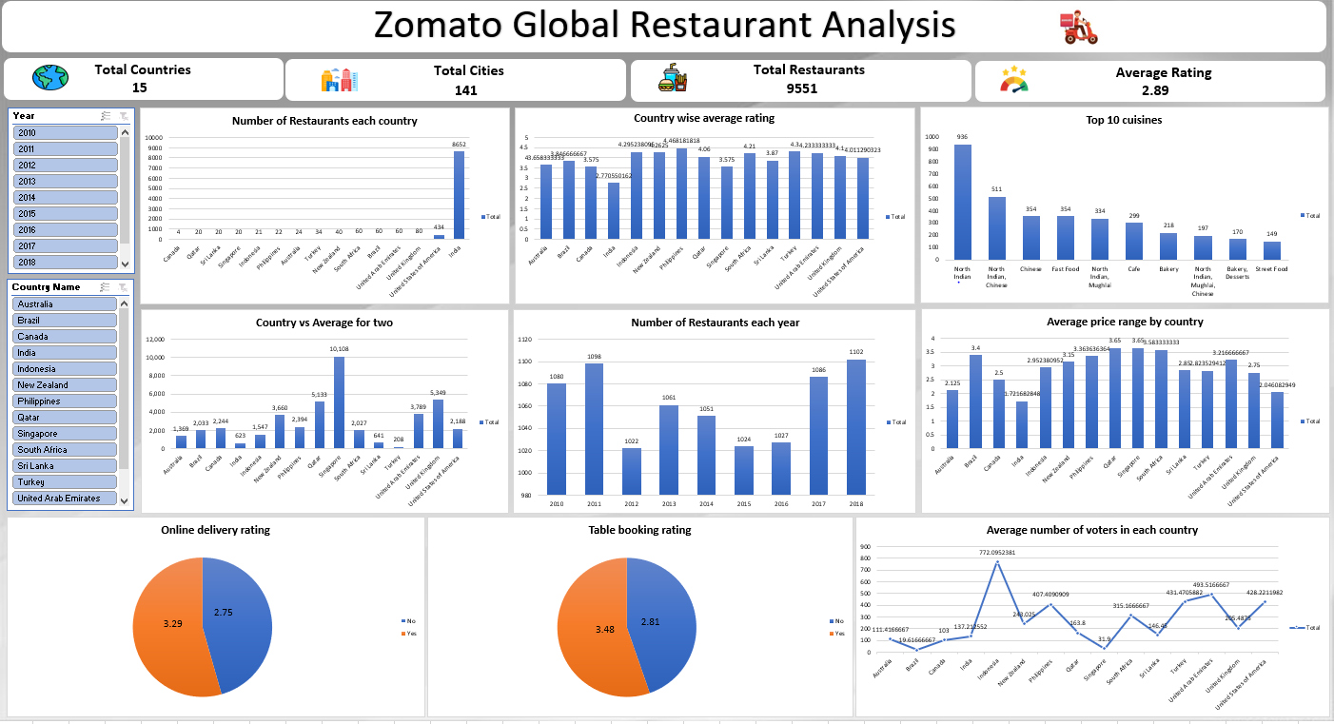

Slide 15
Final Recommendations
Expand into countries with high ratings but low restaurant counts (Indonesia, Philippines, Qatar, Turkey).
Tailor menus & pricing to each country’s preferences.
Present restaurants as high-quality or unique to match what customers expect
Use data to select cities with the highest demand and lowest competition.
Strengthen online delivery & table booking to boost customer satisfaction.

Slide 16
Conclusion
There are new markets with big potential.
Indonesia, Philippines, Qatar, Turkey emerge as prime opportunities.
Past experience can help ensure success in these new markets.
A data-led expansion strategy will ensure smart growth and higher customer satisfaction.

