Slide 1
Data Engineering 2: Big Data Architectures
Project: Prototype of Data Pipeline
By: Kshema Iliger, Spoorti Basarkod Math

Slide 2
User Story
As a data analyst, the goal is to retrieve up-to-date data from an API that includes details about the city, petrol price, price variation, and unit. This will enable to produce a visual aid that will educate viewers about the fluctuations in petrol costs.
Notes:
Project baseline Prototype Data Pipeline and to understand the ETL process through and through

Slide 3



Flow Diagram
Notes:
Firstly, we have written a python script to make API calls
This is where the data is extracted.
Extracted data is then ingested into Google cloud product “Bigquery” where the transformation is taking place.
Queries are run over the data which further help in the next step..
That is, visualization. Data is visualized here by plotting graphs and diagrams.
ETL process
Tech used.

Slide 4
API
API: https://live-petrol-diesel-price-india.p.rapidapi.com/api/petrol-city-all
Datapoints:
City
Price
Change(in price)
Unit
Notes:
Rapid api
Parameter is StateID
Has a rate limit of 150calls/month
Datapoints—
Price and change change every two day.

Slide 5
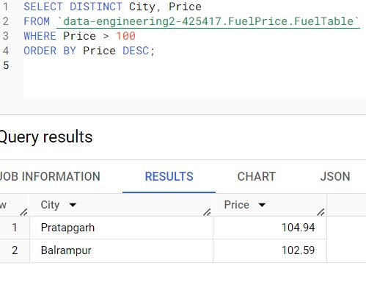
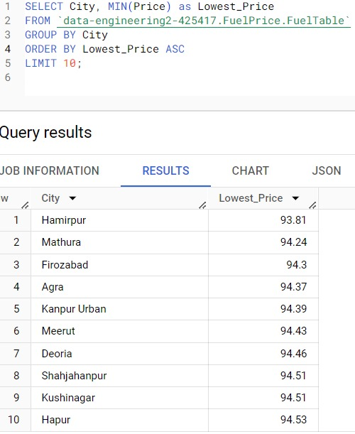
Queries
Above 100 SELECT DISTINCT City, Price
FROM data-engineering2-425417.FuelPrice.FuelTable
WHERE Price > 100 ORDER BY Price DESC;
SELECT City, MIN(Price) as Lowest_Price
FROM data-engineering2-425417.FuelPrice.FuelTable
GROUP BY City ORDER BY Lowest_Price ASC LIMIT 10;
Notes:
All the cities that has price more than 100
10 least petrol priced city

Slide 6
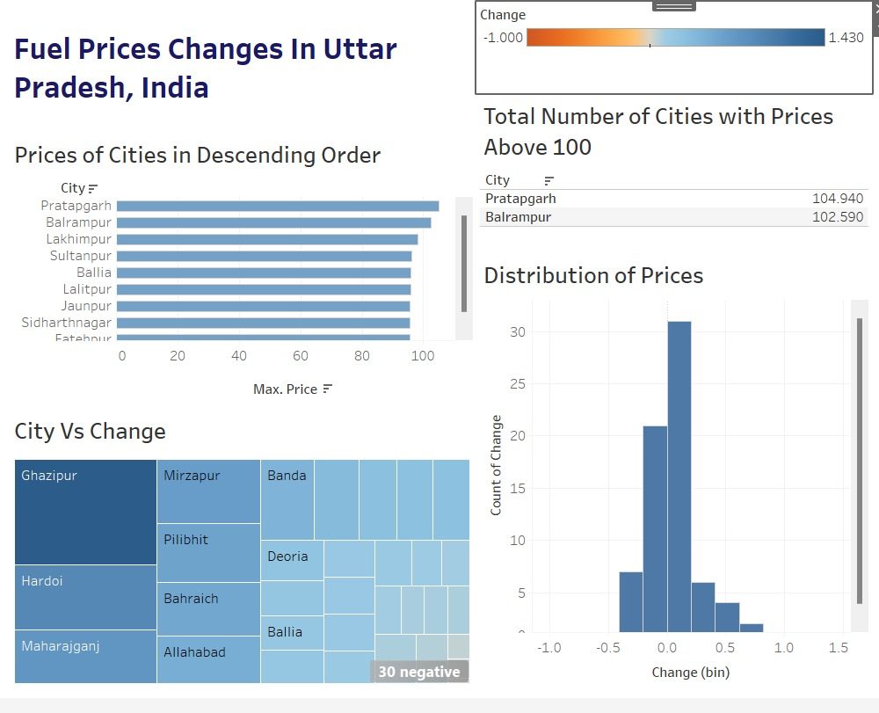
Visualization

