Slide 1


FS12
Week 02
Python Basics II
Mikhail Masyagin
Daniil Devyatkin

Slide 2

Hello, everyone!

Slide 3
Programming paradigm
Procedural Programming (PP);
Functional Programming (FP);
Object Oriented Programming (OOP) [next lesson];
etc.

Slide 4
Functional programming
FP is a programming paradigm that focuses on using functions the building blocks of a program and avoiding mutable data and state;
Programs are built from the composition of functions, which return result;
Variable is immutable, no cycles, recursion;
FP has a good mathematicians basis. (lambda calculus)

Slide 5

FP in Python: # True or False?
Python is multilateral language and it can FP;
Base standard function for FP: `map`, `reduce`, ‘filter’, and lambda functions;
You can use functools library for research more functions;
But before lambda functions intro.
Python

Slide 6
FP in Python: lambda functions
You can define function in this way:
>>> def func(a, b, c): pass
But you can use lambda (anonymous) functions for clean development. Syntax:
>>> lambda <args>: <one string logic>
Example:
>>> (lambda x, y: x + y)(2, 3) # 5
>>> t = [(2, “v”), (1, “d”), (5, “a”)]
>>> sorted(t, key = lambda x: x[1])
# [(5, “a”), (1, “d”), (2, “v”)]

Slide 7
FP in Python: map
`map` is function, which apply some function to iterable collecton, return collection like input;
`map(<func>, <iterable>…)`;
Examples:
>>> map(int, [“1”, “2”, “3”]) # [1, 2, 3]
>>> map(lambda x: x.lower(), [“ABCD”, “S”])
# [“abcd”, “s”]
>>> map(lambda x, y: x + y, [1, 2, 3], [4, 5, 6])
# [5, 7, 9]

Slide 8
FP in Python: reduce
`reduce` function applies the some function to the elements of a sequence, reducing it to a single value, return value;
`reduce(<func>, <iterable>, <init>)`;
Examples:
>>> lst = [1, 24, 17, 14, 9, 32, 2]
>>> cond = lambda a,b: a if (a > b) else b
>>> reduce(cond, lst, 0) # 32

Slide 9
FP in Python: filter
`reduce` function filter a sequence be some condition;
`reduce(<func>, <iterable>)`, func should return bool value;
Examples:
>>> lst = [1, 24, 17, 14, 9, 32, 2]
>>> cond = lambda x: bool((x + 1) % 2)
>>> list(filter(cond, lst)) # [24, 14, 32, 2]

Slide 10
Modules & Packages I: Modules
A module in Python is a file with .py extensions.
It just encapsulation method for readability code;
Example of module import:
>>> import math
>>> math.sqrt(4) # 2
Example of alias:
>>> import math as m
>>> m.sqrt(4) # 2

Slide 11
Modules & Packages I: Modules
Example of import concrete function:
>>> from math import sqrt
>>> sqrt(4) # 2
Also you can use this set up:
>>> from math import sqrt as s
>>> s(4) # 2
Import all:
>>> from math import *
You can write self-module and import it like others.

Slide 12
Modules & Packages II: Packages
If you want write self-library, you should know about packages;
A package in Python is a directory that includes other directories, modules and contains an __init__.py file;
Example:
helloworld-project
|---- helloworld
| |-- __init__.py
| |_ core.py
|-- setup.py

Slide 13
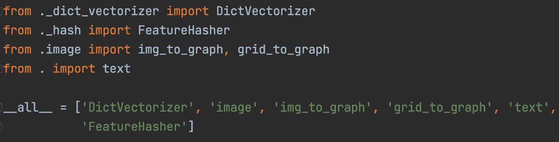
Modules & Packages II: Packages
When importing a package (import package, from my_cool_lib import package ) only __init__.py is imported (everything that is written inside is performed);
Constructor for package, configurate something before import.

Slide 14
Modules & Packages II: Packages
But, what is magic setup.py file in helloworld-project?;
A setup.py is special service file for package manager (pip) and install package;
What setup.py file (can) contain:
    Version;
    Required packages;
    Python version;
    License.

Slide 15
Modules & Packages II: Packages
Distribution:
    A project containing setup.py can be built:
    ‘python setup.py sdist > my_project.tar.gz’;
    This package can be installed and redistributed:
    ‘pip install my_project.tar.gz’.

Slide 16
Modules & Packages III: __main__
Python will run all code in a file unlike other languages, because Python don’t have entry point;
Reminder: `python <some_name>.py`
When the interpreter runs the file as the main program, it sets the __name__ variable to "__main__";
If we have some executable code in module, and we need execute it, when this module is file of main program and don’t execute else, we write next condition: [next slide]

Slide 17
Modules & Packages III: __main__
# ex1.py
...
<some module logic>
...
if __name__ == “__main__”: <some_executable_code>
execute if the module will call like a main program:
`python ex1.py`
# ex2.py
...
<some module logic>
...
<some_executable_code>
# always execute

Slide 18
Modules & Packages IV: requirements.txt
We install package by pip manager;
A few external packages are required to run the project. In order not to build them with pain every time, it is customary to supply a list of these packages along with the source code. It is customary to place the entire list of required packages in the requirements.txt file at the root of the project.

Slide 19
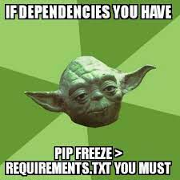
Modules & Packages IV: requirements.txt
Example requirements.txt file:
  django==1.10.2
  pillow==3.3.0
  gunicorn==19.6.0
  torch==2.2.3
  sklearn==0.35
  numpy==1.4.2
  `pip install -r requirements.txt`

Slide 20
I/O & files I
What we can do with file?
  opening operations:
      open;
      close;
      write;
      read;
  Operations without opening:
      rename;
      copy;
      etc.

Slide 21
I/O & files I
When a file is opened, the OS receives a special fd that uniquely determines which file will be used next operation;
In Python, interaction with files is carried out through a special abstract file object;
Syntax and args:
open(file, mode='r', buffering=-1, encoding=None, errors=None, newline=None, closefd=True, opener=None)
Return file’s descriptor.

Slide 22
I/O & files II
f = open("some.file", "r")
data.write(“some text”)
data = f.read()
f.close()
# better
with open("some.file", "r") as f:
data.write(“some text”)
data = f.read()

Slide 23
I/O & files II: Mode
Mode | Description
“r” | Read only.
“w” | Write only. the contents of the file are deleted, if the file does not exist, a new one is created.
“rb” | Analogue “r” mode for binary format.
“wb” | Analogue “w” mode for binary format.
“r+” | “r” + “w” mode
“a” | For writing, the information is added to the end of the file.
“x” | To write if the file does not exist, otherwise an exception will be thrown.

Slide 24
I/O & files III
You can display something in terminal (console) using `print()` function, but this isn’t limited to the terminal.
Syntax `print()` function:
print(value, ..., sep='', end='\n', file=sys.stdout, flush=False)
file is a file-like object (stream). The default is sys.stdout
(can change to stdin or stderr). Here you can specify the file to which you want to write or add data from the print function. You can save output to file!

Slide 25
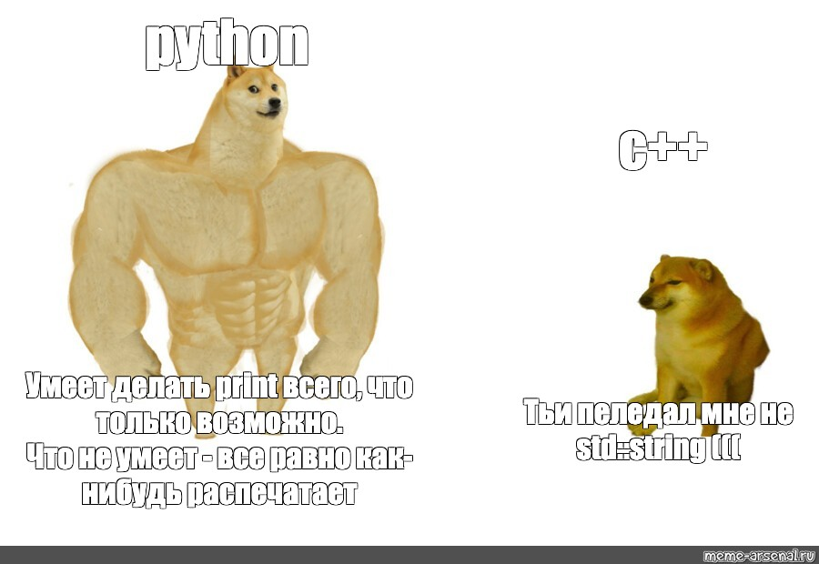
I/O & files: meme

