Slide 1
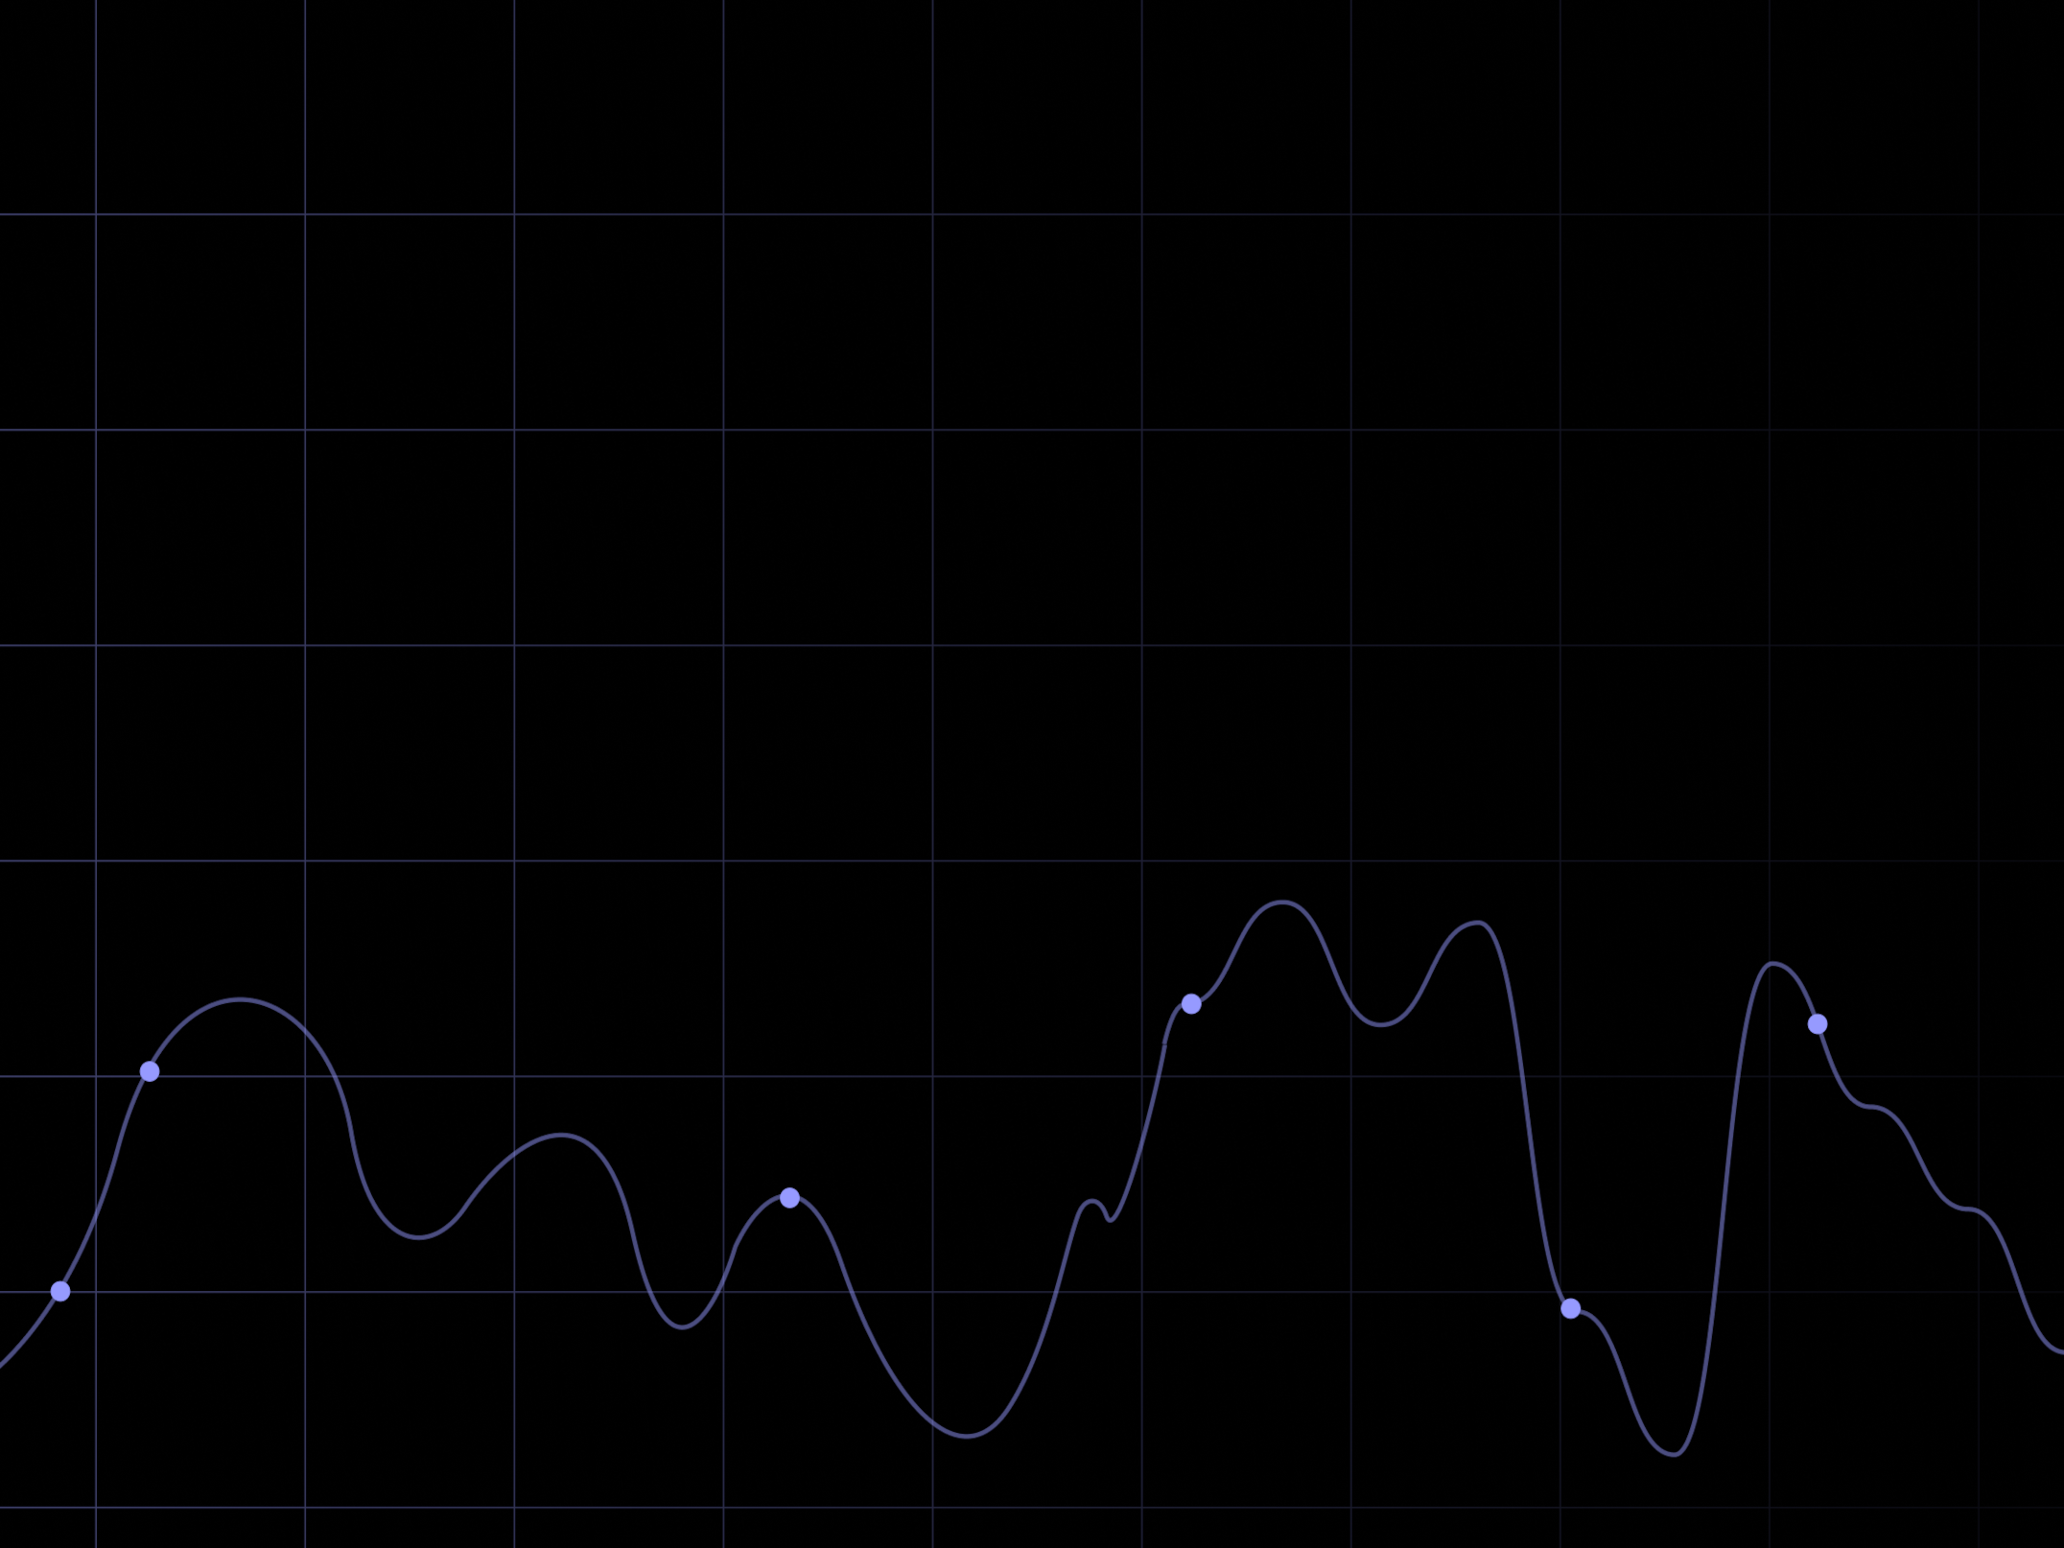

1 Week. Python Basics I.
fs12
bmstu
d. devyatkin
m. masyagin

Slide 2


