Slide 1
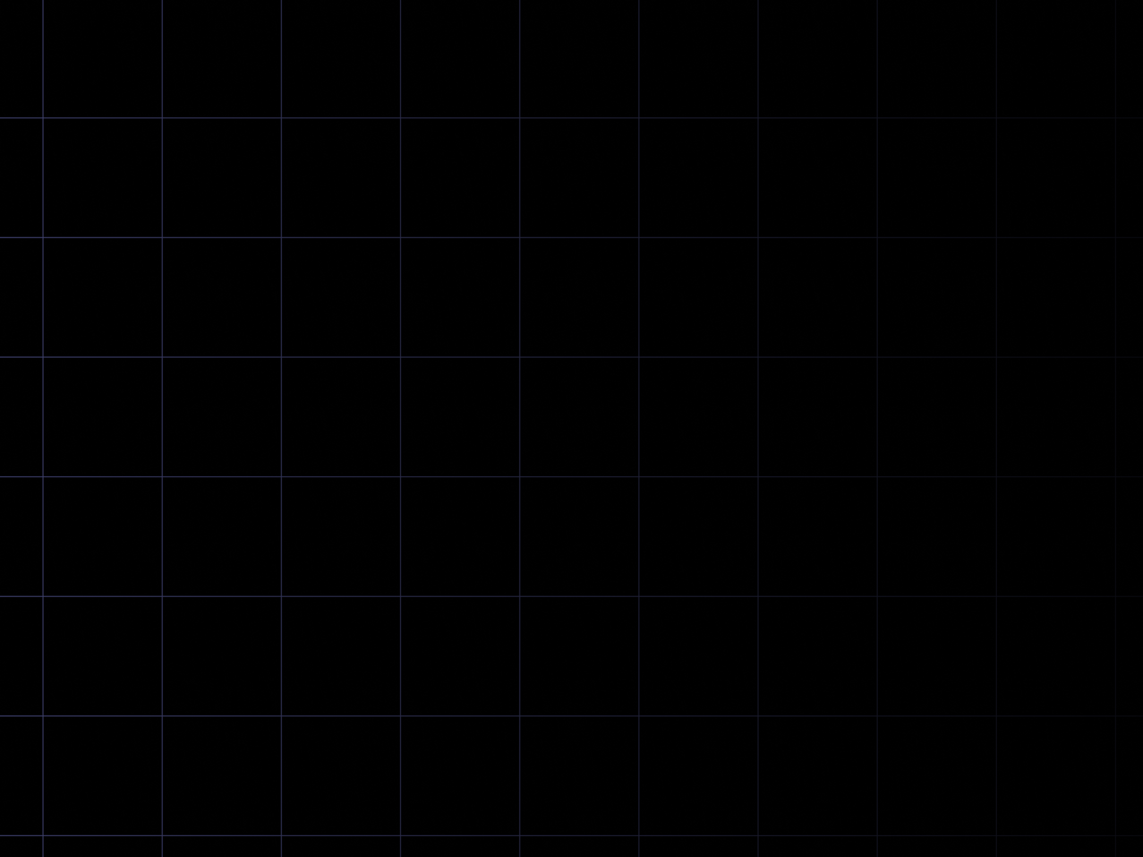

FS12
Week 01
Python Basics I
Mikhail Masyagin
Daniil Devyatkin

