Slide 1
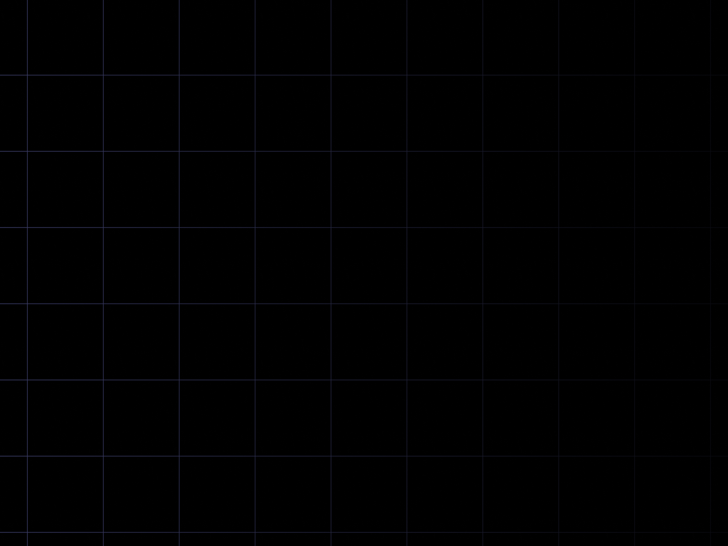

FS12
Week 05
Asymptotic Complexity.
Mikhail Masyagin
Daniil Devyatkin

Slide 2
Intro to Asymptotic Complexity
An algorithm is a formally described computational procedure that obtains the input or its argument, and giving the result
The algorithm defines a mapping F : X → Y, where X set of initial data, Y set of values.
(output);
output function() input {
computing procedure
}

Slide 3
Intro to Asymptotic Complexity
One of the main tasks in development is the analysis of algorithms;
The analysis of the algorithm consists in predicting the amount of computing resources required for its operation. Most often, we are interested in the running time of the algorithm and the amount of RAM used.

Slide 4
Intro to Asymptotic Complexity
Algorithm analysis is done to:
    Algorithm Comparisons;
    For a approximate estimate of programs efficiency in a new environment;
    To identify practical applicability algorithm;

Slide 5
Intro to Asymptotic Complexity
Often the initial data are characterized by natural number n;
Then we can calculate the running time of the algorithm by function depending on n - T(n);
Additional volume memory – M(n);
Example:
    Sorting an array. The size of the original array is important – n;

Slide 6
Intro to Asymptotic Complexity
Given a set of input data, we can calculate how many steps the algorithm takes to complete. However, in order to evaluate the quality of an algorithm, it is required to know how it behaves on all sets of input data.
Definition. The complexity of the algorithm in the best (worst) case is a function that specifies the dependence of the min (max) number of steps of the random access memory machine exec the given algorithm, on the size of the input data.

Slide 7
Intro to Asymptotic Complexity
Definition. The function g(n) is an asymptotic lower bound for the function f(n) if it is possible to find positive constants c and c0 such that for any n > n0 the expression f(n) ≥ c · g(n) is true. For some function g(n) designation is Ω(n). Also is named like a asymptotically lower bound;
Definition. The function g(n) is an asymptotic upper bound for the function f(n) if it is possible to find positive constants c and c0 such that for any n > n0 the expression f(n) ≤ c · g(n) is true. For some function g(n) designation is O(n). Also is named like a asymptotically upper bound.

Slide 8
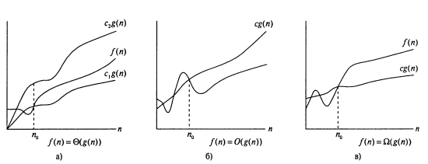
Intro to Asymptotic Complexity
If more formal:
  f(n) ∈ ϴ(g(n)) = { ∃ 𝑐1 > 0, 𝑐2 > 0, 𝑛0 > 0 : 0 ≤ 𝑐1g(n) ≤ f(n) ≤ 𝑐2g(n), ∀ 𝑛 > 𝑛0 };
  f(n) ∈ O(g(n)) = { ∃ 𝑐 > 0, 𝑛0 > 0 : 0 ≤ f(n) ≤ 𝑐 g(n), ∀ 𝑛 > 𝑛0 };
  f(n) ∈ Ω(g(n)) = { ∃ 𝑐 > 0, 𝑛0 > 0 : 0 ≤ 𝑐 g(n) ≤ f(n), ∀ 𝑛 > 𝑛0 };

Slide 9
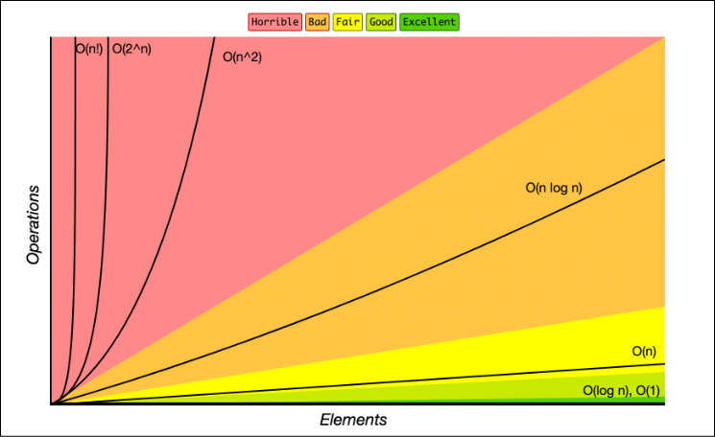
Intro to Asymptotic Complexity
O(logn) – raising a number to a power;
O(n) – add element in array’s beginning;
O(n²) – some sorts algorithms;

Slide 10
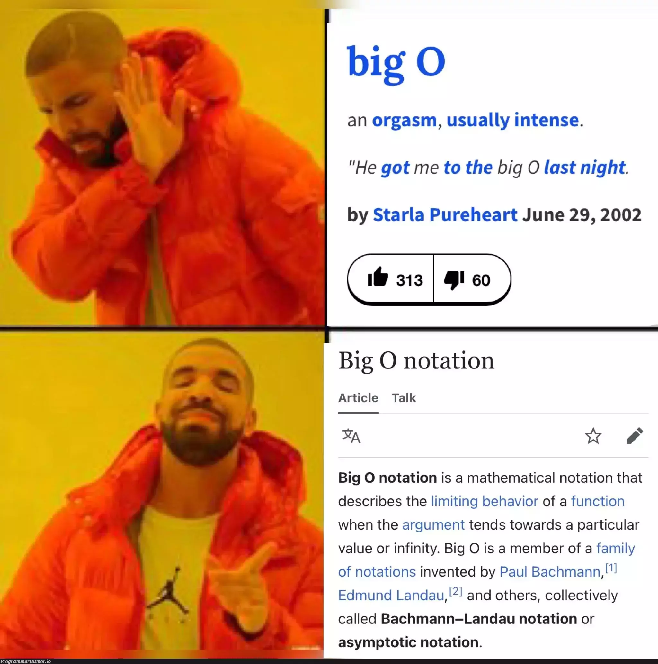
Meme-time!

Slide 11
Complexity of operation
Every simple operation (+, -, /, *, =, condition check, call sub-program) perform in one step;
Cycles and programs are not considered simple operations: they are looking at how the compositions of the operations that make up their body;
Each access to memory is performed in exactly one step.

Slide 12
Complexity of operation
Every simple operation (+, -, /, *, =, condition check, call sub-program) perform in one step;
Cycles and programs are not considered simple operations: they are looking at how the compositions of the operations that make up their body;
Each access to memory is performed in exactly one step.

Slide 13
Complexity of cycles
def f(n) → None:
for i in range(100):
pass
# O(1)
def f(n: int) → None:
for i in range(n):
pass
# O(n)

Slide 14
Complexity of cycles
def f(n: int) → None:
a = 1
for i in range(n):
…
a += 1
# O(1 + n + 1) = O(n)

Slide 15
Complexity of cycles
def f(n: int, k: int) → None:
a = 1
for i in range(n):
…
for i in range(k):
…
a += 1

Slide 16
Complexity of cycles
def f(n: int, k: int) → None:
a = 1
for i in range(n):
…
for i in range(k):
…
a += 1
# O(1 + n + k + 1) = O(n + k)
# if k = n, then O(2n) = O(n)

Slide 17
Complexity of cycles
def f(n: int, k: int) → None:
a = 1
for i in range(n):
for j in range(k):
…
a += 1
# O(1 + n * k + 1) = O(n * k)
# if k = n, then O(n*n) = O(n²)

Slide 18
Complexity of cycles
def f(n: int, k: int) → None:
a = 1
for i in range(n):
for j in range(k):
…
for i in range(n):
...
a += 1

Slide 19
Complexity of cycles
def f(n: int, k: int) → None:
a = 1
for i in range(n):
for j in range(k):
…
for i in range(n):
...
a += 1
# O(1 + n * k + 1 + n) = O(n * k + n) = O(n * k)
# if k = n, then O(n*n) = O(n² + n) = O(n²)

Slide 20
Complexity of recursion
In the general, it is necessary to calculate the recurrence relation;
Asymptotic Complexity - ???
def f(n):
if n in (0, 1): return 1
return n * f(n - 1)

Slide 21
Complexity of recursion
In the general, it is necessary to calculate the recurrence relation;
Asymptotic Complexity - ???
def f(n):
if n in (0, 1): return 1
return n * f(n - 1)
# O(n)
If n == 1 => 1 operations
If n == 2 => 1 + 1 operations
For k + 1 steps => k + 1 => ACk = k

Slide 22
Complexity of recursion
Substitute different argument values and calculate the amount of function calls;
Example:
Asymptotic Complexity - ???
def f(n: int) → int:
if n == 1: return 1
return f(n – 1) + f(n - 1)

Slide 23
Complexity of recursion
Substitute different argument values and calculate the amount of function calls;
Example:
Asymptotic Complexity - ???
def f(n: int) → int:
if n == 1: return 1
if n == 0: return 0
return f(n – 1) + f(n - 2)
# O(1*(2^{n} - 1)) = O(2^{n})
If n == 1 => 1 operation
If n == 2 => 3 operations
If n == 3 => 7 operations
If n == 4 => 15 operations
If n == 5 => 31 operations

Slide 24
Linear & binary search I: Linear
Task 1. Check if the given element is in the array.

Slide 25
Linear & binary search I: Linear
Task 1. Check if the given element is in the array.
Solving. (Long) We sequentially check all elements of the array until we find the given element, or until the end of the array.
Worst case run time???

Slide 26
Linear & binary search I: Linear
Task 1. Check if the given element is in the array.
Solving. (Long) We sequentially check all elements of the array until we find the given element, or until the end of the array.
Worst case run time O(n), where n is amount of array’s elements. Proof: enumerate all elements.

Slide 27

Linear & binary search II: Binary
Task 2. Check if the given element is in the ordered (!) array.
Definition. Ascending array is array A whose elements are comparable, and ∀ i, j ∈ Z : i < j :
A[i] =< A[j]. A descending sorted array is defined similarly.

Slide 28
Linear & binary search II: Binary
Task 2. Check if the given element is in the ordered (!) array.
Solving. Array is ordered – good condition!
    Step. Compare median element with current element. Select the desired half of the array, depending on the result of the comparison. Repeat step while array’s length is not equal 1.

Slide 29
Linear & binary search II: Binary
More deeper. There are 3 variable: left (left bound’s idx), right (right bound’s idx) and mid (middle of array idx), array A and searching value - s. Check if A[mid] == s then cool! If A[mid] > s then left = left, right = mid, mid = (left + right) // 2. A[mid] < s then right = right, left = mid, mid = (left + right) // 2. Repeat.
Run time O(logn), where n is amount of array’s elements. Proof: split the array in half

Slide 30



Linear & binary search II: Binary
Example:
S = -12, left = 0, right = 9

Slide 31
Data structures: Array
Operation | Time
Find min (max) | O(n)
Delete min (max) | O(n)
Add value | O(1)
Get value by index | O(1)
Delete from beginning | O(n)

Slide 32
Heap: Definition
Definition. Max (min) Heap is a abstract treelike data structure, that fulfills three properties:
1) The value at any vertex is not less (greater) than the values of its children;
2) The depth of the leaves (distance to the root) differs by no more than one;
3) The last layer is filled from left to right.
We will consider max heap.

Slide 33
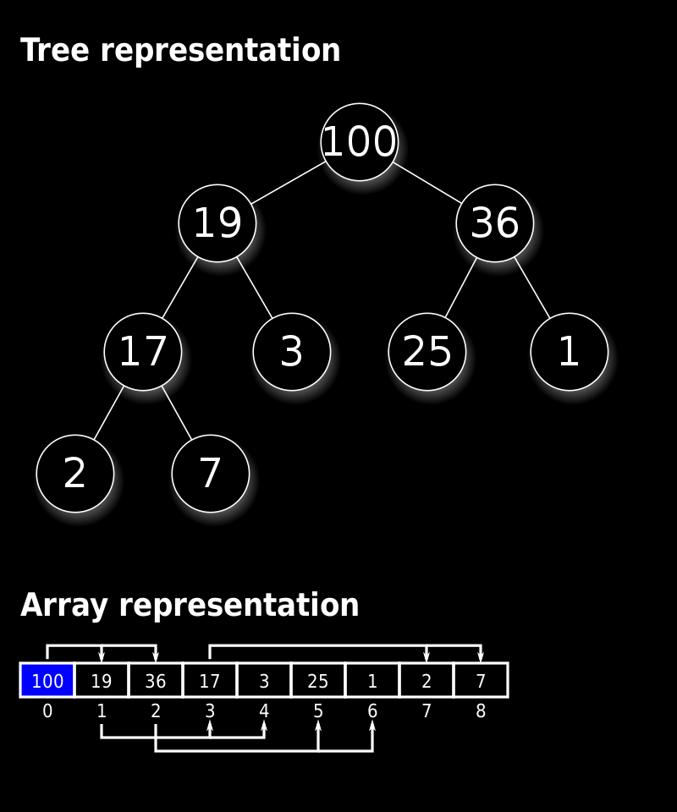
Heap: Visualization
Heap’s visualization like a tree, but in memory it keep as array with some rules!
Also heap calls a binary heap, pyramid and sorting tree.

Slide 34
Heap I
A convenient way to store a binary heap is an array;
Sequentially store all the elements of the heap "in layers".
The root is the first element of the array, the second and third elements are the child elements, and so on.

Slide 35
Heap I
This store case is efficient for given an element; (O(1) for call by index)
If array element indexing starts from 0 then:
    A[0] is the element at the root;
    The children of the element A[i] are the elements A[2i + 1] and A[2i + 2];
    The parent of the element A[i] is the element A[(i – 1)/2].

Slide 36
Heap I
If something element in heap was change, then heap can loss it properties;
For recover heap’s properties there are 2 methods: sift up and sift down:
    Sift up – raise element, that is larger than parent;
    Sift down – omit the element that is smaller than the children;

Slide 37
Heap: Sift Down I
Sift Down (main idea):
  If the i-th element is greater than its children, the entire subtree is already a heap, and nothing needs to be done. Otherwise, we swap the i-th element with the largest of its sons, after which we perform Sift Down for this son;
  Time complexity is O(???).

Slide 38
Heap: Sift Down I
Sift Down (main idea):
  If the i-th element is greater than its children, the entire subtree is already a heap, and nothing needs to be done. Otherwise, we swap the i-th element with the largest of its sons, after which we perform Sift Down for this son;
  Time complexity is O(logn).

Slide 39
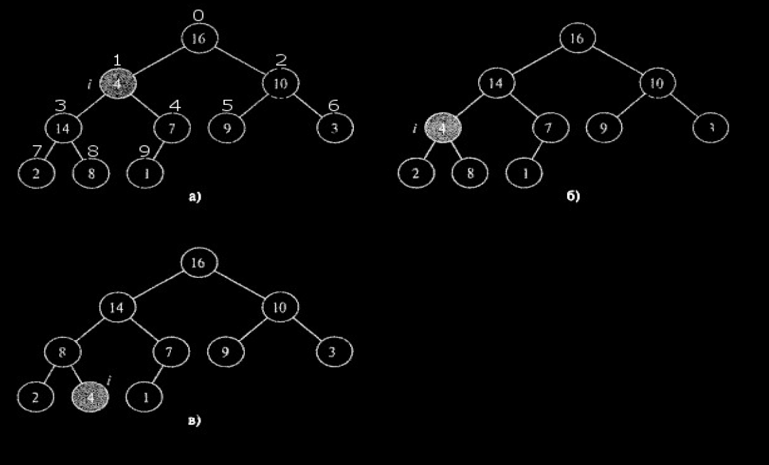
Heap: Sift Down II

Slide 40
Heap: Heap building I
It is also possible to create a heap from an unordered array:
  If you perform Sift Down on all elements of array A, from the last to the first, it becomes a heap;
  SiftDown(A, i) does nothing if;
  It is enough to call SiftDown for all elements of array A from ([n/2] – 1)-th to 1-st;

Slide 41
Heap: Heap building I
It is also possible to create a heap from an unordered array:
  If you perform Sift Down on all elements of array A, from the last to the first, it becomes a heap;
  SiftDown(A, i) does nothing if;
  It is enough to call SiftDown for all elements of array A from ([n/2] – 1)-th to 1-st;
  Time complexity is O(???).

Slide 42
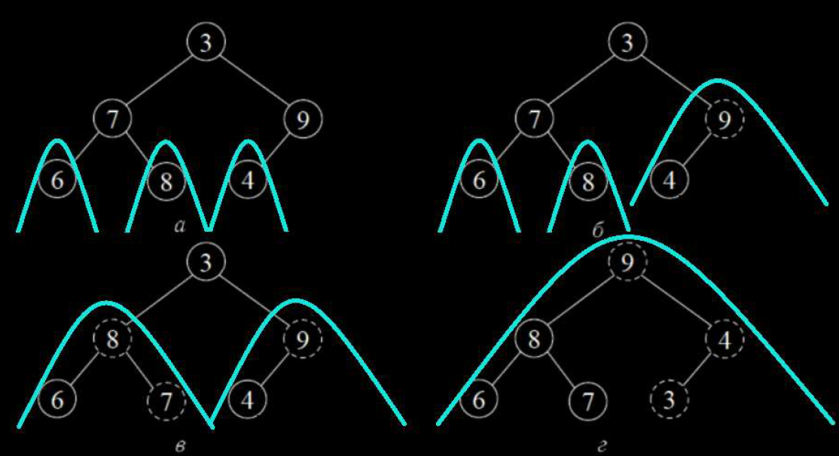
Heap: Heap building II

Slide 43
Heap: Heap building III
Time complexity for heap build is O(n).
Proof. The SiftDown running time for working with a node that is at height h (bottom) is C * h.
At level h, contains no more than nodes.
Total operating time:

Slide 44
Heap: Sift Up I
Restores the ordering property by pushing the element to the top;
If the element is larger than the parent, swaps it with the parent;
If after that the parent is larger than the grandparent, the parent is swapped with the grandparent, and so on.

Slide 45
Heap: Sift Up I
Restores the ordering property by pushing the element to the top;
If the element is larger than the parent, swaps it with the parent;
If after that the parent is larger than the grandparent, the parent is swapped with the grandparent, and so on.
Time complexity is O(logn).

Slide 46
Heap: Add Element To Heap I
1) Let's add an element to the end of the heap;
2) Let's restore the ordering property by pushing the element to the top with SiftUp;
The running time is O(???), if the buffer for the heap allows you to add an element without re-allocation.

Slide 47
Heap: Add Element To Heap I
1) Let's add an element to the end of the heap;
2) Let's restore the ordering property by pushing the element to the top with SiftUp;
The running time is O(logn), if the buffer for the heap allows you to add an element without re-allocation.

Slide 48
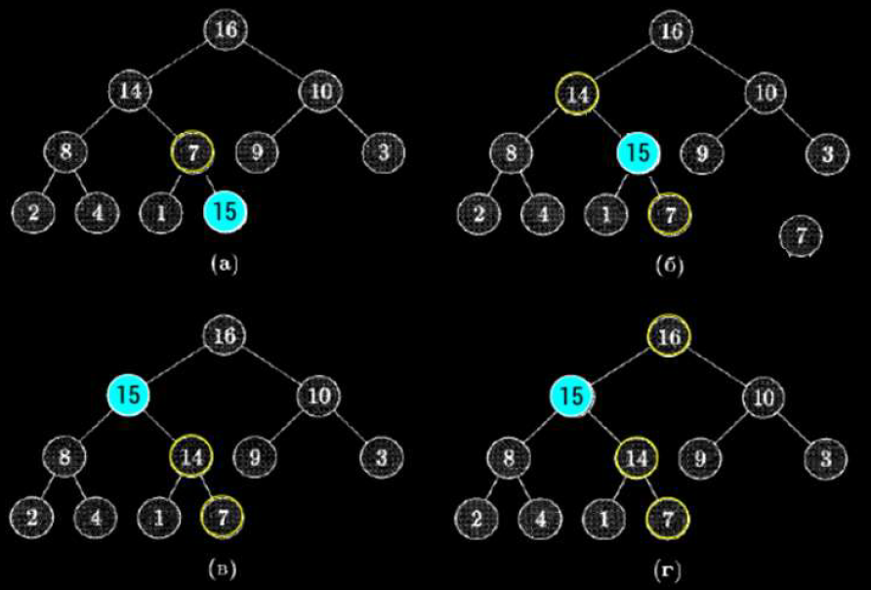
Heap: Add Element To Heap II

Slide 49
Heap: Give Element From Root I
Algorithm:
    1) Store the value of the root element to return;
    2) Copy the last value to the root, delete the last position;
    3) Call SiftDown to root;
    4) Return stored element.
    Time complexity: O(???)

Slide 50
Heap: Give Element From Root I
Algorithm:
    1) Store the value of the root element to return;
    2) Copy the last value to the root, delete the last position;
    3) Call SiftDown to root;
    4) Return stored element.
    Time complexity: O(logn).

Slide 51
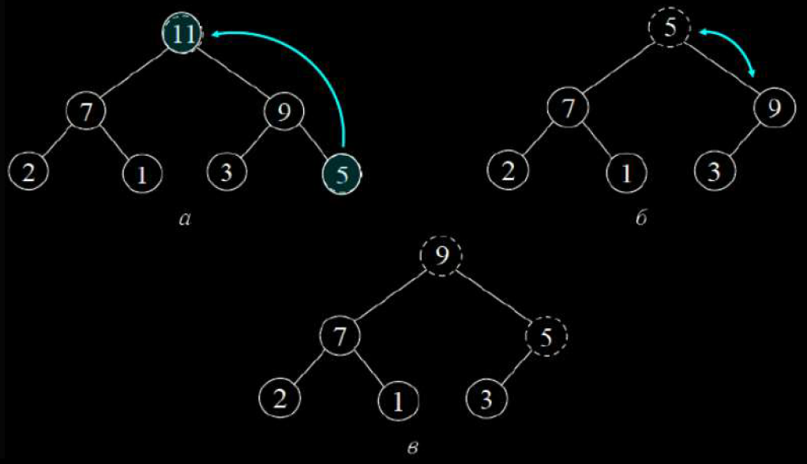
Heap: Give Element From Root II

Slide 52
Heap: Info
Operation | Time
Find min (max) | O(1)
Delete min (max) | O(n logn)
Add | O(n logn)
Get value by index | O(1)
Build heap | O(n)

Slide 53
Sorting
Sorting is element ordering process.
Recap:
  Definition. Ascending array is array A whose elements are comparable, and ∀ i, j ∈ Z : i < j :
  A[i] =< A[j]. A descending sorted array is defined similarly.

Slide 54
Sorting: Types
Definition. A stable sort is one that preserves the order of equal elements.
Example: Sort numbers by high order.

Slide 55
Sorting: Types
Definition. A local sort is one that does not require additional memory.
Example:
                Heap sort;
                Merge sort.

Slide 56
Sorting: Types
Definition. A local sort is one that does not require additional memory.
Example:
                Heap sort;
                Merge sort.

Slide 57
Sorting: Bubble Sort
Sorted array is divided into 2 sides: sorted and unsorted.
Main idea:
  Here you need to sequentially compare the values of neighboring elements and swap numbers if the previous one is greater (less) than the next one.
  Local, stable;

Slide 58
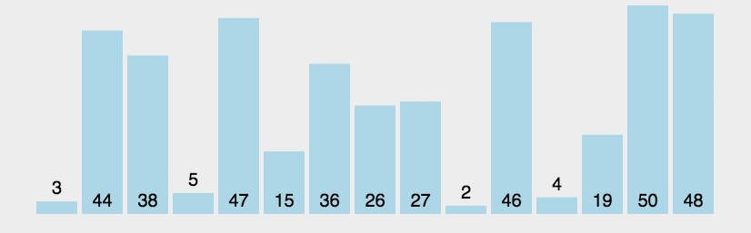
Sorting: Bubble Sort
Example visualization with array:
Time complexity is O(???).

Slide 59
Sorting: Bubble Sort
Example visualization with array:
Time complexity is O(n) if array is sorted and
O(n²) if unsorted.

Slide 60
Sorting: Insertion sort
A simple algorithm often used on small volumes. (len < 60-90)
Sorted array is divided into 2 sides: sorted and unsorted.
Main idea:
  For k step:
  1) take the first element of the right side;
  2) paste it in a suitable place on the left side;
  Local, stable.

Slide 61
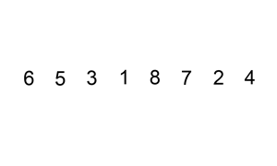
Sorting: Insertion sort
Example visualization with array:
Time complexity is O(???).

Slide 62
Sorting: Insertion sort
Example visualization with array:
Time complexity is O(n) if array is sorted and
O(n²) if unsorted.

Slide 63
Sorting: Insertion sort
Proof.
If array is sorted: 2 * (n – 1) copying and (n – 1) comparison => O(n);
if array is unsorted: 2 * (n – 1) + n * (n – 1) / 2 copying and n * (n – 1) / 2 comparison => O(n²).
Remark: Use binary search in left side!!! => O(n²) for copy with small constant and O(nlogn) copying.

Slide 64
Sorting: Python
There 2 ways of sorting iterable object in Python:
    sorted([…], reverse = …, key = ...) # return new object, for all iterable obj;
    […].sort(reverse = …, key = ...) # inplace method, only for list.

