Slide 1
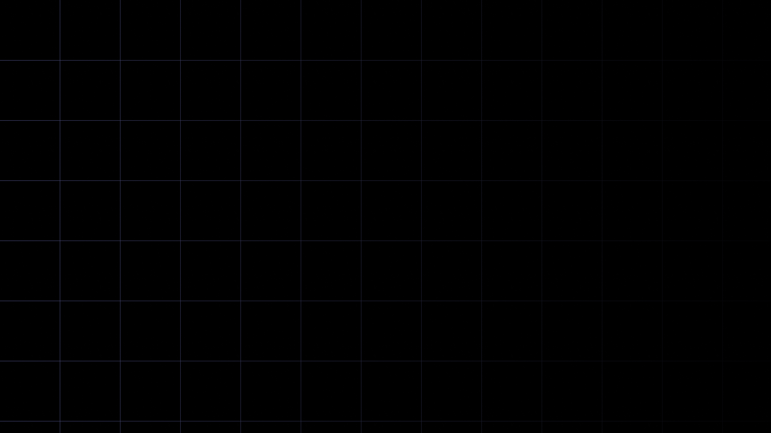

FS12
Week 06
Sorting Algorithms II
Mikhail Masyagin
Daniil Devyatkin

