Slide 1
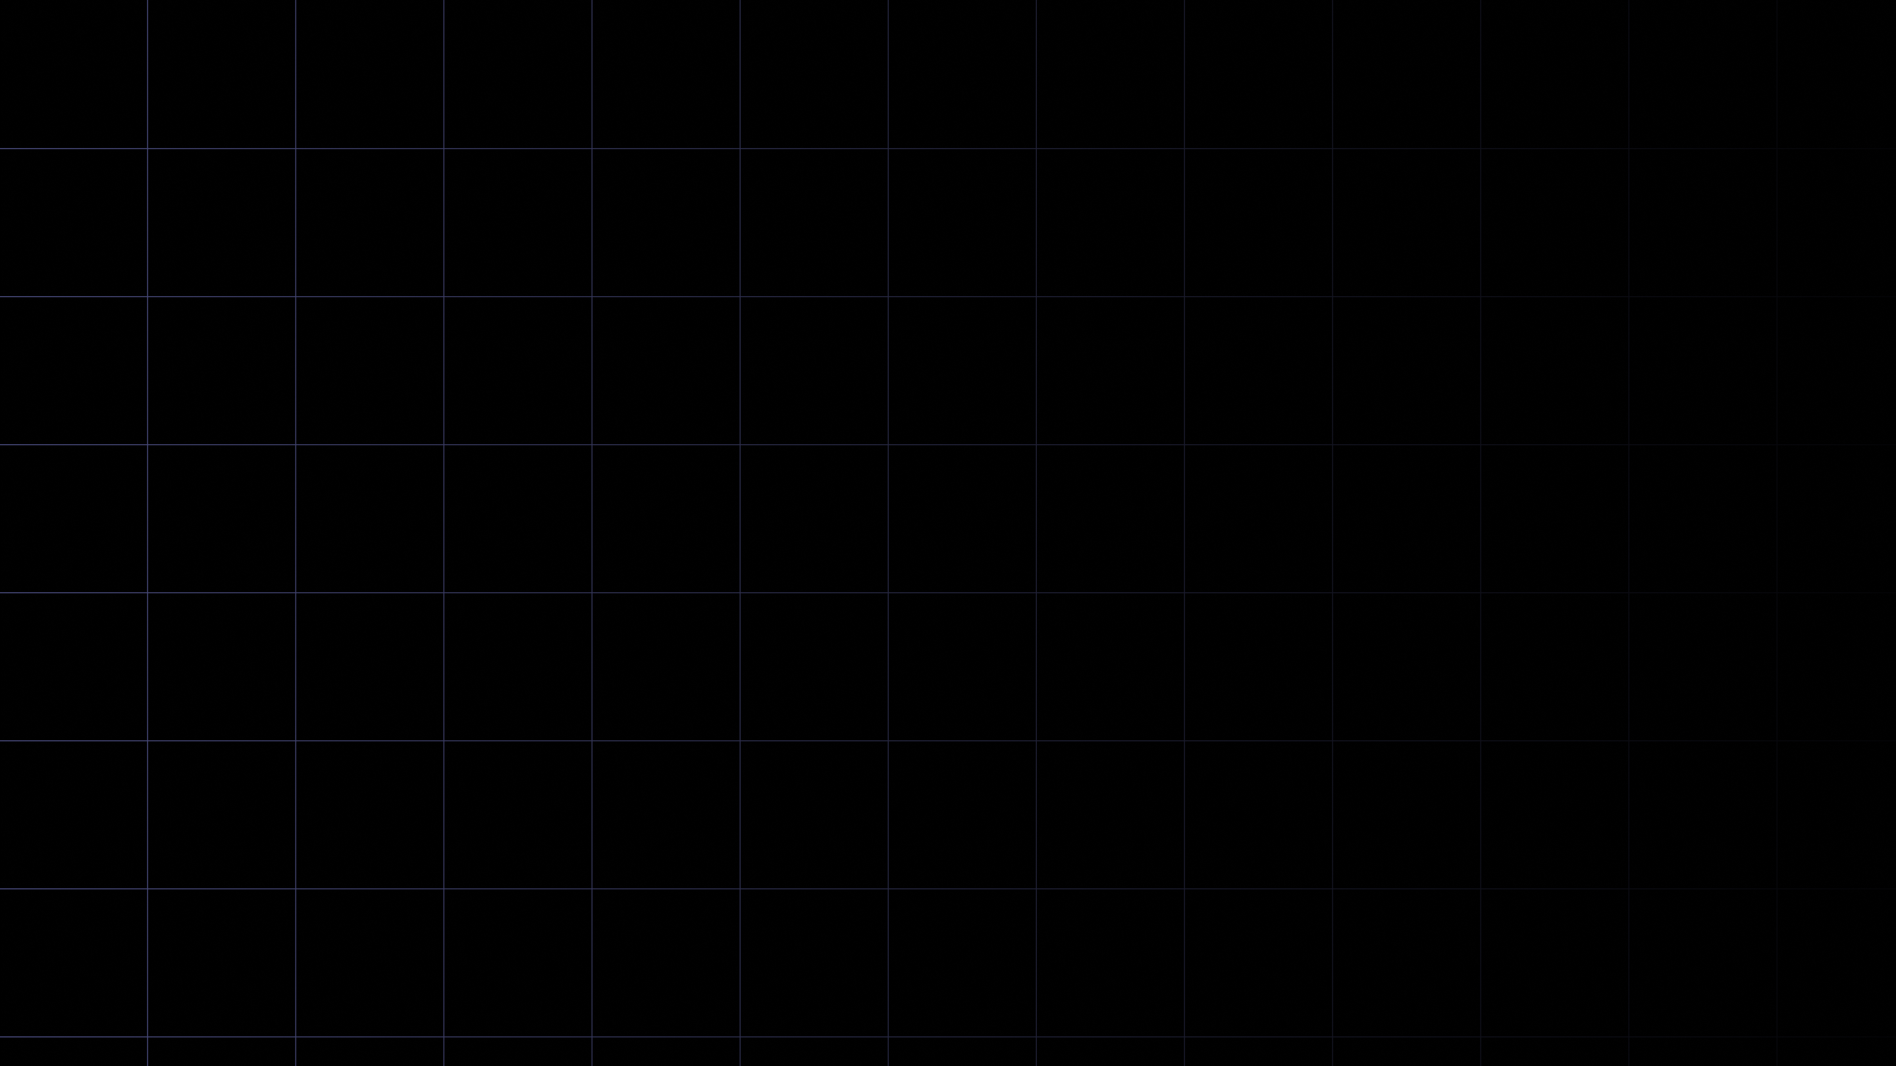

FS12
Week 02
Python Basics II
Mikhail Masyagin
Daniil Devyatkin

