Slide 1


FS12
Week 02
Python Basics II
Mikhail Masyagin
Daniil Devyatkin

Slide 2
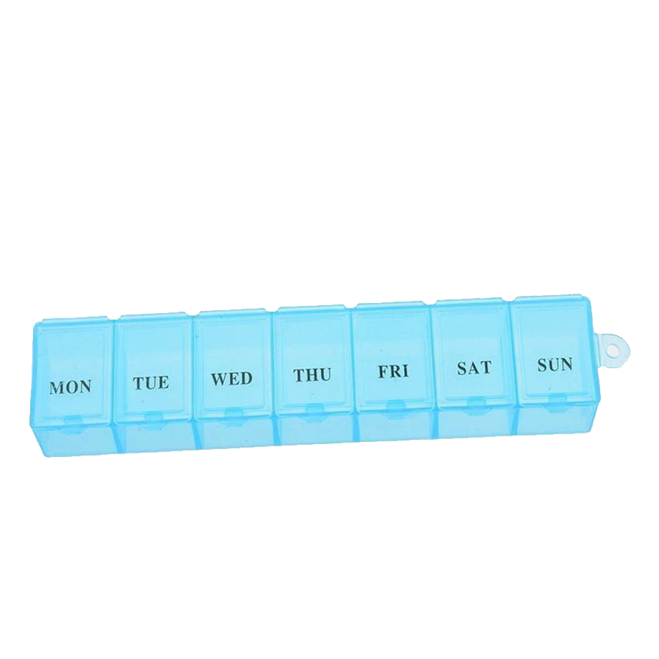
Base Collections Types: List I
What we should do for collect multiply elements in memory? There are good data structure – array. You can imagine pill box:
But array can have big count of elements and option – to increase size. In Python (dynamic) array is represented by a `list()` or `[]`.

Slide 3
Base Collections Types: List II
Empty list creation
>>> lst1 = []
>>> lst1 = list()
Non empty list creation
>>> lst2 = [6, 7, 8, 9, 10, 11]
>>> lst2 = list(collection), where collection is iterable;
Add element to list
>>> lst2.append(4) # inplace method

Slide 4
Base Collections Types: List II
Get element
>>> lst2[1] # 7
Get multiply elements: list[start: stop: step]
>>> lst2[2:6:2] # [8, 10]
>>> lst2[0:len(lst2):2] # [7, 9, 11]
>>> lst2[::-1] # [11, 10, 9, 8, 7, 6]
>>> lst2[:3] # [6, 7, 8]
>>> lst2[3:] # [9, 10, 11]
lst2[0:len(lst2):2] <=> lst2[::2]

Slide 5
Base Collections Types: List III
len(tuple) – return length of list;
list.extend(iterable) – add other collection to list, inplace method;
list.insert(i, x) – insert an item x at a position x;
list.copy() - return a shallow copy of the list;
list.index(x) – retrun pos x in list, if existence;
list.sort(key, reverse) – sorting list inplace by key and reverse order;
sorted(list) – return sorted list;
And more...

Slide 6

Base Collections Types: Tuple I
Empty tuple creation
>>> tpl = ()
>>> tpl1 = tuple()
Non empty tuple creation
>>> tpl2 = (1, )
>>> tpl2 = (1, 2, 3)
>>> tpl2 = tuple(collection)
where collection is iterable;
Add element to tuple
Nothing can be added to tuple!!!

Slide 7
Base Collections Types: Tuple II
len(tuple) – return length of list;
tuple.index(x) – return pos x in list, if existence;
...
            But tuple is faster than list!
Element access similar to lists: see slide 4

Slide 8
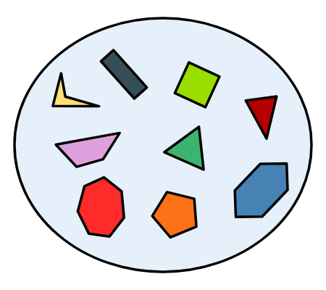
Base Collections Types: Set I
Set is a set from math. Set is a collection of a unique elements. You can add elements to set like a list. In Python set is represented by a `set()` or `{}`.

Slide 9
Base Collections Types: Set II
Empty set creation
>>> s1 = set()
Non empty set creation
>>> s2 = {1, 2, 3}
>>> s2 = set(collection)
where collection is iterable;
Add element to set
>>> s2.add(4) # inplace method
>>> s2.add(1) # collection is not change

Slide 10
Base Collections Types: Set III
len(set) – return length of list;
set.discard(x) – remove the specified item;
set.intersection(set1) – returns a set, that is the intersection of two or more sets;
set.copy() - returns a copy of the set;
set.symmetric_difference(x) –returns a set with the symmetric differences of two sets;
set.issubset(set1) – check, is set1 subset of set;
And more...

Slide 11
Base Collections Types: Set III
Also we apply logical operators to sets;
| - or, & - and, `-` - difference, ^ - xor;
>>> x1 = {1, 3}
>>> x2 = {2, 3, 4}
>>> x1 & x2 # {3}
>>> x1 | x2 # {1, 2, 3 ,4}
>>> x1 – x2 # {1}
>>> x1 ^ x2 # {1, 2, 4}

Slide 12
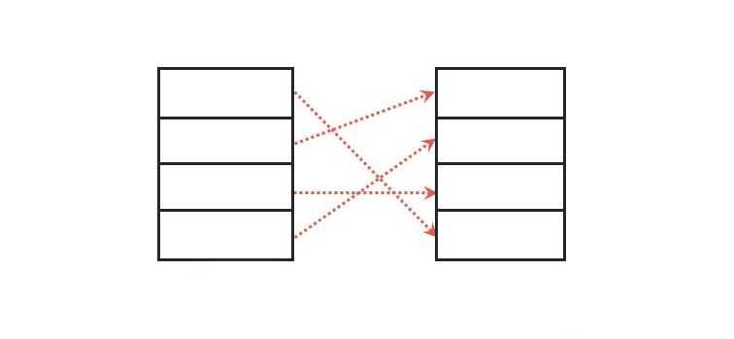
Base Collections Types: Dict I
Dict is a data structure for collecting keys and values, where access to value is by key.
Keys should be unique!!! For example we can use people like a key and their pills like a value.

Slide 13
Base Collections Types: Dict II
Empty dict creation
>>> d1 = dict()
>>> d1 = {}
Non empty tuple creation
>>> d2 = {“a”: 1, “b”: 2, “c”: 3}
>>> d2 = dict(a=1, b=2, c=3)
>>> d2 = dict(list(tuple))
Add element to set
>>> d2[“d”] = 4
>>> d2.update({“e”: 5}) # inplace method

Slide 14
Base Collections Types: Dict III
len(dict) – return amount of keys;
dict.keys() – returns a list of a dict’s keys;
dict.values() - returns a list of all the values in the dict;
dict.items() – returns a list of a tuple for each key value pair;
dict.setdefault(key, value) - returns the value of the specified key.
And more...

Slide 15
Type casting
You can create mapping list → tuple, set → list etc:
>>> list((1, 2, 3)) # [1, 2, 3]
>>> list({1, 2, 3}) # [1, 2, 3]
>>> tuple([1, 2, 3]) # (1, 2, 3)
>>> tuple({1, 2, 3}) # (1, 2, 3)
>>> set([1, 2, 3]) # {1, 2, 3}
>>> set((1, 2, 3)) # {1, 2, 3}

Slide 16
Base Types: immutable or mutable
Mutable
    list
    dict, set
    user defined
Immutable
    int, float, bool
    str, bytes
    tuple, frozenset

Slide 17
Some Python’s Feature
In Python you can create list, tuple, set and dict of elements of different types:
>>> tpl = (1, “a”, True, (76, ), [99])
>>> lst = [1, “a”, True, (76, ), [99]]
>> > s = {1, “a”, True, (76, )}
>>> d = {1: “1”, “2”: 2, }
BUT you can’t use mutable types like a key in dict and elements in set!!!

Slide 18
Container’s iterators
>>> lst = [1, 3, 2]
>>> dct = {1: 11, 2: 22}
Operator `in`:
    >>> 1 in lst # True
    >>> 1 in dct # True
    >>> "3" not in "456" # True
Iteration:
    >>> for val in lst: pass
    >>> for key, val in dct.items(): pass
# tuple and set similarly

Slide 19
Comprehension
Comprehension is a syntax sugar for fast collections building
>>> lst = [n ** 2 for n in range(10) if n % 2]
# [1, 9, 25, 49, 81]
>>> s = {ch for ch in "abcabcbca"}
# {'a', 'c', 'b'}
>>> d = {n: n**2 for n in range(10) if n % 2}
# {1: 1, 3: 9, 5: 25, 7: 49, 9: 81}
>>> gen = (n ** 2 for n in range(10) if n % 2)
# it’s not a tuple!!!

Slide 20

Type hint’s I
For what??? Python is a dynamic PL...
Identifying errors, when you
write code;
readability, comprehensibility,
maintainability for code;
IDE hints;
It’s a good style
VERY useful for LONG time
development;

Slide 21
Type hint’s II
int, float, str, bool;
list, tuple, dict, set;
from typing import *
NamedTuple, NamedDict

Slide 22
Type hint’s Example I
def add(x: float, y: float) → float:
        return x + y

Slide 23
Type hint’s Example I
def get_keys(
x: dict,
is_sort: bool,
) → list:
keys = x.keys()
return sorted(keys) if is_sort else keys
Bad practice
from typing import Mapping, List
def get_keys(
x: Mapping[str, int],
is_sort: bool,
) → List[str]:
keys = x.keys()
return sorted(keys) if is_sort else keys
Best practice

