Slide 1
Email Classification
Berend Tober & Matthew Buhler

Slide 2
Email Classification
How do traditional spam filters work?
Our Basic Approach
Tools:
Python
bash/sed/awk
Spam Assassin
Postfix

Slide 3
Raw Data
4,327 Emails
1,378 Spam Messages
2,949 Ham Messages

Slide 4
What does our data look like?
From - Fri Apr 16 10:29:33 2010
Return-Path: dapotor4203@mtnl.net.in
X-Original-To: m0620212@mail.csmining.org
Delivered-To: m0620212@mail.csmining.org
Received: from mail3.csmining.org (localhost [127.0.0.1])
by mail3.csmining.org (csminingorg Mail) with ESMTP id C7C9B16B91
for <m0620212@mail.csmining.org>; Thu, 15 Apr 2010 21:14:12 +0900 (JST)
Received: from spamgw.csmining.org (spamgw.csmining.org [192.168.18.120])
by mail3.csmining.org (csminingorg Mail) with ESMTP id C3FC816B43
for <m0620212@mail.csmining.org>; Thu, 15 Apr 2010 21:14:12 +0900 (JST)
Date: Thu, 15 Apr 2010 21:14:10 +0900 (JST)
Message-Id: 201004151214.o3FCEAR7008043@gw1.csmining.org
Received: from mtnl.net.in (triband-mum-120.60.8.28.mtnl.net.in [120.60.8.28])
by mx2.csmining.org (csminingorg MX Server2) with ESMTP id 421E96D
for <hibody@csmining.org>; Thu, 15 Apr 2010 21:14:10 +0900 (JST)
From: "Medicines from Pfizer" dapotor4203@mtnl.net.in
To: hibody@csmining.org
Subject: Enter now, hibody, 75% off

Slide 5
What does our data look like?
<!DOCTYPE html PUBLIC "-//W3C//DTD XHTML 1.0 Transitional//EN" "http://www.w3.org/TR/xhtml1/DTD/xhtml1-transitional.dtd">
<html xmlns="http://www.w3.org/1999/xhtml">
<head>
<meta http-equiv="Content-Type" content="text/html; charset=utf-8" />
<title>
having National frequently would view</title>
</head>
<body link="#003366" alink="#003366" vlink="#003366">
<div align="center">
<table border="0" cellpadding="0" cellspacing="0" width="728">
<tbody>
<tr>
<td align="center" width="730">
<div style="padding: 5px; font-family: Arial,Helvetica,sans-serif; font-size: 11px; margin-top: 10px; background-color: rgb(239, 239, 239); color: rgb(102, 102, 102); margin-bottom: 3px;">
To view this email as a web page, <a href="http://f5.pharmlalo.ru/?seufyenow=d87b2b17dd">click here.</a>
</div>
<table bgcolor="#ffffff" border="0" cellpadding="0" width="730">
<tbody>
<tr>
<td align="left" valign="top" width="420">
<div style="font-size: 13px; font-family: arial,helvetica,sans-serif;">
<div style="color: rgb(51, 51, 51); font-size: 16px; font-weight: 700;">
Thu, April 15, 2010</div>
</div>
</td>
<td width="10">&nbsp;</td>
</tr>
</tbody>

Slide 6
Preprocessing Data:
Email File
Header
Body
Domain of sender
Text File
Term Vector
URL
Subject
TF-IDF Vector
Similarity
Accuracy

Slide 7
Email File
Header
Body
Domain of sender
Text File
Term Vector
URL
Subject
TF-IDF Vector
Similarity
Accuracy

Slide 8
Sender Reputation
From: Veronica Styles <lkqyvstyles@site-personals.com>
Parse out the erroneous characters down to just the domain name
site-personals.com
205.178.190.115
dig +short site-personals.com

Slide 9
Results
42.8% of Spam messages were successfully identified based solely on the networks.

Slide 10
Email File
Header
Domain of sender
Body
Text File
Term Vector
TF-IDF Vector
Similarity
Accuracy
URL
Subject

Slide 11
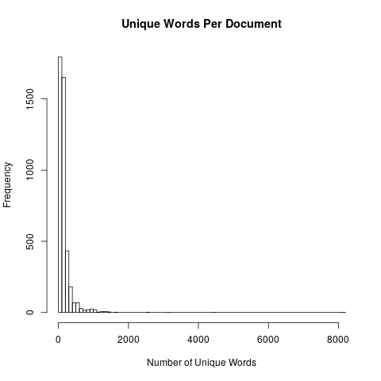
Data

Slide 12
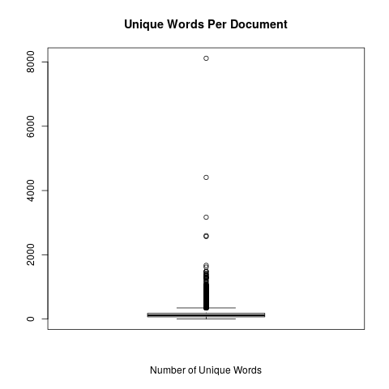
Data

Slide 13
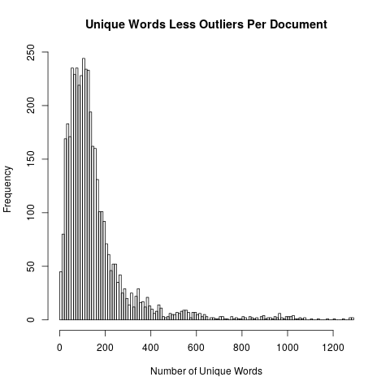
Data with Outliers Removed

Slide 14
Four Contrived Sample Documents
==> examples/poem.eml <==
From: noone@example.com
Subject: A poem about foxes
The nimble brown and white fox jumped over the sleeping dog.
The brown and black dog awoke, looked up at the fox and said, "Woof!"

Slide 15
Four Contrived Sample Documents
==> examples/song.eml <==
From: noone@example.com
Subject: A song about foxes
What does the fox say?
Ding ding ding da ding da ding ding.

Slide 16
Four Contrived Sample Documents
==> examples/skit.eml <==
From: noone@example.com
Subject: A skit about spam
Man: You sit here, dear.
Wife: All right.
Man: Morning!
Waitress: Morning!
Man: Well, what've you got?
Waitress: Well, there's egg and bacon; egg sausage and bacon; egg and spam; egg bacon and spam; egg bacon sausage and spam; spam bacon sausage and spam; spam egg spam spam bacon and spam; spam sausage spam spam bacon spam tomato and spam;
Vikings: Spam spam spam spam...
Waitress: ...spam spam spam egg and spam; spam spam spam spam spam spam baked beans spam spam spam...
Vikings: Spam! Lovely spam! Lovely spam!
Waitress: ...or Lobster Thermidor a Crevette with a mornay sauce served in a Provencale manner with shallots and aubergines garnished with truffle pate, brandy and with a fried egg on top and spam.
Wife: Have you got anything without spam?
Waitress: Well, there's spam egg sausage and spam, that's not got much spam in it.
Wife: I don't want ANY spam!

Slide 17
Four Contrived Sample Documents
Man: Why can't she have egg bacon spam and sausage?
Wife: THAT'S got spam in it!
Man: Hasn't got as much spam in it as spam egg sausage and spam, has it?
Vikings: Spam spam spam spam... (Crescendo through next few lines...)
Wife: Could you do the egg bacon spam and sausage without the spam then?
Waitress: Urgghh! Wife: What do you mean 'Urgghh'? I don't like spam!
Vikings: Lovely spam! Wonderful spam!
Waitress: Shut up! Vikings: Lovely spam! Wonderful spam!
Waitress: Shut up! (Vikings stop) Bloody Vikings! You can't have egg bacon spam and sausage without the spam.
Wife: I don't like spam!
Man: Sshh, dear, don't cause a fuss. I'll have your spam. I love it. I'm having spam spam spam spam spam spam spam beaked beans spam spam spam and spam!
Vikings: Spam spam spam spam. Lovely spam! Wonderful spam!
Waitress: Shut up!! Baked beans are off.
Man: Well could I have her spam instead of the baked beans then?
Waitress: You mean spam spam spam spam spam spam... (but it is too late and the Vikings drown her words)
Vikings: (Singing elaborately...) Spam spam spam spam. Lovely spam! Wonderful spam! Spam spa-a-a-a-a-am spam spa-a-a-a-a-am spam. Lovely spam! Lovely spam! Lovely spam!

Slide 18
Four Contrived Sample Documents
==> examples/spam.eml <==
From: noone@example.com
Subject: A word about Spam
Spam

Slide 19
Term Vectors
==>> examples/poem.term <<==
3 and
2 the
2 fox
2 dog
2 brown
2 The
1 white
1 up
1 sleeping
1 said
1 over
1 nimble
1 looked
1 jumped
1 black
1 awoke
1 at
1 Woof

Slide 20
Term Vectors
==>> examples/song.term <<==
5 ding
2 da
1 the
1 say
1 fox
1 does
1 What
1 Ding

Slide 21
Term Vectors
==> spam.term <==
1 Spam

Slide 22
Term Vectors
==> skit.term <==
95 spam
19 and
13 egg
13 a
11 Lovely
10 bacon
10 Waitress
10 Vikings
9 sausage
7 t
7 Wife
7 Spam
7 Man
7 I
6 it
5 the
5 got
4 you
4 with
4 in
4 have
4 don
4 beans
4 Wonderful
4 Well
3 without
3 up
3 s
3 You
3 Shut
2 there . . .

Slide 23
Term-Frequency/Inverse Document Frequency
where
tf(t,d) is the number of times term t occurs in document d
df(t,D) is the number of documents term t occurs in across the entire corpus D
M is the number of documents.

Slide 24
Document Frequency
==> examples/document_frequency <==
3 the
2 up
2 fox
2 and
2 What
2 Spam
1 your
1 you
1 words
1 without
1 with
1 white
1 what
1 want
1 ve
1 truffle
1 top
1 too
1 tomato
1 through . . .

Slide 25
Term Vectors vs TF-IDF Vectors
==>> examples/poem.term <<==
3 and
2 the
2 fox
2 dog
2 brown
2 The
1 white
1 up
1 sleeping
1 said
1 over
1 nimble
1 looked
1 jumped
1 black
1 awoke
1 at
1 Woof
==>> examples/poem.tfidf <<==
2.772589 dog
2.772589 brown
2.772589 The
2.079442 and
1.386294 white
1.386294 sleeping
1.386294 said
1.386294 over
1.386294 nimble
1.386294 looked
1.386294 jumped
1.386294 fox
1.386294 black
1.386294 awoke
1.386294 at
1.386294 Woof
0.693147 up
0.575364 the

Slide 26
Term Vectors vs TF-IDF Vectors
==>> examples/song.term <<==
5 ding
2 da
1 the
1 say
1 fox
1 does
1 What
1 Ding
==>> examples/song.tfidf <<==
6.931472 ding
2.772589 da
1.386294 say
1.386294 does
1.386294 Ding
0.693147 fox
0.693147 What
0.287682 the

Slide 27
Term Vectors vs TF-IDF Vectors
==>> examples/skit.term <<==
95 spam
19 and
13 egg
13 a
11 Lovely
10 bacon
10 Waitress
10 Vikings
9 sausage
7 t
7 Wife
7 Spam
7 Man
7 I
6 it
5 the
5 got
4 you
4 with
4 in
4 have
4 don
4 beans
4 Wonderful
4 Well
3 without
3 up
3 s
3 You
3 Shut
2 there
2 then
2 spa
2 much
2 mean
2 like
2 her
2 do
2 dear
2 can
==>> examples/skit.tfidf <<==
131.697964 spam
18.021827 egg
18.021827 a
15.249238 Lovely
13.862944 bacon
13.862944 Waitress
13.862944 Vikings
13.169796 and
12.476649 sausage
9.704061 t
9.704061 Wife
9.704061 Man
9.704061 I
8.317766 it
6.931472 got
5.545177 you
5.545177 with
5.545177 in
5.545177 have
5.545177 don
5.545177 beans
5.545177 Wonderful
5.545177 Well
4.852030 Spam
4.158883 without
4.158883 s
4.158883 You
4.158883 Shut
2.772589 there
2.772589 then
2.772589 spa
2.772589 much
2.772589 mean
2.772589 like
2.772589 her
2.772589 do
2.772589 dear
2.772589 can
2.772589 baked
2.772589 as

Slide 28
Term Vectors vs TF-IDF Vectors
==>> examples/spam.term <<==
1 Spam
==>> examples/spam.tfidf <<==
0.693147 Spam

Slide 29
Cosine Similarity
Between vectors x and y

Slide 30
Cosine Similarity
==>> examples/poem.term <<==
3 and
2 the
2 fox
2 dog
2 brown
2 The
1 white
1 up
1 sleeping
1 said
1 over
1 nimble
1 looked
1 jumped
1 black
1 awoke
1 at
1 Woof
==>> examples/song.term <<==
5 ding
2 da
1 the
1 say
1 fox
1 does
1 What
1 Ding

Slide 31
Document Similarity
= "hamminess“
= "spamminess"

Slide 32
Threshold
⇒ "ham”
Where
= "hamminess“
= "spamminess”

Slide 33
Scenarios
Document Frequency
tf-idf vectors compared to the document frequency vector
Average Term Frequency
tf-idf vectors compared average of term vectors
Top-10
tf-idf vectors truncated to the top-ten scoring words in the document
Average TF-IDF
tf-idf vectors compared to the average of tf-idf vectors

Slide 34
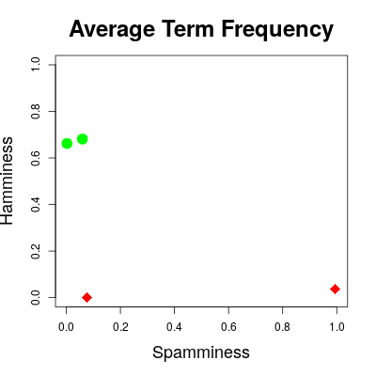
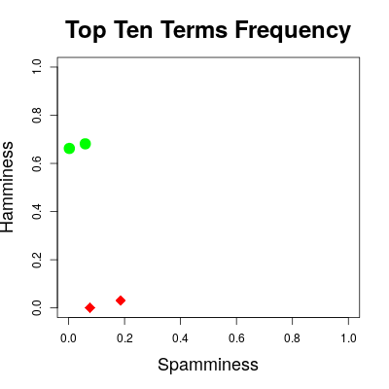
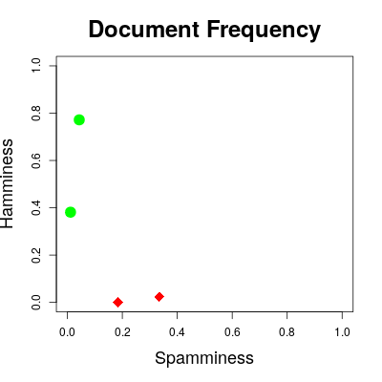
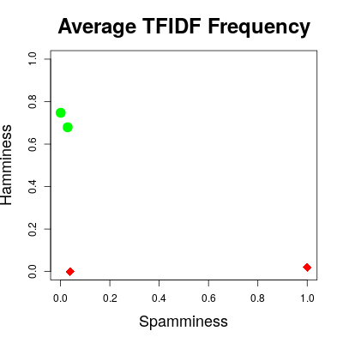
Discriminating Between Ham & Spam

Slide 35
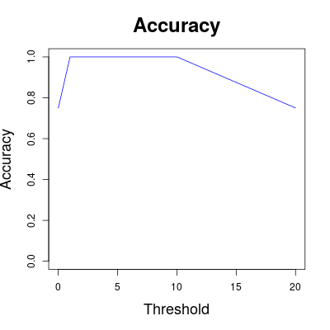
Accuracy

Slide 36
Accuracy
where
m_{ij}(t) is the number of messages actually in class i and identified as class j.
 |  | Predicted Class
 |  | Spam | Ham
Actual Class | Spam | m_{oo}(t) | m₀₁(t)
 | Ham | m₁₀(t) | m₁₁(t)
Note
i=j implies correct classification
i≠j implies incorrect classification

Slide 37
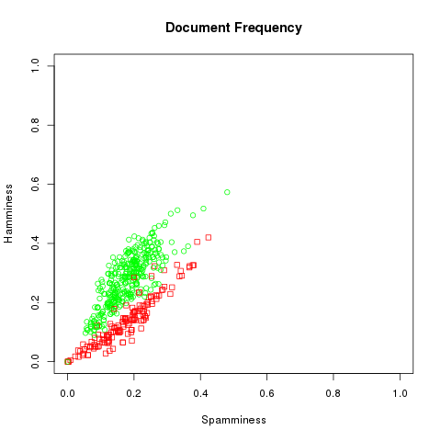
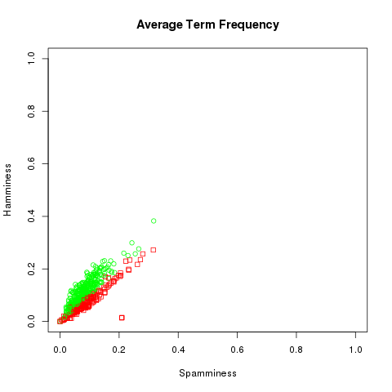
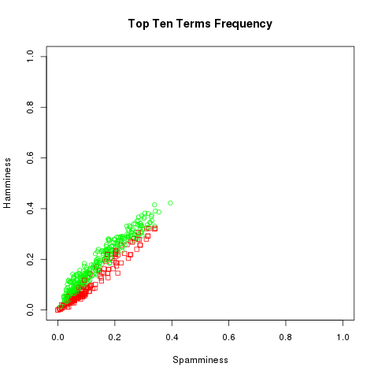
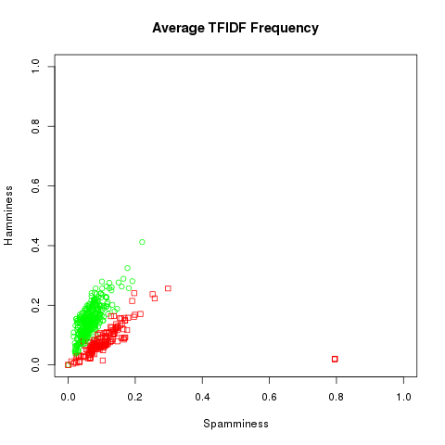
Results

Slide 38
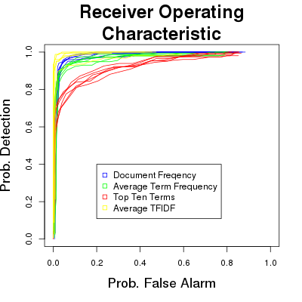
Receiver Operating Characteristics

Slide 39
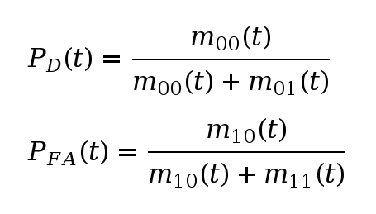
Receiver Operating Characteristics

Slide 40
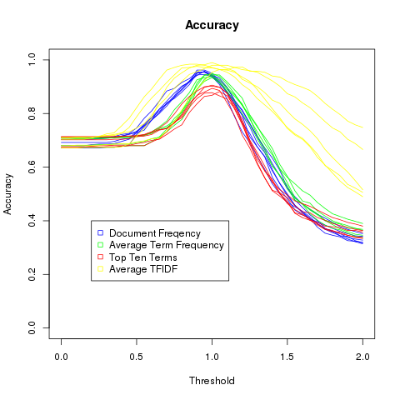
Accuracy

Slide 41
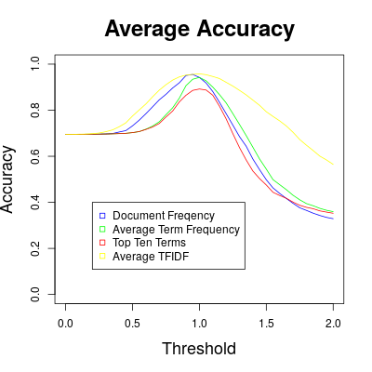
Amateurs vs Pros
How does a commercial spam filter stack up using the same dataset?
Postfix Server
Dovecot as mail delivery agent
Spam Assassin as the filter
Accuracy: 93.8%
Average Maximum Accuracy:
Document Similarity – 95.53%
Average Term Similarity – 94.23%
Top-Ten Term Similarity – 89.2%
Average TFIDF Similarity – 95.8%

