Slide 1
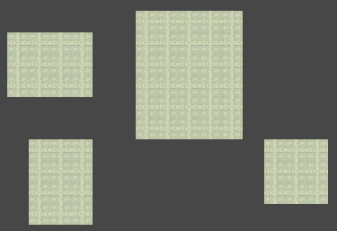
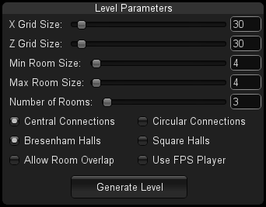
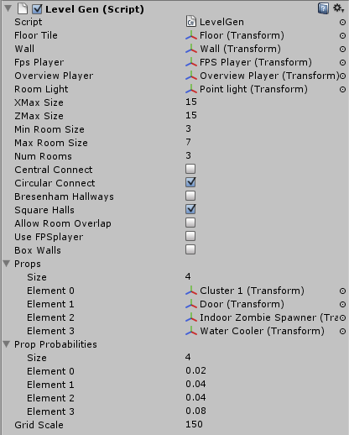
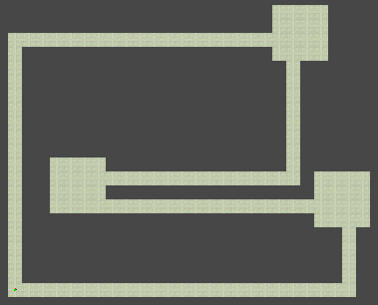
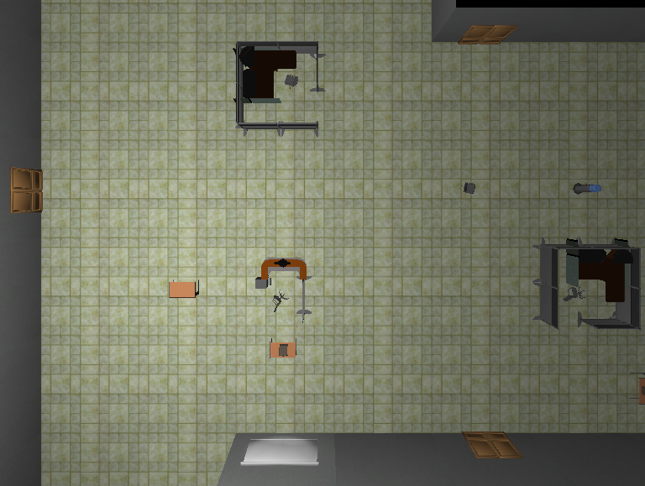
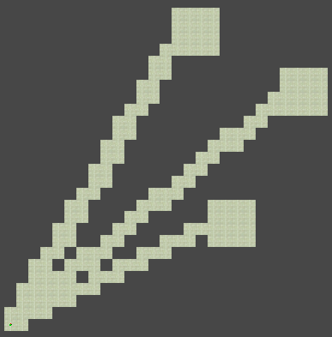
Z-Town Technical Details
Ben Trivett, Drew Switzer, Cameron Jett, Ryan Southard
Department of Computer Science and Engineering
The Ohio State University
Procedural Level Generator
6. Mark Props
A variable public array of game prefabs is used in conjunction with a similarly sized array of float values representing probabilities. Using the same index locations between the arrays, each particular prop placement probability is associated with its proper prop. There are two different kinds of props that can be placed on the floor tiles. Regular props can only be placed on floor tiles where all directly adjacent grid positions (diagonals included) are also floor tiles. Wall props are placed only on floor tiles next to walls and rotated accordingly. The sum of the probabilities between all the regular props should be less than or equal to 1. If the sum is less than 1, then the probability that nothing is placed at that floor tile is 1-sum. Similarly with all of the wall props.
Introduction
We wanted to let the player enter a lot of the buildings in our city to give it an extra layer of exploration. We decided on an office setting for each of the indoor environments. It would take a long time to make the number of levels that we wanted by hand. We made a procedural level generator to automate most of the level creation process.
We used this level generator with various parameters to create unique office environments. Then we placed several items throughout each level to reward the player for exploring them.
Several rooms placed within the grid
3. Mark Level entrance
To create a standardized entry point for each of the levels, the grid point 0,0 is marked as a 1 x 1 room and added to the list of rooms.
7. Create objects
After all of the objects are marked in the grid, we just loop through each point and check to see what items are at each point using the modulus function as described earlier. Then we instantiate them using whatever game prefab we chose in the parameters. A light is then placed in each of the rooms at the random point chosen earlier.
4. Mark hallways
To connect each of the rooms together, several different approaches were used. From the random points in each room we mark a path of floor tiles to ensure all the rooms are connected and reachable. There were two different connection patterns we used, central and circular. Central connections between rooms meant that from the level entry room, a hallway is drawn to each of the other rooms. Circular connections between rooms create hallways from the entry point to the next room, then that room to the next, and so on until every room is reached exactly once. Then the last room connects to the entry point to complete the circular pattern. The level generator supports two different kinds of hallways, square and Bresenham. Square halls mark tiles in a straight line from the start point to the end point in one dimension then the end point to the start point in the other dimension. Bresenham hallways use a variation of the Bresenham line drawing algorithm (often used to make lines with pixels) to make hallways that are jagged but go directly from the start point to the end point. It was modified from the original algorithm to mark extra points to prevent corner to corner connections where the player would not be able to pass. Any combination of these options could be used when marking the hallways.
Parameters
Conclusion
The levels that are generated can be copied from the hierarchy within unity and exported to prefabs to save them. For our game we were able to create a large amount of content in a short period of time with the help of this level generator. The flexibility of the parameters allowed us to create very unique sets of levels with little extra effort. Other projects and themes could be easily created by using different models and textures. There are many improvements that can be made as well. The environment state could be stored using a more robust method involving enumeration and other available tool libraries.
A simple user interface for most of the parameters was made for quick regenerations and changes. There are several parameters that are not discussed because they were used for testing and alternate design decisions.
Procedure
1. Set up grid
The grid is an N by M integer array initialized to zeros to represent nothing exists at that point. In order to differentiate between the objects and support easily storing multiple items at a location in the grid, each object is associated with its own prime number. To store multiple objects at a location, that integer in the grid is replaced by the multiplication of all the objects' prime numbers that exist there. For example, if only a floor tile is at a certain location, the integer would be 2. If you wanted a prop, i.e. a zombie spawner, to be on that floor tile you would multiply 2 by whatever prime is associated with that object; in this case let's say 11. So the integer stored at that point in the grid is 22 representing a floor tile with a zombie spawner on it. Then when it comes time to actually create the objects, all you have to do is take the modulus of each grid integer by each object's prime number and if it is equal to 0, then that object exists at that point and can be instantiated accordingly. Every point in the grid will have either a zero or a product of prime numbers.
Circular connections with Square Halls
2. Mark rooms
Room size is determined by choosing a random width and height between the minimum and maximum room size parameters. Then a random point is picked in the grid as the bottom left corner of the room. If the room extends outside the bounds of the grid from this point or it overlaps another room (optionally okay) then the room placement fails. This process is tried a certain number of times before an exception is thrown to prevent the case that it may be impossible to place the number of rooms desired. If the number of desired rooms is reached, all the rooms are marked in the grid and a random point within each room is saved for light placement and hallway generation.
Central connections with Bresenham Halls
Other Content Generation
The city we used was generated using CityEngine, a software solution for generating large complex city environments developed by Esri and used with permission. By crediting them we are able to use it for non-commercial purposes without violating copyright laws.
Destroyed cars are placed randomly throughout the city on the streets with random orientations. This was accomplished by trying many random downward raycasts over the city and checking for collision with meshes tagged as the street. Then cars were instantiated at those collision points.
5. Mark walls
North and South walls are marked by checking each point from top to bottom and the two adjacent points above and below. If the current point has no floor and the next point is a floor tile, then it would place a North wall. Similarly, it would place a South wall if the previous point was a floor tile and there is no floor at the current point. East and West walls are placed the same way while looping through the grid from left to right.

