Slide 1
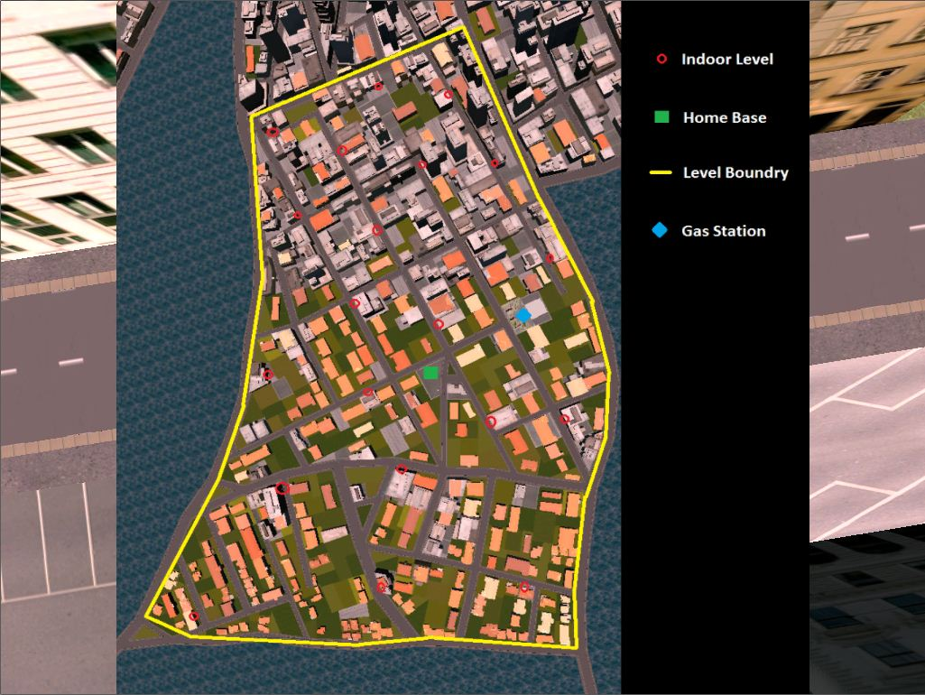
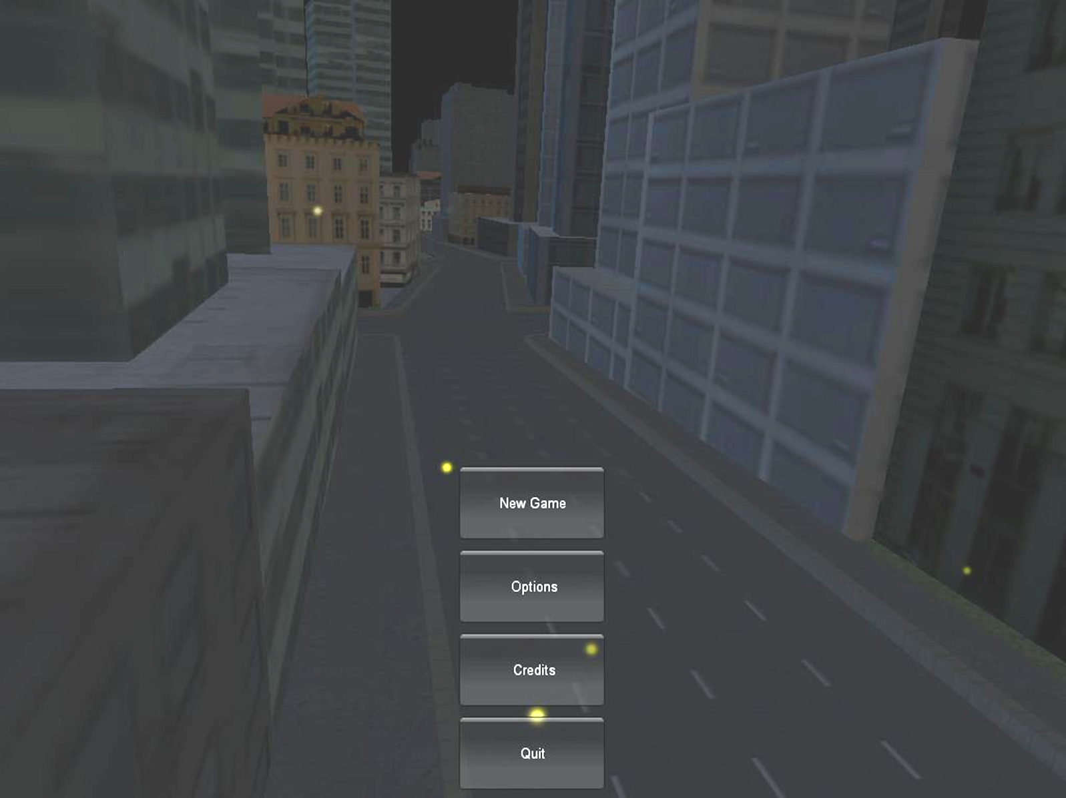
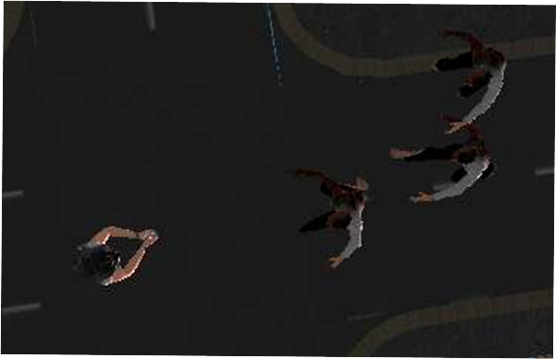
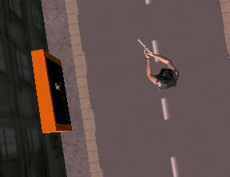
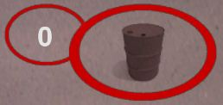
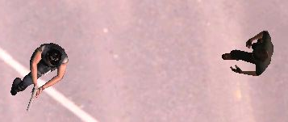
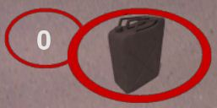
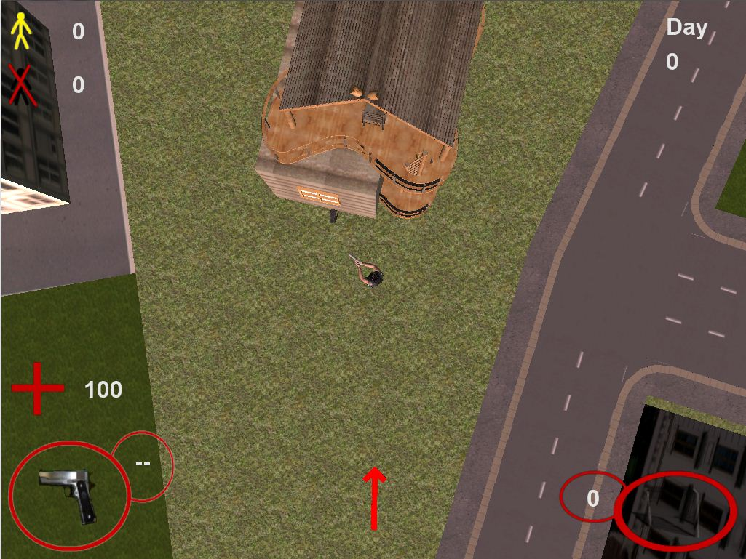
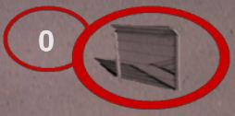
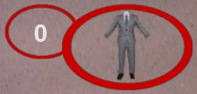
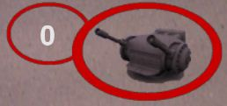
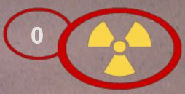
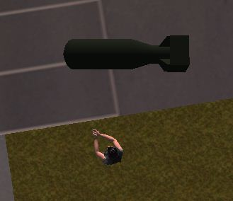
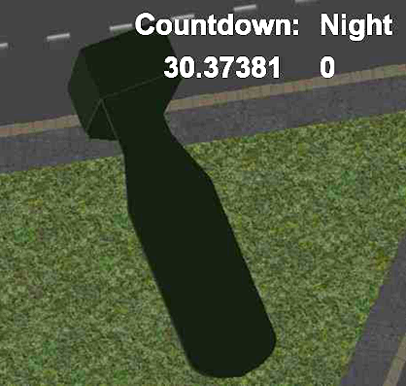
Z-Town User Tutorial
Cameron Jett, Ryan Southard, Drew Switzer, Ben Trivett
Department of Computer Science and Engineering
The Ohio State University
Introduction
Z-Town is zombie apocalypse, top-down shooter. For Z-Town, it was our goal to present the player with user-friendly controls so that the player can focus more on playing the game than struggling through learning controls. Our in-game Heads Up Display, or HUD, was designed to convey information that we thought would be important to the player, but it was designed to be simple so that is does not distract the user from the game. It was our goal for Z-Town to be an entertaining zombie shooter with useful Tower Defense items that could be used to help defend the user from the zombie horde. Keeping this goal in mind, we created overall game objectives that are simple and do not distract the player from playing Z-Town how we intended it to be played.
Game Objective
The game objective of Z-Town is simple, survive the zombie apocalypse. During the day time, zombies go get out of the sun light. This gives the player an opportunity to search the city for Tower Defense items that can be used to bolster the player's defense against the zombie hordes. Other survivors are stranded throughout the city. Find them and escort them back to your home base and maybe they can help fight. However if you goal is total zombie extermination, search for the undetonated nuke lost somewhere in Z-Town
Figure 1: Zombies
Controls
Z-Town can be played using a mouse and keyboard. The controls for Z-Town are as follows:
W - Moves the player up
A – Moves the player left
S – Moves the player down
D – Moves the player right
M – Display the Z-Town map
Esc – Quit game
Arrow Key Up/Down – Change Weapons
Arrow Key Left/Right – Change Tower Defense items
Mouse Move – Aim/Rotate the player (Note: the player will rotate to look at the mouse arrow)
Mouse Left Click – Shoot/Cancel placement of Tower Defense item
Mouse Right Click – Preview/Place current Tower Defense item
Mouse Scroll Up/Down – Zoom in/out
Heads-up Display (HUD)
The HUD is fairly simple and easy to understand once you know what all the symbols mean. Below is a screenshot of the HUD as it is seen in Z-Town.
Figure 1: Heads-up Display
In the top left corner of the screen, the yellow stick-man and number to the left of the icon is the survivor icon. It represents the number of survivors you have found that are available for use. The black stick-man and the number below the survivor icon is the zombie icon. The zombie icon represents how many zombies you have exterminated. In the top right corner where it says “Day” and has the number underneath it is the Day/Night indicator. The number shows how many days the player has survived. The red cross with the number to the right of it is the health icon. This represents how much health the player has remaining. The circular icon in the bottom right is the current weapon icon. This icon shows the current weapon. The red arrow in the bottom center is the compass. This arrow always points back towards the direction of the player's home base. The home base is shown in Figure 1 at the top of the image. The circular icon in the bottom right is the Tower Defense icon. This icon shows the player the current active Tower Defense, and the number represents how many of that particular Tower Defense item is currently in their inventory.
Main Menu
After starting the game and watching the beginning splash screens, you will be at the Main Menu. From here you can start a new game by clicking the “New Game” button. It takes some
time to start a new game, so do not terminate the application if it appears to take a long time starting a new game. Clicking on the “Options” button will display the controls for the game, some game information, and the game objective. Clicking on the “Credits” button will display the credits for the game. Clicking on the “Quit” button will exit the application.
Figure 3: Menu Screen
Tower Defense Items
Tower Defense items are an important part to the Z-Town game play. They will play a big part in aiding the player in surviving the zombie horde each night. Tower Defense items are occasionally dropped by zombies, and they can also be found hidden in indoor levels that are throughout the Z-Town city.
Exploding Barrel: Exploding barrels can be place anywhere in the city. After placing an exploding barrel, the player can shoot the barrel to cause an explosion that is fatal to zombies near the explosion.
Oil Slick: Find these gas cans to lay down an oil slick anywhere in the city. Zombies will slow down as they run through the oil, and the oil can be lit on fire by left clicking to burn zombies standing in the flames.
Wall: Walls can be used to create a barrier between you and the zombies. Be careful though because these zombies will tear through these fences given enough time.
Decoy: Decoys are good at attracting zombies. Use decoys as a distraction to give you time to escape a horde of zombies, or place them next to exploding barrels to maximize exploding barrel damage.
Turret: Turrets are the most useful item in fighting zombies. These turrets will fire at zombies automatically, but you must have a survivor to man each turret. Turrets can only be placed at the home base.
Nuke: The nuke can only be placed at the home base. Use the nuke when the zombie hordes are too overwhelming, if you feel like its your duty to exterminate the zombies in Z-Town, or do not use it at all. It is your choice.
Tower Defense items are placed using a two click system. Right click once to preview the currently selected Tower Defense item. This displays a model of the item by the player. The preview will move around with the player while you decide on where you want to place your Tower Defense item. Clicking a second time to places the item at the displayed location. Left click to cancel the placement of that Tower Defense item. Tower Defense items cannot be moved once they are placed, so place your Tower Defense items wisely. When you find a Tower Defense item in the city, simply run through it to collect that item. It will be automatically added to your player's inventory. Pressing the left and right arrow keys will change the active Tower Defense item.
Indoor Locations
There are 20 indoor locations throughout Z-Town. Tower Defense items and new weapons can be found hidden in the indoor locations, but be careful, zombies roam the indoor locations during all times of the day. The various entrances to the indoor locations can be found by hitting the 'M' key. The 'M' key toggles the mini map. The mini map display shows all the indoor location entrances, as well as the player's home base, and the gas station. Be careful while viewing the mini map because the game does not pause while viewing the mini map.
Figure 4: Mini Map
Indoor levels can be entered using the indoor level entrances. The entrances can be found at the locations with red circles on the mini map. The entrances look like a wooden door frame with a dark entrance. There is also a slight particle effect coming out of the entrance. Simply walk into the entrance to enter the indoor location.
Figure 5: Indoor Location Entrance
Survivors
Survivors are stranded throughout the city. If you choose, you can go rescue survivors and escort them back to your home base. There are three survivors hidden throughout the city at one time. The survivors will stay in one location until they are found. When you find a survivor, walk into the survivor to make them follow you. Most of the survivors you find are injured and slow moving, so it will take some time to escort them back to the home base. Zombies will attack the survivors if they can get near them, so be careful. Once the survivor gets close enough to the home base, they will automatically walk into the building at your home base. Once they are in your building, then you can use them to place turrets at your home base.
Figure 6: Survivor Following the Player
Nuke
There is an undetonated nuke hidden somewhere in Z-Town. When you find the nuke, you can return it to your home base and reactivate it. The nuke can only be used at the home base. Reactivating the nuke will trigger a countdown. The countdown will be displayed in the HUD, and it will show how many seconds are left until the nuke detonates. The Zombies, who sense their impending doom upon the nuke’s activation, will come and attack the player no matter what time of day it is. If you are still alive when the countdown reaches zero, the nuke will explode, killing you and all the zombies, but possibly saving the world from a wide-spread epidemic.
Player Movement
It is important to note that the player runs slower when he is running backwards. When being chased by zombies, you can run backwards and shoot at the zombies chasing you, but most zombies will be able to catch you while you are running backwards. It is a good strategy to run facing forward to get some distance between the player and the zombie before turning around and shooting at them. Another thing users will notice is that the player shoots less accurately while he is running. While the player is running, his arms sway causing decreased accuracy. It is easier to aim with the player while the player is standing still. Using a well-timed combination of these strategies will help you survive the zombie apocalypse.
Installing Z-Town
To install Z-Town, go to the location http://www.cse.ohio-state.edu/~crawfis/cse786/. Click on the Groups tab, and then click on the “Game Group” link. Find and save the Z-Town installer to your computer. Once the installer is downloaded, go to where you saved the installer on your computer and double click on the installer. Follow the prompts from the installer to install Z-Town onto your computer. Once the installation is complete, you should be able to play Z-Town.
Figure 7: Player Finding the Nuke
Figure 8: The Nuke Countdown

