Slide 1
Presenter: Rajkumar Sairi
Python
Overview

Slide 2
Development started in the 1980’s by Guido van Rossum. and first released in 1991
Python Versions 2.x and 3.x
Current version is 3.8.3.
Interpreted, high level language. It will be converted into a machine readable form by a compiler or interpreter. Low level language is machine readable form of program. Whereas the high level language will be in human readable form
Supports a multitude of programming paradigms.
OOP, functional, procedural, logic, structured, etc.
General purpose.
Very comprehensive standard library includes numeric modules, crypto services, OS interfaces, networking modules, GUI support, development tools, etc.
Python's name is derived from the British comedy group Monty Python
About Python

Slide 3
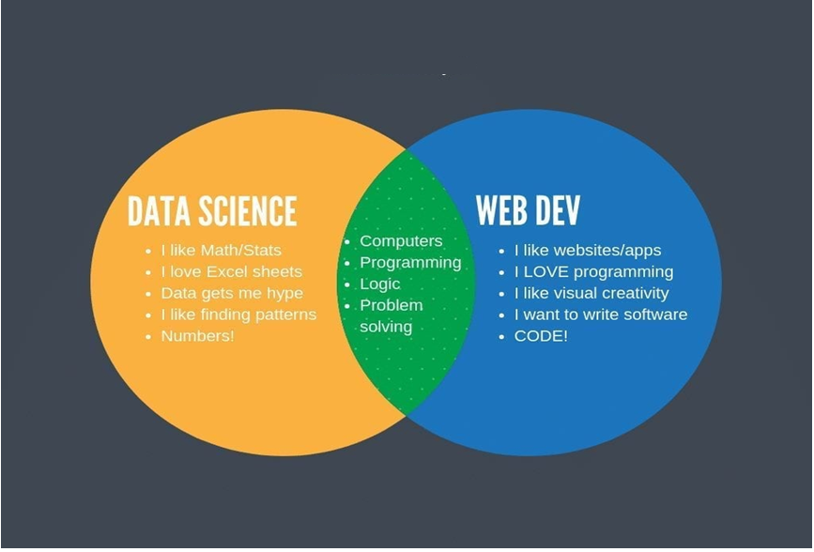
Python Used

Slide 4

Python IDE

Slide 5
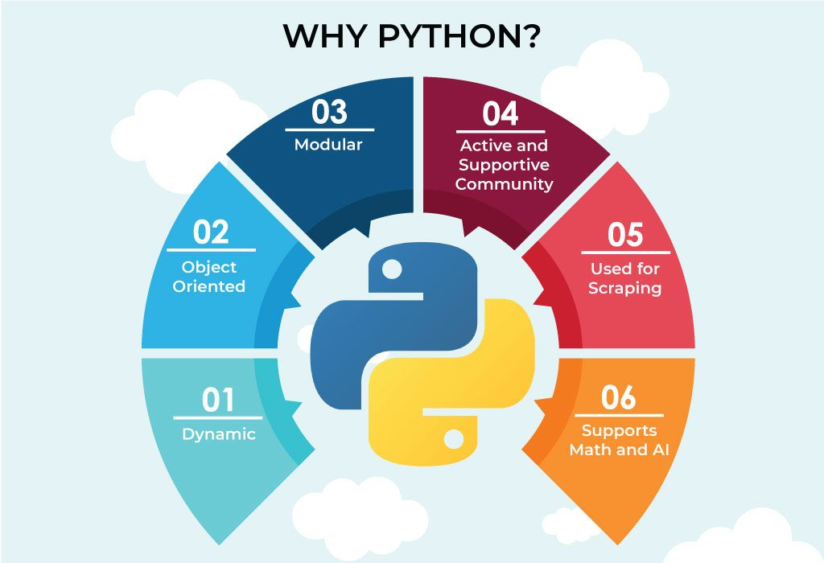

Slide 6
Features and fundamentals
Easy to learn.
Supports quick development.
Cross-platform.
Open Source.
Extensible.
Embeddable.
Large standard library and active community.
Useful for a wide variety of applications.
Whitespace is significant in Python. Where other languages may use {} or (), Python uses indentation to denote code blocks.
Comments
Single-line comments denoted by #.
Multi-line comments begin and end with three “s.
Typically, multi-line comments are meant for documentation.
# here’s a comment
for i in range(0,3):
print i
def myfunc():
"""here’s a comment about
the myfunc function"""
print "I'm in a function!"

Slide 7
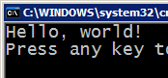



Compiling and Interpreting
Many languages require you to compile (translate) your program into a form that the machine understands.
Python is instead directly interpreted into machine instructions.
compile
execute
source code
Hello.java
byte code
Hello.class
output
interpret
source code
Hello.py
output

Slide 8
Python Variables
Numbers
String
List
Tuple
Dictionary
Sets

Slide 9
Numeric Types
$ python >>> 3 + 2 5 >>> 18 % 5 3 >>> abs(-7) 7 >>> float(9) 9.0 >>> int(5.3) 5 >>> complex(1,2) (1+2j) >>> 2 ** 8 256
Numeric
int: equivalent to C’s long int in 2.x but unlimited in 3.x.
float: equivalent to C’s doubles.
long: unlimited in 2.x and unavailable in 3.x.
complex: complex numbers.
Supported operations include constructors (i.e. int(3)), arithmetic, negation, modulus, absolute value, exponentiation, etc.

Slide 10
Strings Types
Created by simply enclosing characters in either single- or double-quotes.
It’s enough to simply assign the string to a variable.
Python supports a number of escape sequences such as ‘\t’, ‘\n’, etc.
Placing ‘r’ before a string will yield its raw value.
There is a string formatting operator ‘%’ similar to C. A list of string formatting symbols is available here.
Two string literals beside one another are automatically concatenated together.
mystring = "Hi, I'm a string!"
$ python ex.py
Hello,
\tWorld!\n
Python is so cool.
print "\tHello,\n"
print r"\tWorld!\n"
print "Python is " "so cool."

Slide 11
Python Functions
String Functions
count(str, beg= 0,end=len(string))
find(str, beg=0 end=len(string))
isdigit()
islower()
Isupper()
List Functions
List.append(obj)
List.insert(index,obj)
List.remove(obj)
List.reverse()
Tuple Functions
Len(tup1)
Max(tup1)
Min(tup1)
Dict Functions
Dict.items() – return a list of dict’s (key,value) as tuple
Dict.keys() – return list of dict keys
Dict.get(key, default=None) – for Key key, returs value or default if key not in dict

Slide 12
Python Functions
Function is a block of organized, reusable code that is used to perform a single, related action. Functionsprovide better modularity for your application and a high degree of code reusing. As you already know,Python gives you many built-in functions like print(), etc. but you can also create your own functions.
Function blocks begin with the keyword def followed by the function name and parentheses ( ( ) ).
Any input parameters or arguments should be placed within these parentheses. You can also define parameters inside these parentheses.
The first statement of a function can be an optional statement - the documentation string of the function or docstring.
The code block within every function starts with a colon (:) and is indented.
The statement return [expression] exits a function, optionally passing back an expression to the caller. A return statement with no arguments is the same as return None.
def functionname( parameters ):
"function_docstring"
function_suite
return [expression]
Example:
def printme( str ):
"This prints a passed string into this function"
print str
return
Lambda function:-
lambda arg1, arg2, ...argN : expression using arguments
sum = lambda x, y: x + y # def sum(x,y): return x + y

Slide 13
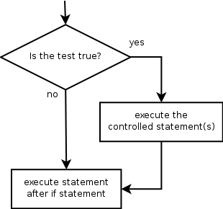
Condition / Decision Making/ Selection (if/elif/else)
If…else
if condition:
statement(s)
else:
statement(s)
Elif
If condition:
statement(s)
Elif condition:
statement(s)
Elif condition2:
statement(s)
………………..
Else:
statement(s)
if statement: Executes a group of statements only if a certain condition is true. Otherwise, the statements are skipped.
If syntax:
if condition:
statement(s).

Slide 14
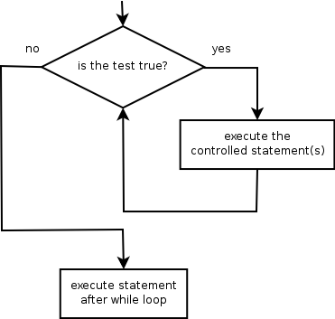
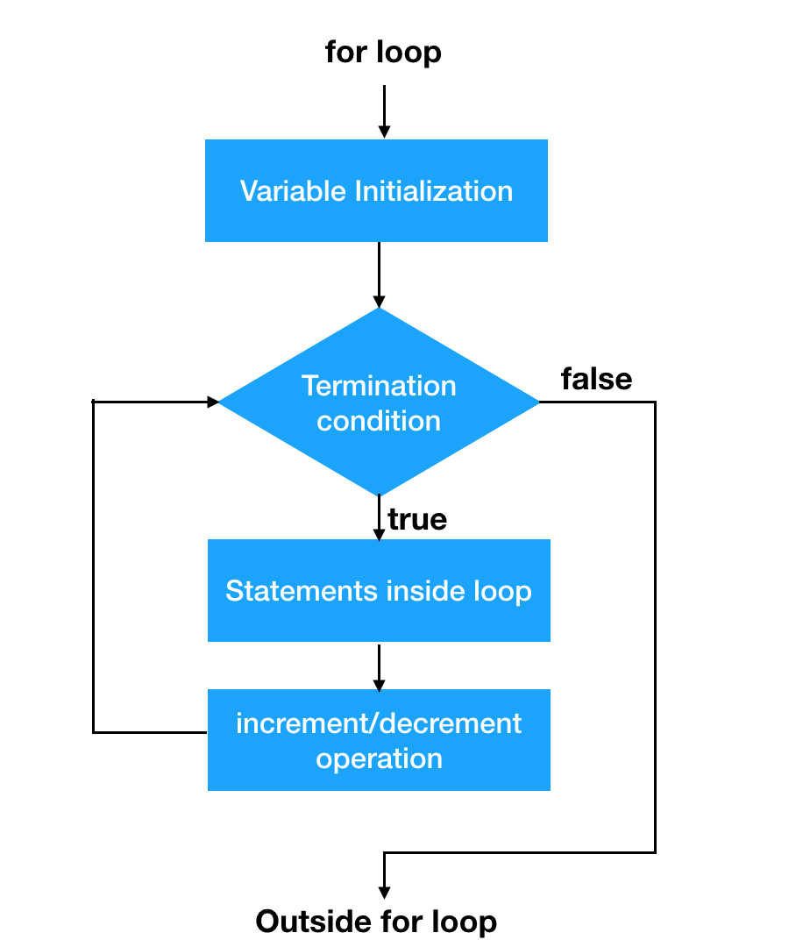
Repetitions/Loops(For , While)
Some loops incrementally compute a value that is initialized outside the loop. This is sometimes called a cumulative sum.
sum = 0
for i in range(1, 11):
sum = sum + (i * i)
print "sum of first 10 squares is", sum
Output:
sum of first 10 squares is 385
while loop: Executes a group of statements as long as a condition is True.
good for indefinite loops (repeat an unknown number of times)
Syntax:
while condition:
statements
Example:
number = 1
while number < 200:
print number,
number = number * 2
Output:
1 2 4 8 16 32 64 128
While Expression:
Statement(s)

Slide 15
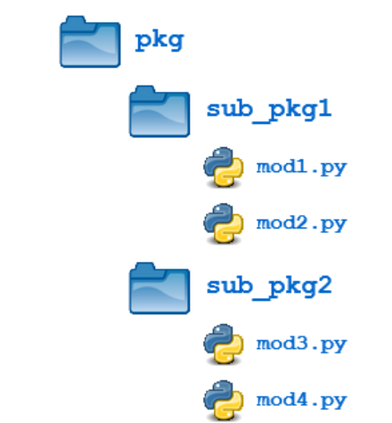
Python Module and Package
A module is a file consisting of Python code. A module can define functions, classes and variables. A module can also include runnable code.
import module1[, module2[,... moduleN]
Import module as md
from modname import name1[, name2[, ... nameN]]
From modname import module1 as md
Example – os, math,dir([module name]),globals(),locals(),sys etc..
A package is a hierarchical file directory structure that defines a single Python application environment that consists of modules and subpackages and sub-subpackages, and so on.

Slide 16
File Handling
Open File:
file_object=open(f_name[,access_mode][,buffering])
Mode | Description
r | Opens a file for reading only. The file pointer is placed at the beginning of the file. This is the default mode.
rb | Opens a file for reading only in binary format. The file pointer is placed at the beginning of the file. This is the default mode.
r+ | Opens a file for both reading and writing. The file pointer is placed at the beginning of the file.
rb+ | Opens a file for both reading and writing in binary format. The file pointer is placed at the beginning of the file.
w | Opens a file for writing only. Overwrites the file if the file exists. If the file does not exist, creates a new file for writing.
wb | Opens a file for writing only in binary format. Overwrites the file if the file exists. If the file does not exist, creates a new file for writing.
w+ | Opens a file for both writing and reading. Overwrites the existing file if the file exists. If the file does not exist, creates a new file for reading and writing.
wb+ | Opens a file for both writing and reading in binary format. Overwrites the existing file if the file exists. If the file does not exist, creates a new file for reading and writing.
a | Opens a file for appending. The file pointer is at the end of the file if the file exists. That is, the file is in the append mode. If the file does not exist, it creates a new file for writing.
ab | Opens a file for appending in binary format. The file pointer is at the end of the file if the file exists. That is, the file is in the append mode. If the file does not exist, it creates a new file for writing.
a+ | Opens a file for both appending and reading. The file pointer is at the end of the file if the file exists. The file opens in the append mode. If the file does not exist, it creates a new file for reading and writing.
ab+ | Opens a file for both appending and reading in binary format. The file pointer is at the end of the file if the file exists. The file opens in the append mode. If the file does not exist, it creates a new file for reading and writing.

Slide 17
Python Classes and Objects
Class: Code that defines the attributes and methods of a kind of object (A class is a collection of variables and functions working with these variables)
Classes are defined using the class keyword with a very familiar structure:
class ClassName: <statement-1> . . . <statement-N>
There is no notion of a header file to include so we don’t need to break up the creation of a class into declaration and definition. We just declare and use it!
Object: A single software unit that combines attributes and methods
Let’s say I have a simple class which does not much of anything at all.
class MyClass: """"A simple example class docstring""" i = 12345 def f(self): return 'hello world'
I can create a new instance of MyClass using the familiar function notation.
Attribute: A "characteristic" of an object; like a variable associated with a kind of object
Method: A "behavior" of an object; like a function associated with a kind of object
Instantiate: To create an object; A single object is called an Instance
x = MyClass()

Slide 18
Python Classes and Objects
I can access the attributes and methods of my object in the following way:
We can define the special method __init__() which is automatically invoked for new instances (constructor).
Constructor: A special method that is automatically invoked right after a new object is created
>>> num = x.i >>> x.f()
class MyClass: """A simple example class""" i = 12345 def __init__(self): print "I just created a MyClass object!" def f(self): return 'hello world'

Slide 19
Python Classes and Objects
Now, when I instantiate a MyClass object, the following happens:
We can also pass arguments to our __init__ function:
>>> y = MyClass() I just created a MyClass object!
>>> class Complex: ... def __init__(self, realpart, imagpart): ... self.r = realpart ... self.i = imagpart >>> x = Complex(3.0, -4.5) >>> x.r, x.i (3.0, -4.5)
hasattr(x, 'year') # Returns true if year attribute exists getattr(x, 'year') # Returns value of year attribute setattr(x, 'year', 2015) # Set attribute year to 2015 delattr(x, 'year') # Delete attribute year
There are also some built-in functions we can use to accomplish the same tasks.

Slide 20
Oops(Object Oriented Programming)
Inheritance: The transfer of the characteristics of a class to other classes that are derived from it.
Encapsulation/Data Abstraction/Data hiding: we can restrict access to methods and variables. This prevents data from direct modification which is called encapsulation. An object's attributes may or may not be visible outside the class definition. You need to name attributes with a double underscore prefix, and those attributes then are not be directly visible to outsiders.
Polymorphism: Polymorphism is an ability (in OOP) to use a common interface for multiple forms (data types).
Suppose, we need to color a shape, there are multiple shape options (rectangle, square, circle). However we could use the same method to color any shape. This concept is called Polymorphism.
Function overloading: The assignment of more than one behavior to a particular function. The operation performed varies by the types of objects or arguments involved.
Operator overloading: The assignment of more than one function to a particular operator.

Slide 21
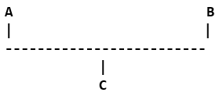
Oops(Object Oriented Programming)
Inheritance
class SubClassName (ParentClass1[, ParentClass2, ...]):
'Optional class documentation string’
class_suite
Multiple Inheritance
Multilevel Inheritance
Method overwriting: Sub class method/function can overwrite its parent class method by use this feature we can write different functionality in Subclass method.
Types of Inheritance

Slide 22
Exceptions
SystemExit Raised by the sys.exit() function.
StandardError: Base class for all built-in exceptions except StopIteration and SystemExit.
ArithmeticError: Base class for all errors that occur for numeric calculation.
OverflowError: Raised when a calculation exceeds maximum limit for a numeric type.
FloatingPointError Raised when a floating point calculation fails.
ZeroDivisonError
Raised when division or modulo by zero takes place for all numeric types.
AssertionError Raised in case of failure of the Assert statement.
AttributeError Raised in case of failure of attribute reference or assignment.
EOFError
Raised when there is no input from either the raw_input() or input() function and the end of file is reached.
ImportError Raised when an import statement fails.
LookupError Base class for all lookup errors.
IndexError Raised when an index is not found in a sequence.
KeyError Raised when the specified key is not found in the dictionary.
NameError
Raised when an identifier is not found in the local or global namespace.
UnboundLocalError
Raised when trying to access a local variable in a function or method but no value has been assigned to it.

Slide 23
Exceptions
EnvironmentError: Base class for all exceptions that occur outside the Python environment.
IOError: Raised when an input/ output operation fails, such as the print statement or the open() function when trying to open a file that does not exist.
OSError: Raised for operating system-related errors.
SyntaxError: Raised when there is an error in Python syntax.
IndentationError: Raised when indentation is not specified properly.
SystemError: Raised when the interpreter finds an internal problem, but when this error is encountered the Python interpreter does not exit.
SystemExit: Raised when Python interpreter is quit by using the sys.exit() function. If not handled in the code, causes the interpreter to exit.
TypeError: Raised when an operation or function is attempted that is invalid for the specified data type.
ValueError: Raised when the built-in function for a data type has the valid type of arguments, but the arguments have invalid values specified.
RuntimeError: Raised when a generated error does not fall into any category.
Raised when an abstract method that needs to be impNotImplementedError: lemented in an inherited class is not actually implemented.

Slide 24
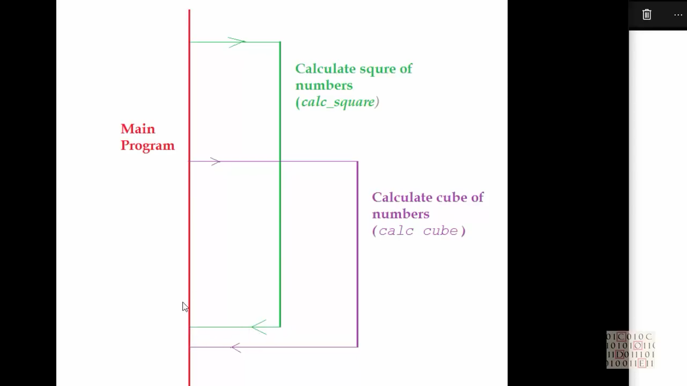
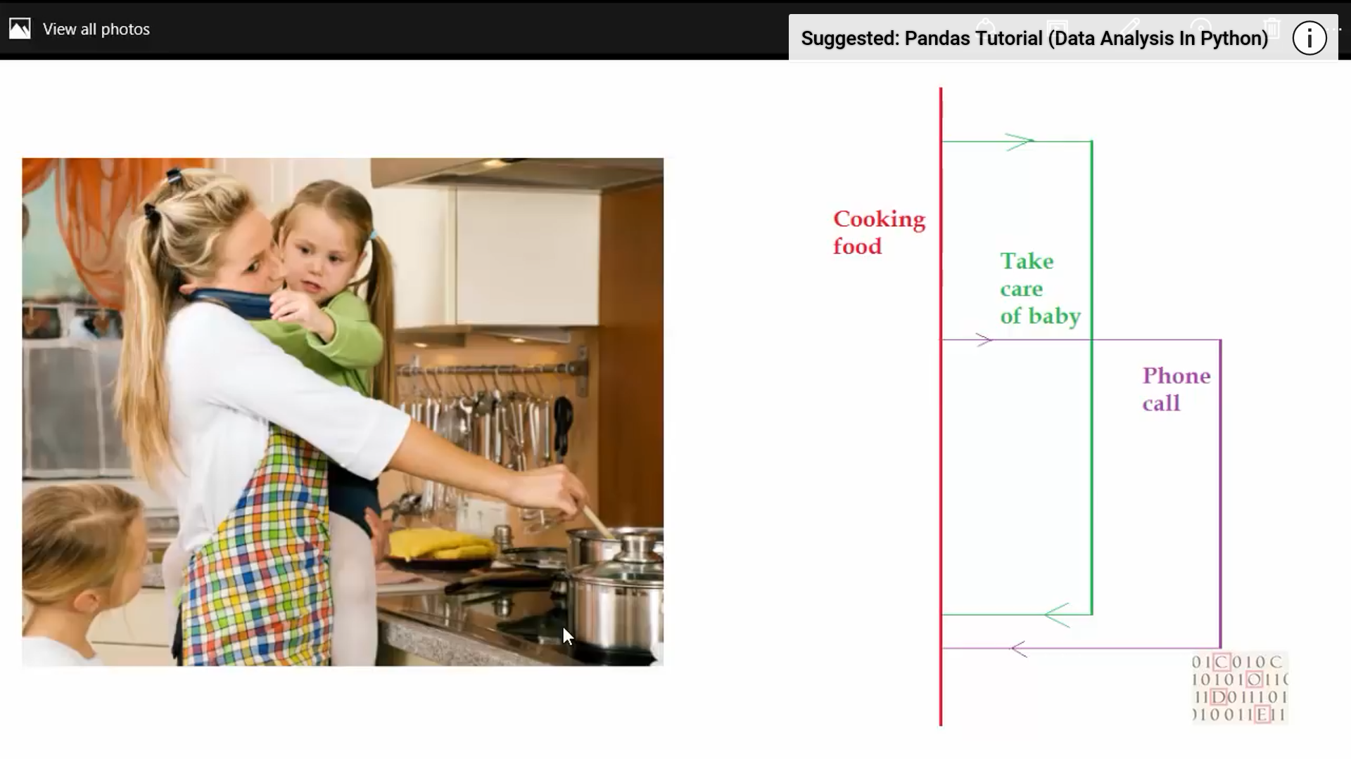
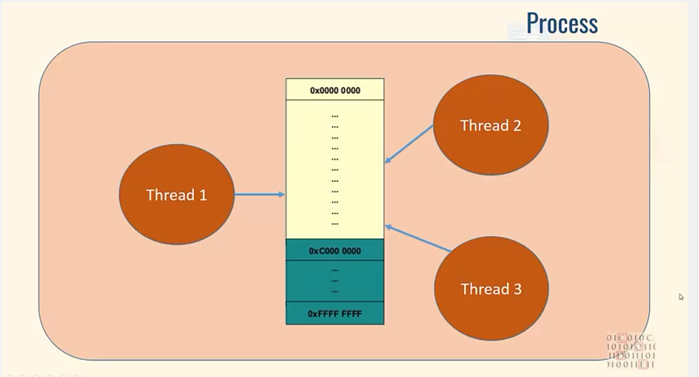
Multithreading
Multithreading is the ability of a central processing unit (CPU) (or a single core in a multi-core processor) to provide multiple threads of execution concurrently, supported by the operating system.
Running several threads is similar to running several different programs concurrently −
Multiple threads within a process share the same data space with the main thread and can therefore share information or communicate with each other more easily than if they were separate processes.

Slide 25
MultiProcessing
Multiprocessing refers to the ability of a system to support more than one processor at the same time. Applications in a multiprocessing system are broken to smaller routines that run independently. The operating system allocates these threads to the processors improving performance of the system.
Consider a computer system with a single processor. If it is assigned several processes at the same time, it will have to interrupt each task and switch briefly to another, to keep all of the processes going. This situation is just like a chef working in a kitchen alone. He has to do several tasks like baking, stirring, kneading dough, etc.
So the gist is that: The more tasks you must do at once, the more difficult it gets to keep track of them all, and keeping the timing right becomes more of a challenge. This is where the concept of multiprocessing arises! A multiprocessing system can have:
multiprocessor, i.e. a computer with more than one central processor.
multi-core processor, i.e. a single computing component with two or more independent actual processing units (called “cores”).
Here, the CPU can easily executes several tasks at once, with each task using its own processor.
It is just like the chef in last situation being assisted by his assistants. Now, they can divide the tasks among themselves and chef doesn’t need to switch between his tasks.

Slide 26
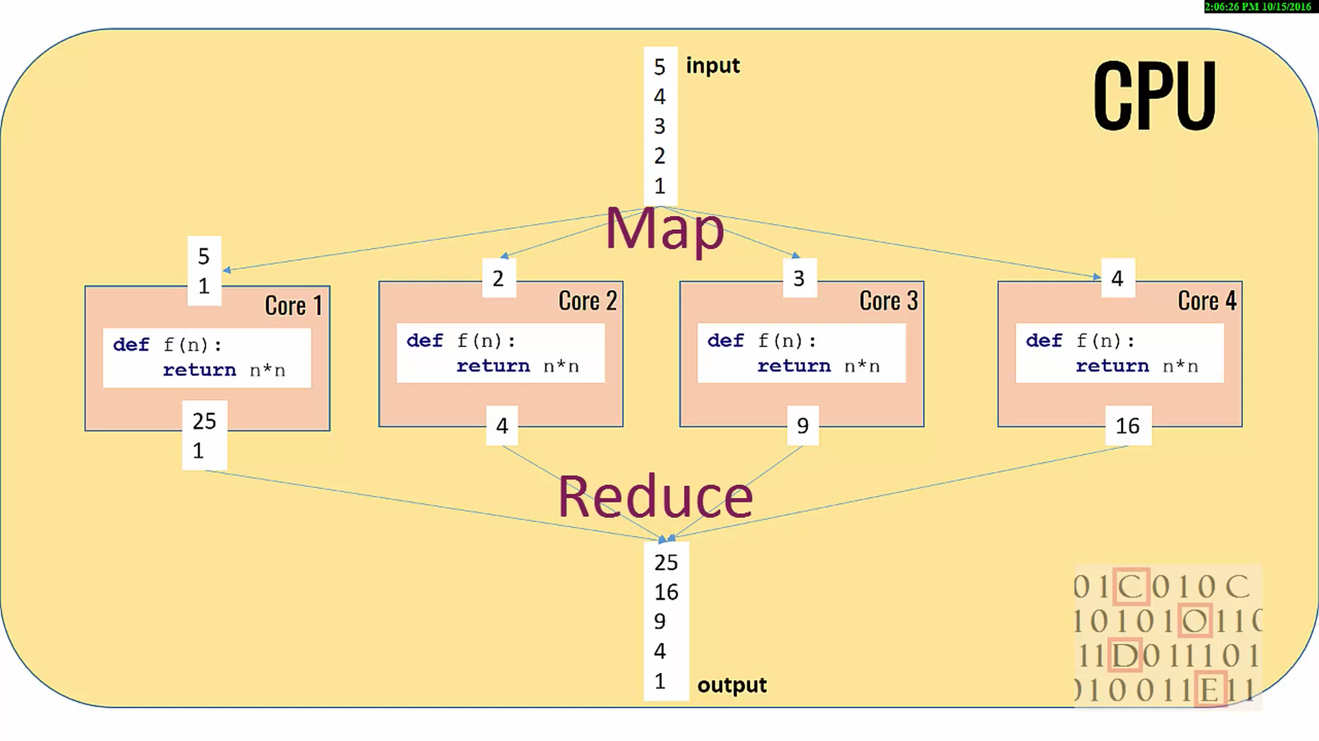
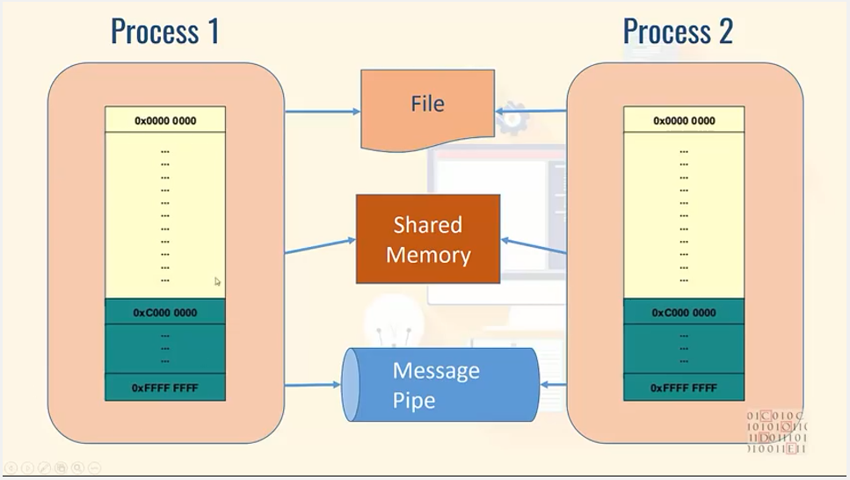
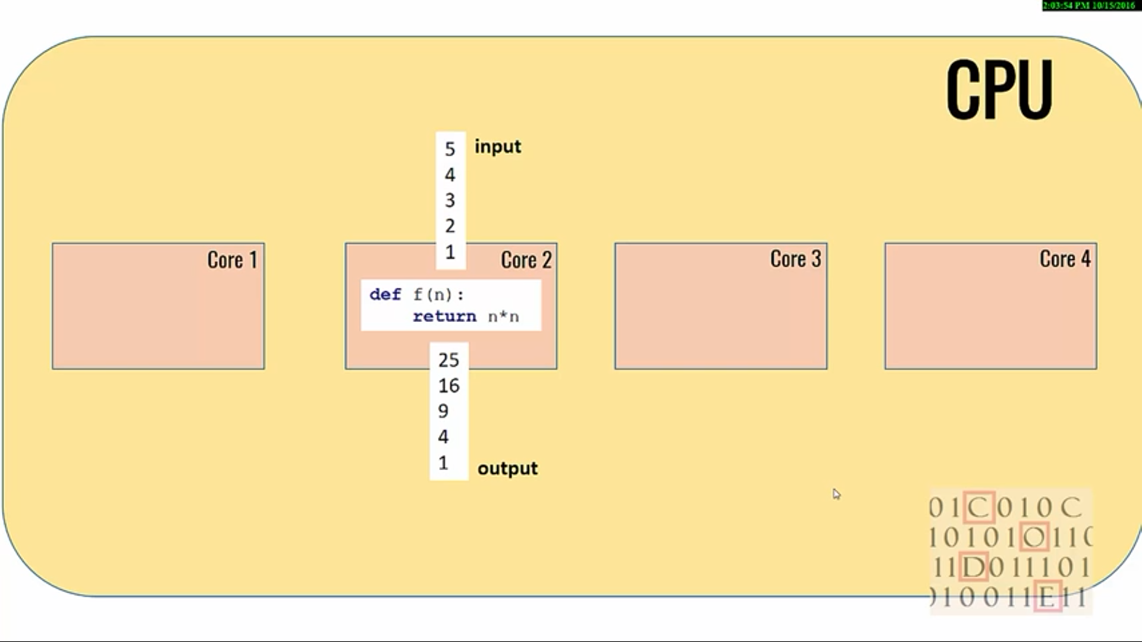
MultiProcessing

Slide 27
Multiprocessing
Pros:
* Separate memory space
* Code is usually straightforward
* Code is usually straightforward
* Child processes are interruptible/killable
Cons:
* Larger memory footprint

Slide 29


Slide 30


