Slide 1
Data Aggregation and DHIS2 Integration
From EMR SQL Database to KHIS (DHIS2) via FastAPI Service

Slide 2
System Architecture Overview
1. EMR Data stored in Microsoft SQL Server (Facility Level)
2. Data aggregated via SQL Stored Procedure
3. FastAPI Backend calls stored procedure to fetch summary
4. Data mapped to DHIS2 Data Elements using a Mapping File
5. FastAPI sends aggregated data to DHIS2 via REST API
6. DHIS2 holds summarized indicators for national reporting

Slide 3
EMR Database Structure Example
Table: ANC_Visit
Columns:
- ANCID
- Gravida
- Para
- FacilityCode
- VisitID
- IsFirstANC
- Gestation
- ExpectedDeliveryDate
- CreatedBy, DateCreated
- ...etc

Slide 4
Stored Procedure for Aggregation
CREATE PROCEDURE GetANCSummary @Month VARCHAR(7), @FacilityCode VARCHAR(10)
AS
BEGIN
SELECT
COUNT(CASE WHEN IsFirstANC = 1 THEN 1 END) AS FirstANC,
COUNT(CASE WHEN VisitCount >= 4 THEN 1 END) AS ANC4,
COUNT(CASE WHEN VisitCount >= 8 THEN 1 END) AS ANC8,
SUM(CASE WHEN Gestation BETWEEN 12 AND 13 THEN 1 ELSE 0 END) AS Gestation_12_13
FROM ANC_Visit
WHERE FORMAT(DateCreated, 'yyyy-MM') = @Month
AND (@FacilityCode = 'ALL' OR FacilityCode = @FacilityCode);
END;

Slide 5
Creating a Dataset in KHIS/DHIS2
1. Log into KHIS (DHIS2) as Admin
2. Navigate to Maintenance → Dataset
3. Create a new Dataset: 'ANC Summary'
4. Add Data Elements:
- First ANC Visit
- Completed 4 ANC Visits
- Completed 8 ANC Visits
- Gestation (12–13 weeks)
5. Assign to Organization Units (Facilities)
6. Define Reporting Periods (Monthly)

Slide 6
Creating the Data Mapping File
Example mapping.json:
{
"FirstANC": "DE12345",
"ANC4": "DE67890",
"ANC8": "DE54321",
"Gestation_12_13": "DE98765"
}
Purpose:
- Maps EMR indicators to DHIS2 Data Element UIDs
- Used by FastAPI service for data posting

Slide 7
FastAPI Application Overview
1. UI allows selection of Month, Facility, and Program
2. Backend executes stored procedure with parameters
3. Aggregated results are loaded into JSON
4. Mapping file applied to convert to DHIS2 payload format
5. Data pushed via POST /api/dataValueSets to DHIS2 instance

Slide 8
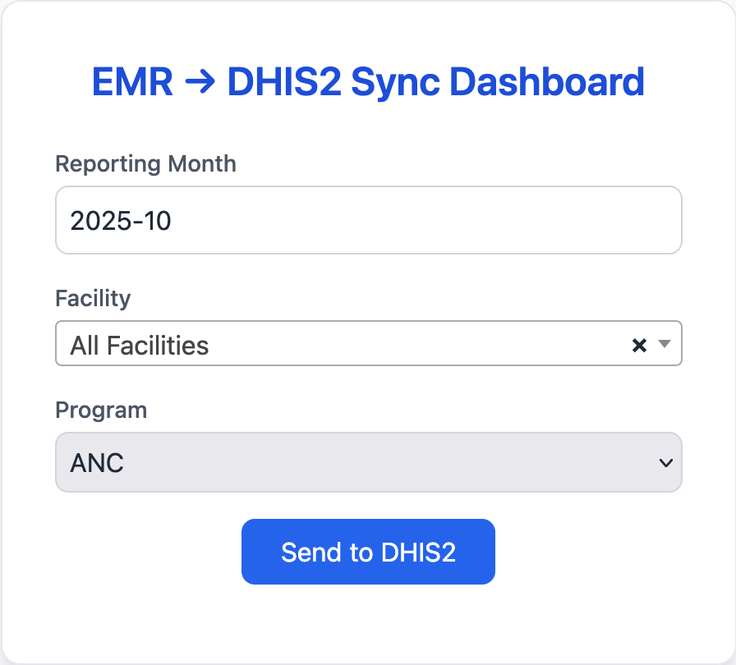
UI-1

Slide 9
Example FastAPI Snippet
@app.post('/submit')
def submit(month: str, facility: str, program: str):
conn = pyodbc.connect(conn_str)
cursor = conn.cursor()
cursor.execute('EXEC GetANCSummary ?, ?', (month, facility))
result = cursor.fetchone()
payload = {
'dataSet': 'ANC_DATASET_ID',
'period': month.replace('-', ''),
'orgUnit': facility,
'dataValues': [
{'dataElement': mapping['FirstANC'], 'value': result.FirstANC},
{'dataElement': mapping['ANC4'], 'value': result.ANC4}
]
}
requests.post(f'{dhis_url}/api/dataValueSets', json=payload, auth=(user, pass))
return {'status': 'Submitted'}

Slide 10
DHIS2 Sync Dashboard (FastAPI UI)
Features:
- Select Reporting Month, Facility, and Program
- Submit button triggers backend sync
- Success/Failure status shown on summary page
- Logs stored in Sync History table for traceability

Slide 11
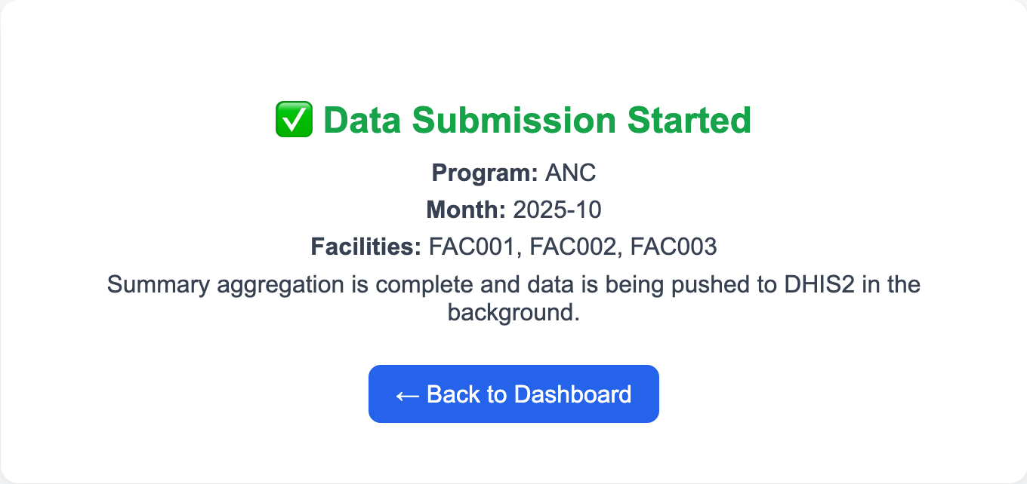
Data Submission

Slide 12
Summary and Benefits
✔ Automated EMR → DHIS2 aggregation
✔ Facility-level and national-level data consistency
✔ Reduced manual entry errors
✔ Real-time submission tracking
✔ Modular design for new programs (PMTCT, ART, etc.)
✔ Scalable architecture for future integration

Slide 13
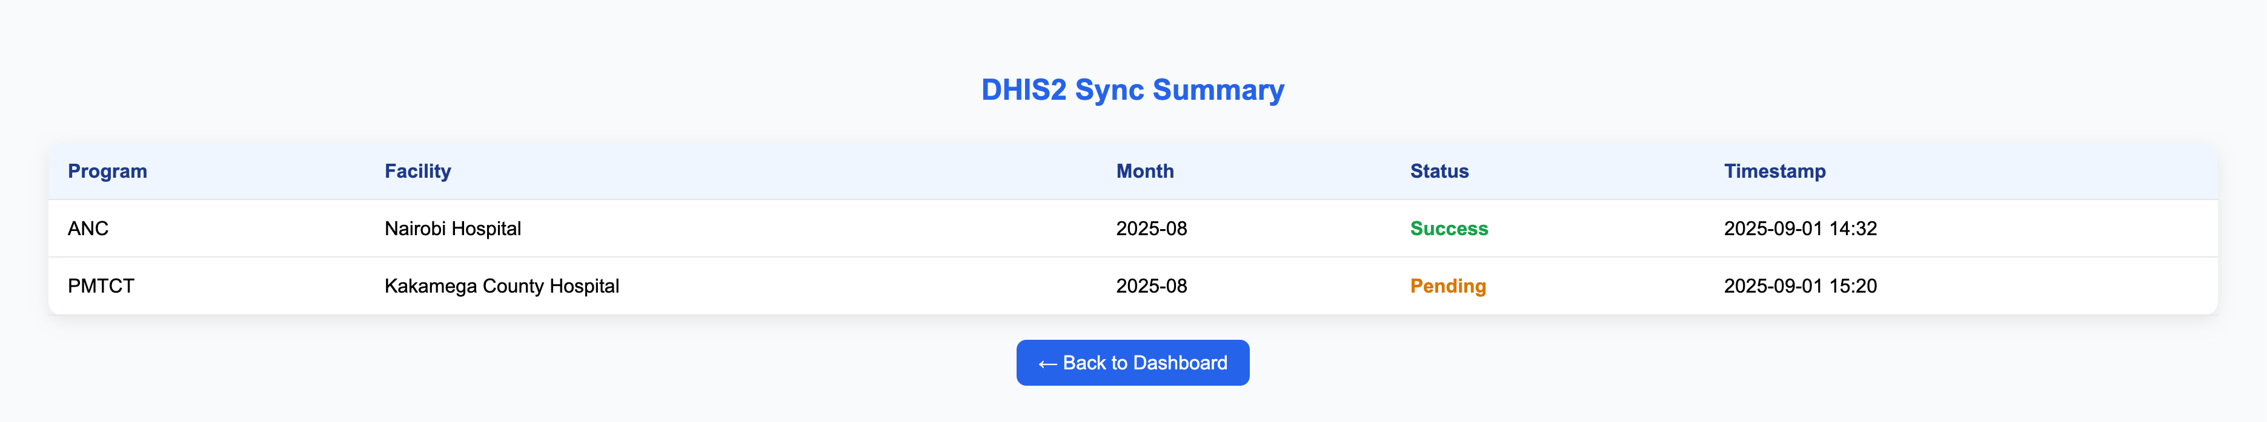
Summary

