Slide 1


+
=
AWSOMENESS

Slide 2
STARTING AN IONIC PROJECT
Create a folder in which you are going to save your project
Open your favorite terminal and go to the folder you created
The first step is to create an ionic project

Slide 3
How to create an ionic project
Run this command
ionic start MyGoogleDevApp blank

Slide 4
Add firebase cordova plugin
To add firebase cordova plugin the following the commands are run
ionic cordova plugin add cordova-plugin-firebase
npm install --save @ionic-native/firebase
Add the plugins the the apps module

Slide 5
Add provider to implement firebase analytics
The next step is to create a provider that will implement firebase analytics, you will use this provider to log events to firebase in your app
ionic generate provider FirebaseLogger
Add the provider the the app modules

Slide 6
Let get to the fun stuff
I call this the fun stuff because there is nothing much more to do

Slide 7
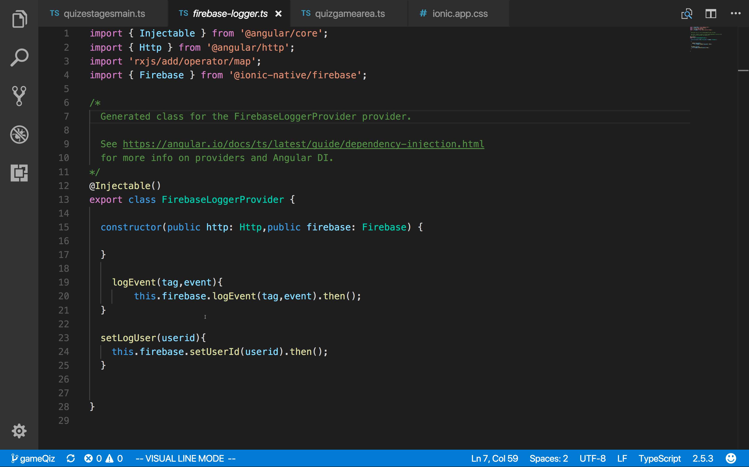

Slide 8
So how do I play with
All that’s now left is to add your provider and call the method in the provider with the content you want to log.
Check example below

Slide 9
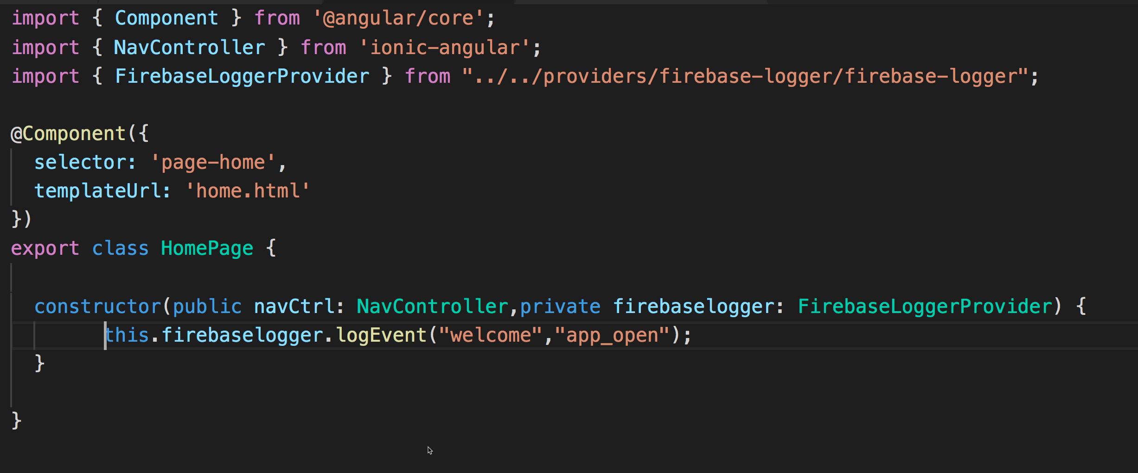

Slide 10

Lets add some $$$ to the equation

Slide 11
Getting started with adMob
We start by adding the admob free cordova plugin
ionic cordova plugin add cordova-plugin-admob-free
npm install --save @ionic-native/admob-free
Add admob plugin to the apps module

Slide 12
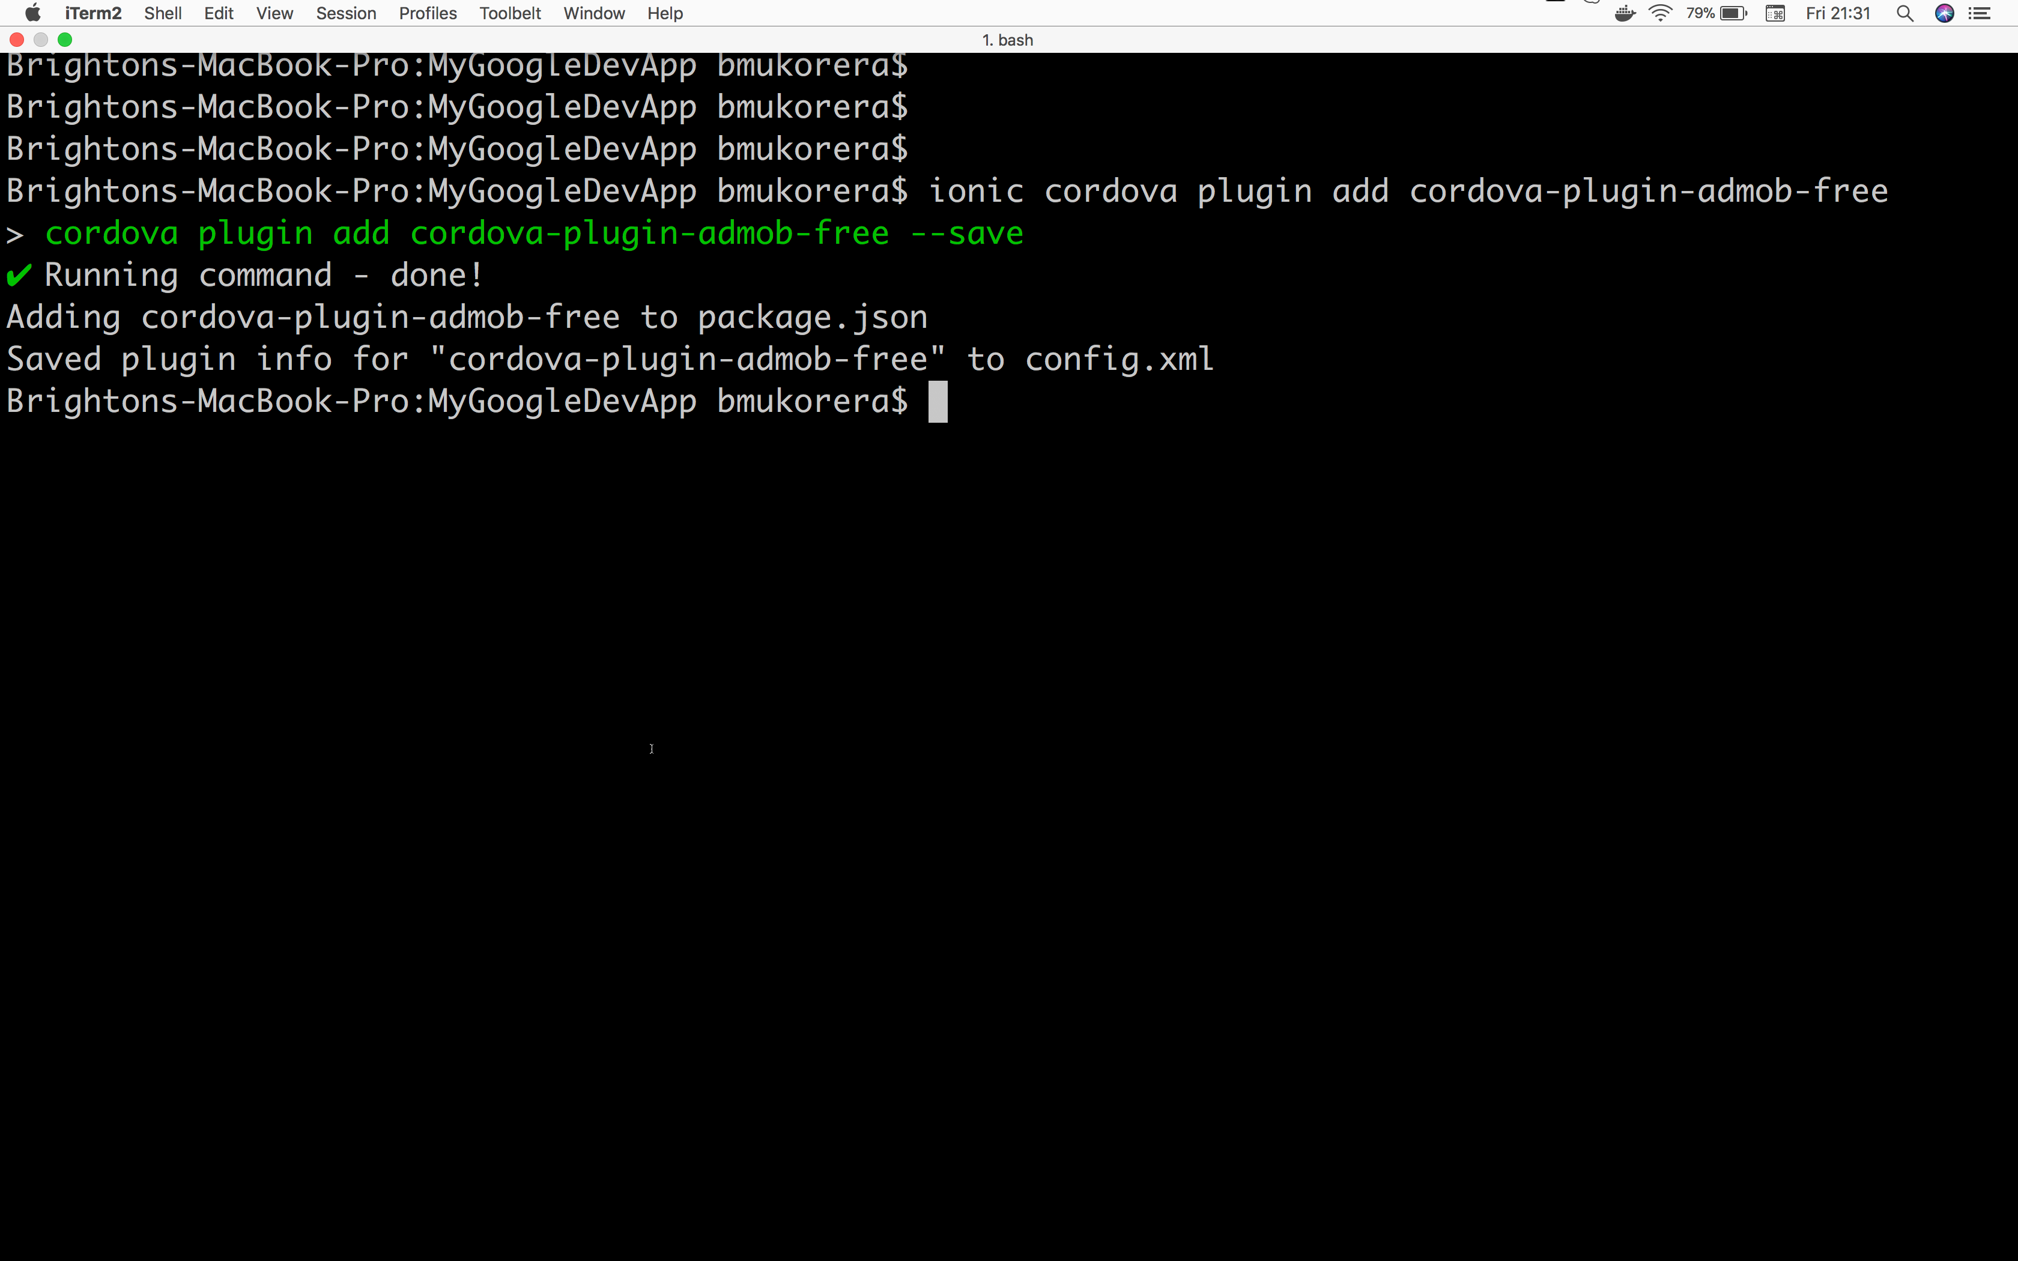

Slide 13
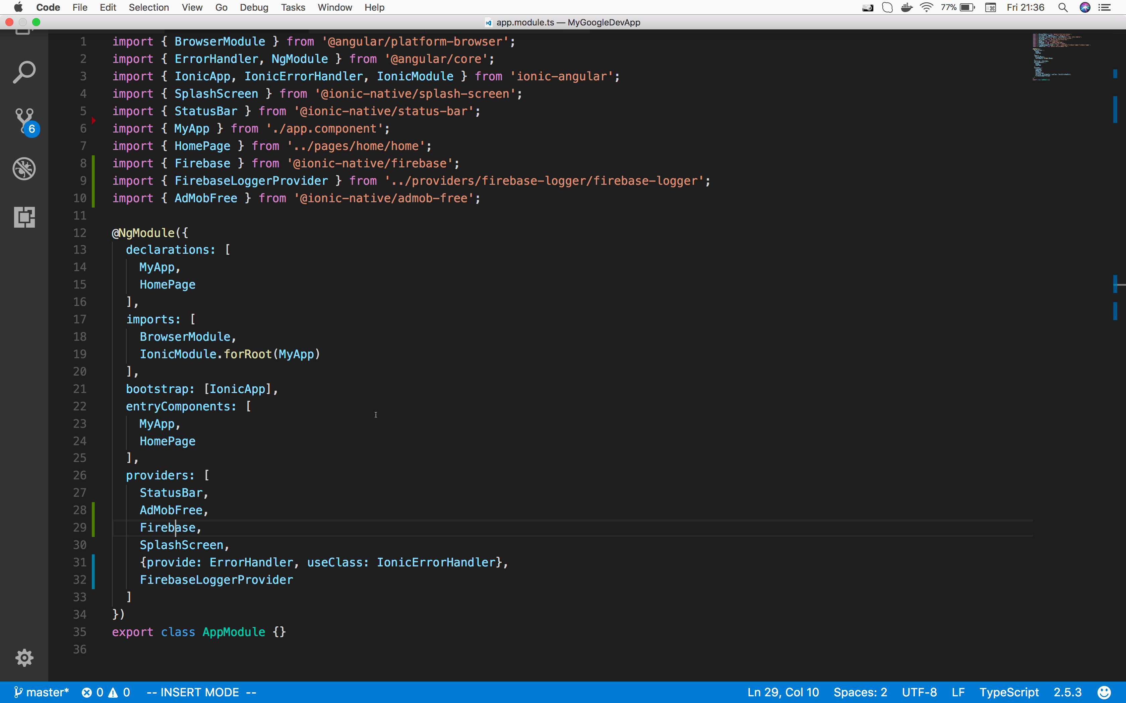

Slide 14
We have now set up AdMob in the firebase app
The next step is to setup an AdMob project
From the Admob project you define the ad unit that you are to add to the project

Slide 15
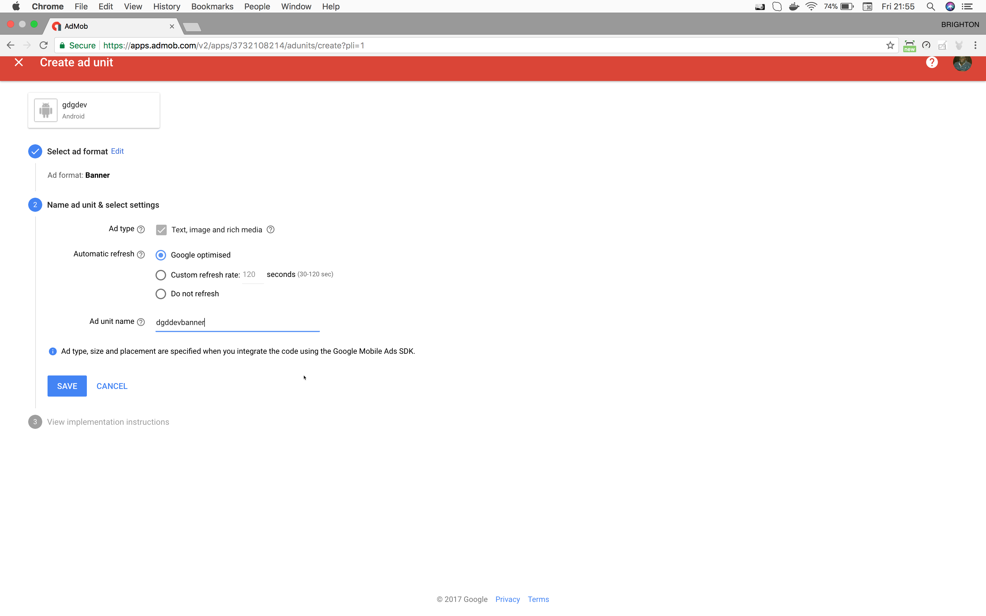

Slide 16
Once the ad unit is set up all that is left is to initialise the adunits in the app

Slide 17
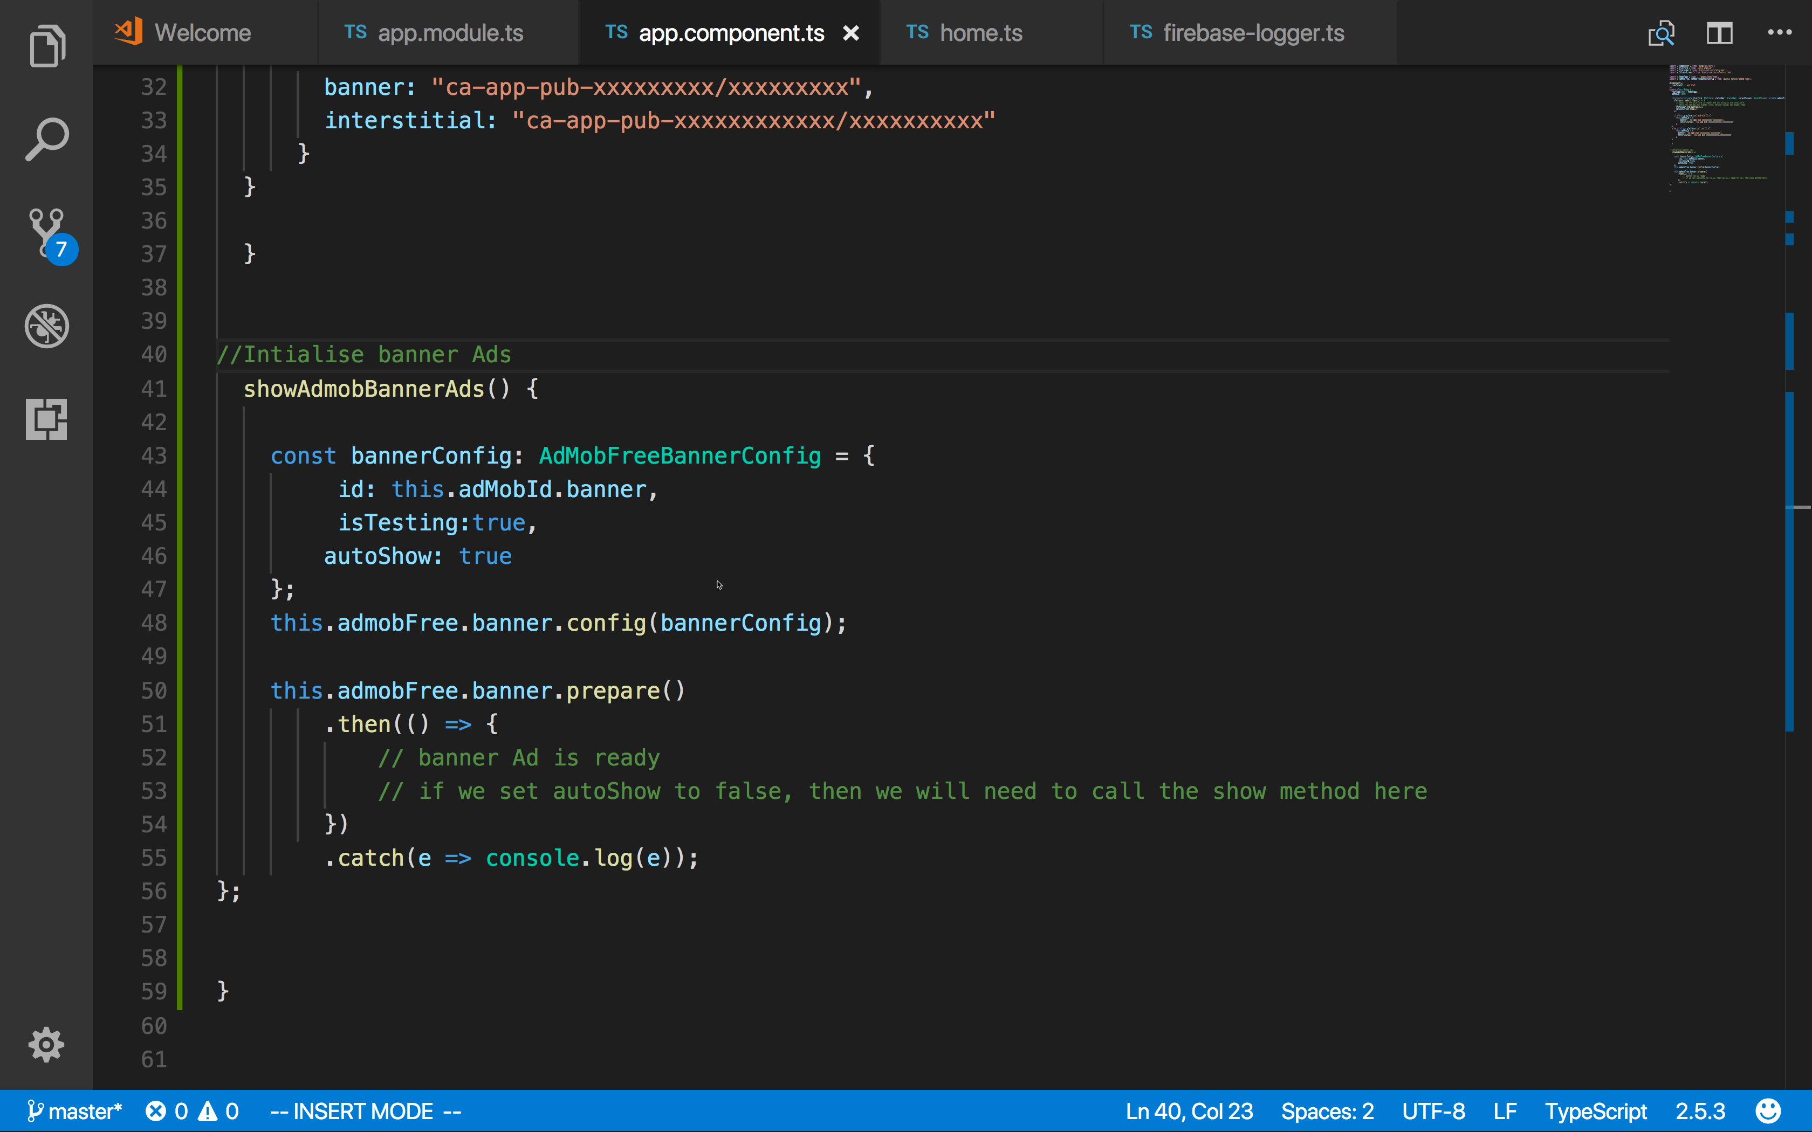

Slide 18
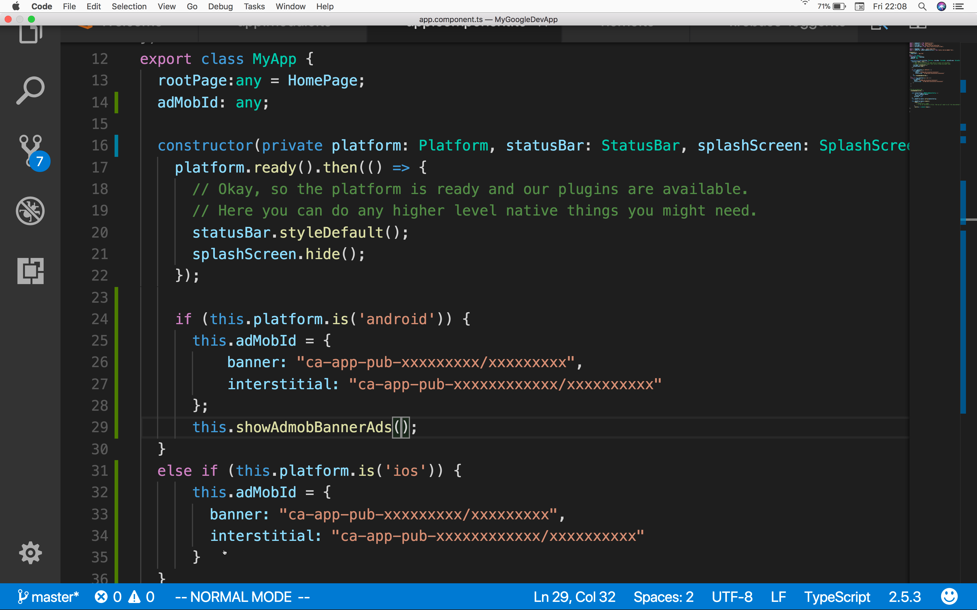

Slide 19
Resources
https://github.com/bmukorera/GdG2017
bmukorera@gmail.com
/
bright@bmukorera.com

Slide 20
Thank you
And
Happy coding

