Slide 1
Stream and Batch Processing in the Cloud with Data Microservices
Marius Bogoevici and Mark Fisher, Pivotal
Notes:
00-10: intro 5 slides
10-15: dataflow demo: http | file (no detail just the curl+tail)
15-18: the stack diagram
18-30: spring-cloud-stream slides
30-40: spring-cloud-stream demo
40-45: dataflow intro
45-55: dataflow custom processor demo, add tap
55-60: task + quick demo
60-75: marius demo on dataflow...
http | log on CF with scaling?
Q&A

Slide 2
Stream and Batch Processing in the Cloud with Data Microservices
Use Cases
Predictive maintenance
Fraud detection
QoS measurement
Log analysis
High throughput/low latency
Growing quantities of data
Immediate response is required
Grouping and ordering of data
Partitioning
Windowing

Slide 3
Stream and Batch Processing in the Cloud with Data Microservices
Use Cases
ETL
Account Reconciliation
Machine Learning (e.g. model updates)
Periodic activities
Finite datasets
Retry, Skip, Stop, Restart
Dynamic resource allocation
Increasing demand for the realm of batch processing use-cases to move to real-time (“aka Stream Processing”)

Slide 4
Stream and Batch Processing in the Cloud with Data Microservices
Huge quantities of data to be analyzed efficiently
Scaling requirements
Massive storage
Massive computing power (memory/CPU)
Massive scalability, from a few machines to data center level
Reliance on platform’s resource management abilities
public and private cloud: AWS
cluster managers: Apache YARN, Apache Mesos, Kubernetes
full application platforms: Cloud Foundry

Slide 5
Stream and Batch Processing in the Cloud with Data Microservices
Microservice pattern applied to data processing applications
Typical benefits:
scalability, isolation, agility, continuous deployment, operational control
Tuning process-specific resources
Instance count
Memory
CPU
Event-driven
Notes:
A very short discussion on microservices, pointing to pre

Slide 6
Demo
dataflow:> stream create demo --definition “http | file”

Slide 7
Data Flow Shell
REST client, CURL, etc.
Data Flow UI
Local
Data Flow Server
Cloud Foundry
Data Flow Server
Apache Yarn
Data Flow Server
Apache Mesos
Data Flow Server
Kubernetes
Data Flow Server
Spring Cloud Data Flow
Spring Cloud Stream
Modules
Spring Cloud Task
Modules
Spring Cloud Stream
Spring Cloud Task
Spring Integration
Spring Boot
Spring Batch
Notes:
can adopt at any level
high level: DSL via UI/Shell
low level: boot programming model for spring-cloud-stream/task apps
decomposition of Spring XD

Slide 8
Spring Cloud Stream
Event-driven microservice framework
Built on Spring stack:
Spring Boot: full-stack standalone apps, configuration
Spring Integration: messaging primitives and enterprise integration patterns
Simplify access to middleware
Common abstractions
Middleware binding
Consumer groups
Partitioning
Pluggable Binder API

Slide 9
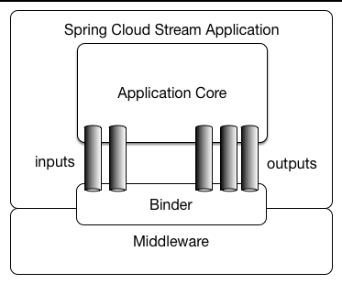
Spring Cloud Stream in a nutshell

Slide 10
Programming model
package org.springframework.cloud.stream.messaging;
public interface Processor {
String INPUT = "input";
String OUTPUT = "output";
@Input(Processor.INPUT)
SubscribableChannel input();
@Output(Processor.OUTPUT)
MessageChannel output();
}
@EnableBinding(Processor.class)
public class UpperCase {
@Transformer(inputChannel = Processor.INPUT, outputChannel=Processor.OUTPUT)
public String process(String message) {
return message.toUpperCase();
}
}

Slide 11
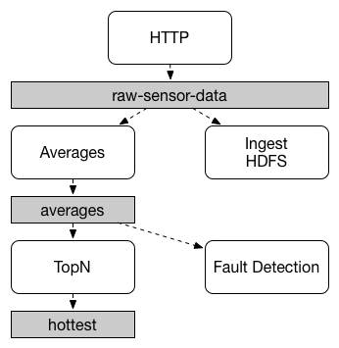
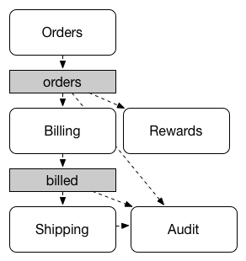
Event-driven model, publish subscribe semantics
Published data broadcast to all subscribers
Reduce data pipeline complexity
Fits both data streaming and event-driven microservice use cases

Slide 12
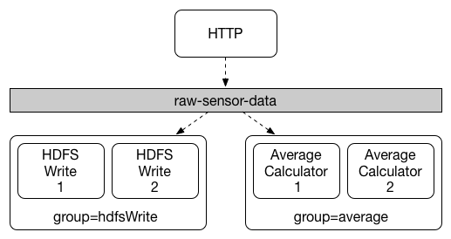
Consumer groups
Borrowed from Kafka, applied across all binders
Groups of competing consumers within the pub-sub architecture
Used in scaling and partitioning

Slide 13
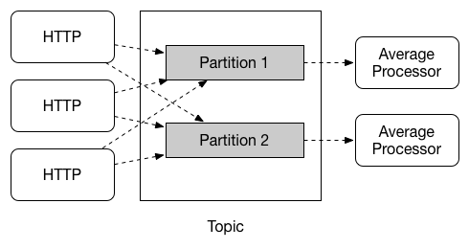
Partitioning
Required for stateful processing scenarios involving data groups (e.g. average calculation)
Outputs can specify a data partitioning strategy: SpEL, own implementation
Inputs can be bound to a specific partition

Slide 14
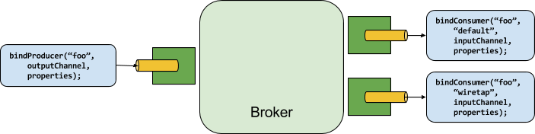
Binder SPI

Slide 15
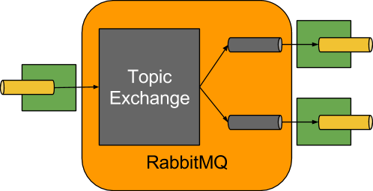
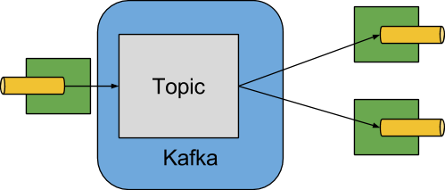
Binder Implementations
Other implementations: Redis, Gemfire, … your own!

Slide 16
Spring Cloud Task
@SpringBootApplication @EnableTask public class MyApp { @Bean public MyTaskApplication myTask() { return new MyTaskApplication(); }
public static void main(String[] args) { SpringApplication.run(MyApp.class); }
public static class MyTaskApplication implements CommandLineRunner { @Override public void run(String... strings) throws Exception { System.out.println("Hello World"); } } }
task can be deployed, executed and removed on demand
result of the process persists beyond the life of the task for future reporting

Slide 17
Spring Cloud Data Flow
Orchestration Layer for Streams and Tasks
DSL
Repositories for Stream and Task Definitions
REST API
Shell
UI
SPI for Deployment and Lifecycle Management
Load Balance
Scale Up/Down
Allocate Resources
Check Status

Slide 18
Data Flow Developer Experience
1: Implement Spring Cloud Stream Microservice App:
@EnableBinding(Processor.class)
public class UpperCase {
@Transformer(inputChannel = Processor.INPUT, outputChannel=Processor.OUTPUT)
public String process(String message) {
return message.toUpperCase();
}
}
2: Build and Install:
$ mvn clean install
3: Register Module with Data Flow:
dataflow:> module register --name uppercase --type processor --coordinates group:artifact:version
4: Define Stream via DSL:
dataflow:> stream create demo --definition
"http --server.port=9000 | uppercase | file --directory=/tmp/devnexus"

Slide 19
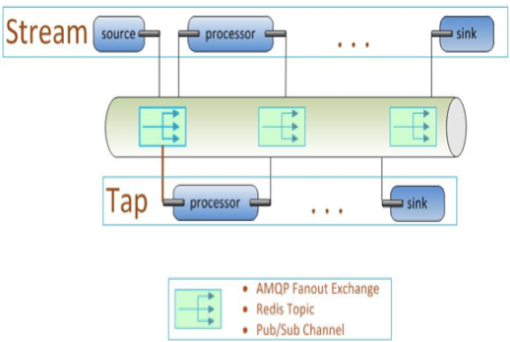
Wire Tap
dataflow:> stream create demo --definition
"http --server.port=9000 | uppercase | file --directory=/tmp/devnexus"
dataflow:> stream create tap --definition ":demo.http > counter --store=redis"
Notes:
Listens to data in a Stream
Decoupled from the primary Stream’s lifecycle

Slide 20
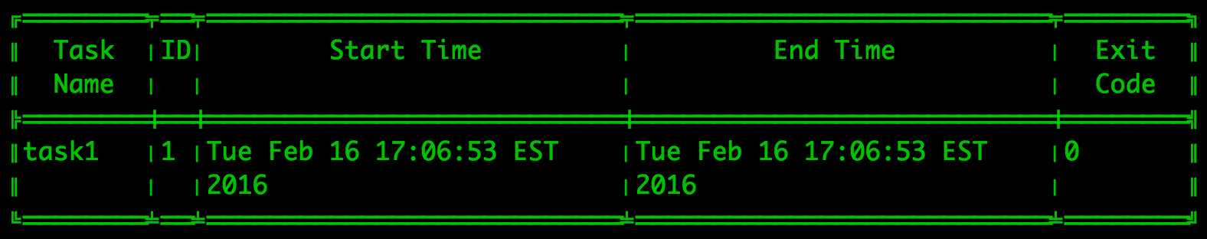
Launching Tasks via Data Flow
dataflow:> task create task1 --definition timestamp
dataflow:> task launch task1
dataflow:> task execution list

Slide 21
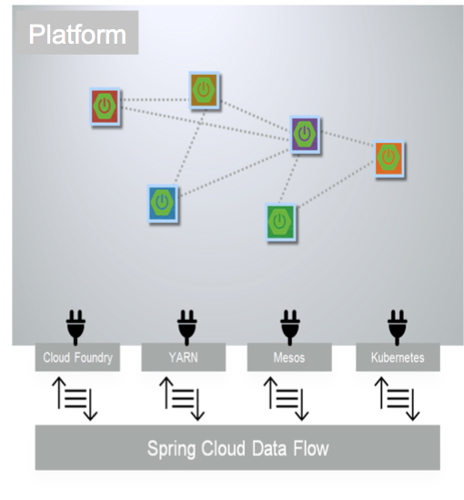
Deployer SPI
deploy Spring Cloud Stream apps
deploy Spring Cloud Task apps
in both cases, pass Spring Boot Configuration Properties in an appropriate way for the target platform
support for checking status of individual apps as well as app group (e.g. stream)
https://github.com/spring-cloud/spring-cloud-dataflow-admin-cloudfoundry
https://github.com/spring-cloud/spring-cloud-dataflow-admin-yarn
https://github.com/spring-cloud/spring-cloud-dataflow-admin-mesos
https://github.com/spring-cloud/spring-cloud-dataflow-admin-kubernetes

Slide 22
Links
http://cloud.spring.io/spring-cloud-stream
https://github.com/spring-cloud/spring-cloud-stream
http://cloud.spring.io/spring-cloud-task
https://github.com/spring-cloud/spring-cloud-task
http://cloud.spring.io/spring-cloud-dataflow
https://github.com/spring-cloud/spring-cloud-dataflow

Slide 23


Open.
Agile.
Cloud-Ready.

