Slide 1


PCF dotnet
State of dotnet on PCF
Yadhav Jayaraman
Platform Architect
@yadhavj
yjayaraman@pivotal.io

Slide 2
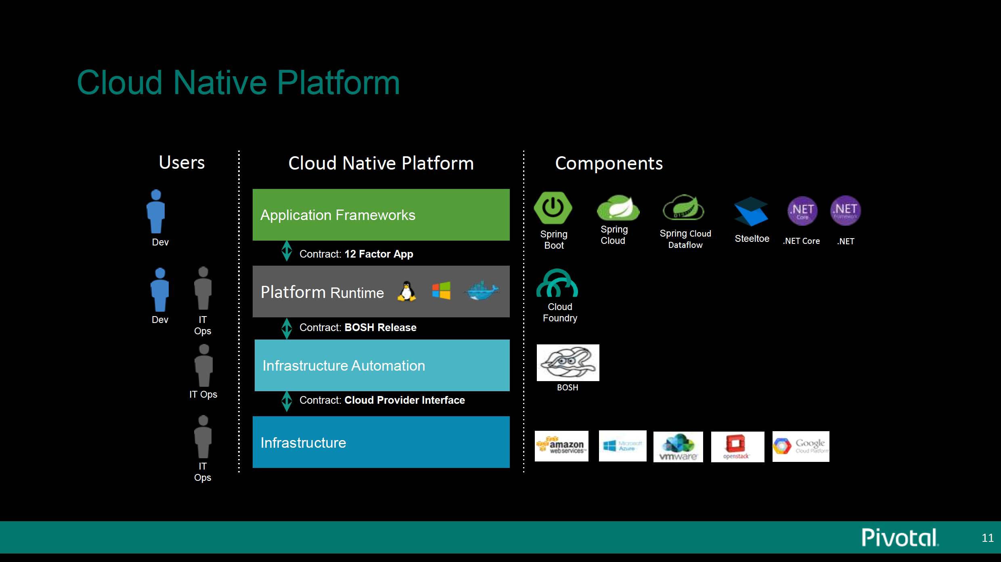

Notes:
Where does steel toe fit.

Slide 3
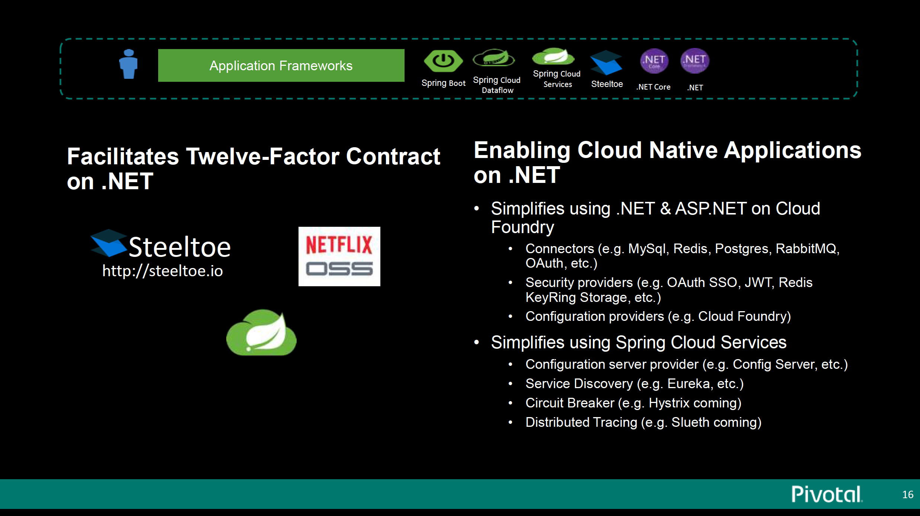
Source: Gartner
Notes:
Steeltoe is about simplyfing .net and ASP .net on CF
Spring Java world there are connectors.
Same features in steeltoe made in the .net way
Additional security UAA and Oauth functionalities
Configuration provider – enables one to parse vcap, cf_env variables
Other area is with Spring Cloud Services – Spring Cloud Config server, as well as Eureka server for service discovery
We are also working on circuit breaker implementation and distributed tracing – Sleuth
Also coming with circuit breakers, stream services, spring cloud bus services.

Slide 4
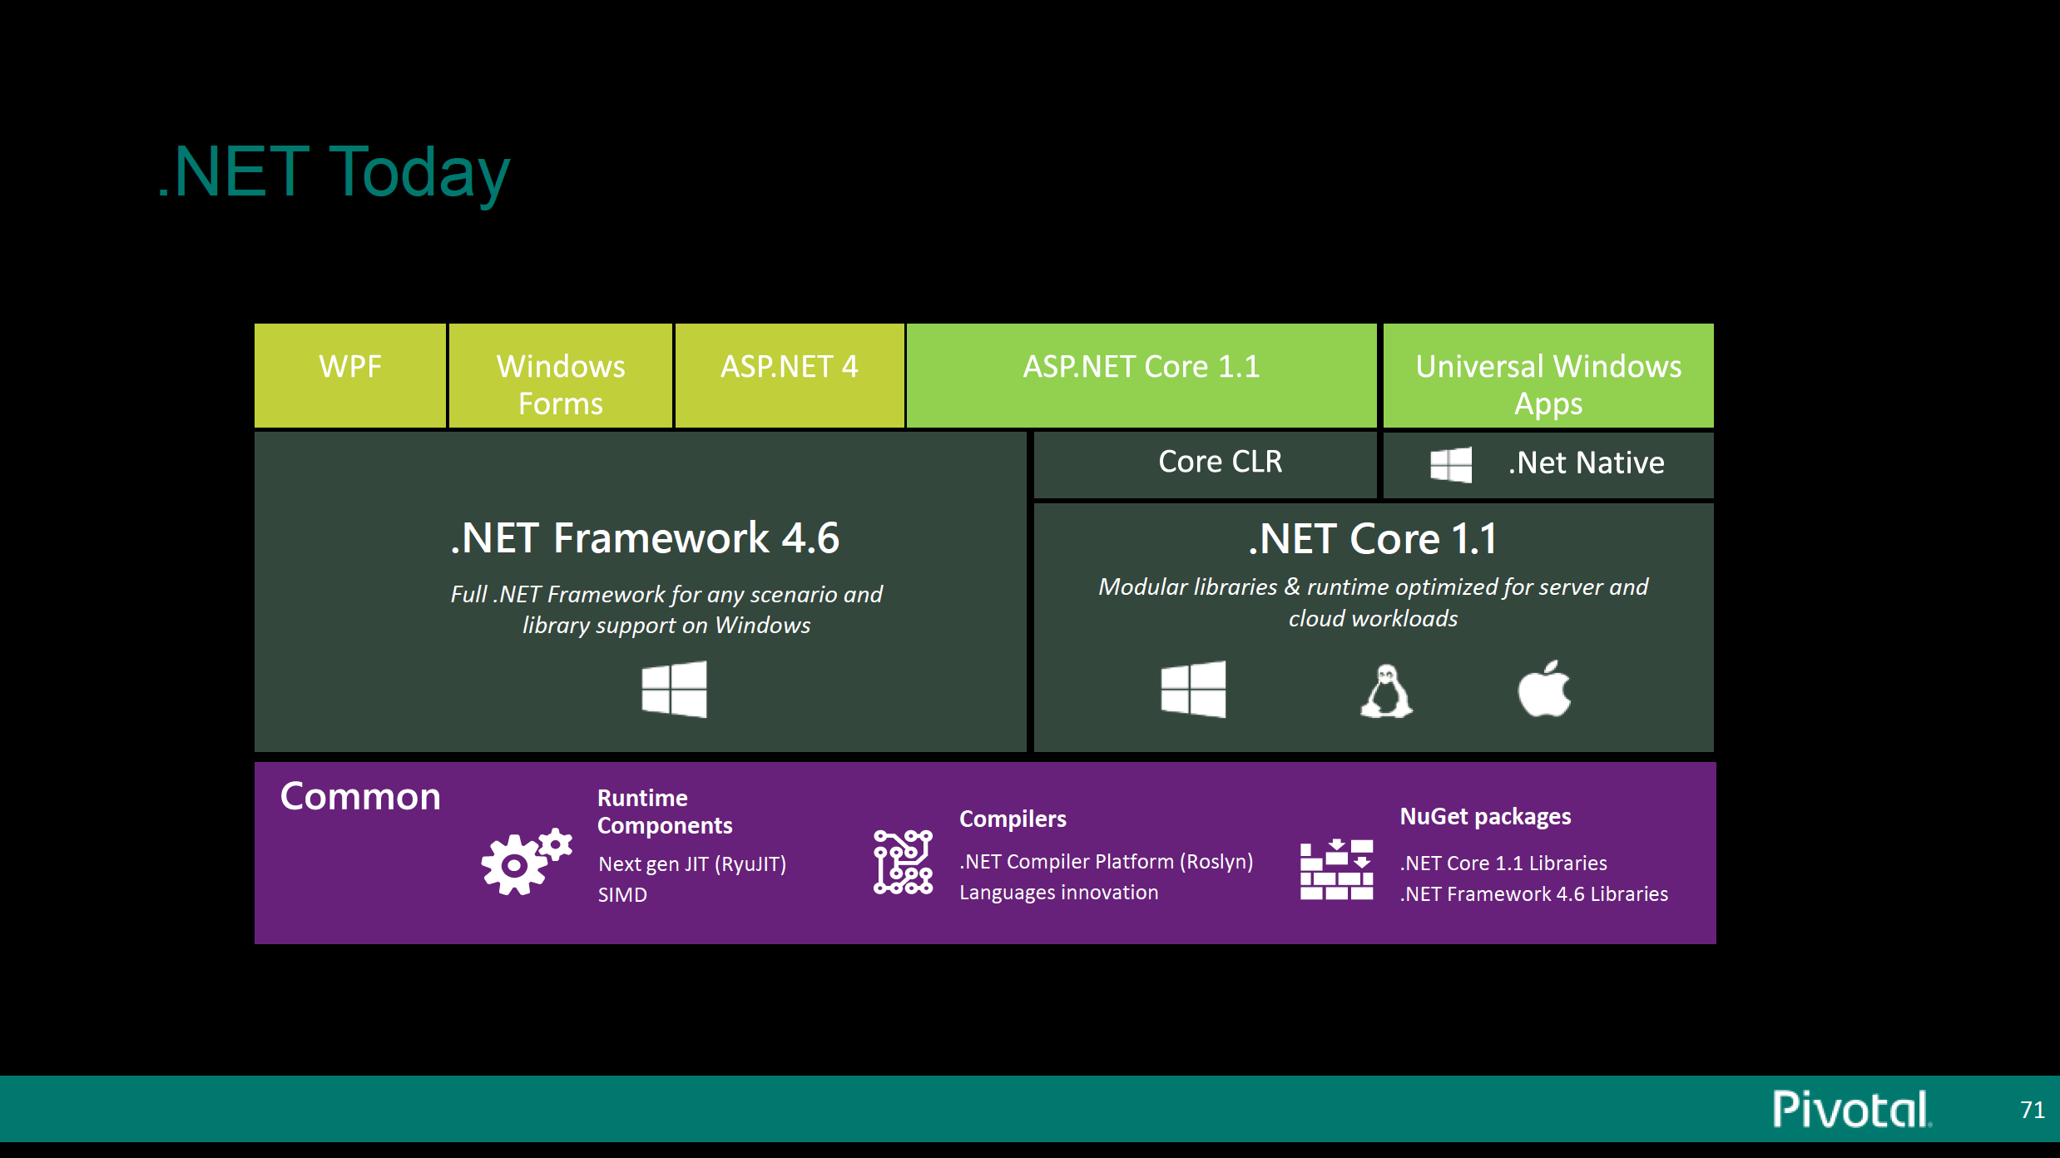
Notes:
State of .NET today. .NET fraemwork 4.x
.NET Core 2.0 (On PCF 1.1) is only supported.
Microsoft has moved to a cross platform version – windows, linux and OSX
Left is legacy workld. And right is the new world of .NET
Below are common drivers and libraries
There is also a new package manager called nuget.
What is nuget.

Slide 5
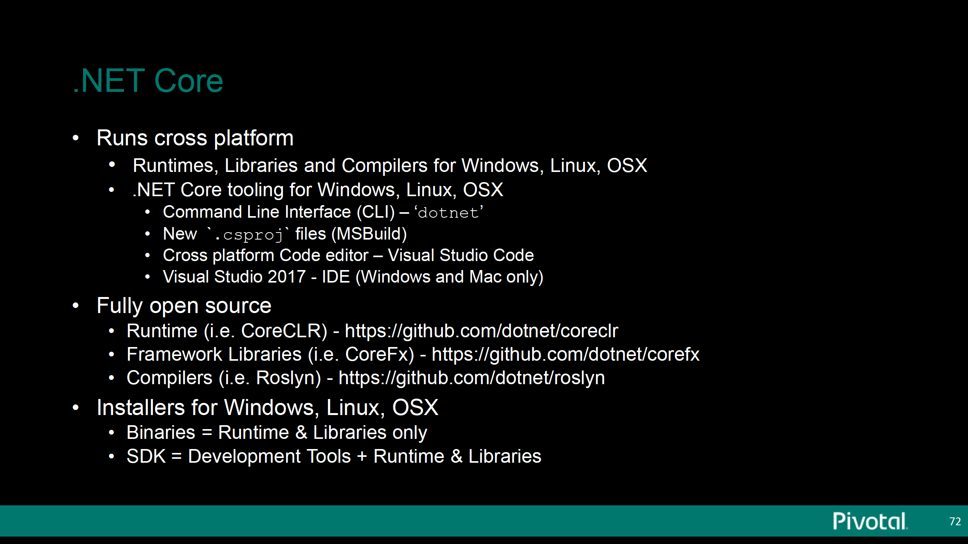
Notes:
.net ore is completely open source
it comes with

Slide 6
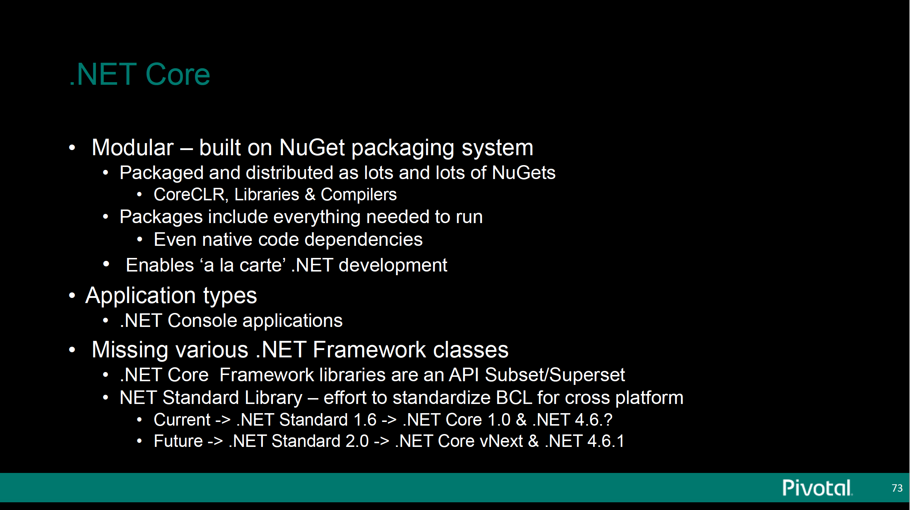
Notes:
It is very modular. .net core is all packages as nuget packages. You can also package up native dependencies
In .net core everything is a console application
With .net 1.1 sdk you only run console app. You need .net framework 1.4.x to run
In .net core everything comes as part of one sdk.

Slide 7
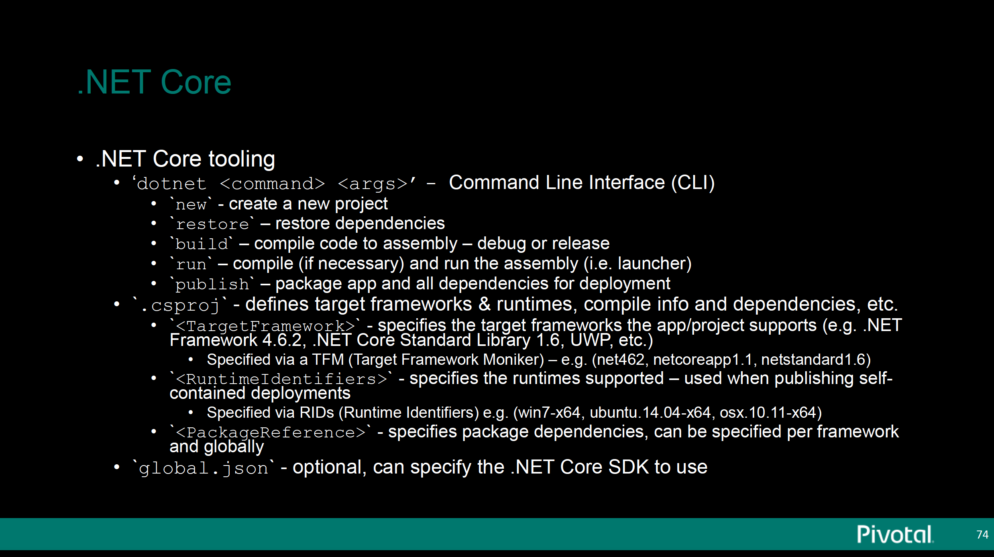
Notes:
New tooling in .net core
There is a new project file called csproj
You can specify target framewor –core or legacy
Runtime – Windows

Slide 8
Notes:
Different kinds of publishing options
Self-contained app
Portable app
Don’t get .netcore and asp.net core they are very diferent

Slide 9
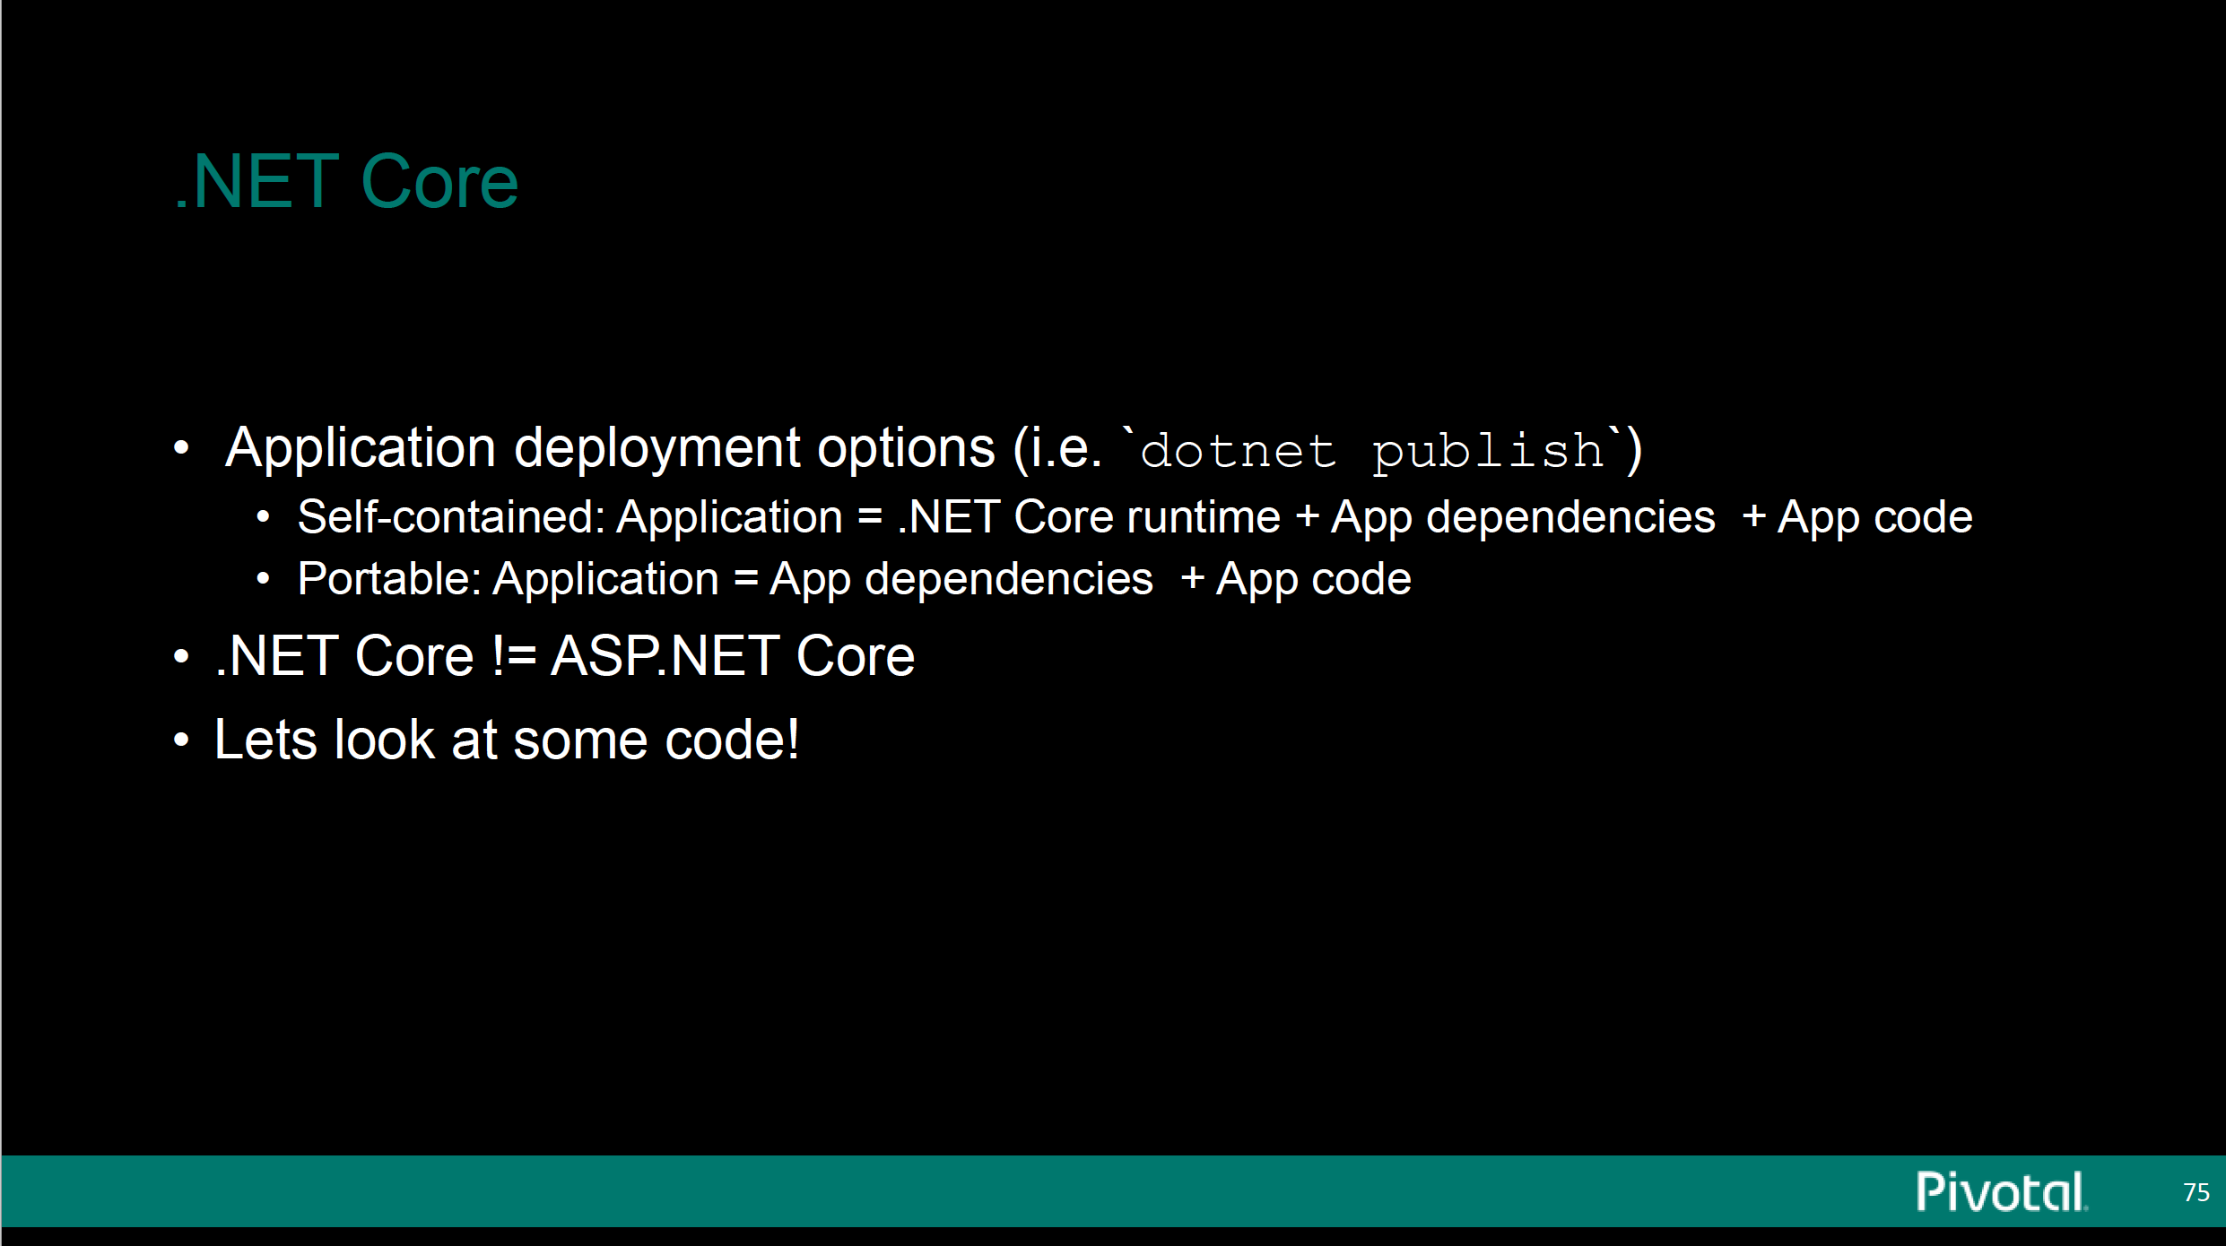
Notes:
Different kinds of publishing options
Self-contained app
Portable app
Don’t get .netcore and asp.net core they are very diferent

Slide 10
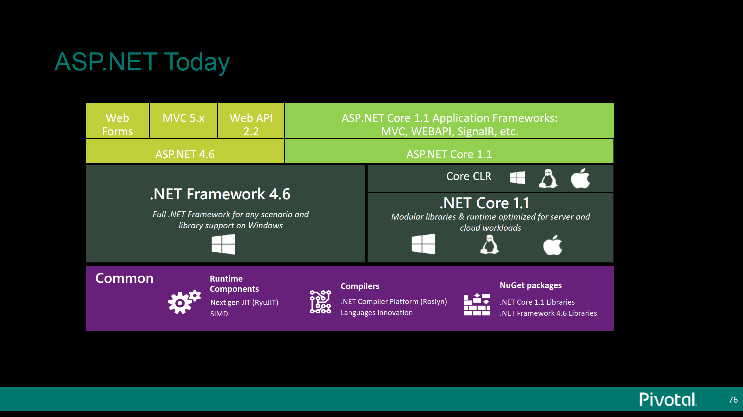
Notes:
Where does steel toe fit.

Slide 11
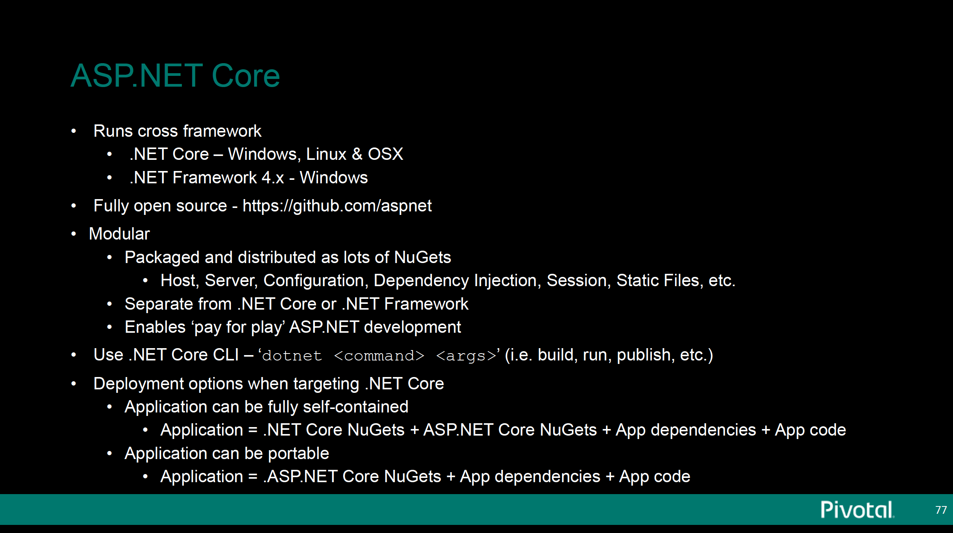
Notes:
Just like dotnet we have 2 version asp.net
ASP.net legcy 4.6.x and asp.net core (1.1)
This runs cross framework – can run legacy .net framework and core clr
Asp.ent
The beauty is if your app has libraries that depned on asp.net 4.x, your asp.net core app can run on both frameworks

Slide 12
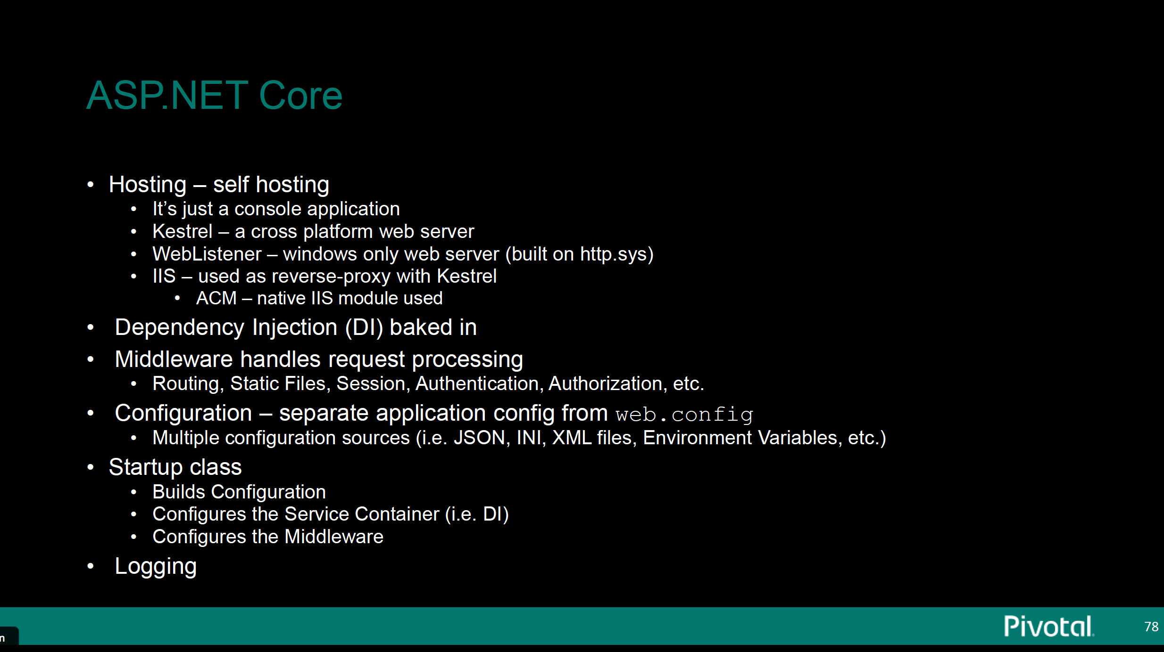
Notes:
Asp.net core allows for self-hosting
IIS is no longer required for asp.net app. IIS doesn’t exist in linux and osx. IIS when used is used as reverse proxy – they have moved away from IIS
It is a simple console app
2 web servers
DI is core to asp.net and it is pluggable (you can swap with other implementations.)

