Slide 1
Biometric Authorization for Building Security
Brian Murphy
linkedin.com/in/brianmurphy94
bpm9231@nyu.edu
Brian Murphy
Notes:
Welcome

Slide 2
Overview
Confidentiality of Building Access
Solution
Man vs. Machine
Results
Future work
linkedin.com/in/brianmurphy94
bpm9231@nyu.edu
BM
Notes:
Flow:
Problem- breaches affect lives. Existing methods rely on cameras, scanners, etc. which can be beaten. In comes biometrics.
-Related Research on biometrics, one non. Limits of each.
Solution-introduce gait analysis/recognition, why it works, how. Questions- Are models accurate? Are machines better than humans for this?
Datasets and existing research on it. Now we need to compare this to humans
Experiment setup-
used CASIA-B to make 27 gifs, 9 each from bg, cl, and nm.
Made a HTML,CSS, JS replit FE to allow human subject interaction, and a Flask API to get data from it. Used fetch to link them
Results
Out of X people, sort by the types. Overall scored Y. Anything that was interesting
Future Work-
Pick dataset with more varied images/subjects- people had issues telling them apart. Consider color recordings
During testing, had to go from 9 to 6 images due to overload. Make FE cleaner, users had difficulty telling what they were doing, prompting edits during.
Build machine learning models myself, using the same data subset as humans exposed to
Other
Wrap
Promote, link to GitHub repos, replits

Slide 3
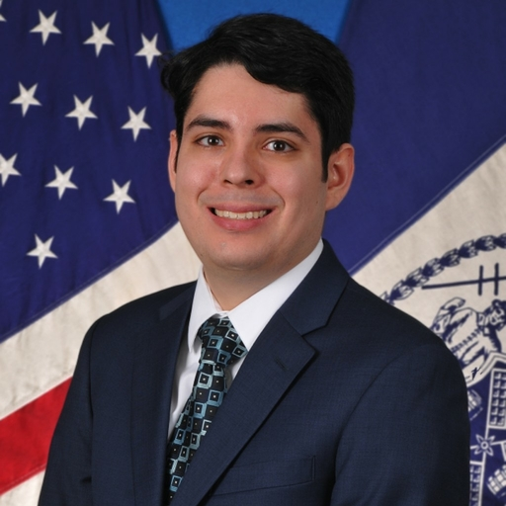



Who am I?
Brian Murphy, Staff Analyst, NYC Gov
5 years of service
Information Technology Officer for ACES
Back-end Developer, tech enthusiast
NYU MS in Cybersecurity Cyber Fellow
LinkedIn: https://www.linkedin.com/in/brianmurphy94/
linkedin.com/in/brianmurphy94
bpm9231@nyu.edu
BM
Notes:
Self introduction

Slide 4

Confidentiality of Building Access- Problem
High attacker reward, high organization risk
Common solutions have issues
Impersonation, broken scanners
Long
Biometrics
linkedin.com/in/brianmurphy94
bpm9231@nyu.edu
BM

Slide 5

Biometric and Alternative Solutions
Voice Recognition
Many samples needed
High turnover orgs
Recording attacks
Fingerprint Scanners
Gathering
Lines
ECG Card
Gathering
Mentality dependent
RFID Cards
Physical card, reproduction
linkedin.com/in/brianmurphy94
bpm9231@nyu.edu
BM
Notes:
Voice- 100% accuracy.
-sampling, not appropriate for high turnover orgs
-Recording attacks
Fingerprint- unique, not a physical item
-Gathering, lines at scanner
ECG- unique, even if stolen can’t be reused
Gathering privacy concerns, temperamental
RFID- okay fine so lets use an RFID.

Slide 6

Gait Analysis and Recognition
Gait is unique
Questions:
Can models be accurate?
Are they better than humans?
Hypothesis
linkedin.com/in/brianmurphy94
bpm9231@nyu.edu
BM
Notes:
Machine learning models can be built
Non-intrusive gathering
Nothing carried to attack

Slide 7
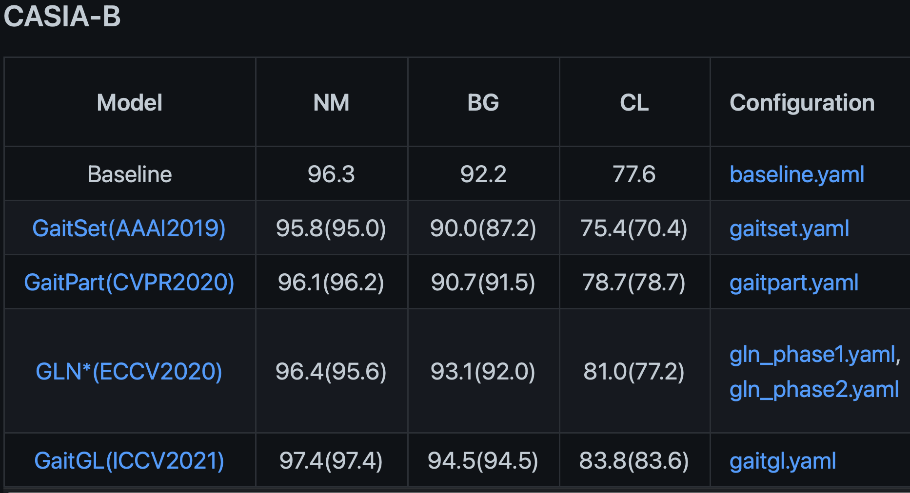
Can they be accurate?
Short answer: yes
Institute of Automation, Chinese Academy of Science CASIA sets
Research
CASIA-B
Are they better than humans?
linkedin.com/in/brianmurphy94
bpm9231@nyu.edu
BM

Slide 8
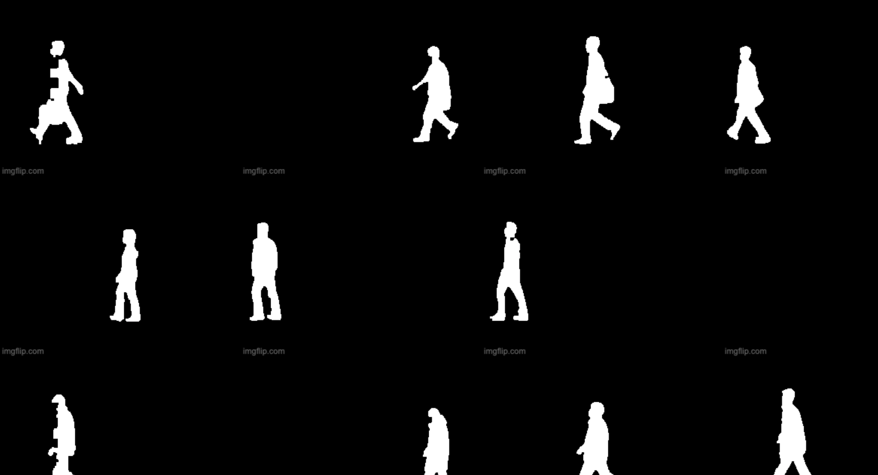
Setup
Subset of CASIA-B silhouettes
Imgflip
Experiment
Show authorized persons
Show random gifs
Subjects identify
Replit
linkedin.com/in/brianmurphy94
bpm9231@nyu.edu
BM

Slide 9
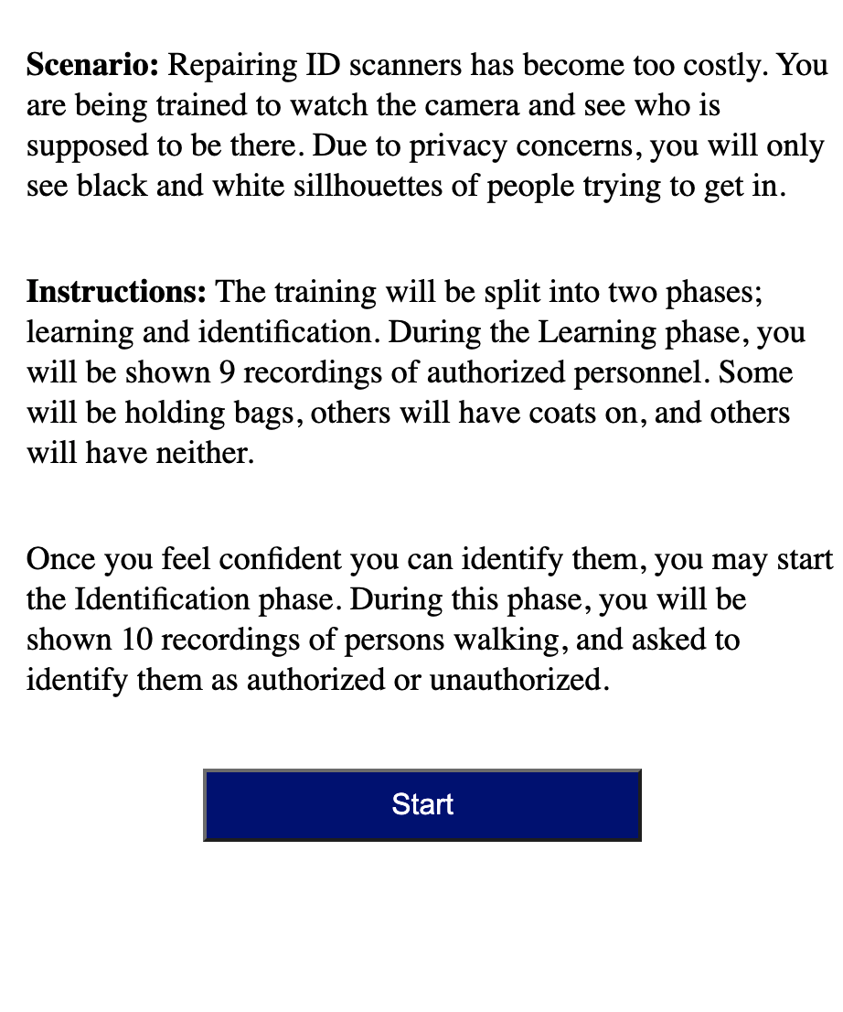
Implementation
repl.it- FE and BE API
HTML,CSS, JS to show gifs
Instructions
linkedin.com/in/brianmurphy94
bpm9231@nyu.edu
BM

Slide 10
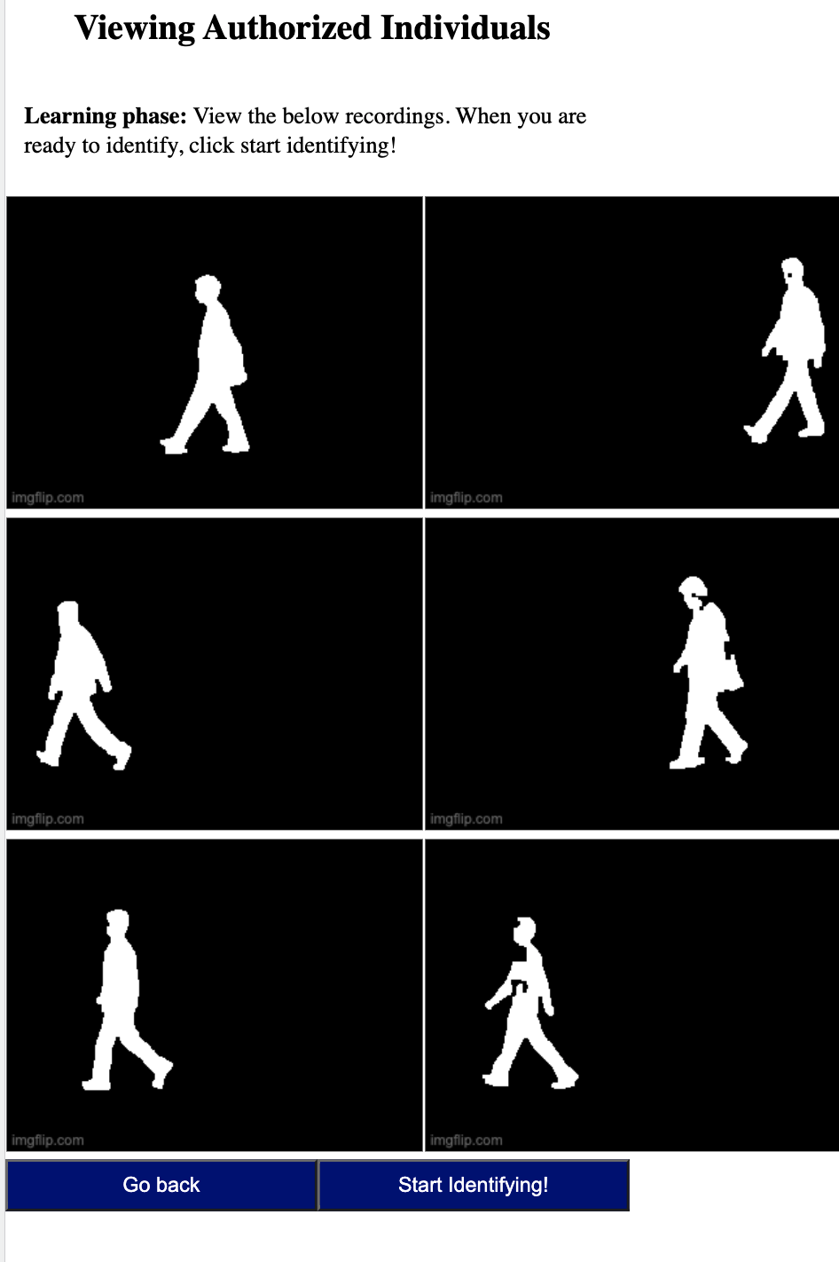
Implementation
repl.it- FE and BE API
HTML,CSS, JS to show gifs
Instructions
6 or 9 authorized shown
linkedin.com/in/brianmurphy94
bpm9231@nyu.edu
BM

Slide 11
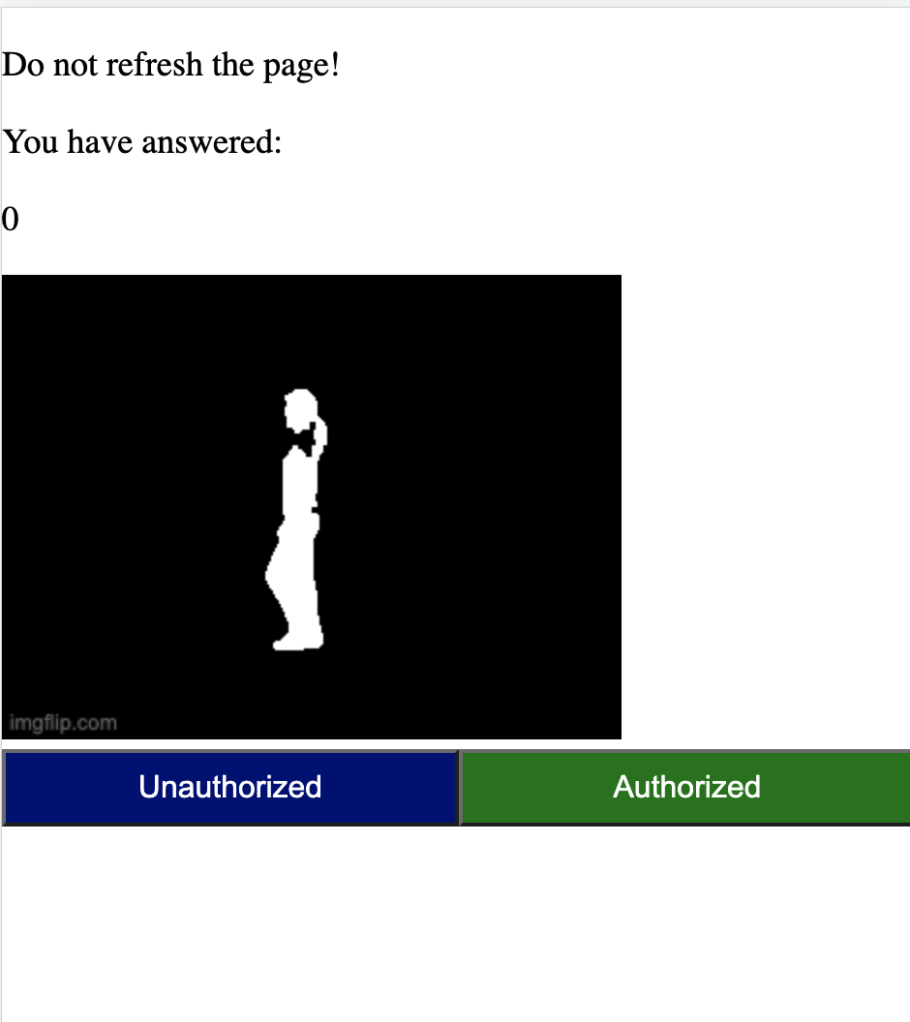
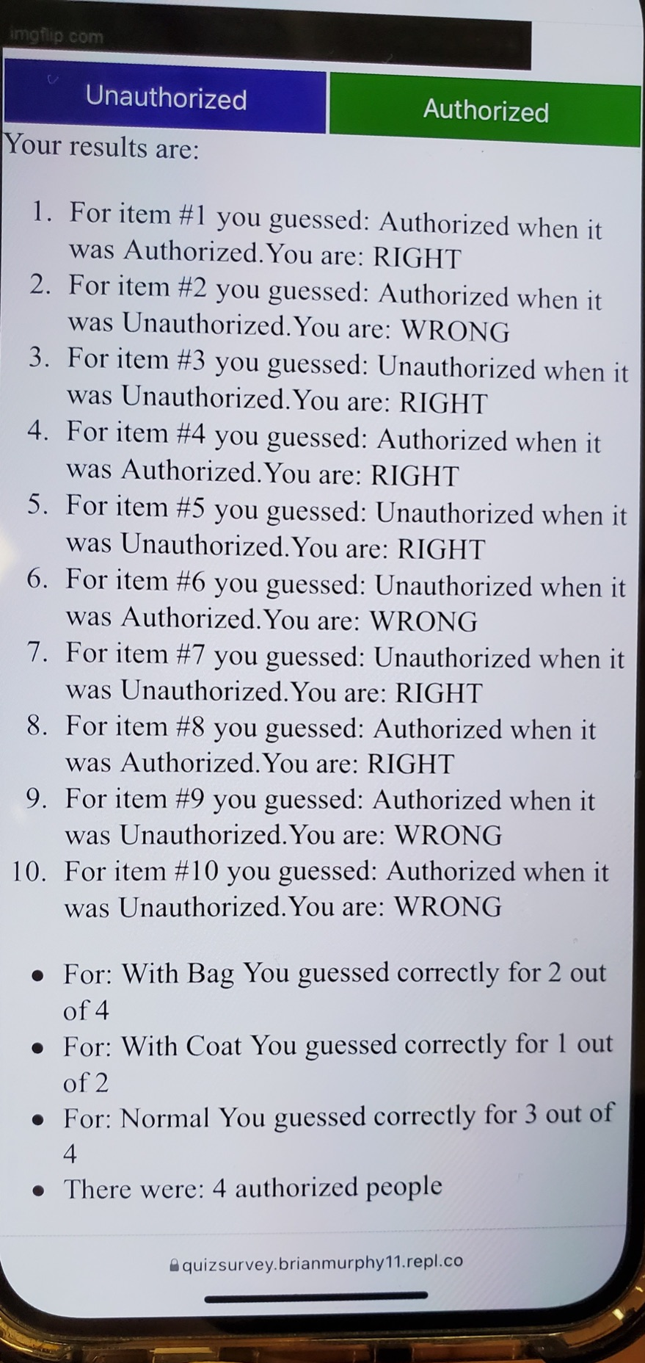
Implementation
repl.it- FE and BE API
HTML,CSS, JS to show gifs
Instructions
6 or 9 authorized shown
Show gif, identify
Show results at the end
Data pushed to a Flask API, also on repl.it
linkedin.com/in/brianmurphy94
bpm9231@nyu.edu
BM

Slide 12
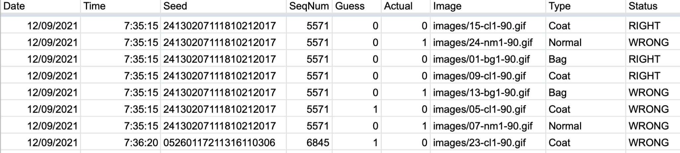
Results
linkedin.com/in/brianmurphy94
bpm9231@nyu.edu
BM

Slide 13
Results
Results by type of gif
Results by end result
 | Right |  | Wrong |  | Grand Total
Type | Number | Percentage | Number | Percentage | Number | Percentage
Bag | 26 | 28.89% | 40 | 37.74% | 66 | 33.67%
Coat | 30 | 33.33% | 24 | 22.64% | 54 | 27.55%
Normal | 34 | 37.78% | 42 | 39.62% | 76 | 38.78%
Total | 90 | 100.00% | 106 | 100.00% | 196 | 100.00%
Status | Bag | Coat | Normal | Grand Total
RIGHT | 39.39% | 55.56% | 44.74% | 45.92%
WRONG | 60.61% | 44.44% | 55.26% | 54.08%
Grand Total | 100.00% | 100.00% | 100.00% | 100.00%
linkedin.com/in/brianmurphy94
bpm9231@nyu.edu
BM

Slide 14
Future Work
Fixing issues
Data Issues
Similar, use different sets
Could have tracked more
Technical Issues
Glitches
Unable to test locally
Replit sleep
User Issues
Too similar!
Cheating
Understanding and accessibility
User
Data
Technical
linkedin.com/in/brianmurphy94
bpm9231@nyu.edu
BM
Notes:
Accessibility- buttons, hard to read
Understanding- many weren't sure what they were doing. One thought he was checking for bombs at the TSA, and stopped everyone with bags

Slide 15
Acknowledgements and References
[1] S. Mohamed and W. Martono, "Design of Fusion Classifiers for Voice- Based Access Control System of Building Security," 2009 WRI World Congress on Computer Science and Information Engineering, 2009, pp. 80-84, doi: 10.1109/CSIE.2009.983. J. Clerk Maxwell, A Treatise on Electricity and Magnetism, 3rd ed., vol. 2. Oxford: Clarendon, 1892, pp.68–73.
[2] F. Zeng et al., "Biometric Electrocardiogram Card for Access Control System," 2011 Fifth International Conference on Genetic and Evolutionary Computing, 2011, pp. 373-376, doi: 10.1109/ICGEC.2011.92.
[3] R. T. Hans, "Using a biometric system to control access and exit of vehicles at Tshwane University of Technology," 2014 International Conference on Computer, Communications, and Control Technology (I4CT), 2014, pp. 230-233, doi: 10.1109/I4CT.2014.6914180.
[4] P. V. Bindu, K. D. Al-Hanawi, A. M. Al-Abri and V. Mahadevan, "IoT Based Safety System for School Children: A Contactless Access Control for Post Covid School Conveyance," 2021 2nd International Conference for Emerging Technology (INCET), 2021, pp. 1-4, doi: 10.1109/INCET51464.2021.9456314.
[5] H. Chao, K. Wang, Y. He, J. Zhang and J. Feng, "GaitSet: Cross-view Gait Recognition through Utilizing Gait as a Deep Set," in IEEE Transactions on Pattern Analysis and Machine Intelligence, doi: 10.1109/TPAMI.2021.3057879.
[6] C. Fan et al., "GaitPart: Temporal Part-Based Model for Gait Recognition," 2020 IEEE/CVF Conference on Computer Vision and Pattern Recognition (CVPR), 2020, pp. 14213-14221, doi: 10.1109/CVPR42600.2020.01423.
https://ieeexplore-ieee-org.proxy.library.nyu.edu/document/5170665
https://ieeexplore-ieee-org.proxy.library.nyu.edu/stamp/stamp.jsp?tp=&arnumber=6042804&isnumber=6042702
https://ieeexplore-ieee-org.proxy.library.nyu.edu/stamp/stamp.jsp?tp=&arnumber=6914180&isnumber=6914123
https://ieeexplore-ieee-org.proxy.library.nyu.edu/stamp/stamp.jsp?tp=&arnumber=9456314&isnumber=9456045
https://ieeexplore-ieee-org.proxy.library.nyu.edu/stamp/stamp.jsp?tp=&arnumber=9351667
https://ieeexplore-ieee-org.proxy.library.nyu.edu/stamp/stamp.jsp?tp=&arnumber=9156784
linkedin.com/in/brianmurphy94
bpm9231@nyu.edu
BM

Slide 16
Acknowledgements and References
OpenGait Authors:
Chao Fan (樊超), 12131100@mail.sustech.edu.cn
Chuanfu Shen (沈川福), 11950016@mail.sustech.edu.cn
Junhao Liang (梁峻豪), 12132342@mail.sustech.edu.cn
GLN: Saihui Hou (侯赛辉)
GaitGL: Beibei Lin (林贝贝)
https://github.com/ShiqiYu/OpenGait
Slide Images:
https://cliparting.com/free-building-clipart-27363/
https://engineering.nyu.edu/academics/programs/master-science
https://github.com/ShiqiYu/OpenGait
linkedin.com/in/brianmurphy94
bpm9231@nyu.edu
BM

Slide 17

Acknowledgements and References
NYU Tandon ISP Course Professors:
Paola Garcia, MS.
Brandon Sloane, MS.
Aspen Olmsted, Ph. D.
ISP TA’s
Roman Garber
Kiran Chaudhry
Alon Hillel-Tuch
Steven Angulo
Julio Nunez
linkedin.com/in/brianmurphy94
bpm9231@nyu.edu
BM

Slide 18
Wrap Up
Brian Murphy, Staff Analyst
My LinkedIn: https://www.linkedin.com/in/brianmurphy94/
GitHub Repo: https://github.com/bmurdata/ISP-Building-Security
Write-up link:
Thank you for watching! Questions?
Email or comment
linkedin.com/in/brianmurphy94
bpm9231@nyu.edu
BM

