Slide 1
WonderHop
Your comprehensive search tool to travel and exploration

Slide 2


Our Team - Group 20
Zamirah Morgan
Brian Murphy
Reporting Specialist by day
MS Cybersecurity student by night
Frontend developer for the weekend
Vacation planner
Analyst by day
MS Cybersecurity student by night
Backend developer for the weekend
Vacation stresser

Slide 3
Problem
Travel planning is hard
Finding inspiration is harder
Sharing travel plans often requires multiple websites

Slide 4
WonderHop Features
Search for travel destinations
Add budget, places by day, flights and dates, and itinerary
See other users trips
Share your own dream trips
Find weather and other details before you go

Slide 5
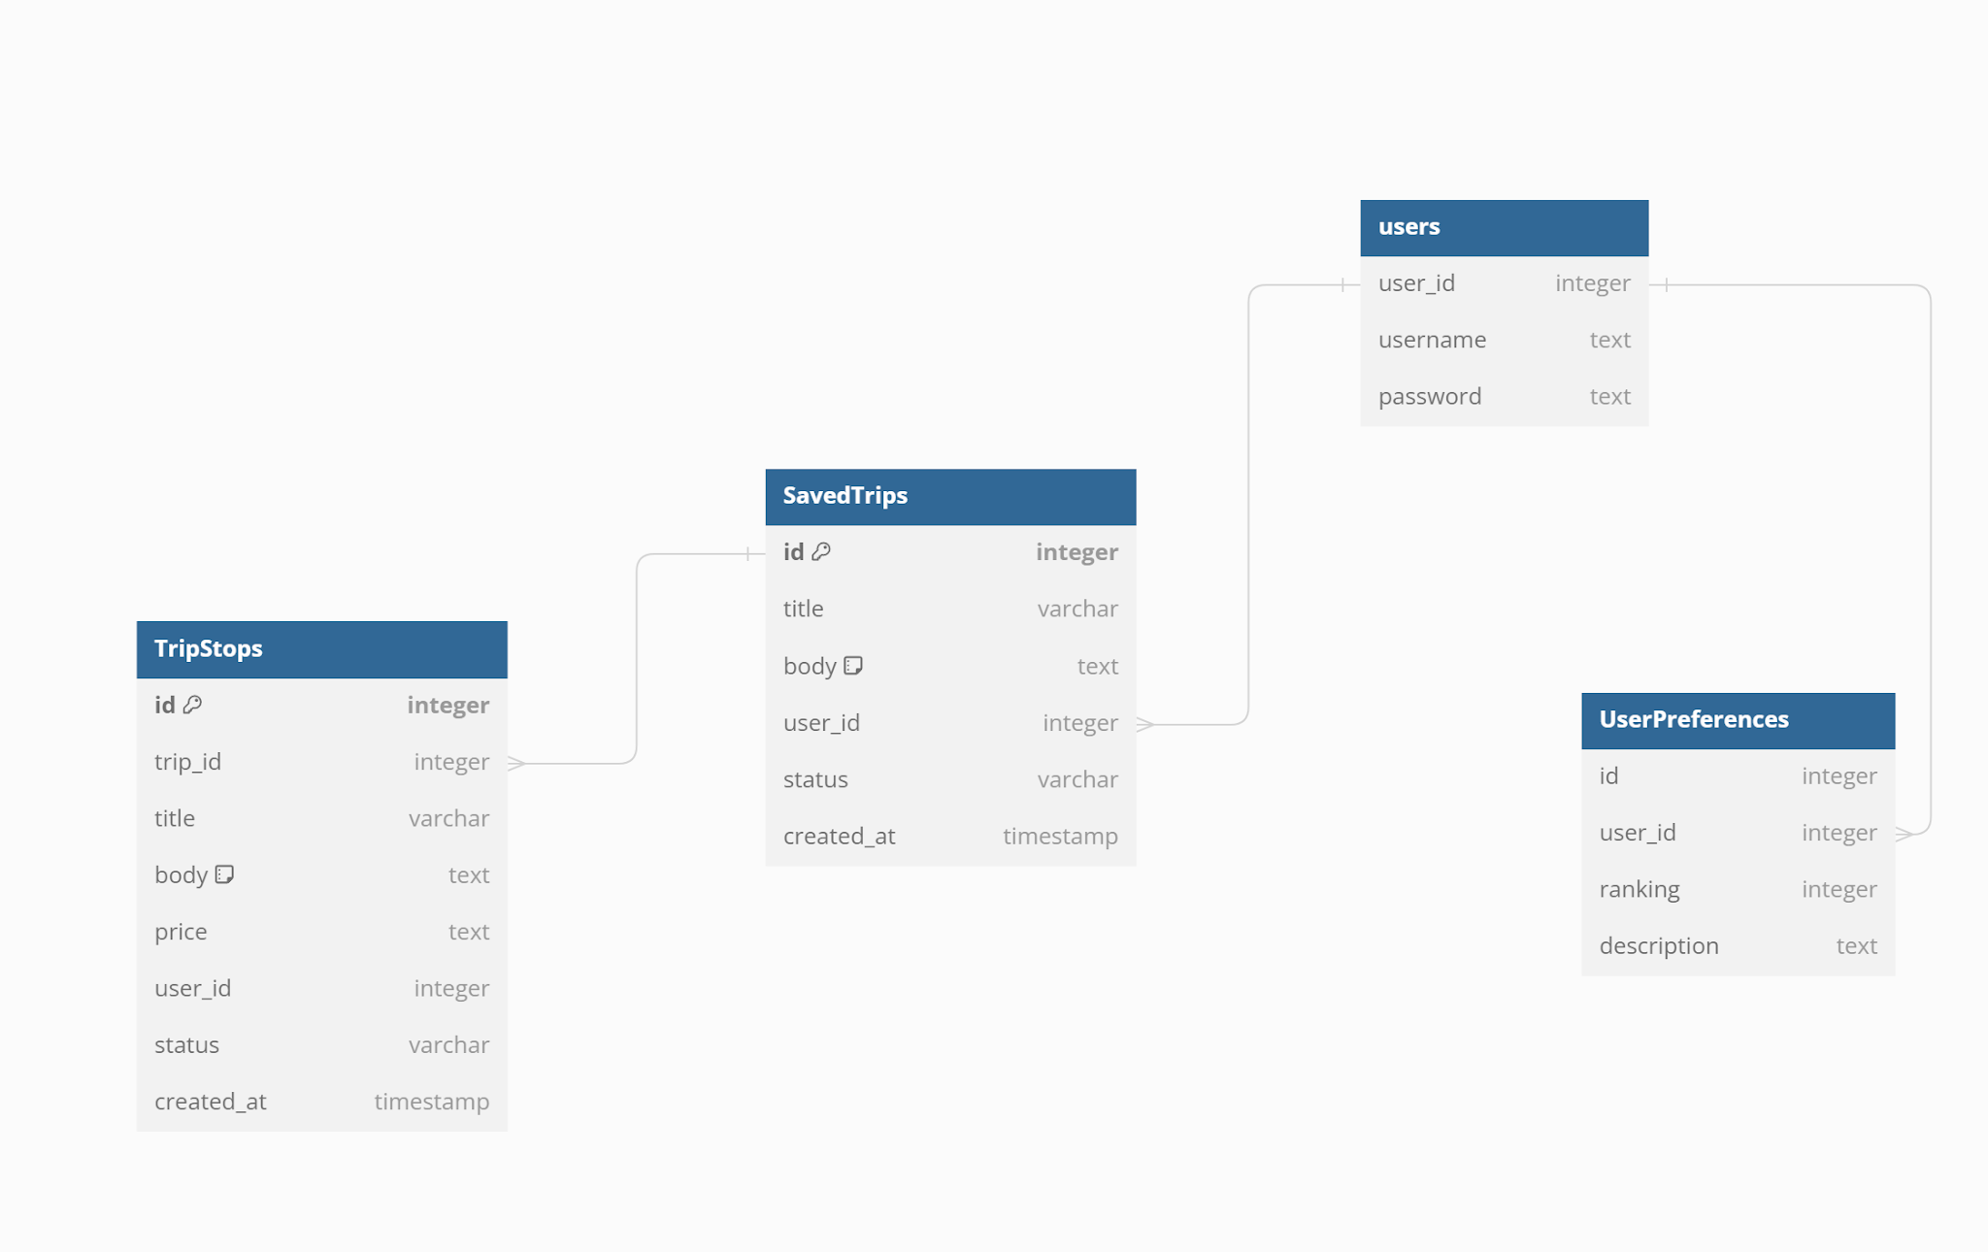
ERD

Slide 6
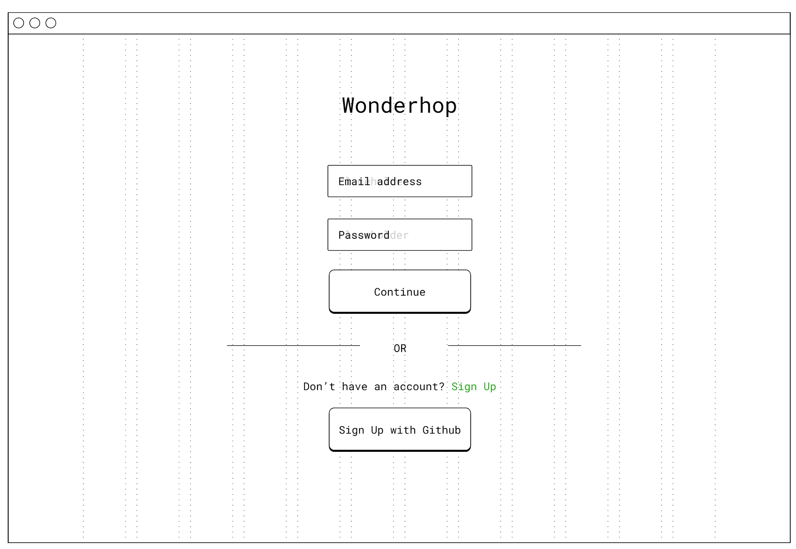
Login

Slide 7
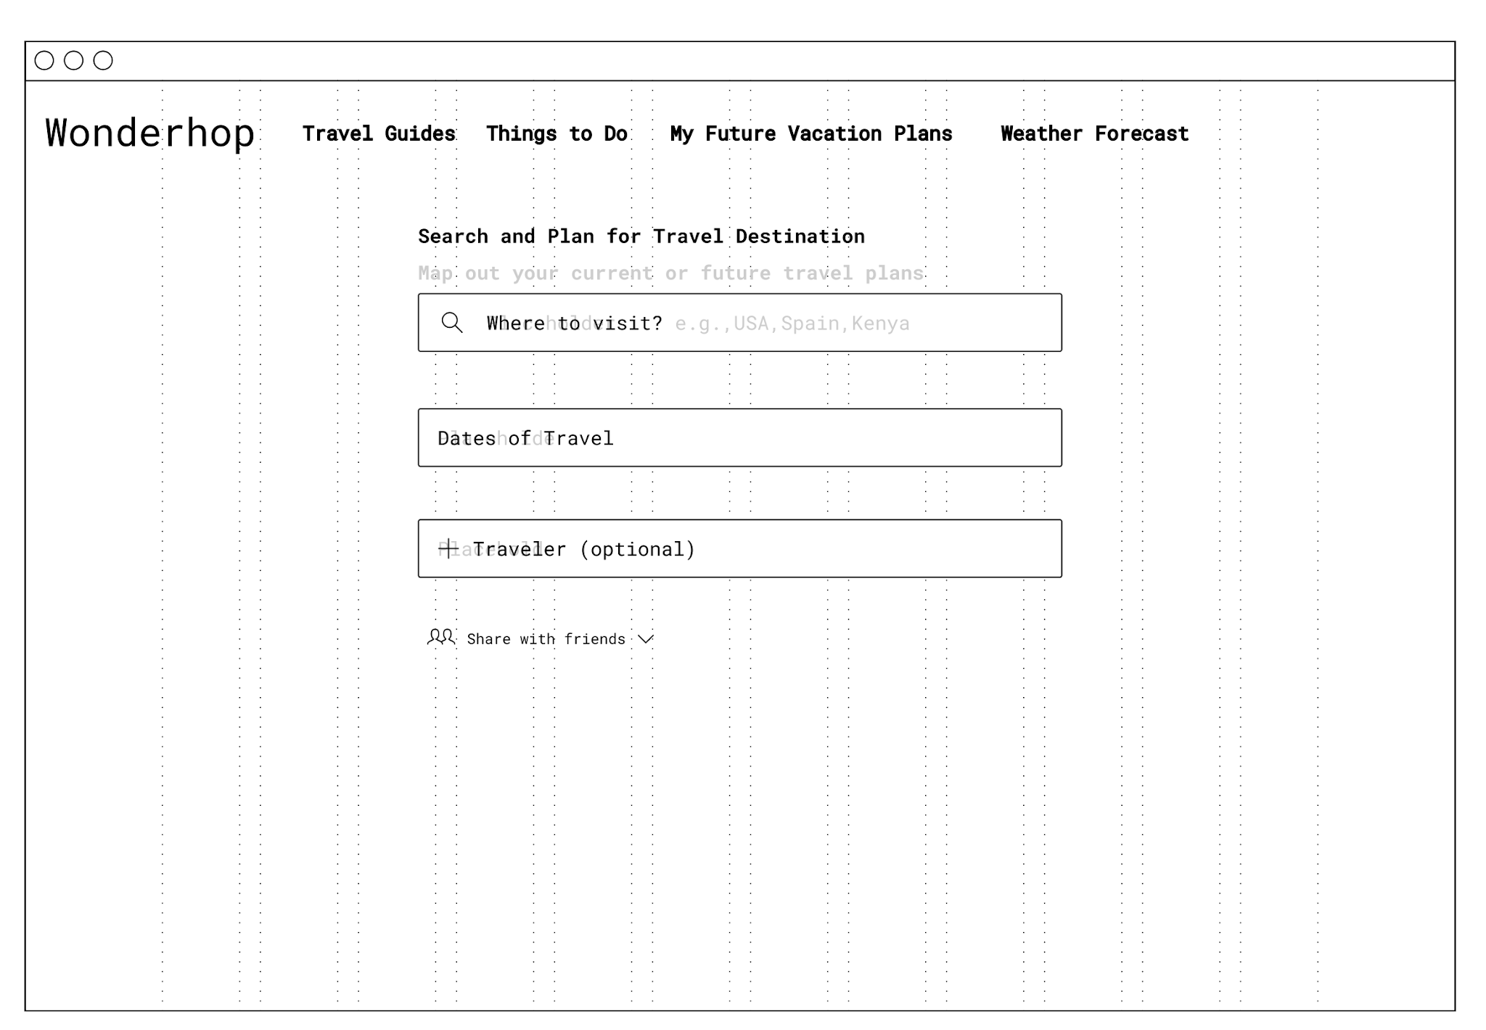
Search

Slide 8
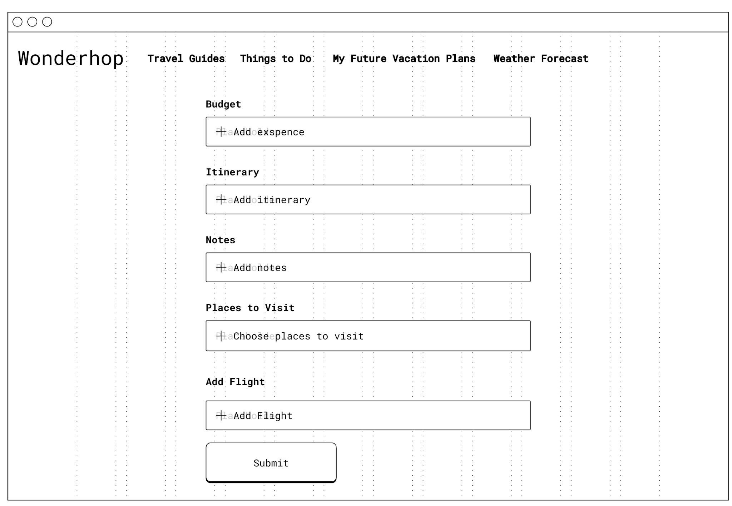
Filters

Slide 9
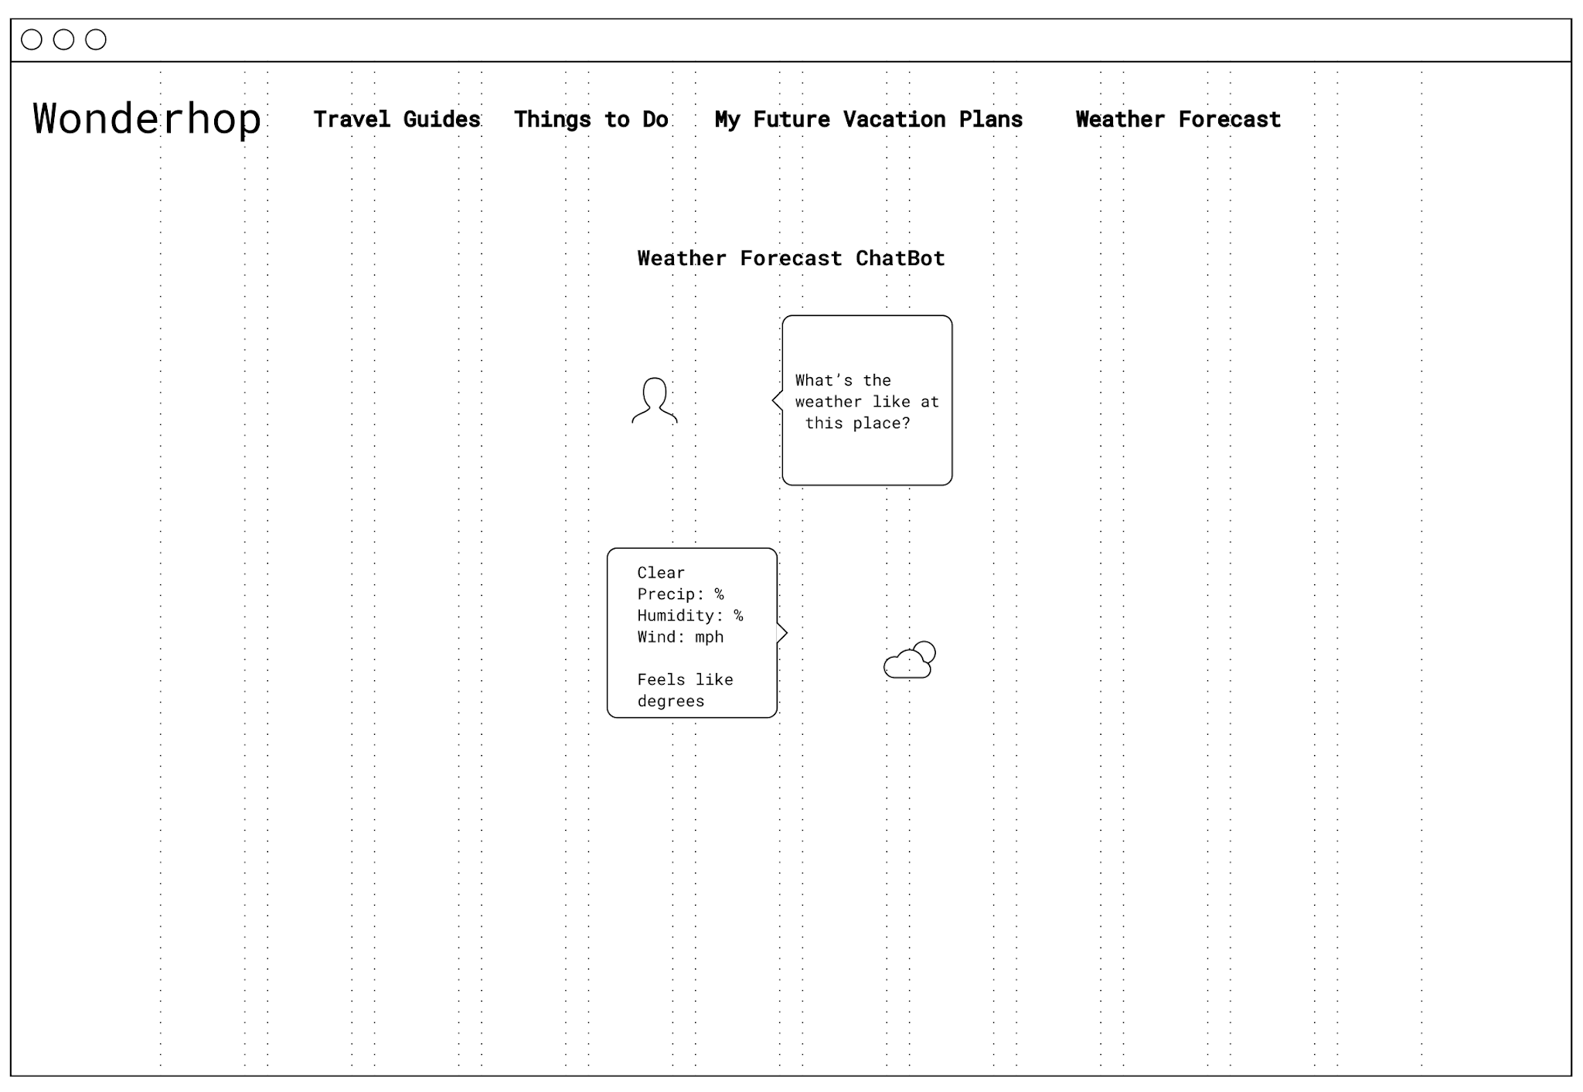
Chatbot

Slide 10
Plan
Build out frontend
Build a static backend, implement a API later
Link to a chatbot(stretch)

Slide 11
Possible Pain Points- Frontend
Build out frontend, ui/ux for design and user behavior
Integrating with the backend

Slide 12
Possible Pain Points-Backend
Finding an API to facilitate search
Building a chatbot, or finding one
Integrating with frontend

Slide 13
Conclusion
WonderHop makes travel planning and sharing easier than ever before

