Slide 1
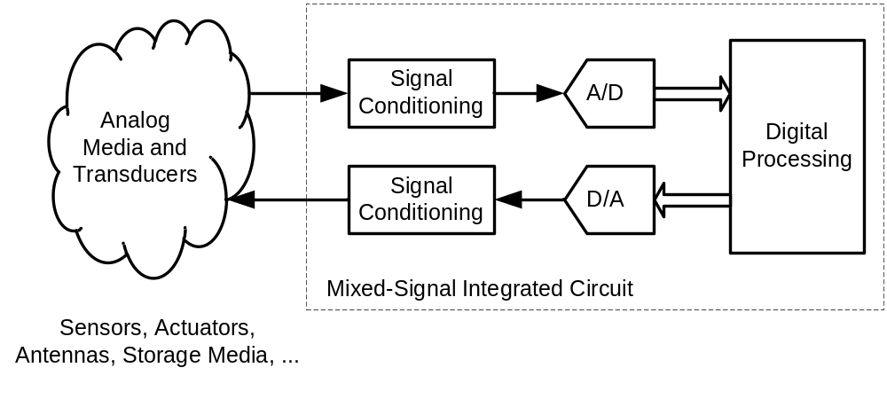
Figure 1-1

Slide 2
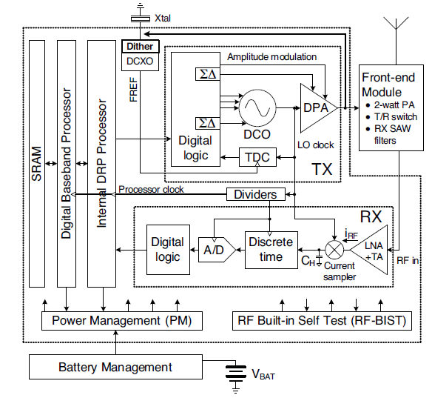
Figure 1-2

Slide 3
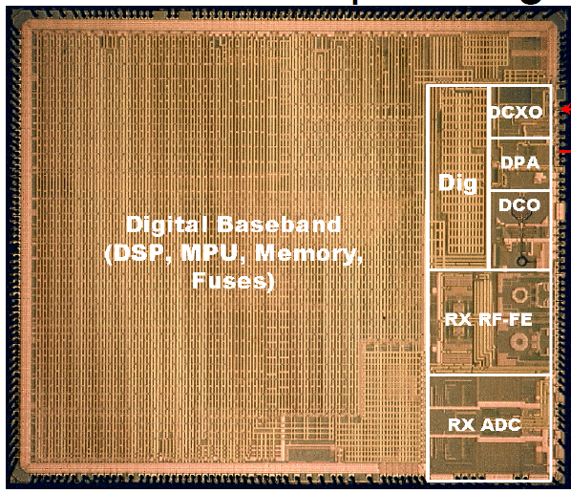
Figure 1-3

Slide 4
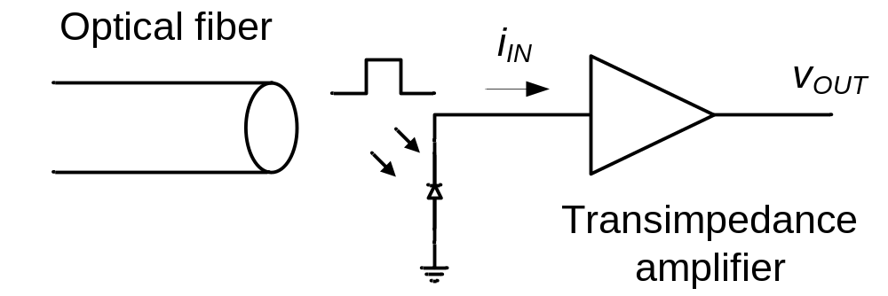
Figure 1-4

Slide 5
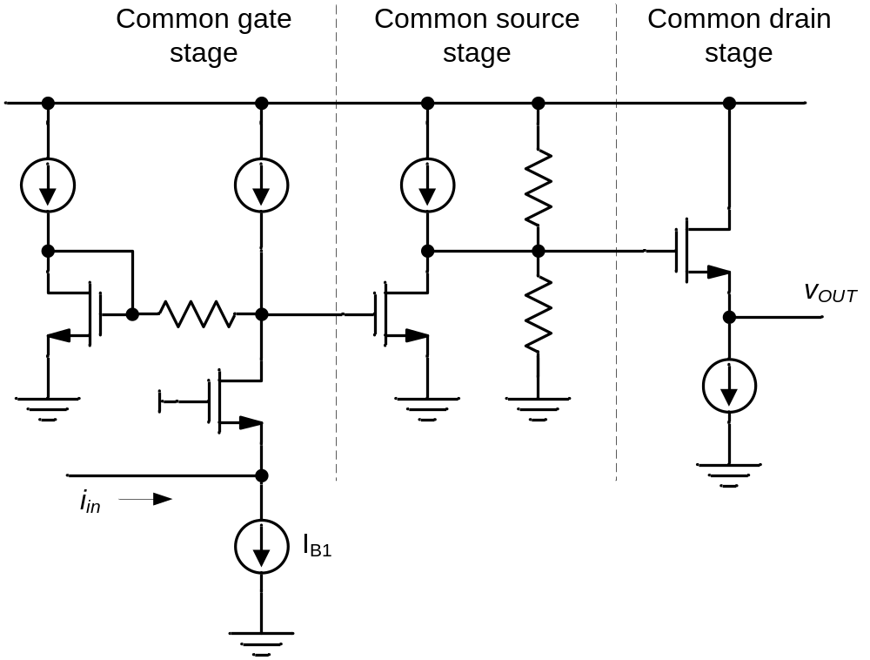
Figure 1-5

Slide 6
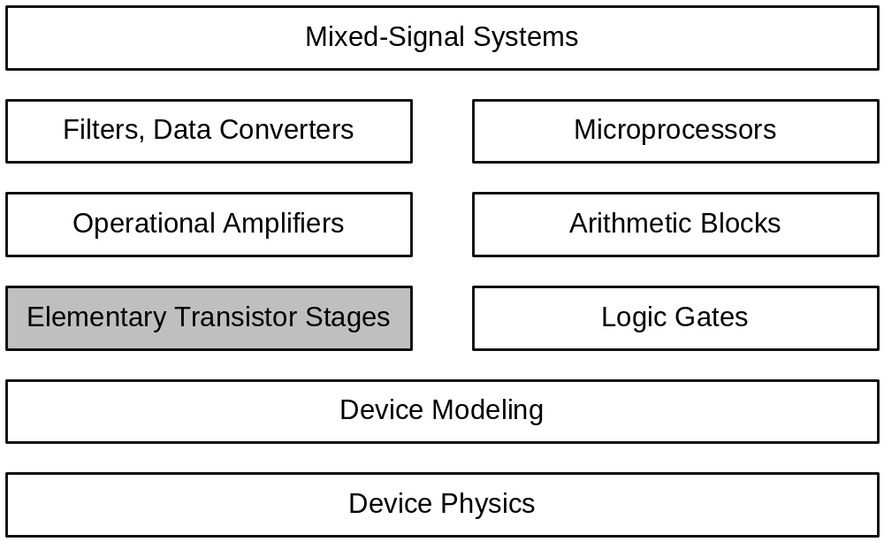
Figure 1-6
Analog
Digital

Slide 7
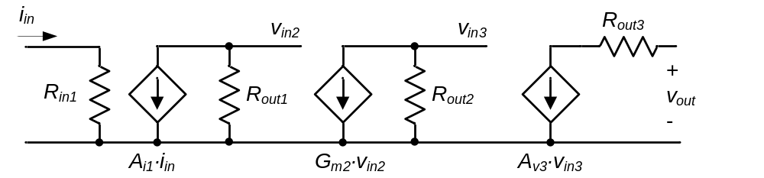
Figure 1-7

Slide 8
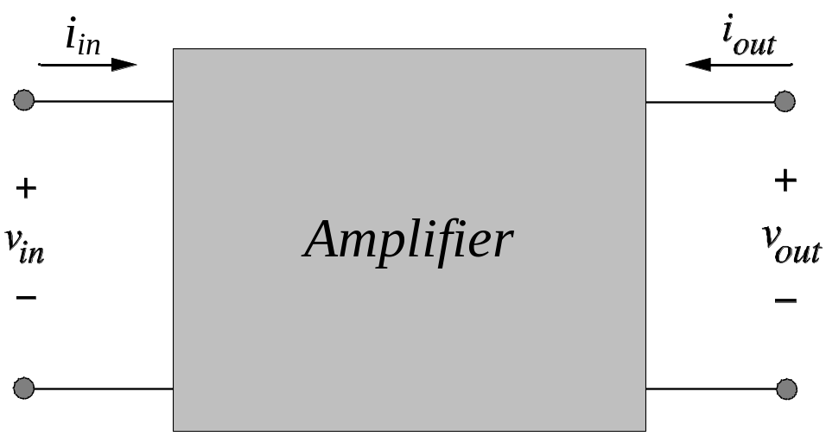
Figure 1-8

Slide 9
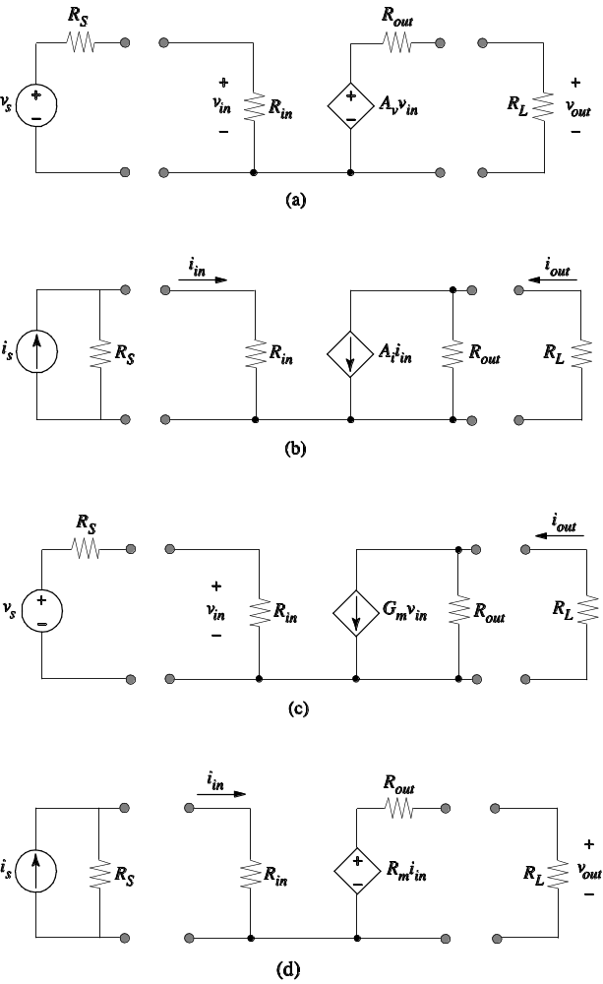
Figure 1-9
(Howe & Sodini, Figure 8.2)

Slide 10
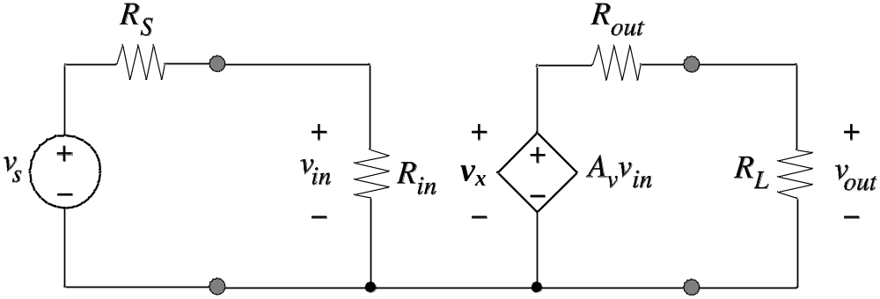
Figure 1-10

Slide 11
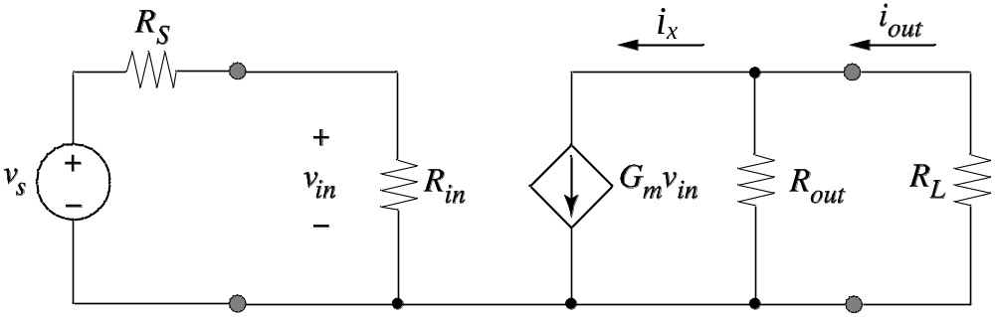
Figure Ex1-1
(Howe & Sodini, Figure 8.5)

Slide 12
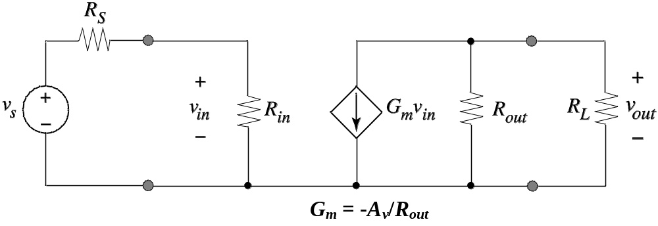
Figure 1-11

Slide 13
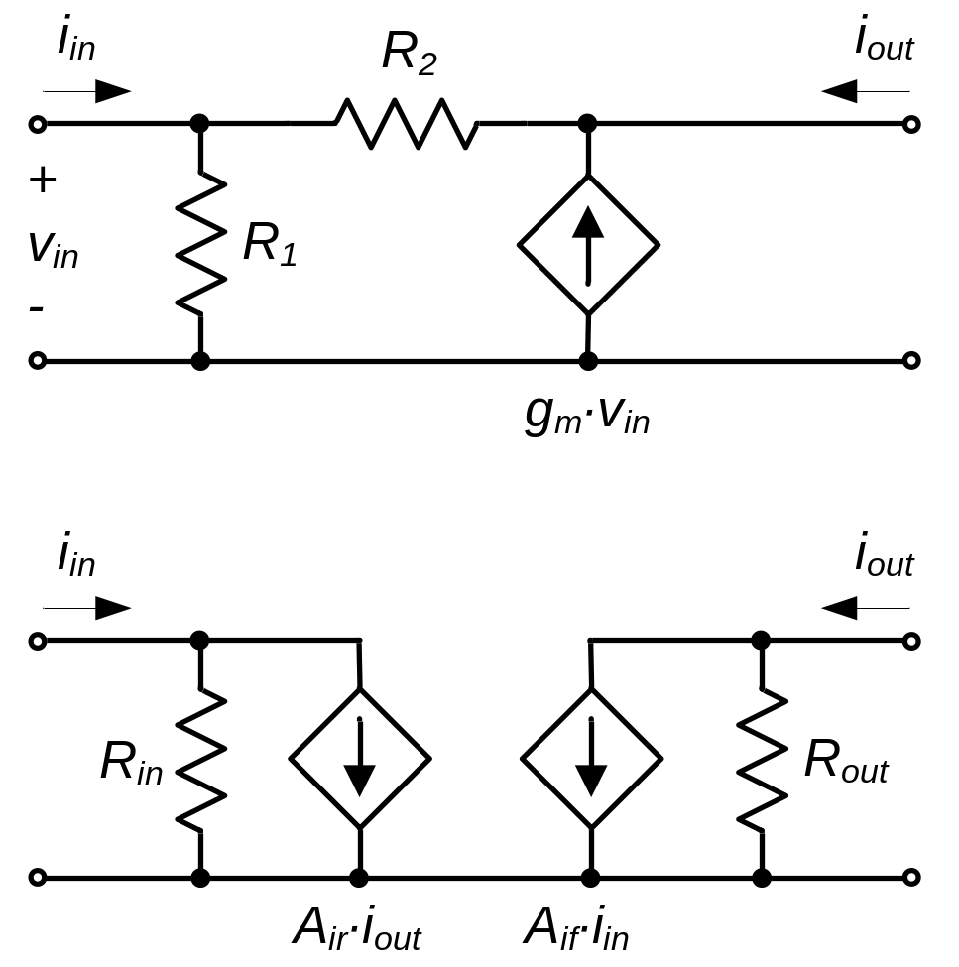
Figure 1-12
(a)
(b)

Slide 14
Figure Ex1-1
(Howe & Sodini, Figure 8.5)

Slide 15
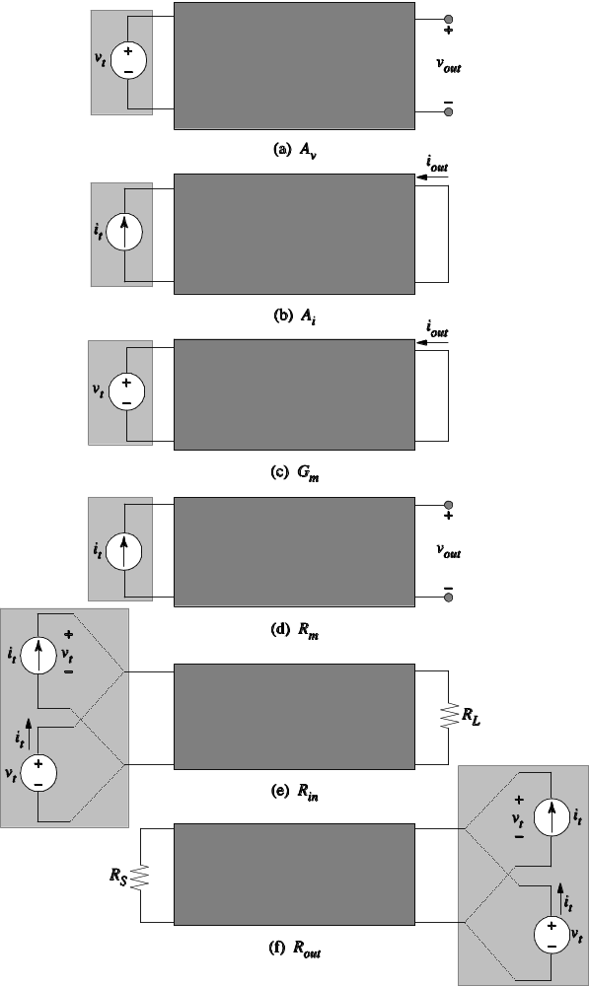
Figure 1-13
(Howe & Sodini, Figure 8.3)

Slide 16
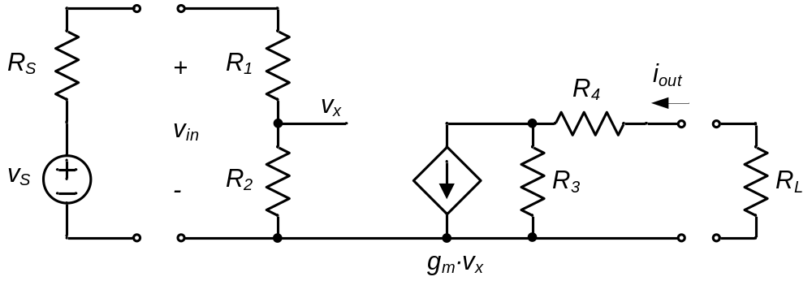
Figure Ex1-2

Slide 17
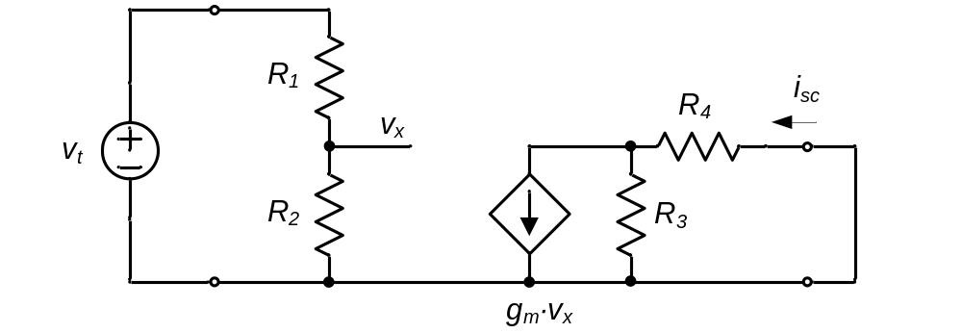
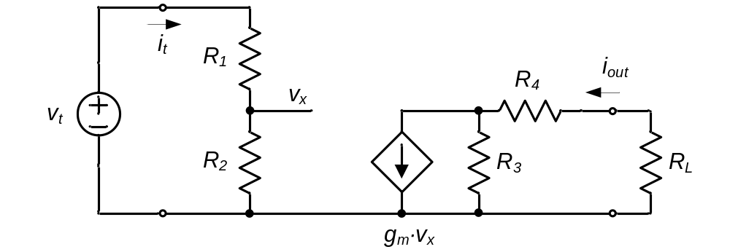
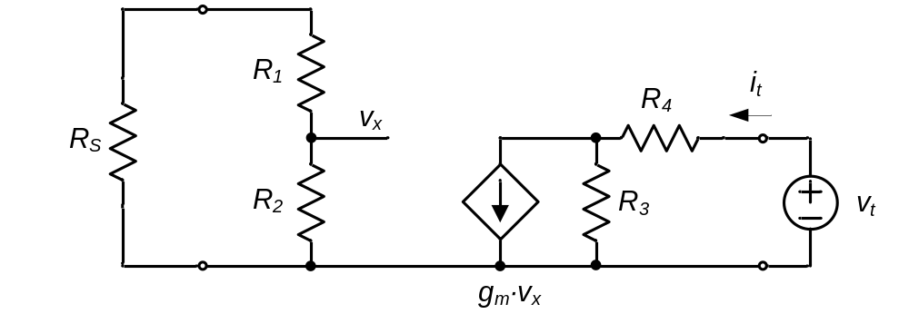
Ex1-2 (Solution)

Slide 18
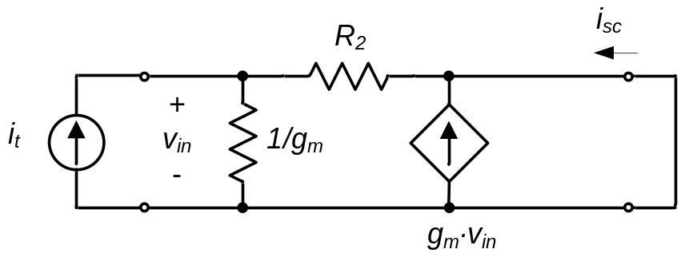
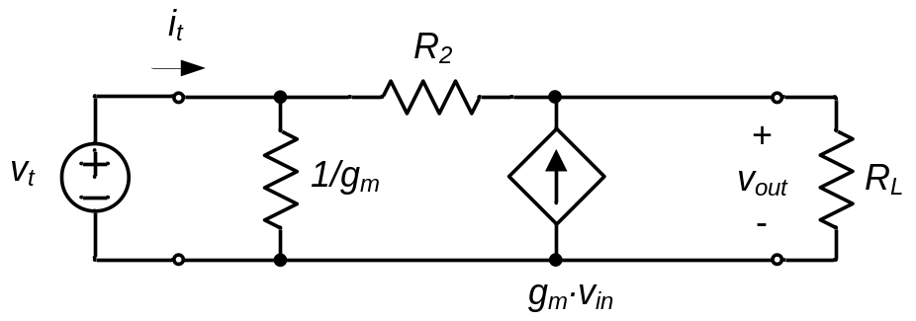
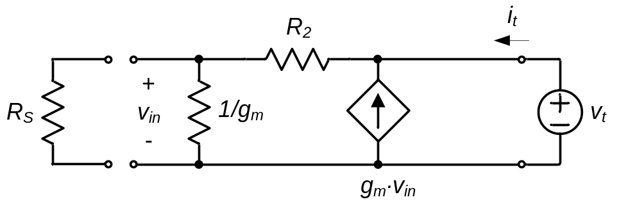
Ex1-3 (Solution)
(1)
(2)
(3)

Slide 19
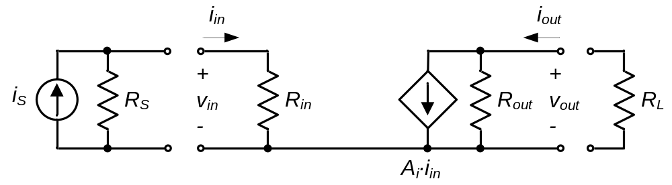
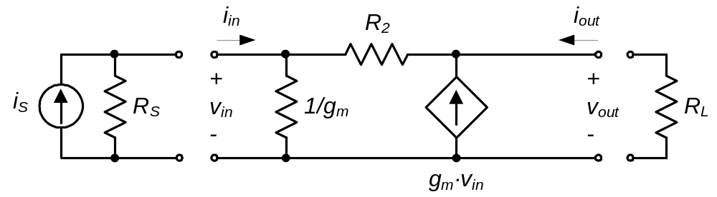
Ex1-3 (Solution)
(4)
(5)

Slide 20
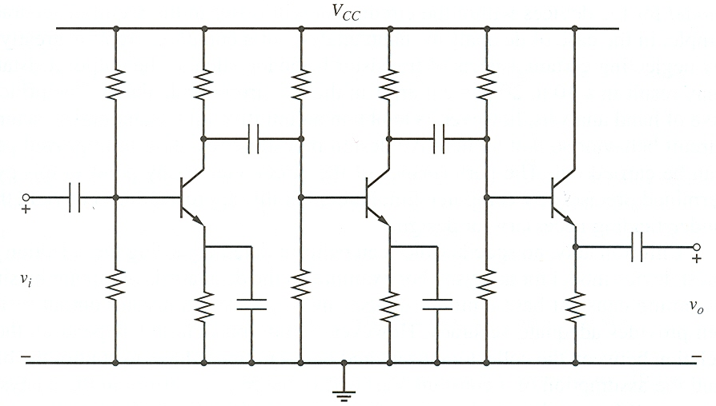
Figure 1-14

Slide 21
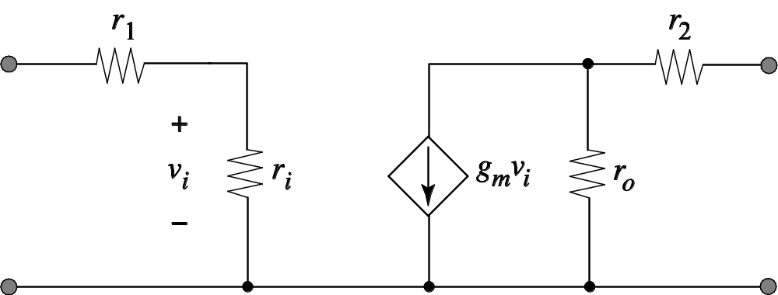
Figure P1-1

Slide 22
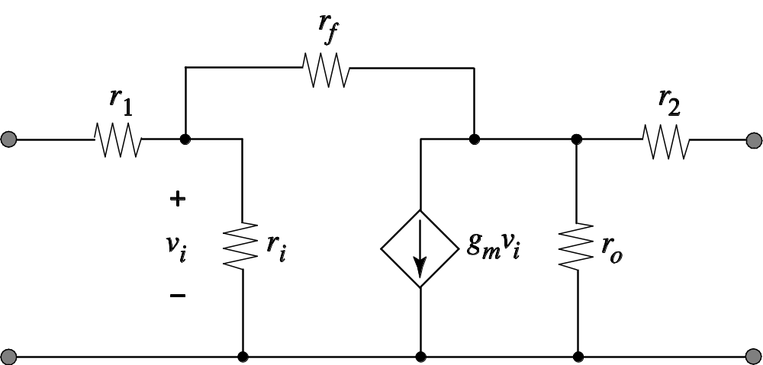
Figure P1-5

