Slide 1
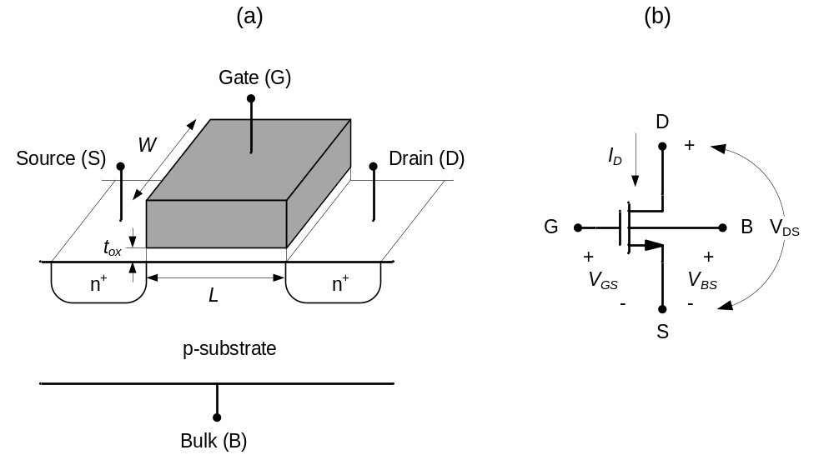
Figure 2-1

Slide 2
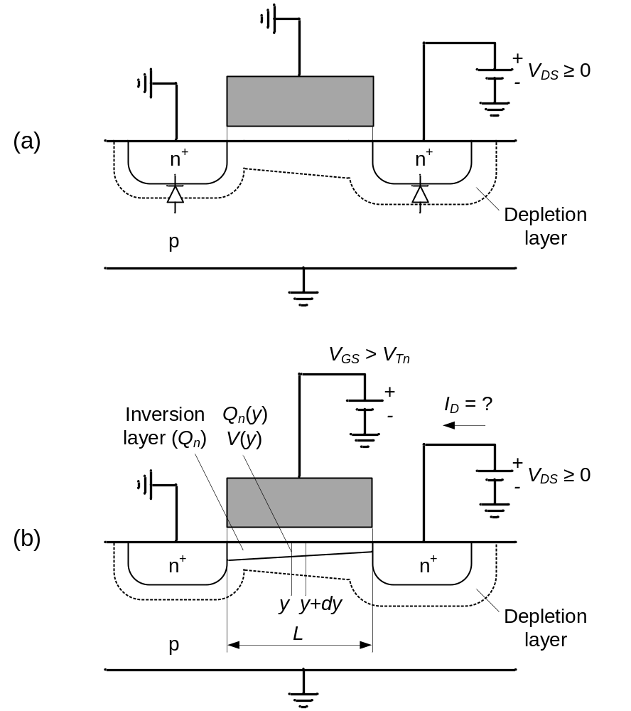
Figure 2-2

Slide 3
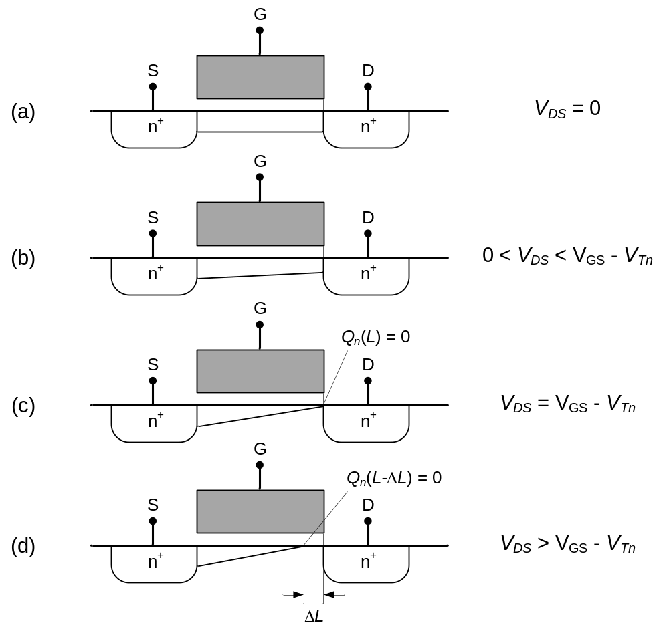
Figure 2-3

Slide 4
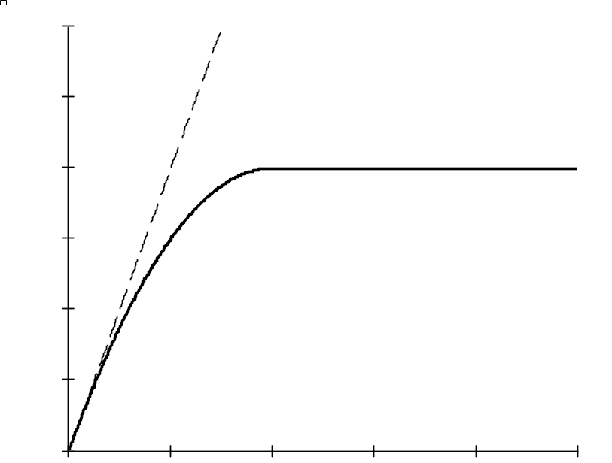
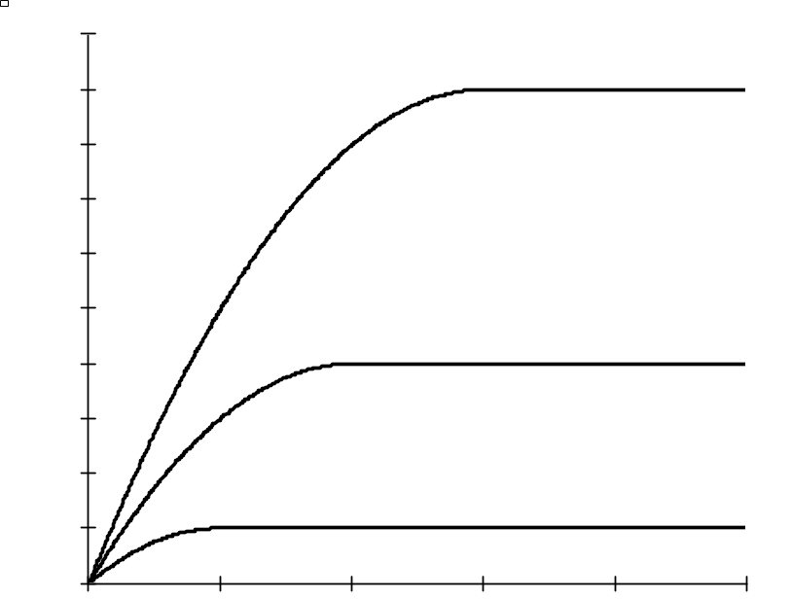
Figure 2-4
(a)
(b)
I_{D} [mA]
I_{D} [mA]
I_{D} = V_{DS}/R_{on}
V_{GS3} – V_{Tn} = 3V
2
1
V_{GS2} – V_{Tn} = 2V
Triode
Region
Saturation
Region
1
0.5
V_{GS1} – V_{Tn} = 1V
1
2
3
4
V_{DS} [V]
1
2
3
4
V_{DS} [V]
V_{DSsat}
V_{DSsat1}
V_{DSsat2}
V_{DSsat3}

Slide 5
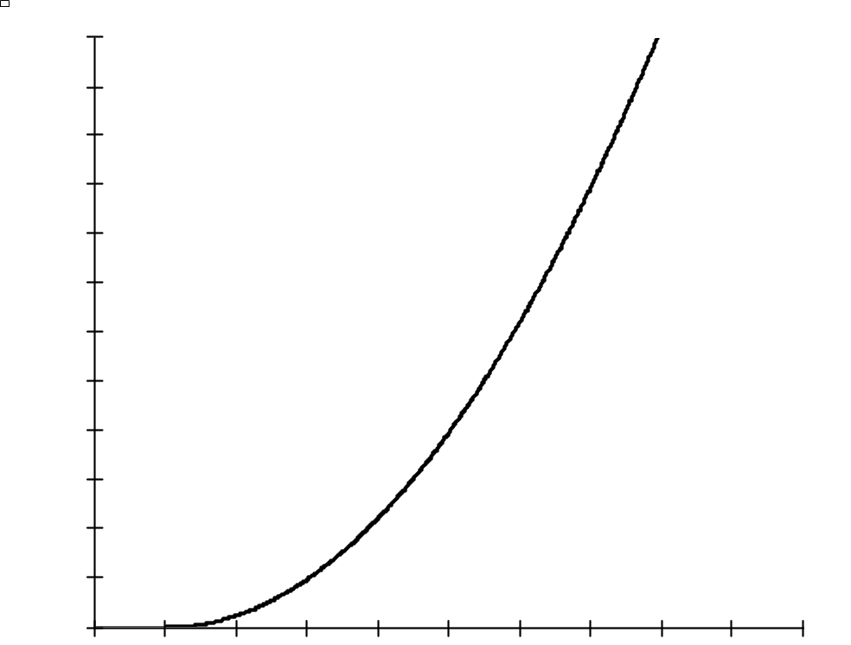
Figure 2-5
I_{D} [mA]
3
2
1
V_{GS} [V]
V_{Tn}
1
2
3
4

Slide 6
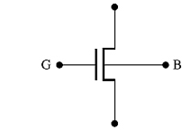
Figure 2-6
(a)
(b)
G
S
D
S
B
-
V_{GS}
-
V_{BS}
+
+
p+
p+
n+
V_{DS}
n-well
I_{D}
+
p-substrate
D

Slide 7
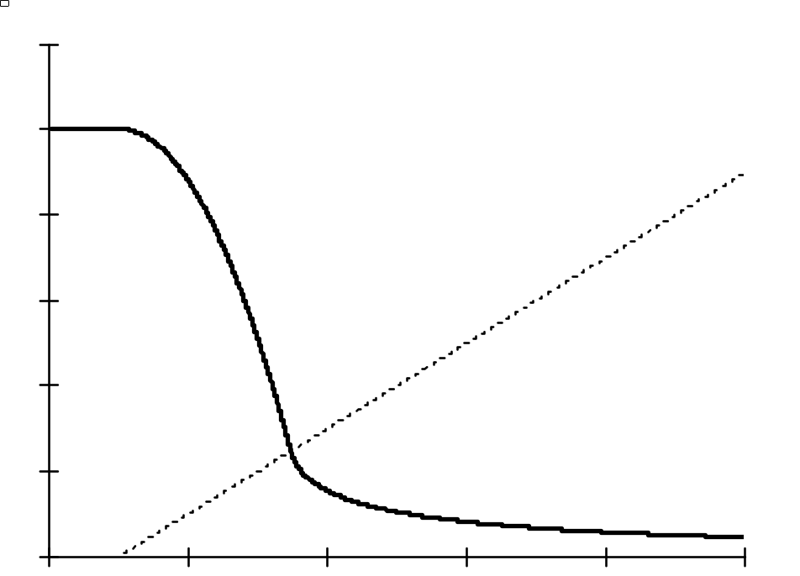
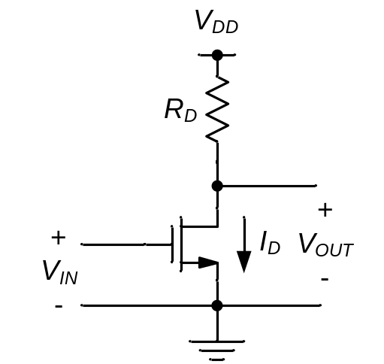
Figure 2-7
(a)
V_{OUT} [V]
(b)
5
A
V_{IN} – V_{Tn}
3
B
1
C
D
V_{IN} [V]
V_{Tn}
1
3
5

Slide 8
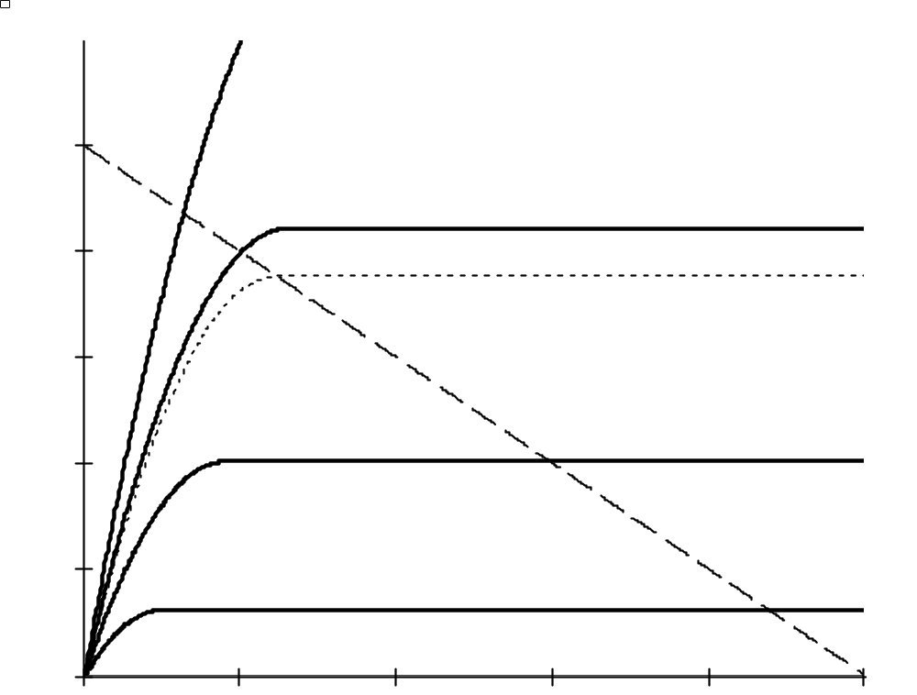
Figure 2-8
I_{D} [mA]
V_{IN} = 2.2V
V_{DD}/R_{D}
1.0
D
V_{IN} = 1.8V
V_{IN} = 1.728V
C
Load line
I_{D} = (V_{DD}-V_{OUT})/R_{D}
0.6
V_{IN} = 1.4V
B
0.2
V_{IN} = 1V
A
V_{DS} = V_{OUT}
[V]
1
3
5
V_{DD}

Slide 9
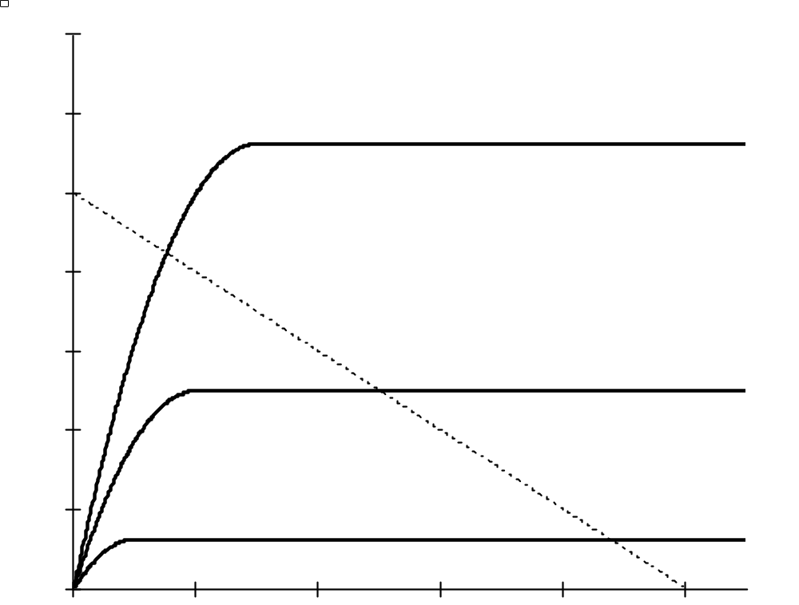
Figure Ex2-3
I_{D} [mA]
0.6
V_{IN} = 2V
0.4
V_{IN} = 1.5V
0.2
V_{IN} = 1V
V_{DS} = V_{OUT}
[V]
1
2.5
3
5

Slide 10
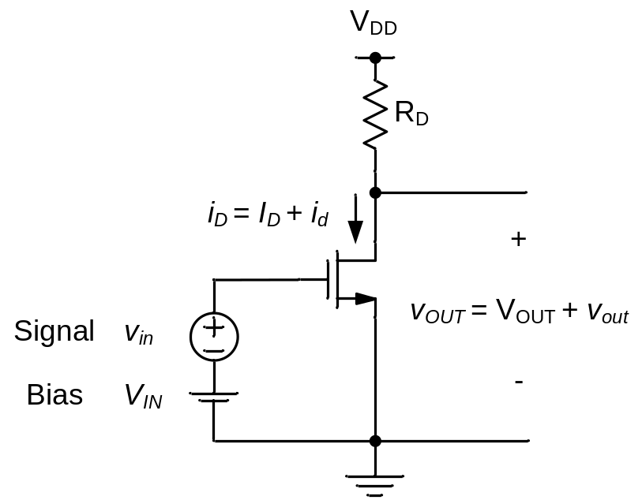
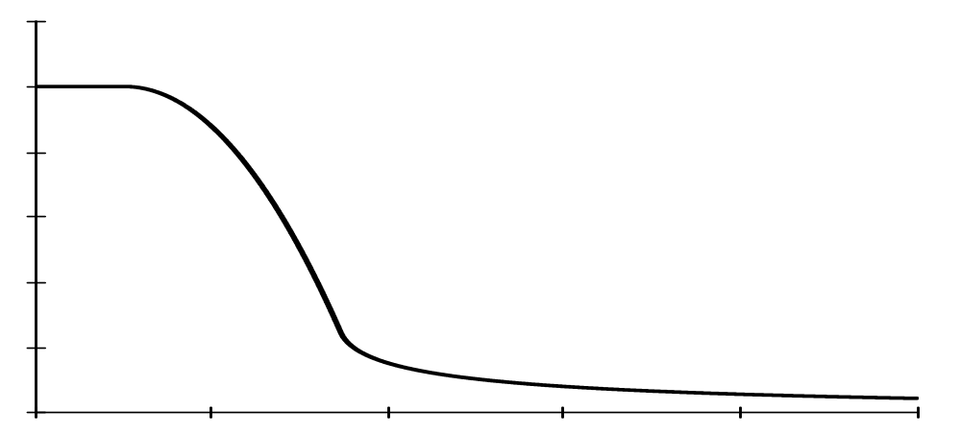
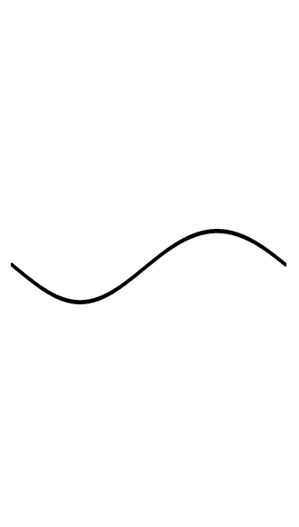

Figure 2-9
(a)
(b)
v_{OUT}
Bias Point (Q)
v_{out}
V_{OUT}
v_{in}
v_{IN}
V_{IN}

Slide 11
Figure 2-10
v_{out}
v_{OUT}
A_{v}
A_{v}
Small-signal model
v_{in}
Tangent
V_{OUT}
Q
v_{IN}
V_{IN}

Slide 12
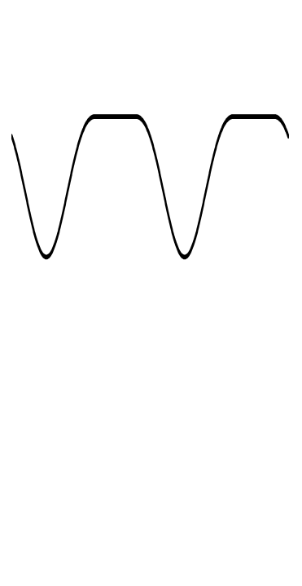
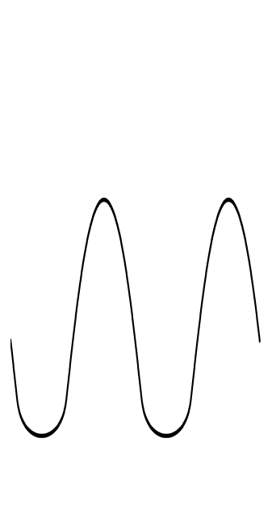
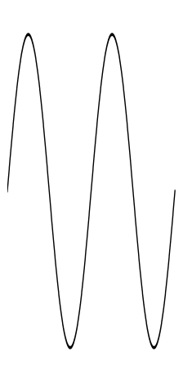
Figure 2-11
(a)
(b)
v_{OUT}
v_{OUT}
v_{out}
Q
v_{out}
Q
v_{IN}
v_{IN}
v_{in}
v_{in}

Slide 13
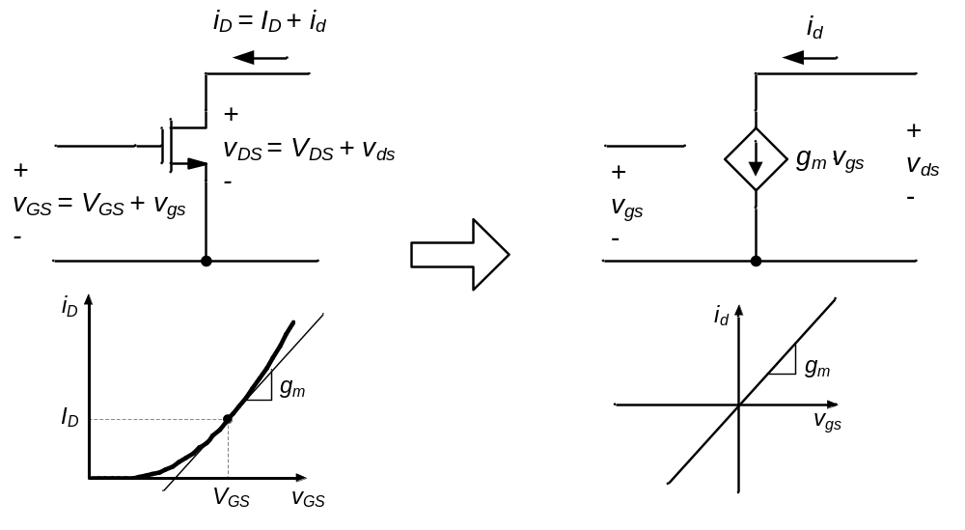
Figure 2-12
(a)
(b)
Q

Slide 14
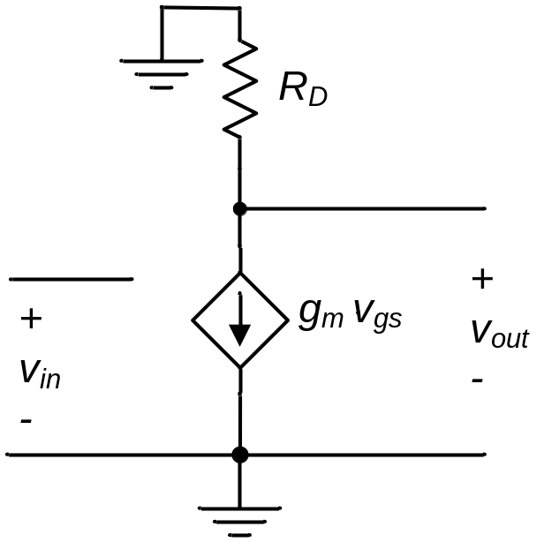
Figure 2-13

Slide 15
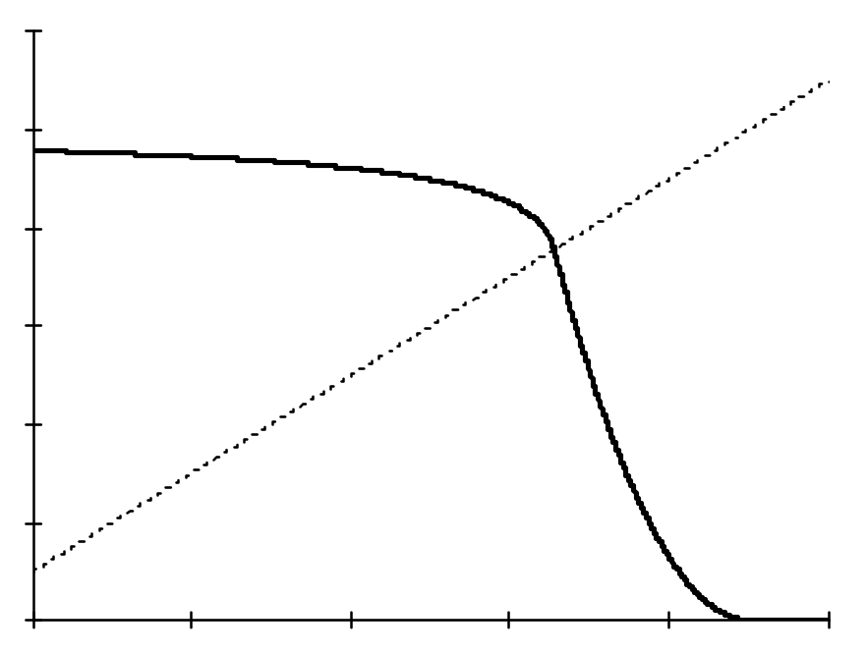
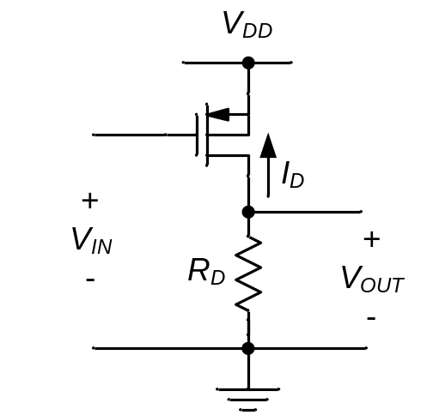
Figure 2-14
(a)
V_{OUT} [V]
(b)
5
D
C
V_{IN} + |V_{Tp} |
3
B
1
A
V_{IN} [V]
1
3
5
V_{DD} - |V_{Tp} |

Slide 16
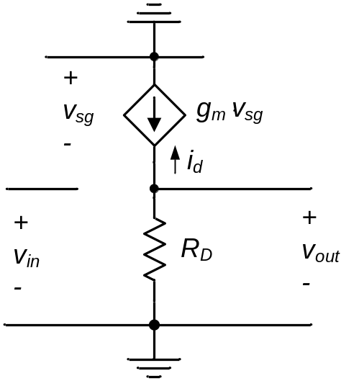
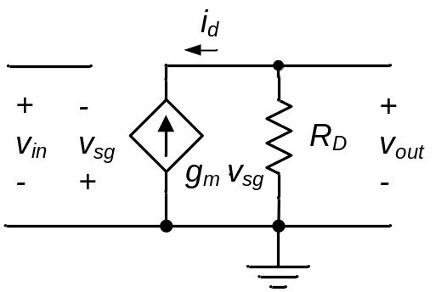
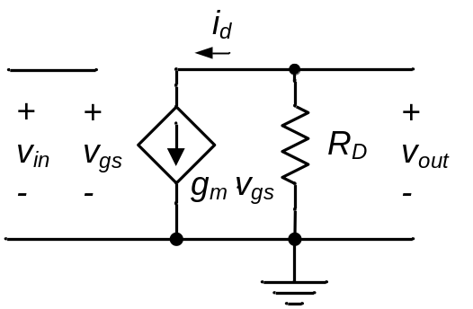
Figure 2-15
(a)
(b)
(c)

Slide 17
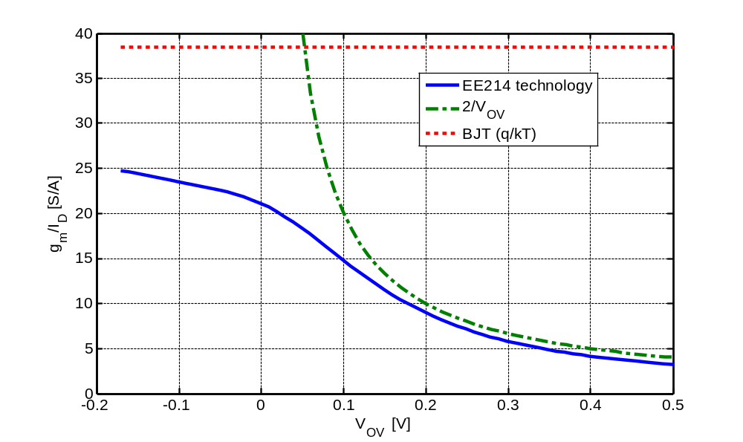
Figure 2-16
Eq. (3.29)
Actual MOSFET
Model valid for V_{OV} ≥ 150 mV

Slide 18
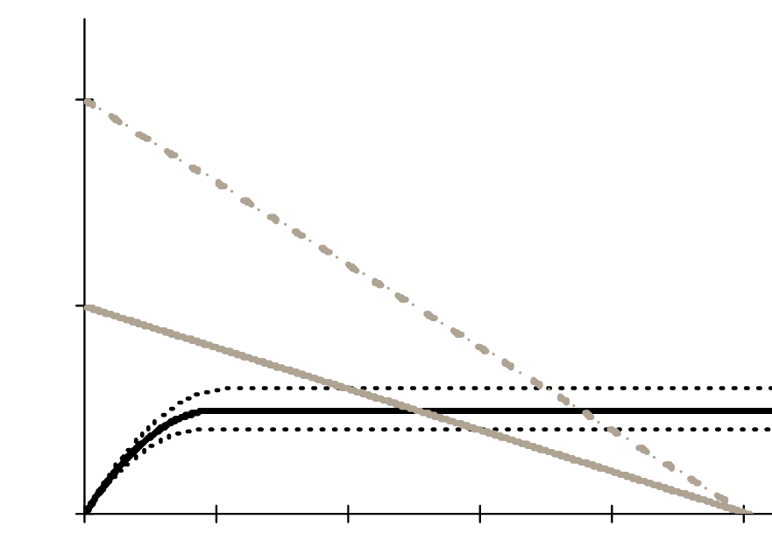
Figure 2-17
i_{D}
Small R_{D}
Intercepts at V_{DD}/R_{D}
Large R_{D}
i_{d} ≅ g_{m}v_{in}
Q₁
Q₂
I_{D}
v_{OUT}
V_{DD}
v_{out}

Slide 19
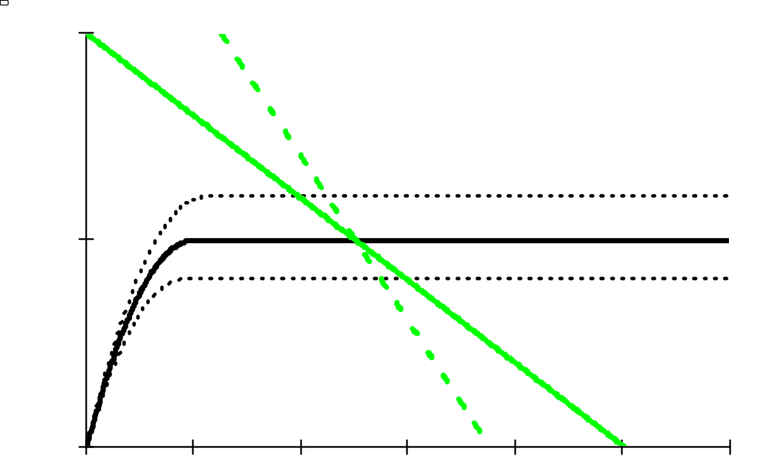
Figure 2-18
i_{D}
Large
R_{D}
Small
R_{D}
I_{D}
Q
v_{OUT}

Slide 20
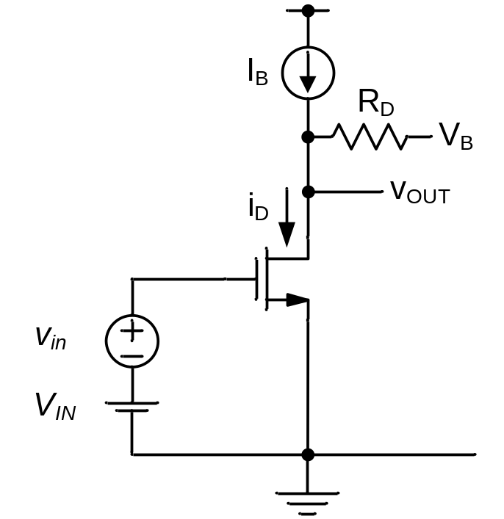
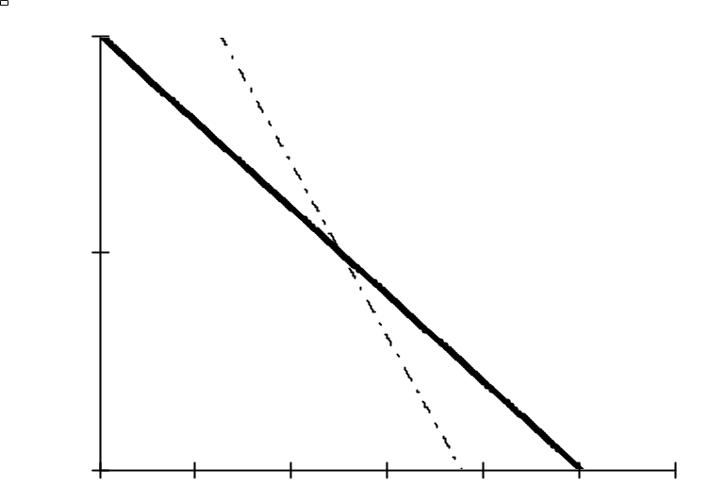
Figure 2-19
(a)
(b)
i_{D}
I_{B}
Q
v_{OUT}
V_{B}

Slide 21
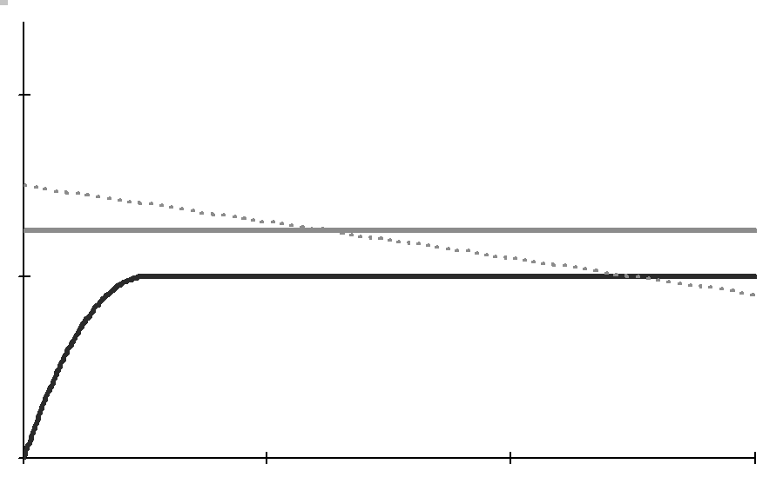
Figure 2-20
1/R_{D}
I_{B}
I_{D}
ΔI
Q
ΔV= ΔI⋅R_{D}
V_{B}
V_{OUT}
v_{OUT}

Slide 22
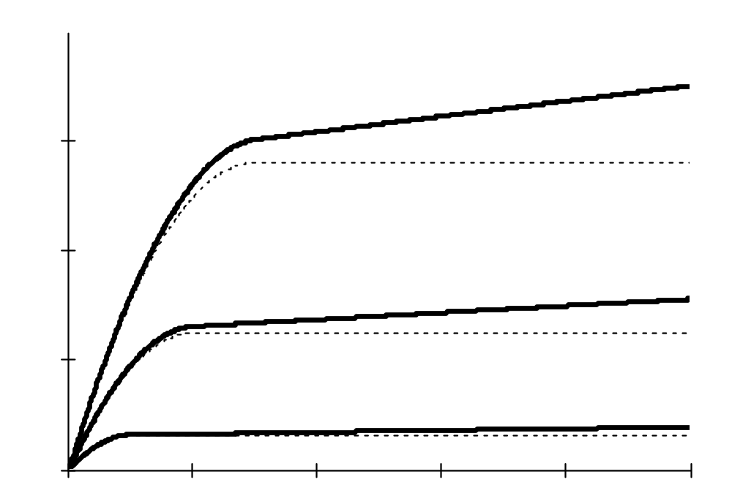
Figure 2-21
I_{D} [mA]
0.6
V_{OV3} = 1.5V
0.4
V_{OV2} = 1V
0.2
V_{OV1}= 0.5V
V_{DS} [V]

Slide 23
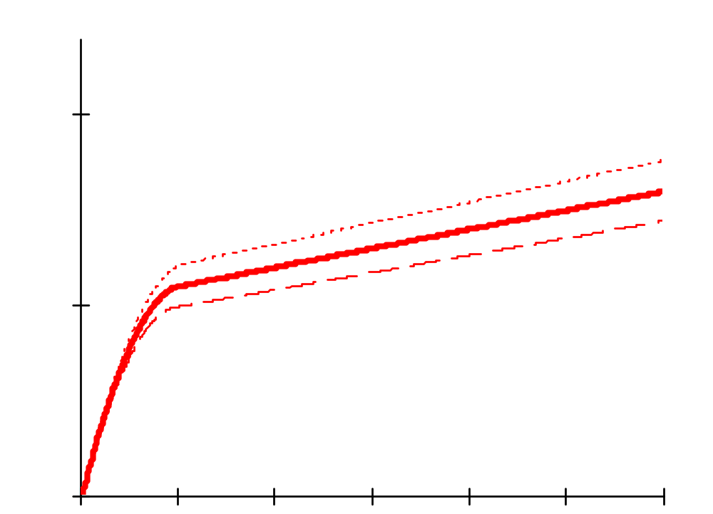
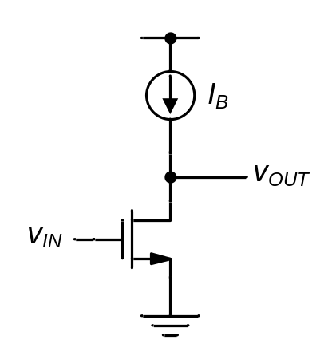
Figure 2-22
(a)
(b)
i_{D}
v_{IN}
Q
V_{IN}
I_{D}=I_{B}
v_{out}
v_{OUT}

Slide 24
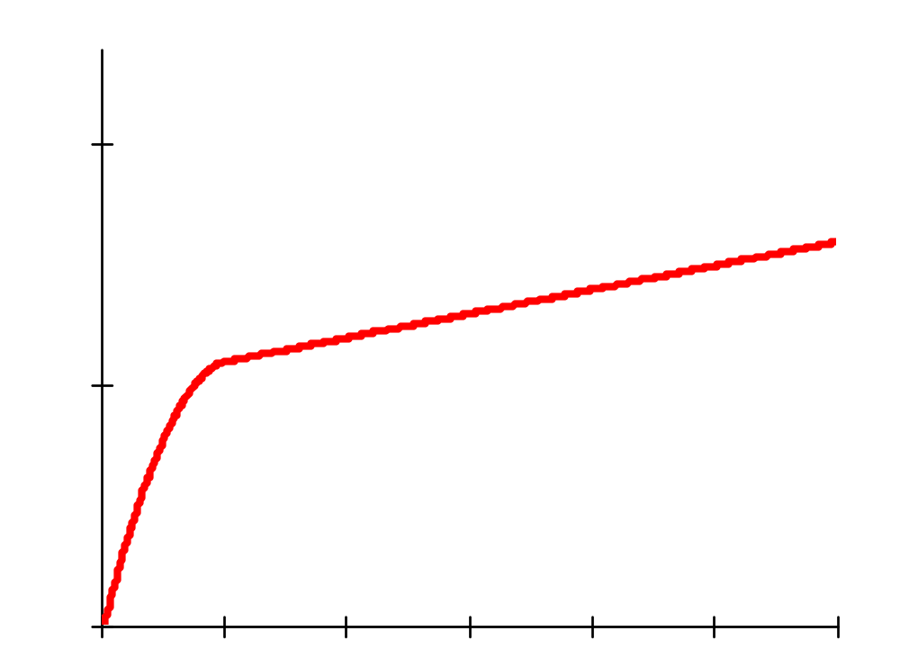
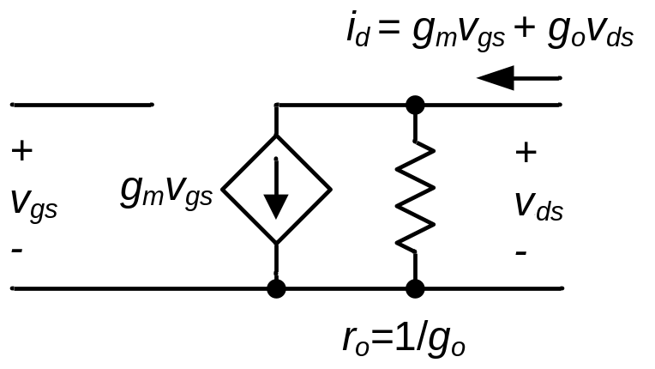
Figure 2-23
(a)
i_{d}
(b)
g_{o}
i_{D}
v_{ds}
Tangent
I_{D}
Q
v_{DS}
V_{DS}

Slide 25
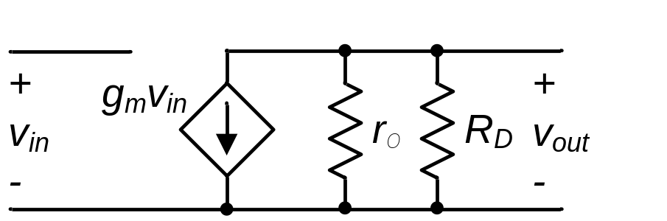
Figure 2-24
R_{out}

Slide 26
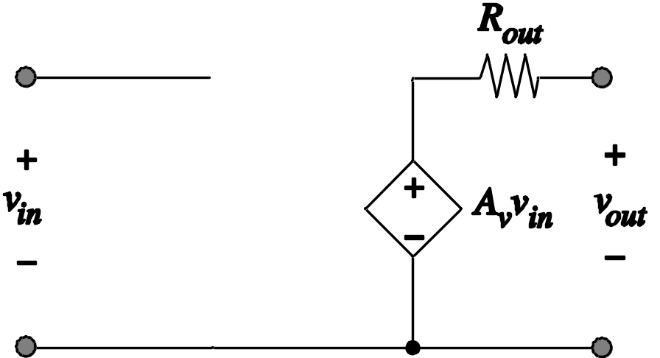
Figure 2-25

Slide 27
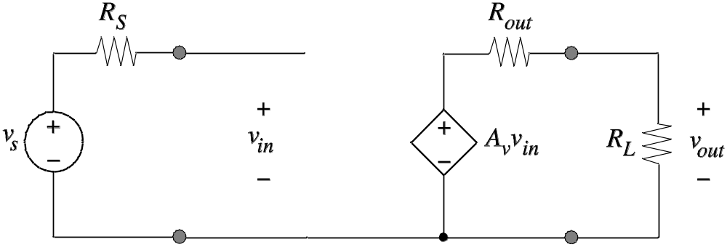
Figure 2-26

Slide 28
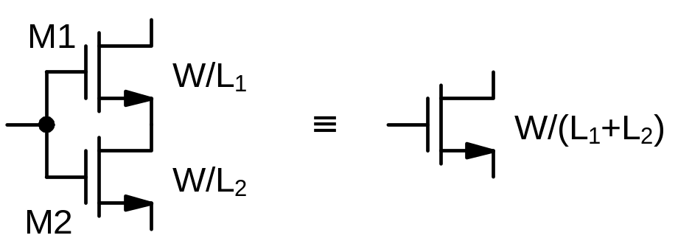
Figure P2-2

Slide 29
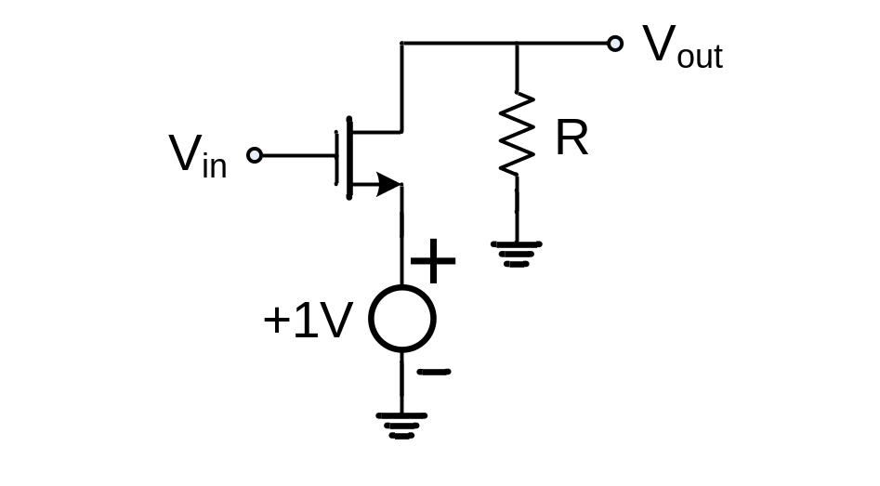
Figure P2-5

Slide 30
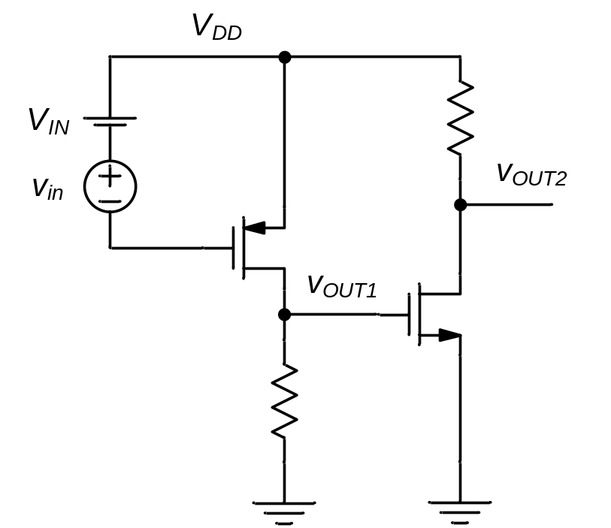
Figure P2-12

Slide 31
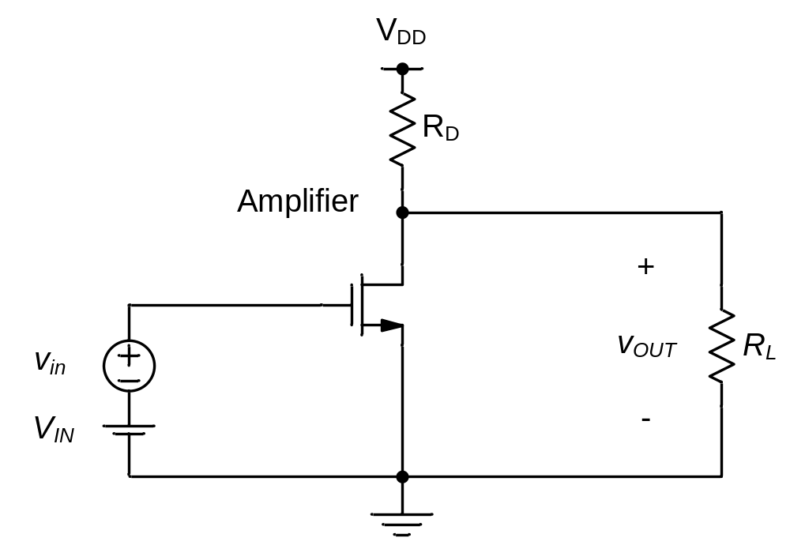
Figure P2-17

