Slide 1
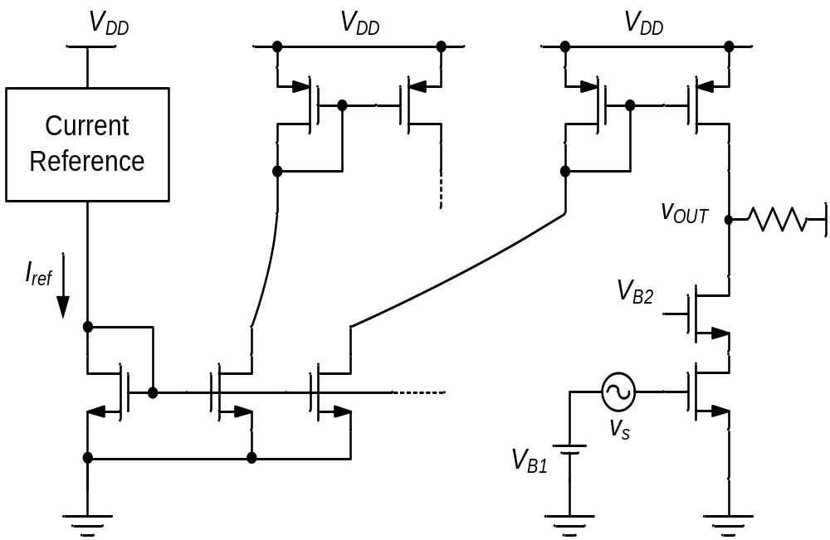
Figure 5-1
Process Variation and Device Mismatch
Section 5.2
Section 5.4
Voltage Biasing
Considerations
Section 5.5
Current Mirrors
Section 5.3

Slide 2
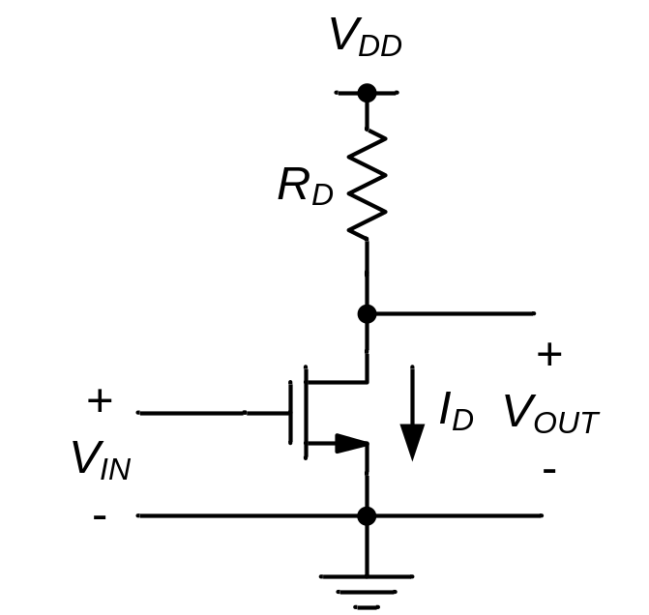
Figure Ex5-1

Slide 3
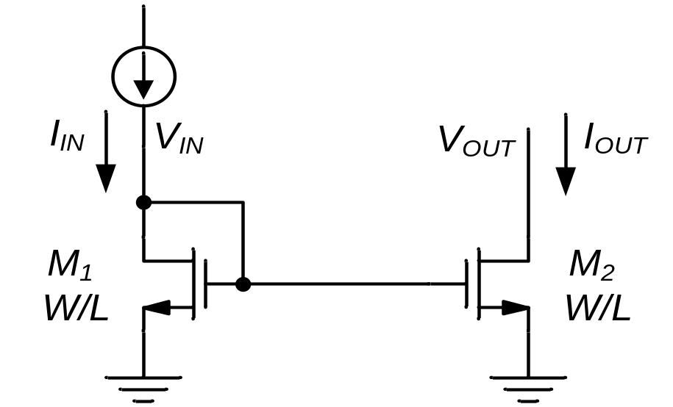
Figure 5-2

Slide 4
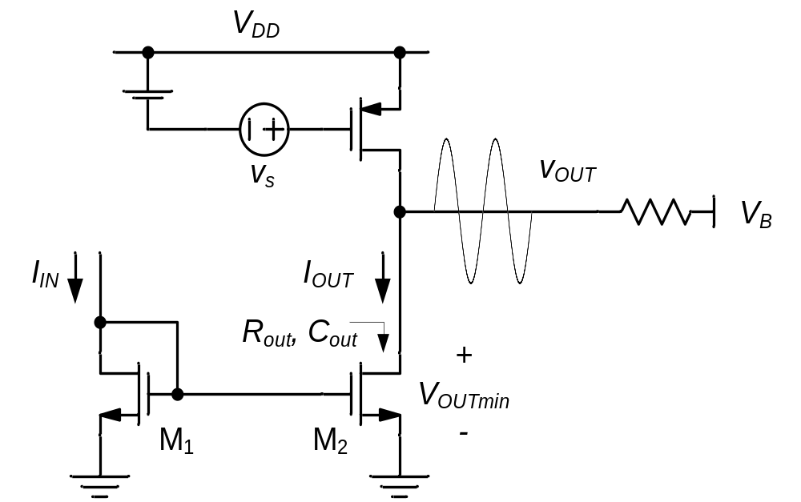
Figure 5-3

Slide 5
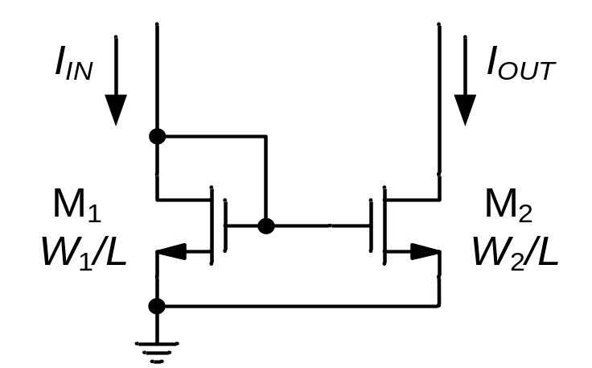
Figure 5-4
I_{IN}
I_{OUT}
W₁
W₂
ΔW
W₂ = 2W₁
(ideally)
GND
ΔW

Slide 6
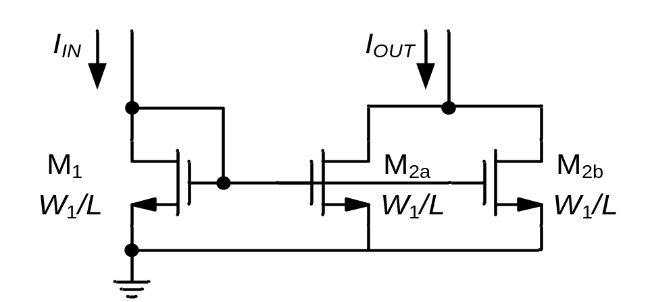
Figure 5-5
I_{IN}
I_{OUT}
W₁
W₁
W₁
ΔW
ΔW
ΔW
GND

Slide 7
Figure 5-6
I_{IN}
I_{OUT}
W₁
W₁
GND
W₂ = 2W₁

Slide 8
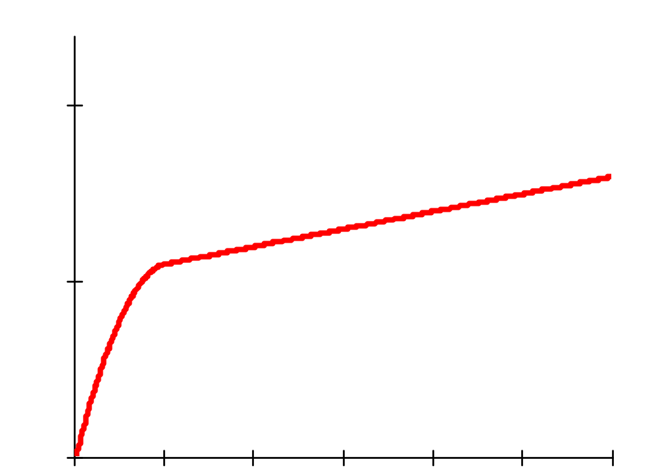
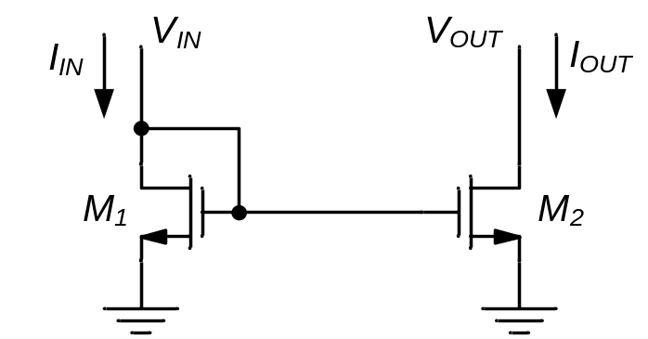
Figure 5-7
I_{D}
I-V characteristic of M₁ and M₂
(V_{GS2} = V_{GS1} = V_{DS1})
I_{OUT}
I_{IN}
g_{o}
W₁ = W₂ = W
L₁ = L₂ = L
V_{IN}
V_{OUT}
V_{DS}

Slide 9
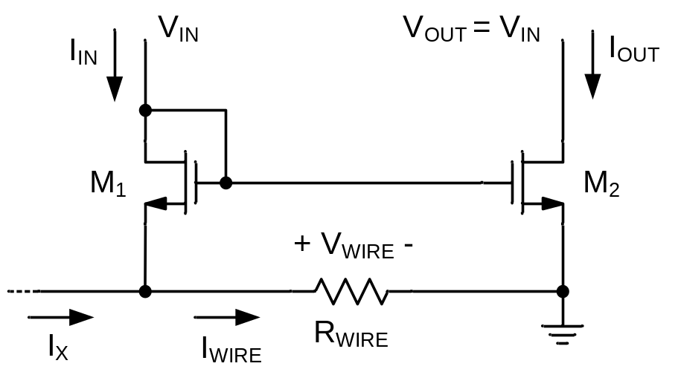
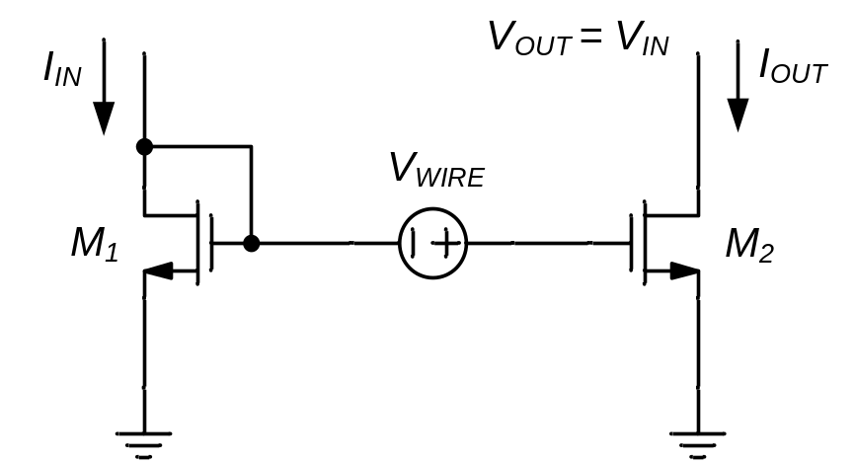
Figure 5-8
(a)
(b)
W₁ = W₂ = W
L₁ = L₂ = L
W₁ = W₂ = W
L₁ = L₂ = L

Slide 10
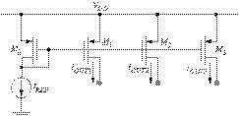
Figure 5-9
(Howe & Sodini, Figure 9-31)

Slide 11
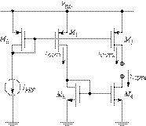
Figure 5-10
(Howe & Sodini, Figure 9-32)

Slide 12
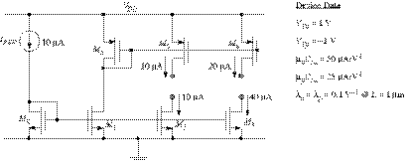
Figure Ex5-3
M4
M5
M6
Delete
MR
M1
M2
M3
(Howe & Sodini, Figure Ex 9-8)

Slide 13
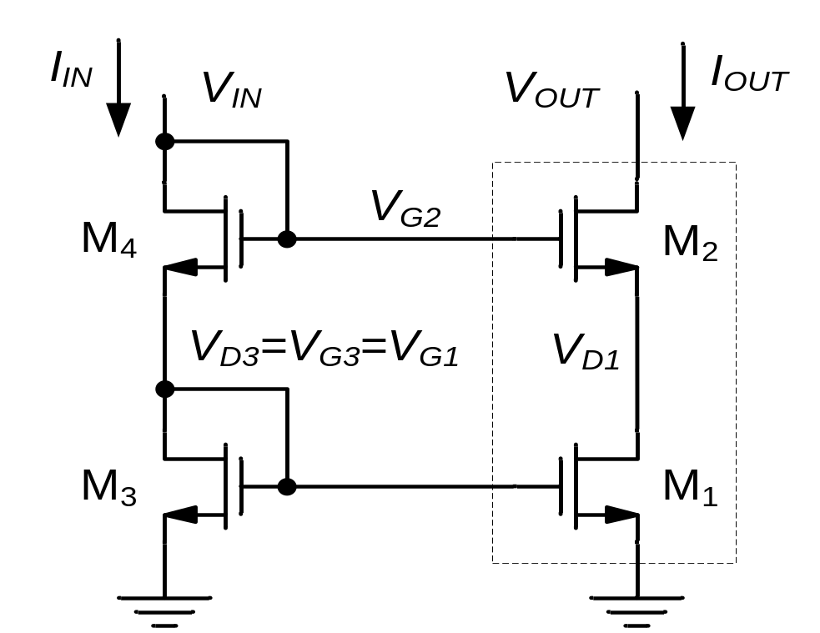
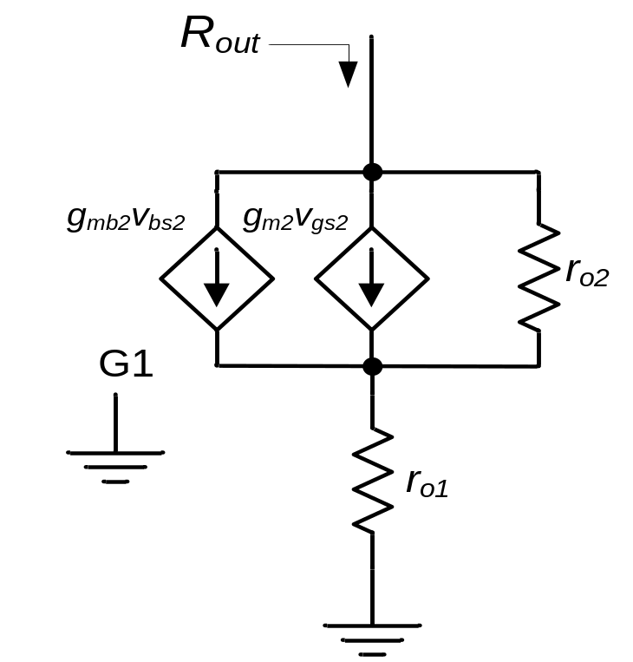
Figure 5-11
Cascode
Stage
(a)
(b)

Slide 14
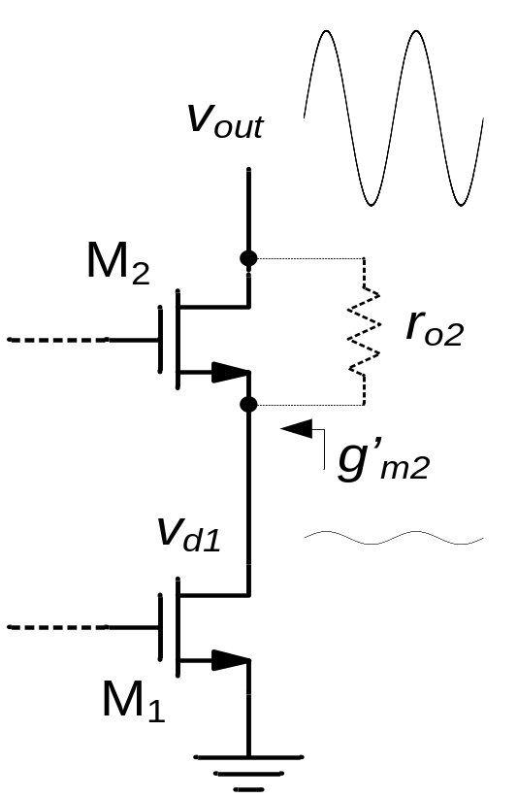


Figure 5-12
v_{out}
Voltage divider between r_{o2} and g’_{m2}
Small i_{out}
v_{d1}
I_{OUT}
g_{o1}
I-V characteristic of M₁
V_{D1}
V_{DS}

Slide 15
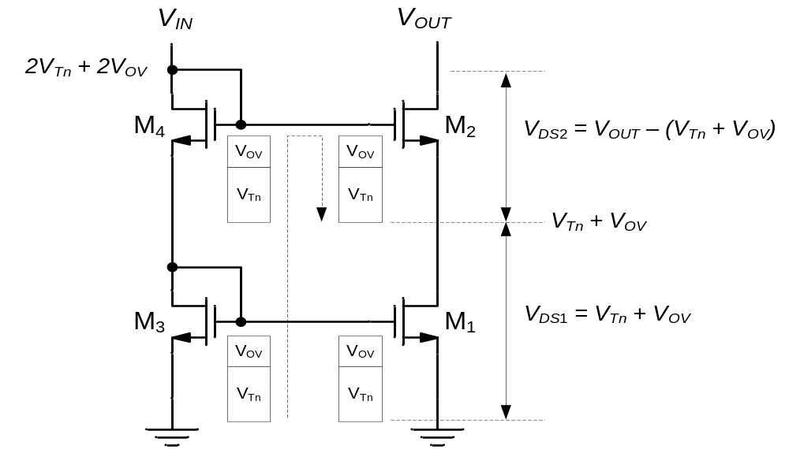
Figure 5-13

Slide 16
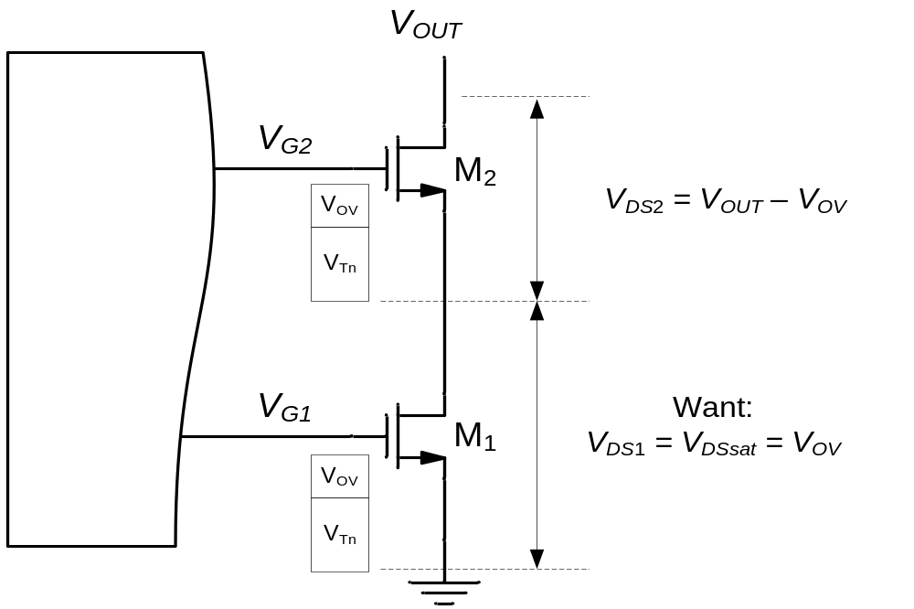
Figure 5-14

Slide 17
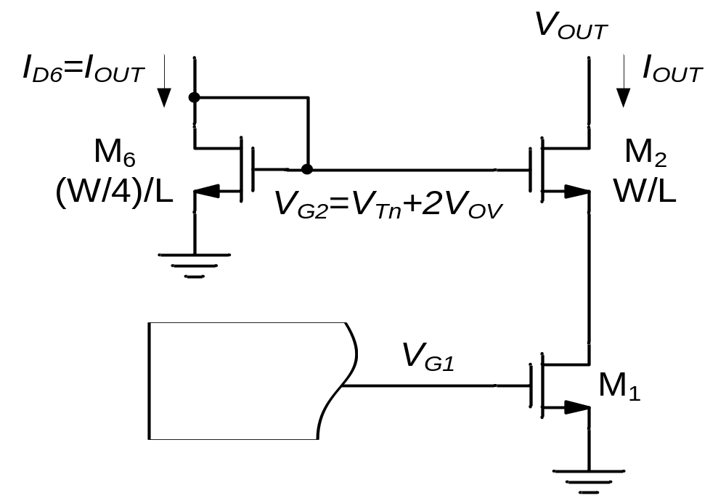
Figure 5-15

Slide 18
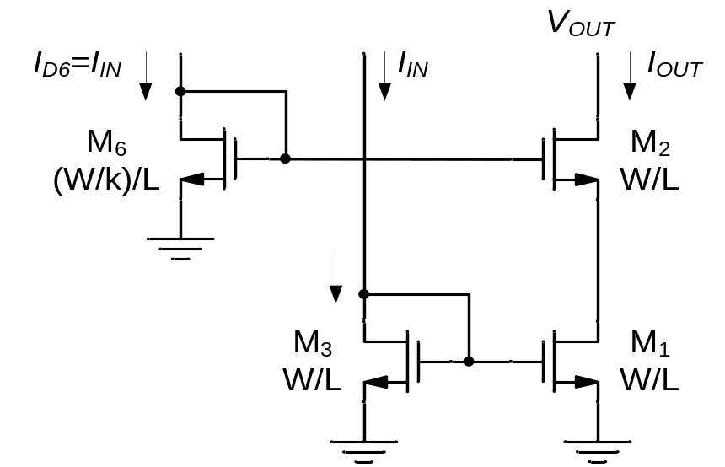
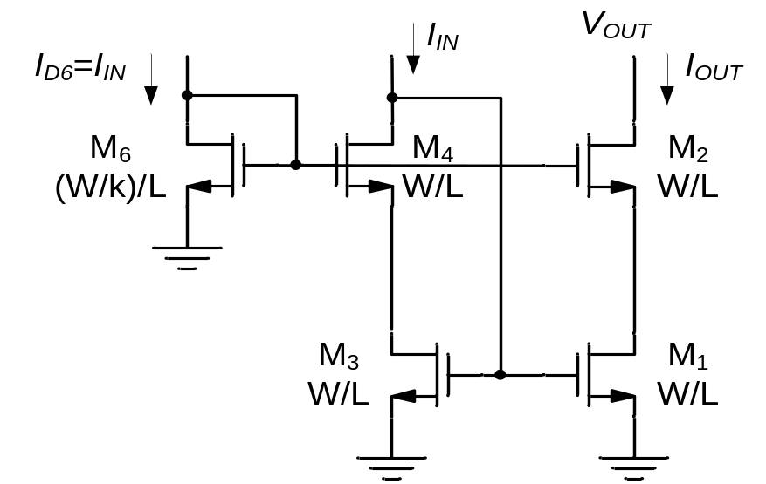
Figure 5-16
(a)
(b)

Slide 19
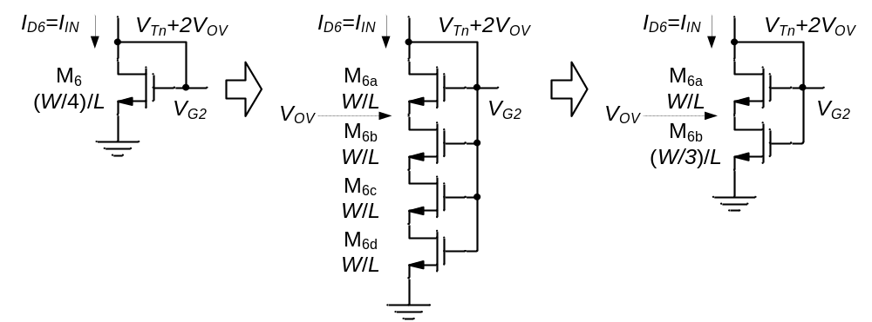
Figure 5-17
(a)
(b)
(c)

Slide 20
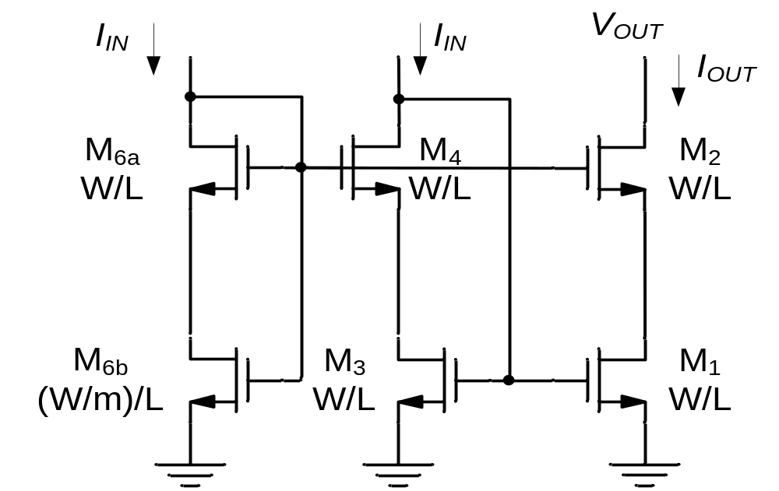
Figure 5-18

Slide 21
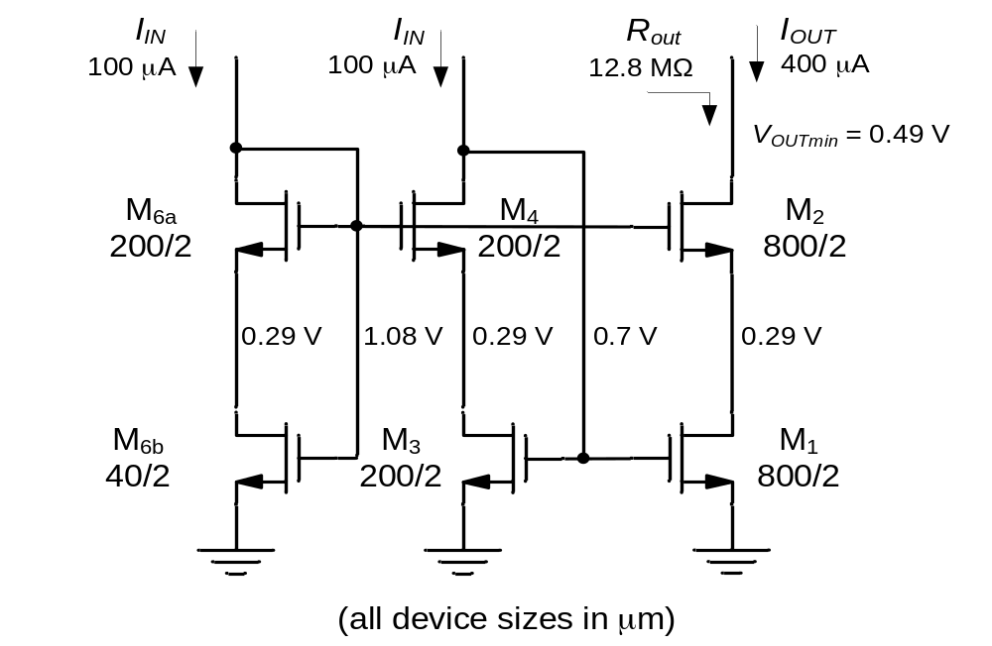
Solution to Ex 5-4

Slide 22
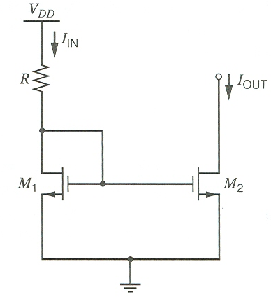
Figure 5-19

Slide 23
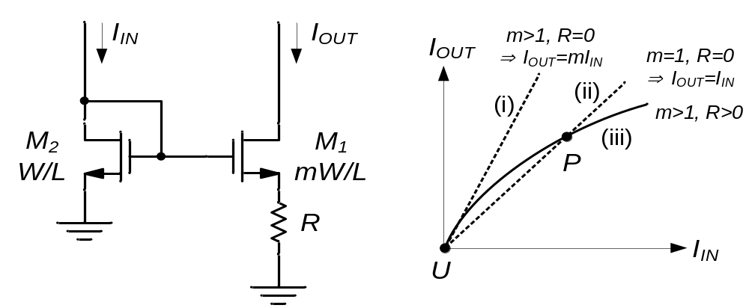
Figure 5-20
(a)
(b)

Slide 24
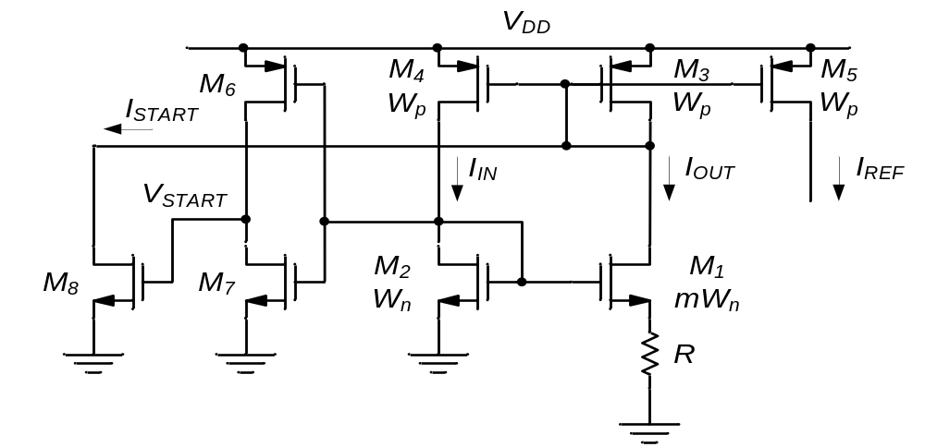
Figure 5-21
Start-up circuit

Slide 25
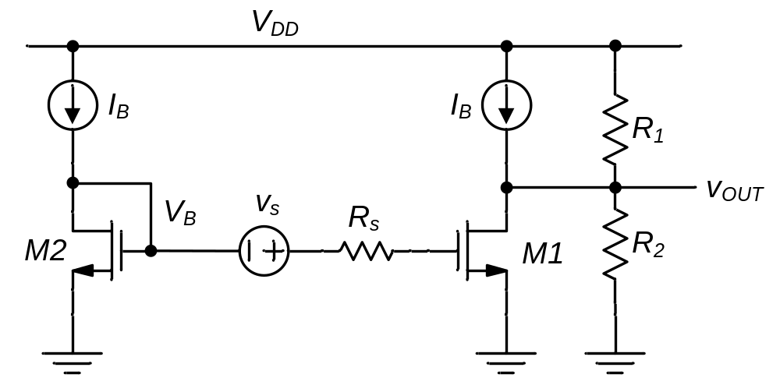
Figure 5-22
Transducer

Slide 26
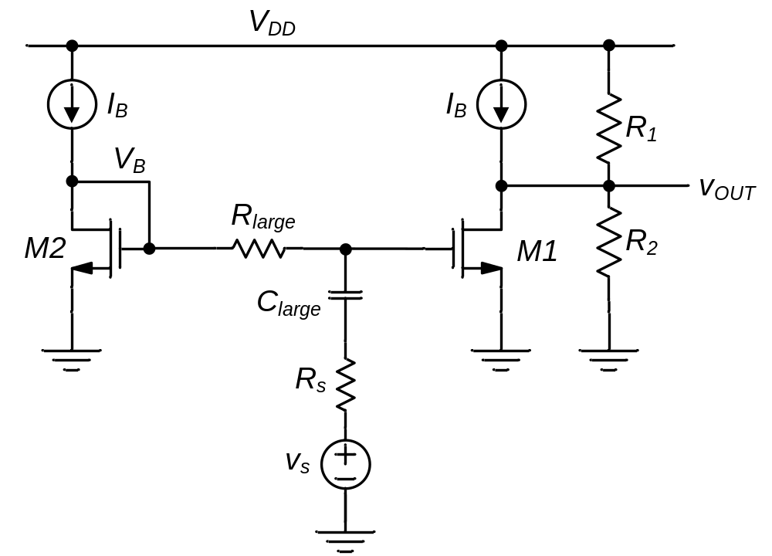
Figure 5-23
Transducer

Slide 27
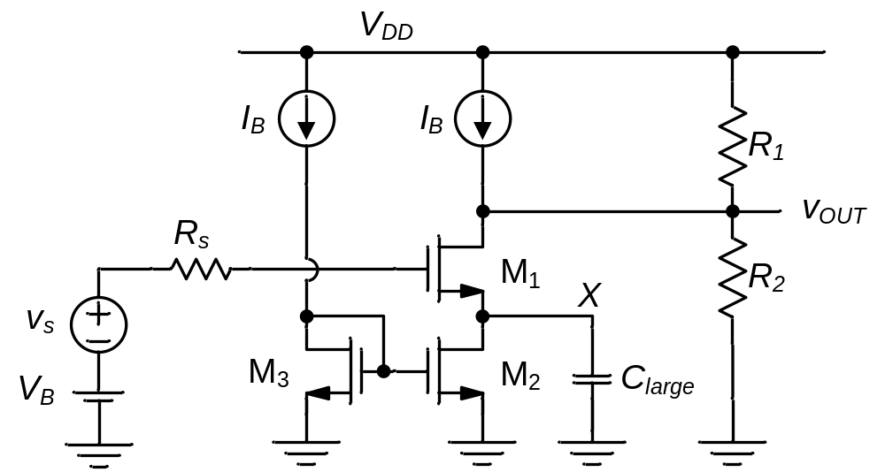
Figure 5-24

Slide 28
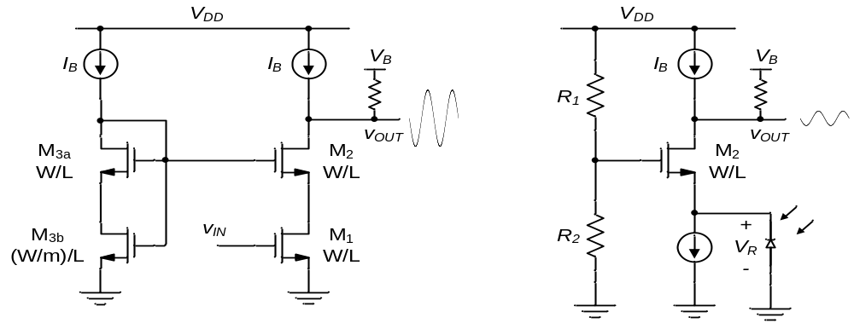
Figure 5-25
(a)
(b)

Slide 29
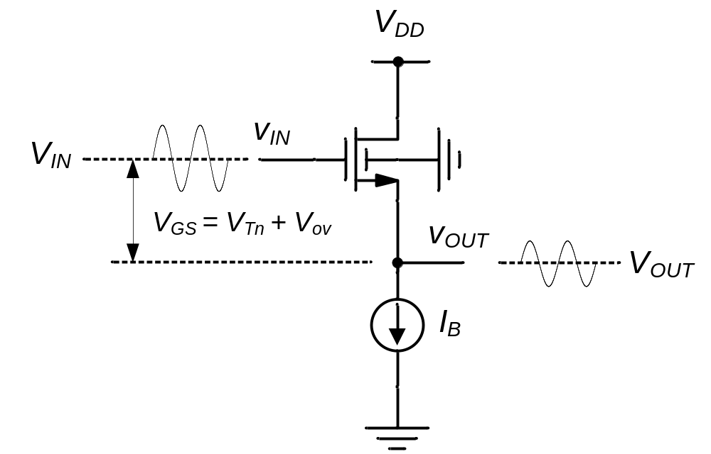
Figure 5-26

Slide 30
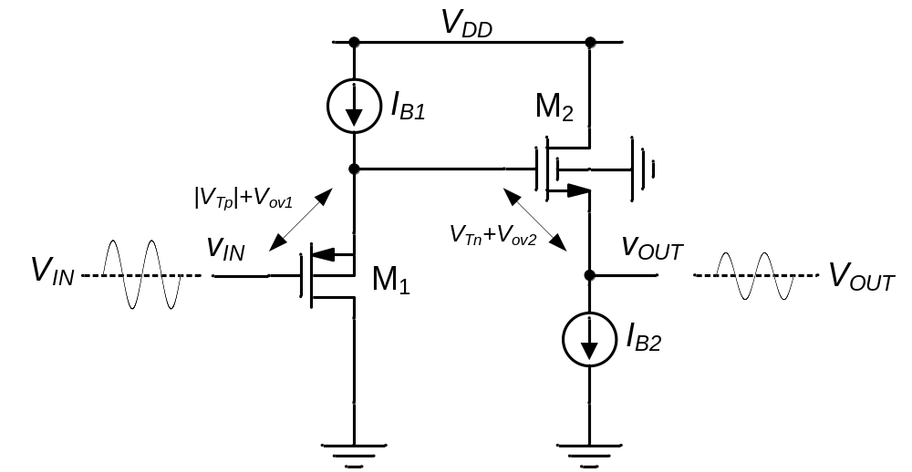
Figure 5-27

Slide 31
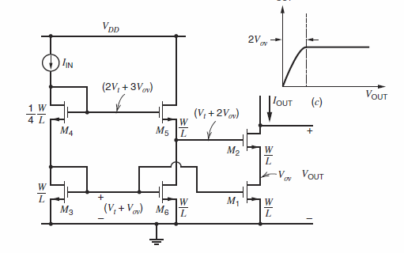
Problem P5.5

Slide 32
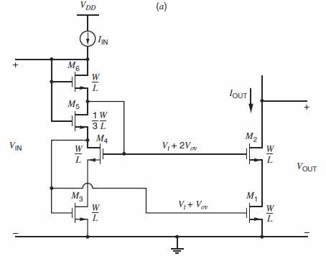
Problem P5.6

Slide 33
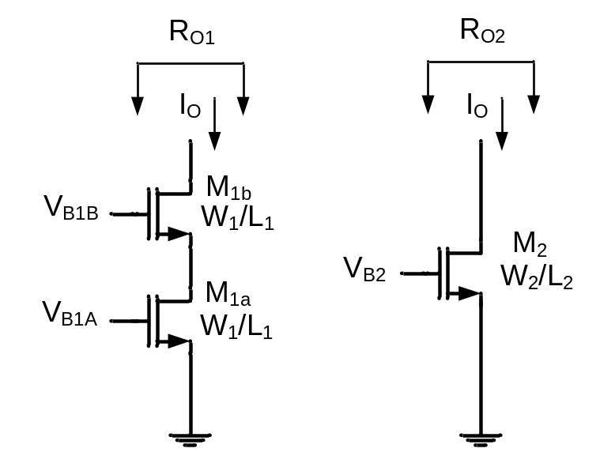
Problem P5.9

Slide 34
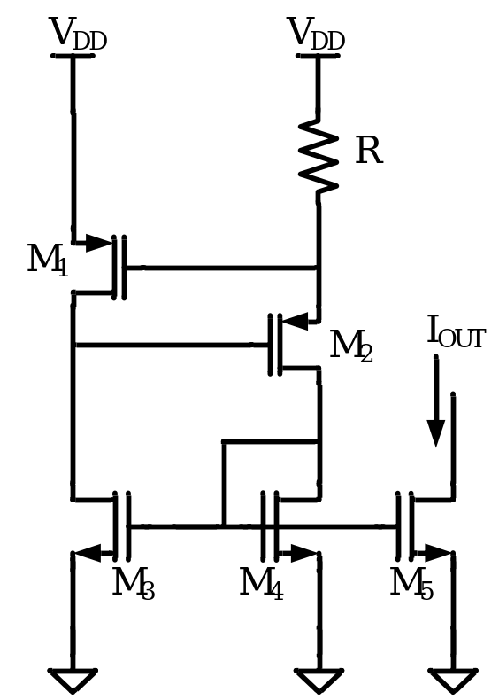
Problem P5.10

Slide 35
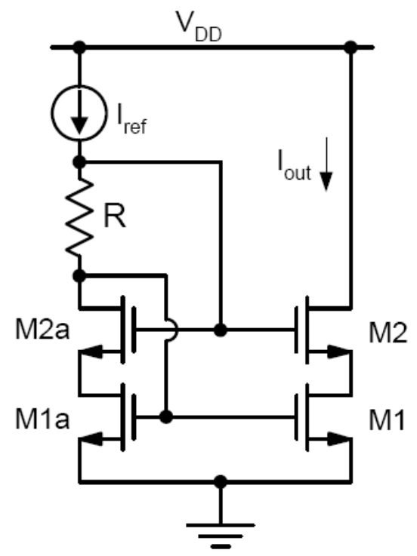
Problem P5.11

Slide 36
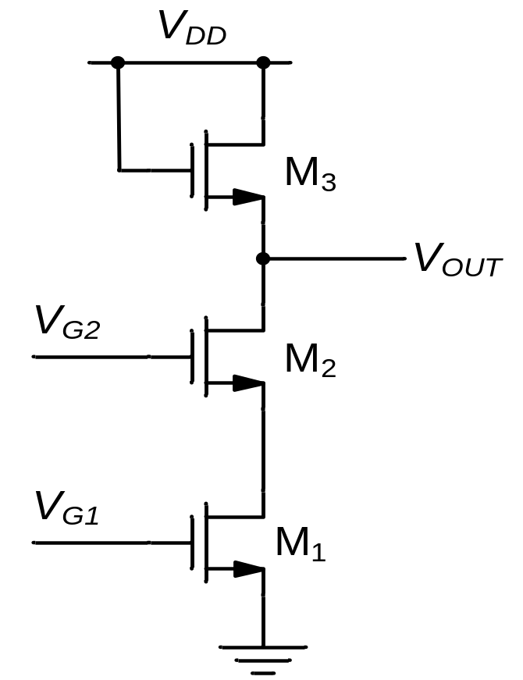
Problem P5.12

Slide 37
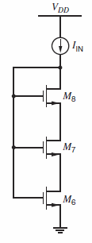
Problem P5.13

