Slide 1
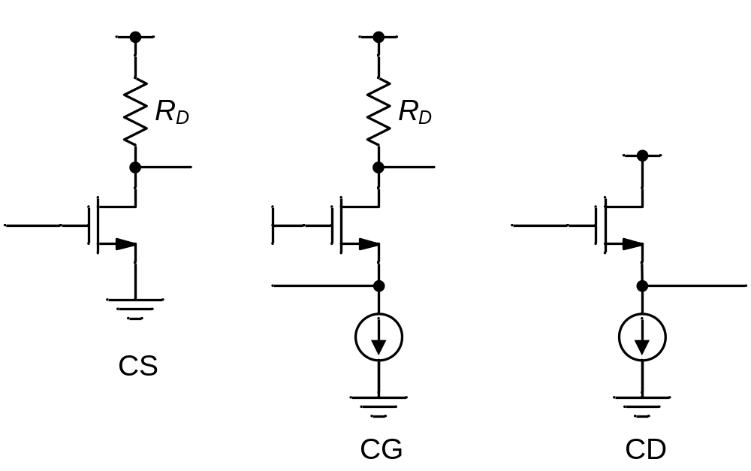
Figure 6-1

Slide 2
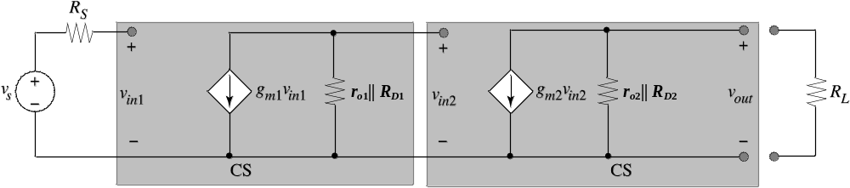
Figure 6-2

Slide 3
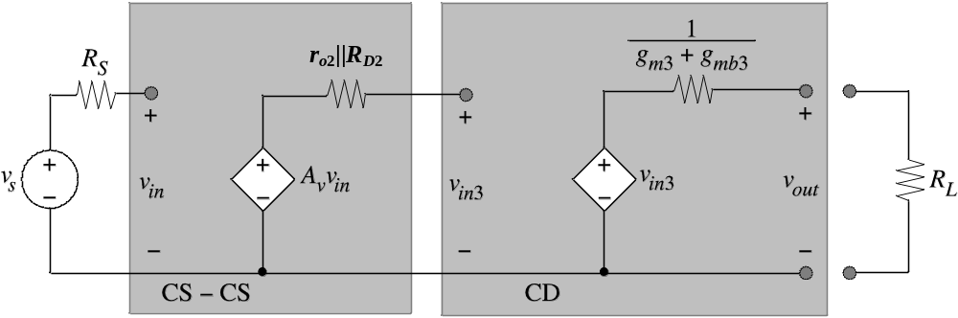
Figure 6-3

Slide 4
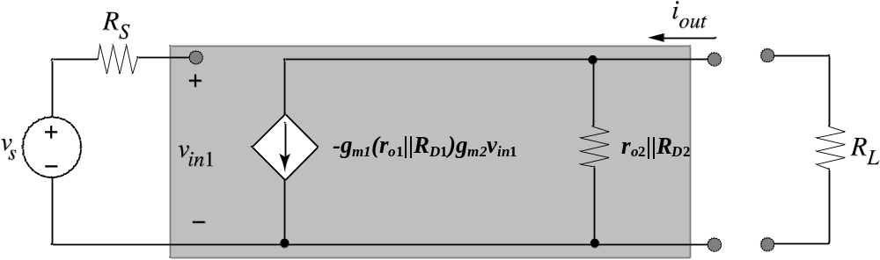
Figure 6-4

Slide 5
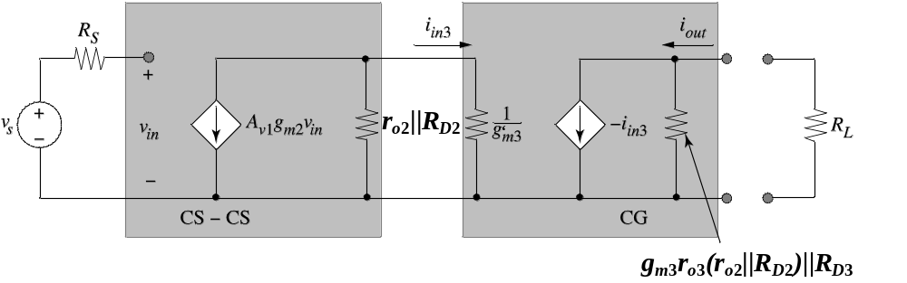
Figure 6-5

Slide 6
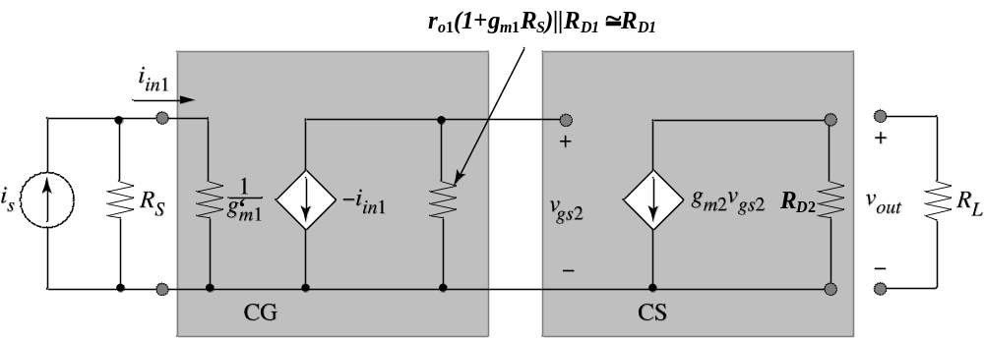
Figure Ex6-1A

Slide 7
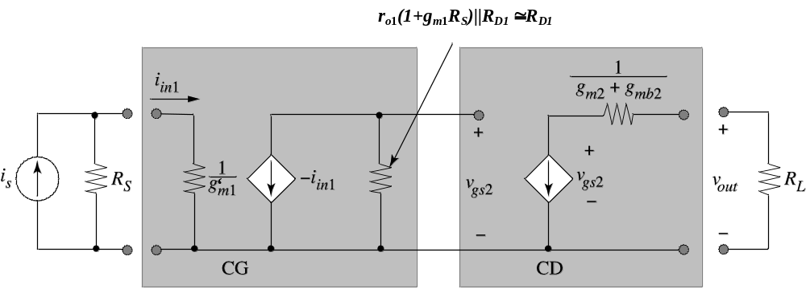
Figure Ex6-1B

Slide 8
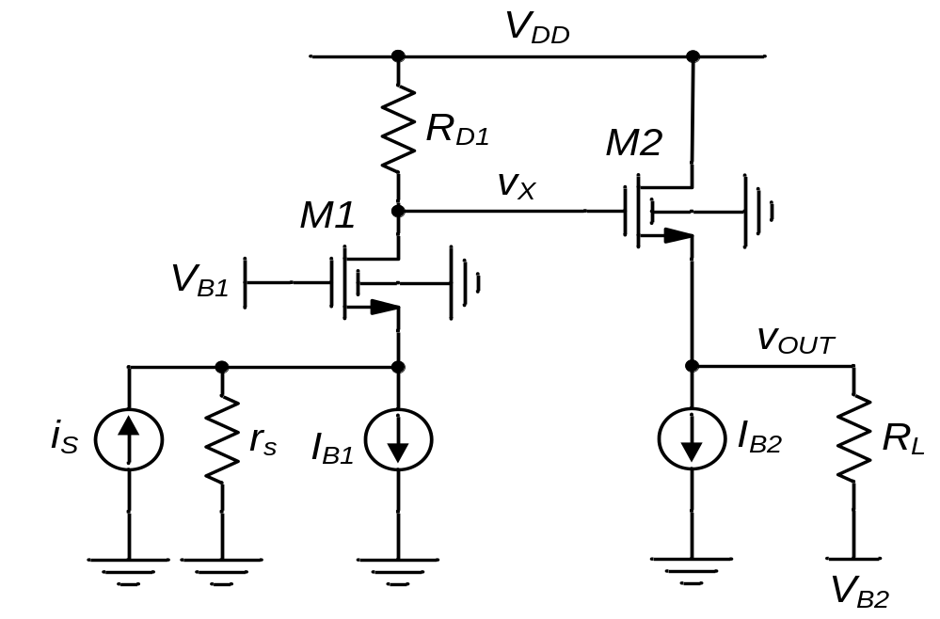
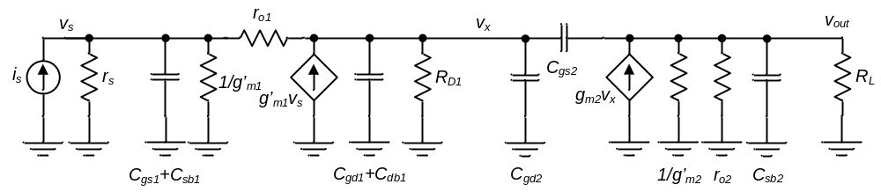
Figure 6-6
(a)
(b)
CG Stage
CD Stage
C_{s1}
C_{x}

Slide 9
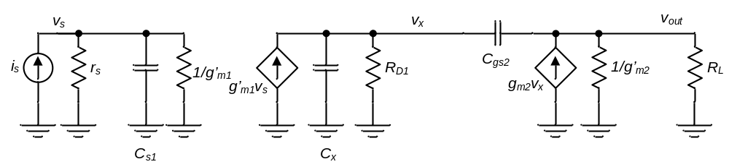
Figure 6-7

Slide 10
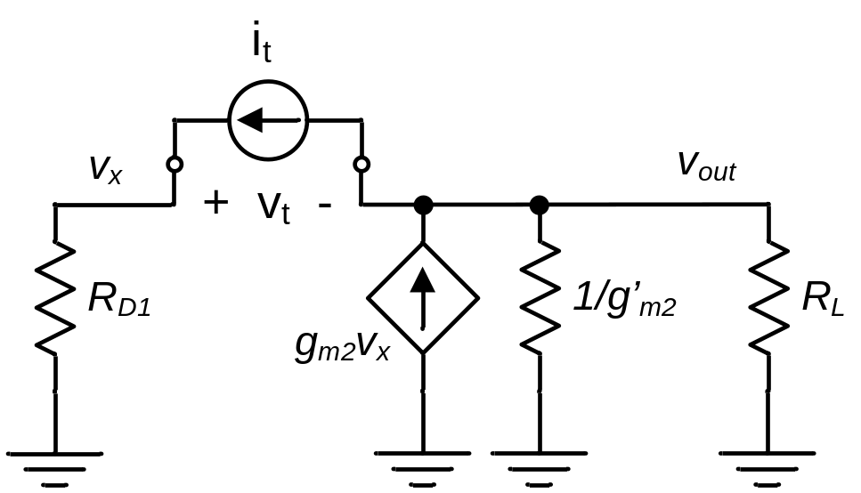
Example 6-2 Solution

Slide 11
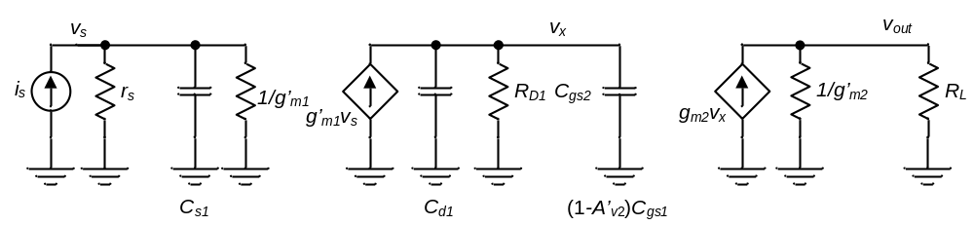
Example 6-3 Solution

Slide 12
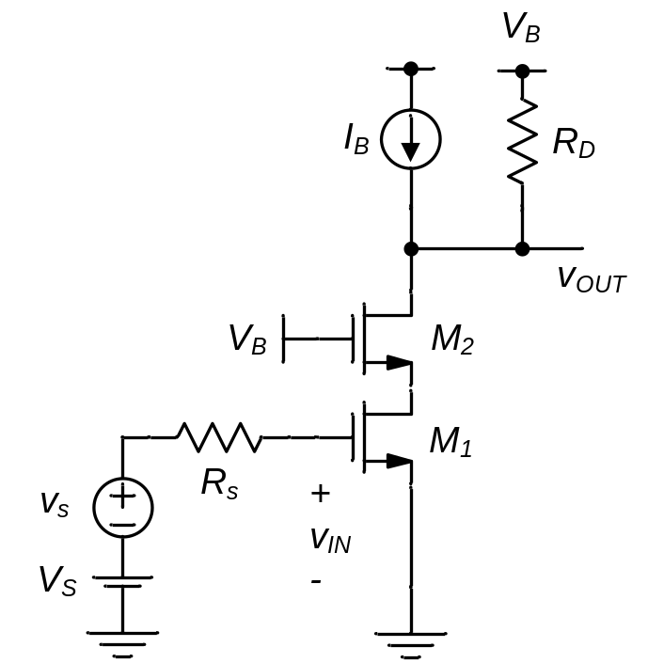
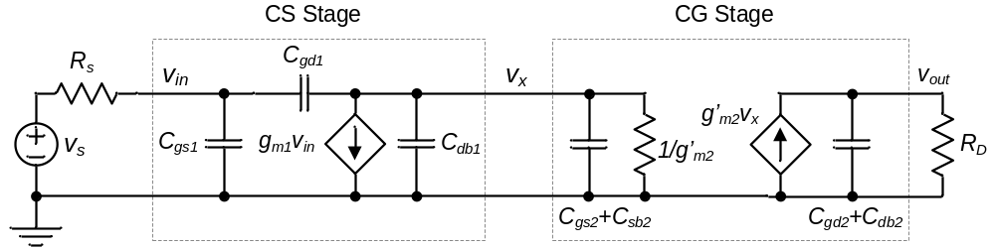
Figure 6-8
(a)
(b)
C_{x}
C_{d2}

Slide 13
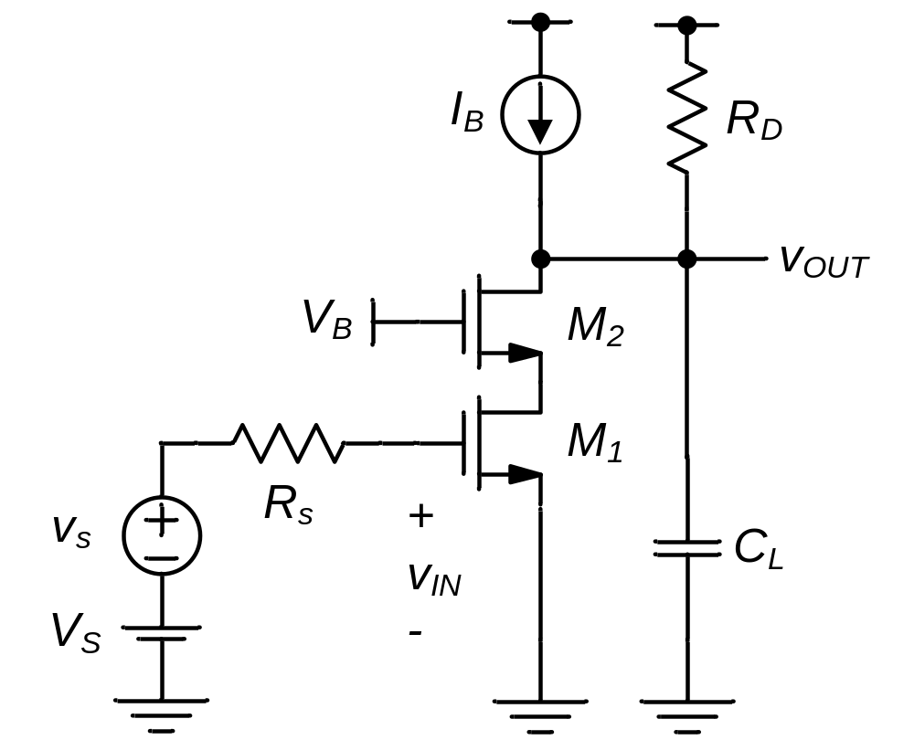
Figure Ex6-3

Slide 14
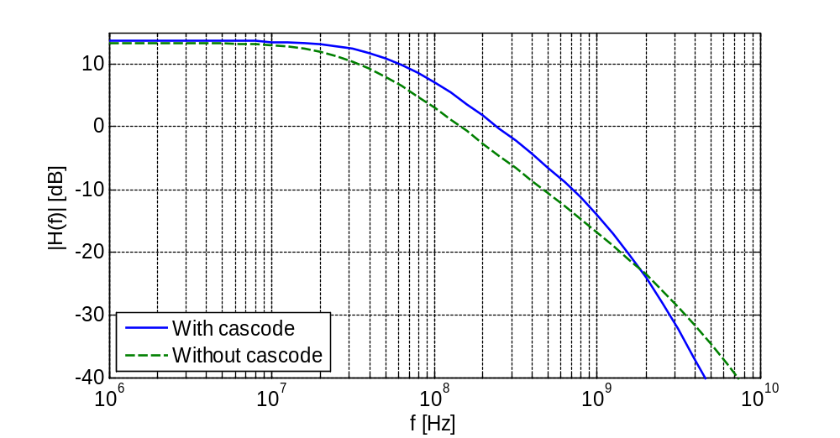
Figure 6-9
-20dB/dec
Cascode amplifier
CS amplifier

Slide 15
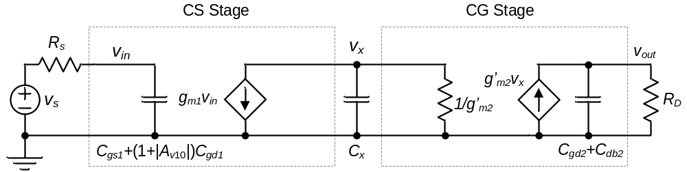
Figure 6-10

Slide 16
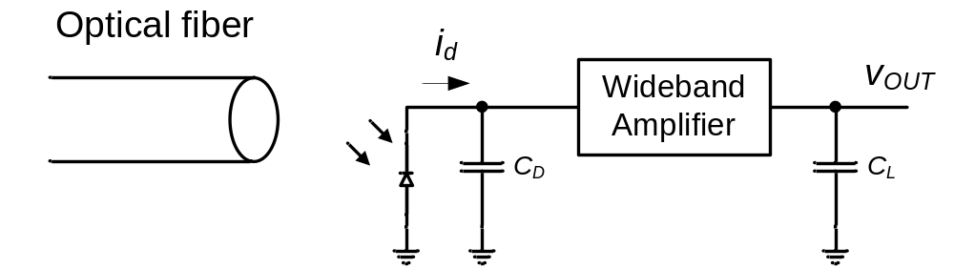
Figure 6-11

Slide 17
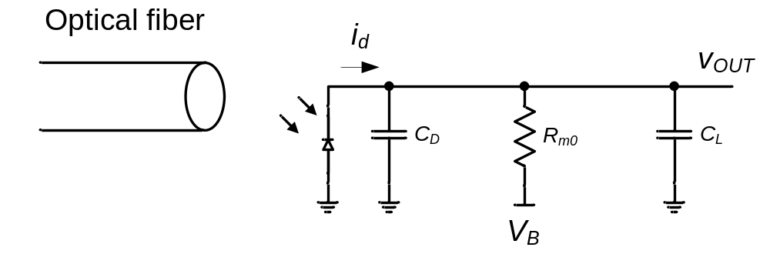
Figure 6-12

Slide 18
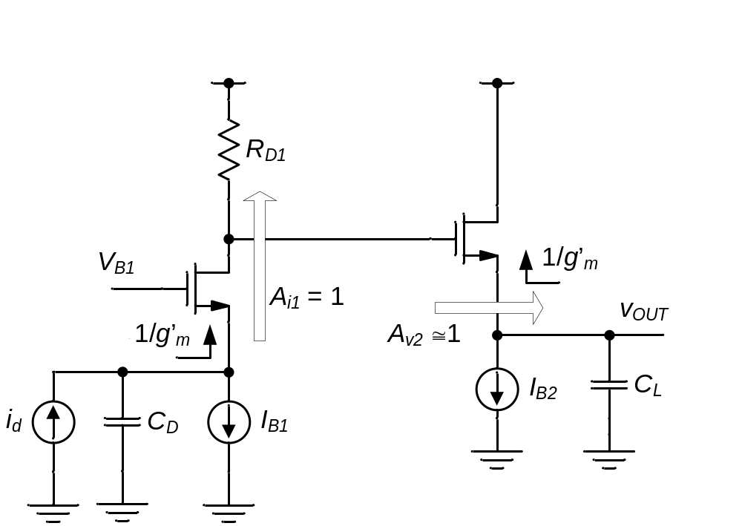
Figure 6-13

Slide 19
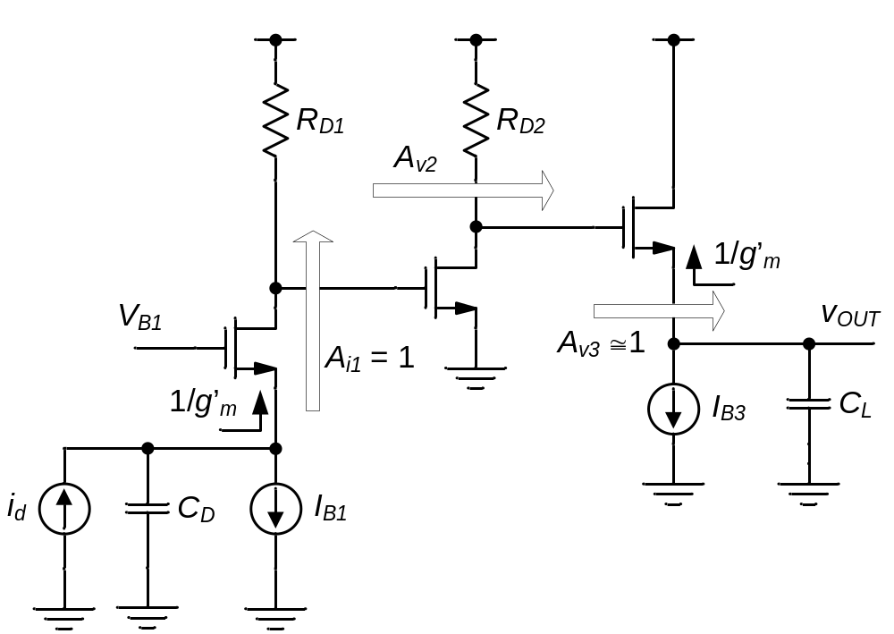
Figure 6-14

Slide 20
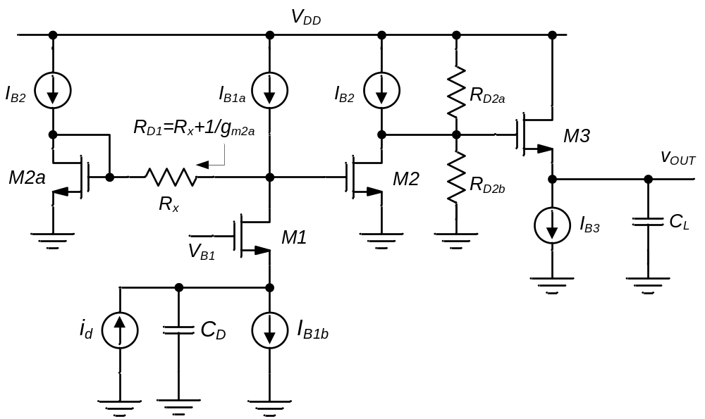
Figure 6-15
R_{D2} = R_{D2a} || R_{D2b}

Slide 21
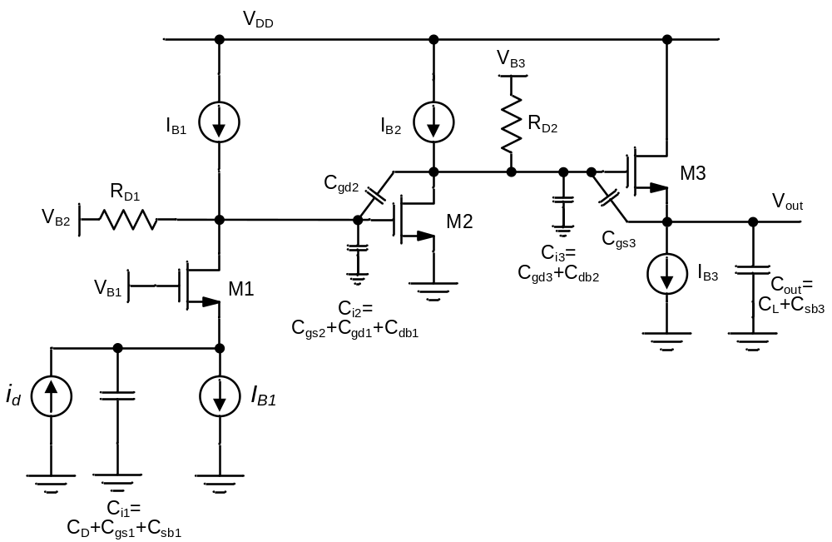
Figure 6-16

Slide 22
Figure 6-17
% Design script for three-stage transresistance amplifier
%%%%%%%%%%%%%%%%%%%%%%%%%%%%%%%%%%%%%%%%%%%%%%%%%%%%%%%%%%%%%%%%%%
% Process technology parameters
kp_n = 50e-6;
Cox = 2.3e-3;
mu_n = kp_n/Cox;
Cov = 0.5e-9;
gmb_gm = 0.2;
%%%%%%%%%%%%%%%%%%%%%%%%%%%%%%%%%%%%%%%%%%%%%%%%%%%%%%%%%%%%%%%%%%
% Design specifications
Rm = 2e3;
CD = 5e-12;
CL = 10e-12;
IDtot = 3e-3;
%%%%%%%%%%%%%%%%%%%%%%%%%%%%%%%%%%%%%%%%%%%%%%%%%%%%%%%%%%%%%%%%%%%
% Design choices
VOV1 = 0.3;
VOV2 = 0.3;
VOV3 = 0.3;
L1 = 1e-6;
L2 = 1e-6;
L3 = 1e-6;
%%%%%%%%%%%%%%%%%%%%%%%%%%%%%%%%%%%%%%%%%%%%%%%%%%%%%%%%%%%%%%%%%%%
% optimization parameters
ID1_IDtot = 0.25;
ID3_IDtot = 0.25;
Av20 = 10;
%%%%%%%%%%%%%%%%%%%%%%%%%%%%%%%%%%%%%%%%%%%%%%%%%%%%%%%%%%%
% Compute drain currents
ID1 = IDtot*ID1_IDtot;
ID3 = IDtot*ID3_IDtot;
ID2 = IDtot - ID1 - ID3;
% Calculations for M1
gm1 = 2*ID1/VOV1;
W1 = 2*ID1/(kp_n/L1*VOV1^2);
Cgs1 = 2/3*W1*L1*Cox + W1*Cov;
tau_in = (Cgs1+CD)/(gm1*(1+gmb_gm));
% Calculations for M3
gm3 = 2*ID3/VOV3;
W3 = 2*ID3/(kp_n/L3*VOV3^2);
Cgs3 = 2/3*W3*L3*Cox + W3*Cov;
Cgd3 = W3*Cov;
Av30 = 1-gmb_gm;
tau_out = (CL+Cgs3)/(gm3*(1+gmb_gm));
% Calculations for M2
gm2 = 2*ID2/VOV2;
W2 = 2*ID2/(kp_n/L2*VOV2^2);
Cgs2 = 2/3*W2*L2*Cox + W2*Cov;
Cgd2 = W2*Cov;
RD1 = Rm/Av20/Av30;
RD2 = Av20/gm2;
tau_core = RD1*(Cgs2 + (1+Av20)*Cgd2) + RD2*(Cgd3+(1-Av30)*Cgs3);
% Total time constant and bandwidth estimate
tau_tot = tau_i1 + tau_core + tau_out
f3dB = 1/2/pi/tau_tot

Slide 23
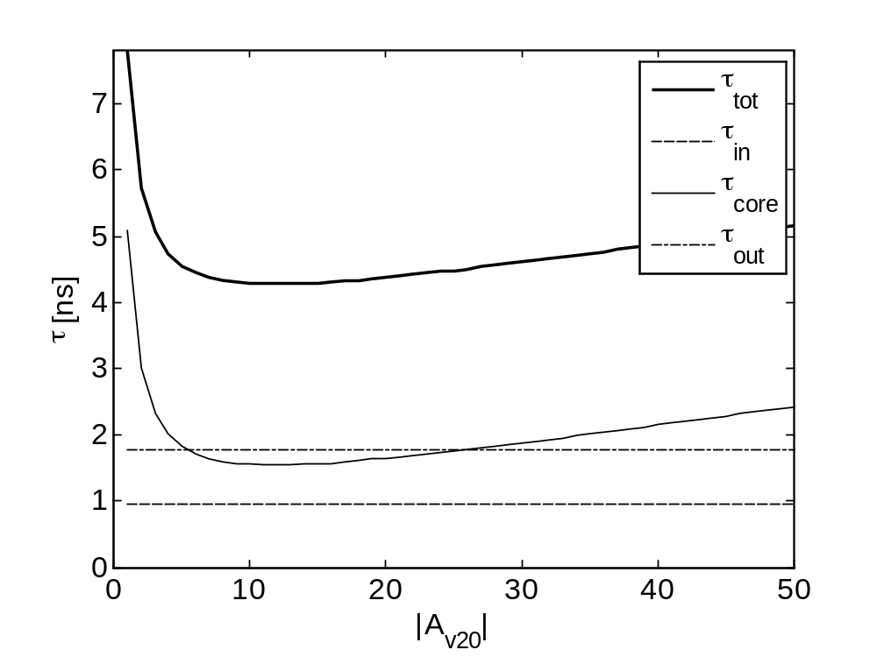
Figure 6-18

Slide 24
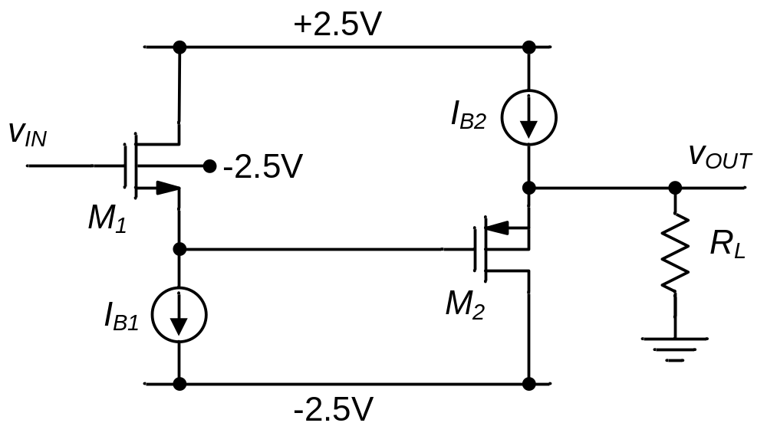
Figure P6-3
Howe & Sodini, Fig. P9-3

Slide 25
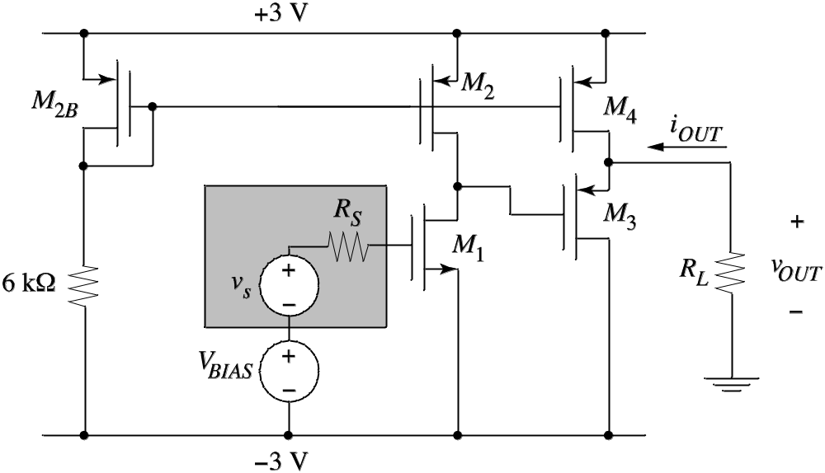
Figure P6-5
Howe & Sodini, Fig. P9-17

Slide 26
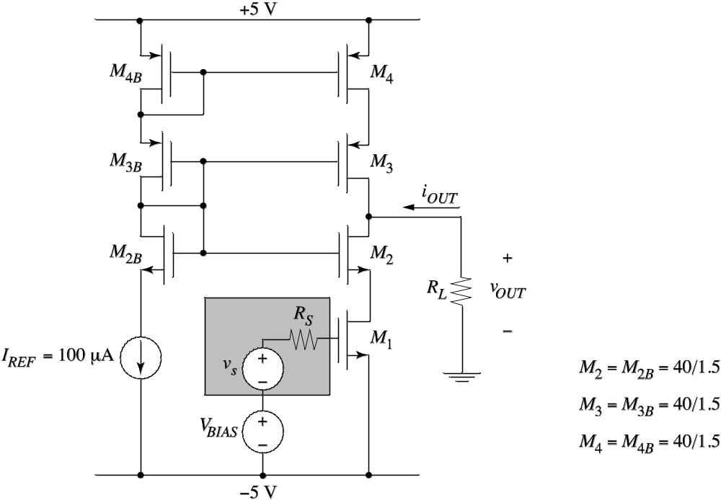
Figure P6-6
Howe & Sodini, Fig. P9-20

Slide 27
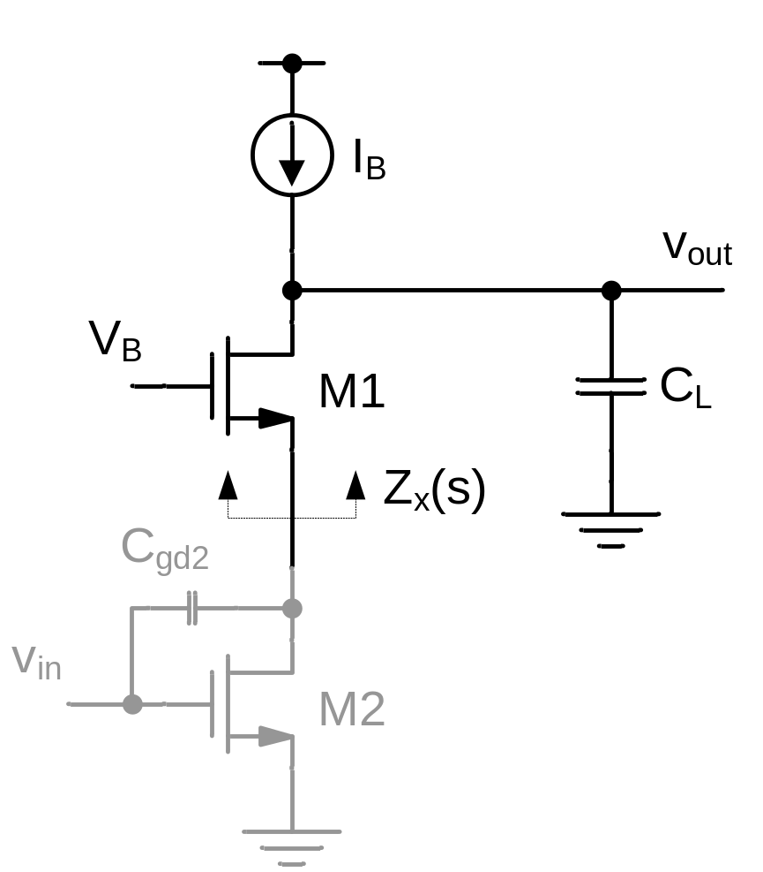
Figure P6-7

Slide 28
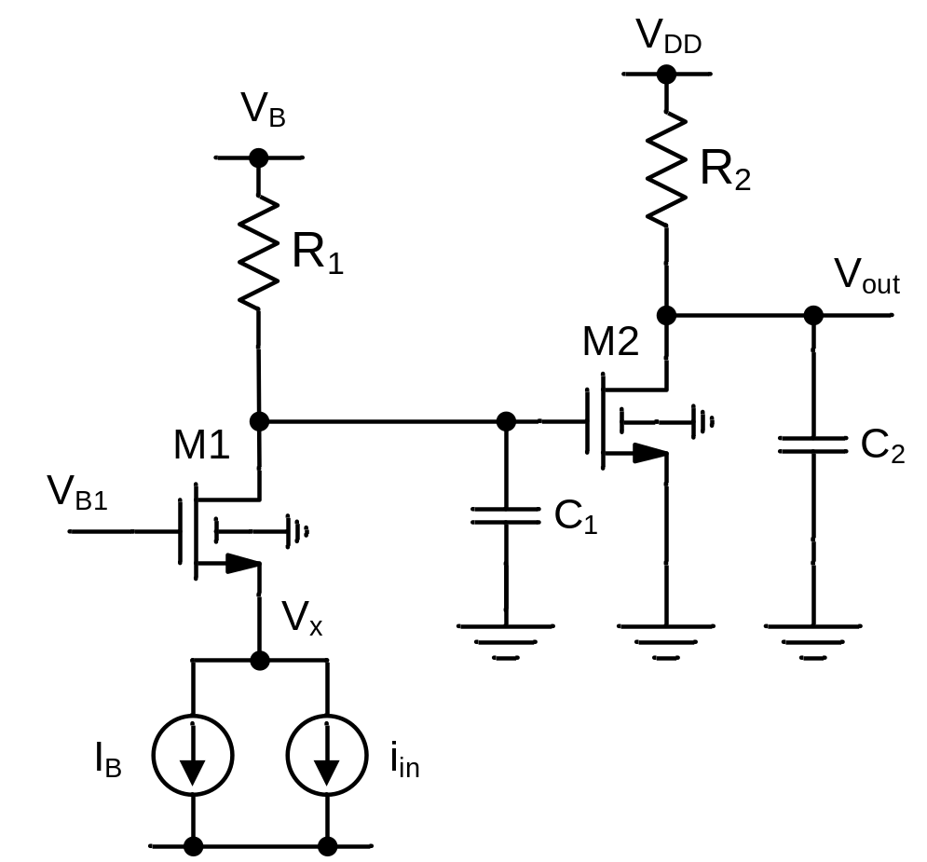
Figure P6-8

Slide 29
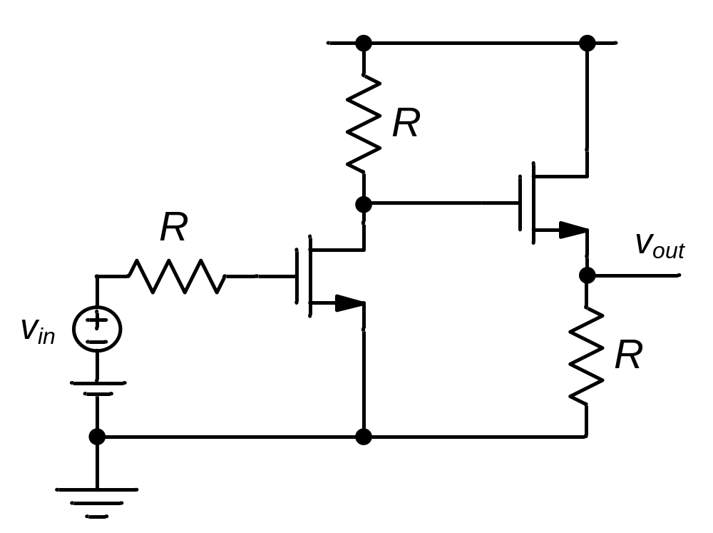
Figure P6-9

Slide 30
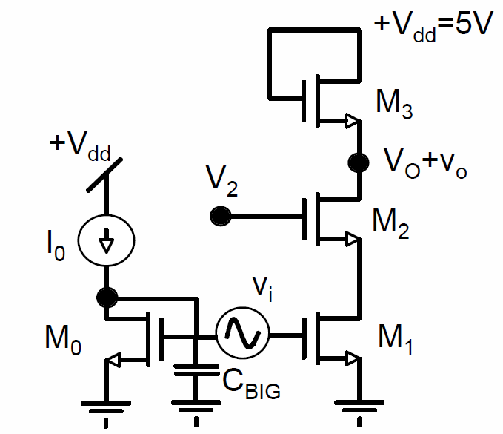
Figure P6-12
V_{DD} = +2.5V

Slide 31
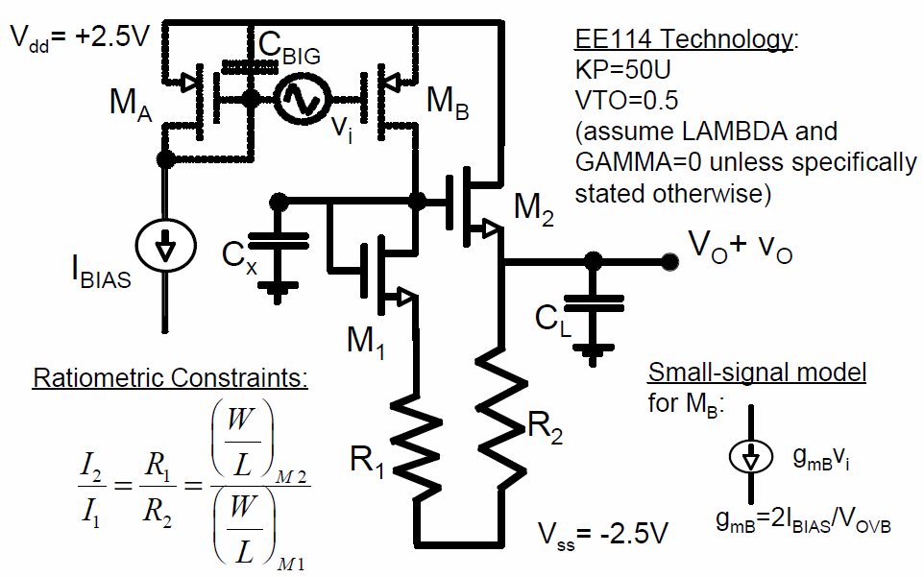
Figure P6-13
V_{DD} = +2.5V
V_{SS} = -2.5V

Slide 32
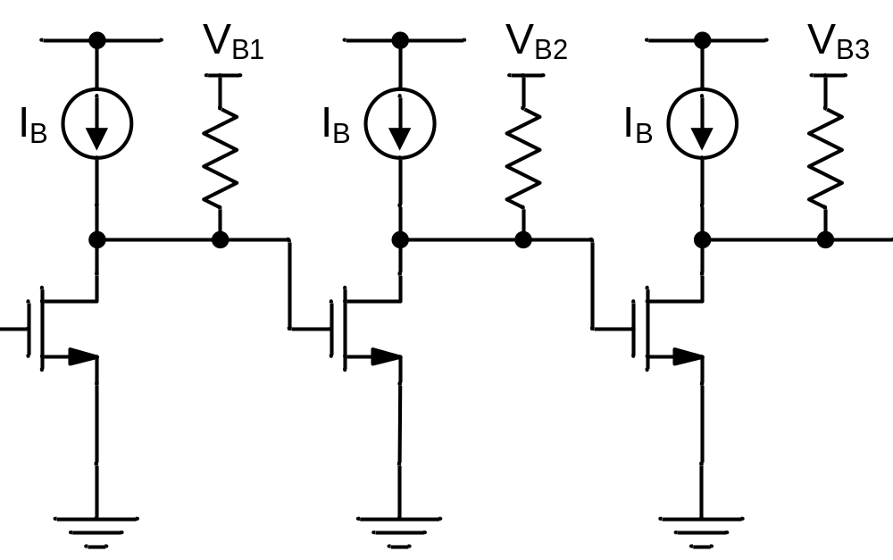
Figure P6-14

Slide 33
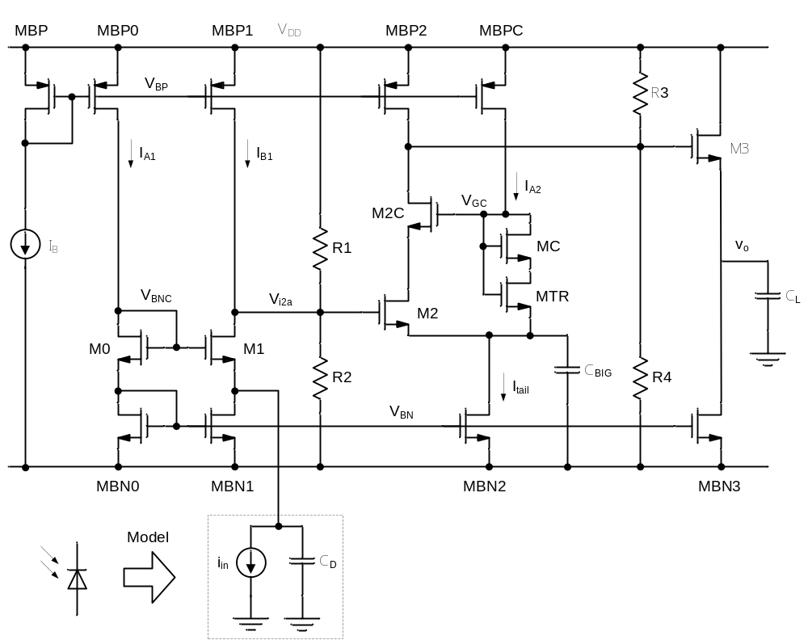
Figure P6-15

