Slide 1
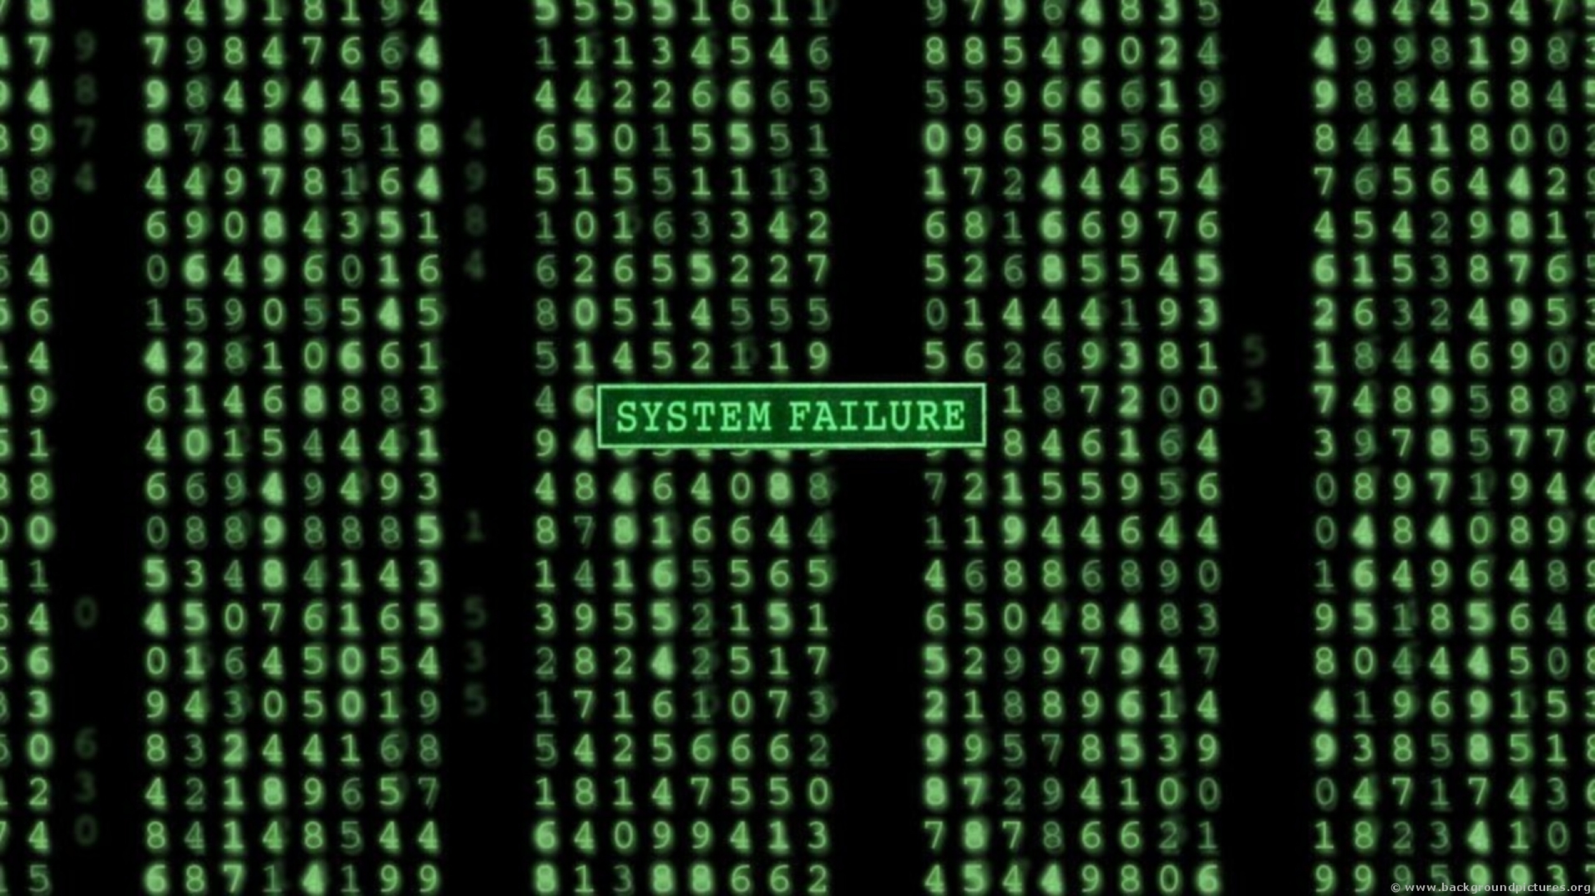

Developer-Module Networks & Failure Prediction
Can They Really Be Valid Defect Predictors?
Bryan J Muscedere
Rafi Turas

Slide 2
Introduction
As we’ve seen in the course, they are many advantages to early defect prediction.
Many studies have been published looking at whether internal metrics can be used as failure predictors.
Studies have looked at:
Code measures
People and organizational metrics
Social networks

Slide 3
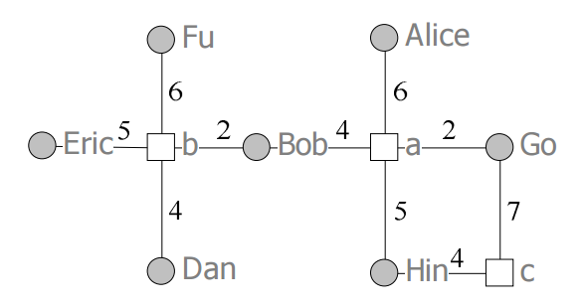
Developer-Module Networks
Social network.
Contains actors.
Files and developers.
Contains ties.
Commits between files and developers.
Can compute social network metrics like betweenness centrality.

Slide 4
Can Developers-Module Networks Predict Failures?
Published by Pingzer et al. in 2009
Study of Windows Vista and its associated binaries and developers.
Looked at whether the developer-module network for Windows Vista could predict failure-prone binaries.
Used centrality metrics to predict.

Slide 5
Limitations with Previous Work
Windows Vista is a great start.
Large software project with lots of developers and binaries.
However, extrapolating results to other software domains can be dangerous.
Are developer-module networks valid predictors of failures in other domains?

Slide 6
Our Project
GitHub hosts tens of thousands of different projects:
Open-source
Hobbyist.
GitHub contains a wealth of data.
Why don’t we build developer-module networks for a slew of GitHub projects?

Slide 7
Research Questions
RQ1: Is the centrality of a file related to the number of commits and bug fixes in a file?
RQ2: Can centrality be used as a valid predictor for defects?

Slide 8
The Boa Project
Project that aims to develop a high-level language for mining code version repositories.
Comprised of two elements:
Domain specific language for mining code repositories.
Large online dataset from GitHub and Surgeforge (September 2013)
Has an Eclipse plugin and Java API.

Slide 9
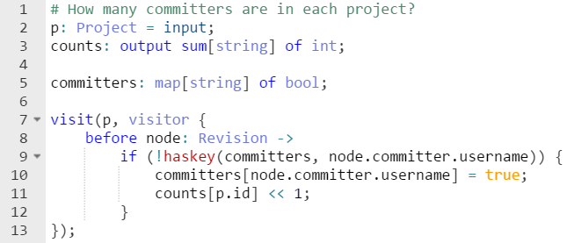
Example of Boa: Number of Committers

Slide 10
Methodology
Determine adequate projects stored in Boa.
Pull associated file, user, and commit information for a desired project.
Build contribution network from the project data.
Compute betweenness, closeness, and degree centrality.
Run logical regression on the social network and determine precision and recall.

Slide 11
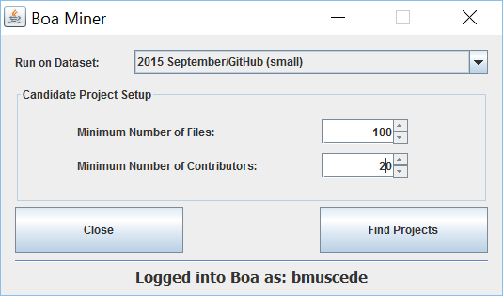

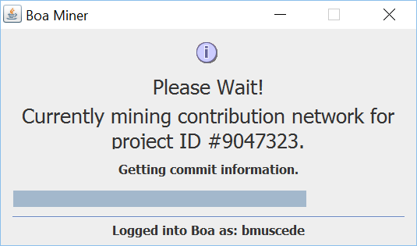
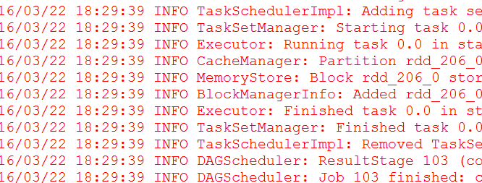
Software Tool: NetworkMine
Boa Software Miner
Social Network Builder

Slide 12
Next Steps: Software Tool

Slide 13
Next Steps: Software Tool
In the future, we will look at additional data sources.

Slide 14
Projects Used in Study
We performed our methodology on 15 different GitHub projects.
Project Statistics:
Max Contributors | Min Contributors | Average Contributors
353 | 102 | 314.20
Max Files | Min Files | Average Files | Average Commits Per File | Average Bug Fixes Per File
11,935 | 1,451 | 3,281.73 | 42.80 | 7.12

Slide 15
Spearman Correlation Results
Determines how data metrics correlate with each other.
Values +/-0.7 are considered significant.
 | Commits | Failures | Betweeness | Closeness | Degree
Commits | 1
Failures |  | 1
Betweenness |  |  | 1
Closeness |  |  |  | 1
Degree |  |  |  |  | 1
Values are significant at the 0.01 level (2-tailed).

Slide 16
Logistical Regression Results
Performed 100 times on the data.
Each time, 66% of the graph was placed in a training set and 44% was placed in a test set.
 | Precision | Recall
Average (Mean)
Median
Standard Deviation

Slide 17
Logistical Regression Results

Slide 18
Conclusion
We show that GitHub projects can
Lots of future work!
Use linear regression to predict number of bugs.
Tool improvements.
Change data source to speed up data mining.

Slide 19
Thanks For Listening
Any Questions?

