Slide 1


Developer-Module Networks & Failure Prediction
Can Network Centrality Be A Valid Defect Predictor?
Bryan J Muscedere
Rafi Turas

Slide 2
Introduction
As we’ve seen in the course, they are many advantages to early defect prediction.
Many studies have been published looking at whether internal metrics can be used as failure predictors.
Studies have looked at:
Code measures
People and organizational metrics
Social networks
Notes:
Rafi talks here.

Slide 3
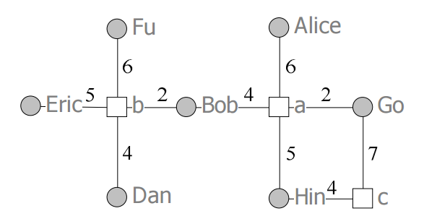
Developer-Module Networks
Social network.
Contains actors.
Files and developers.
Contains ties.
Commits between files and developers.
Betweenness, closeness, degree centrality.

Slide 4
Can Developers-Module Networks Predict Failures?
Published by Pingzer et al. in 2009
Study of Windows Vista and its associated binaries and developers.
Looked at whether the developer-module network for Windows Vista could predict failure-prone binaries.
Used centrality metrics to predict.

Slide 5
Limitations with Previous Work
Windows Vista is a great start.
Large software project with lots of developers and binaries.
However, extrapolating results to other software domains can be dangerous.
Are developer-module networks valid predictors of failures in other domains?

Slide 6
Our Project
GitHub hosts tens of thousands of different projects:
Open-source
Hobbyist.
GitHub contains a wealth of data.
Why don’t we build developer-module networks for a slew of GitHub projects?

Slide 7
Research Questions
RQ1: Is the centrality of a file related to the number of commits and bug fixes in a file?
RQ2: Can centrality be used as a valid predictor for defects?

Slide 8
Methodology

Slide 9
The Boa Project
Project that aims to develop a high-level language for mining code version repositories.
Comprised of two elements:
Domain specific language for mining code repositories.
Large online dataset from GitHub and Surgeforge (September 2015)
Has an Eclipse plugin and Java API.
Notes:
Bryan talks here.

Slide 10
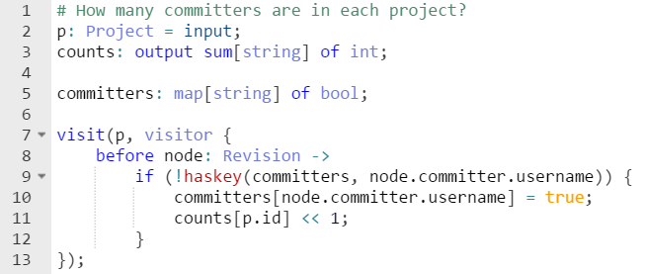
Example of Boa: Number of Committers

Slide 11
Methodology
Pull associated file, user, and commit information for a desired project from Boa.
Build contribution network from the project data.
Compute betweenness, closeness, and degree centrality.
Calculate Spearman correlation for each metric.
Run logistical regression on the social network and determine precision and recall.

Slide 12
Software Tool: NetworkMine

Slide 13
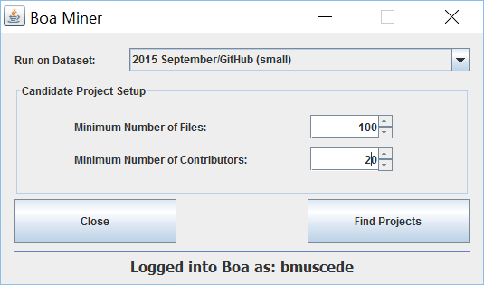

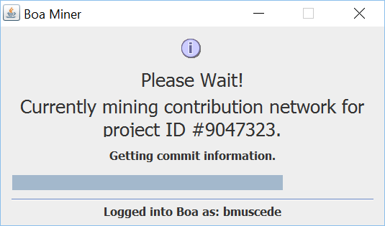
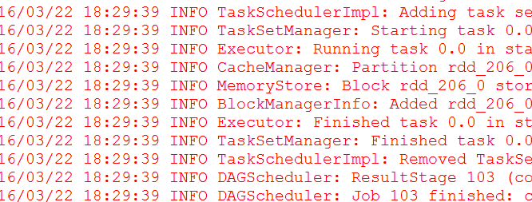
Software Tool: NetworkMine
Boa Software Miner
Social Network Builder

Slide 14
Study Results

Slide 15
Projects Used in Study
Project Statistics:
Max Contributors | Min Contributors | Average Contributors
308 | 102 | 190.20
Max Files | Min Files | Average Files
6,683 | 1,448 | 3,268.47
Average Commits Per File | Average Bug Fixes Per File
26.9 | 4.33

Slide 16
Spearman Correlation: All Projects
Determines how data metrics correlate with each other.
Values +/-0.7 are considered to be strongly correlated.
 | Commits | Bug Fixes | Betweenness | Closeness | Degree
Commits | 1.00 | 0.811 | 0.507 | 0.173 | 0.852
Bug Fixes |  | 1.00 | 0.453 | 0.213 | 0.750
Betweenness |  |  | 1.00 | 0.627 | 0.723
Closeness |  |  |  | 1.00 | 0.459
Degree |  |  |  |  | 1.00
Values are significant at the 0.01 level (2-tailed).

Slide 17
Spearman: MarkUs vs Caf-Platform
 | Commits | Bug Fixes | Betweenness | Closeness | Degree
Commits | 1 | 0.845 | 0.633 | -0.206 | 0.929
Bug Fixes |  | 1 | 0.589 | -0.024 | 0.869
Betweenness |  |  | 1 | 0.120 | 0.765
Closeness |  |  |  | 1 | -0.035
Degree |  |  |  |  | 1
MarkUs
 | Commits | Bug Fixes | Betweenness | Closeness | Degree
Commits | 1 | 0.927 | 0.803 | 0.870 | 0.9711
Bug Fixes |  | 1 | 0.783 | 0.821 | 0.933
Betweenness |  |  | 1 | 0.899 | 0.868
Closeness |  |  |  | 1 | 0.926
Degree |  |  |  |  | 1
Caf-Platform

Slide 18
Logistical Regression
Performed 100 times on the data.
Each time, 60% of the graph was placed in a training set and 40% was placed in a test set.
Labelled 0 for non-bug-prone and 1 for bug-prone.

Slide 19
Logistical Regression: All Projects
 | Precision | Recall
Average (Mean) | 0.756 | 0.765
Median | 0.730 | 0.781
Standard Deviation | 0.119 | 0.123

Slide 20
Precision and Recall: Caf-Platform
Average | 0.753
Median | 0.753
Standard Dev. | 0.0205
Average | 0.816
Median | 0.813
Standard Dev. | 0.0186

Slide 21
Conclusion
We show that, for some GitHub projects, we can predict the presence of bug-prone files using centrality.
Lots of future work!
Check larger projects.
Use linear regression to predict number of bugs.
Tool improvements.

Slide 22
Thanks For Listening
Any Questions?

Slide 23
Image Credits
[1] Matrix: http://ecx.images-amazon.com/images/I/61lpwViZjpL._SX466_.jpg
[2] GitHub Image: http://img.gawkerassets.com/img/18efmtxt7i5nvjpg/original.jpg
[3] Developer Module Network: M. Pingzer, N. Nagappan and B. Murphy, "Can Developer-Module Networks Predict Failures?," in Special Interest Group on Software Engineering (SIGSOFT), Atlanta, Georgia, 2008.
[4] Apache Spark Logo: http://spark.apache.org/images/spark-logo-trademark.png

