Slide 1
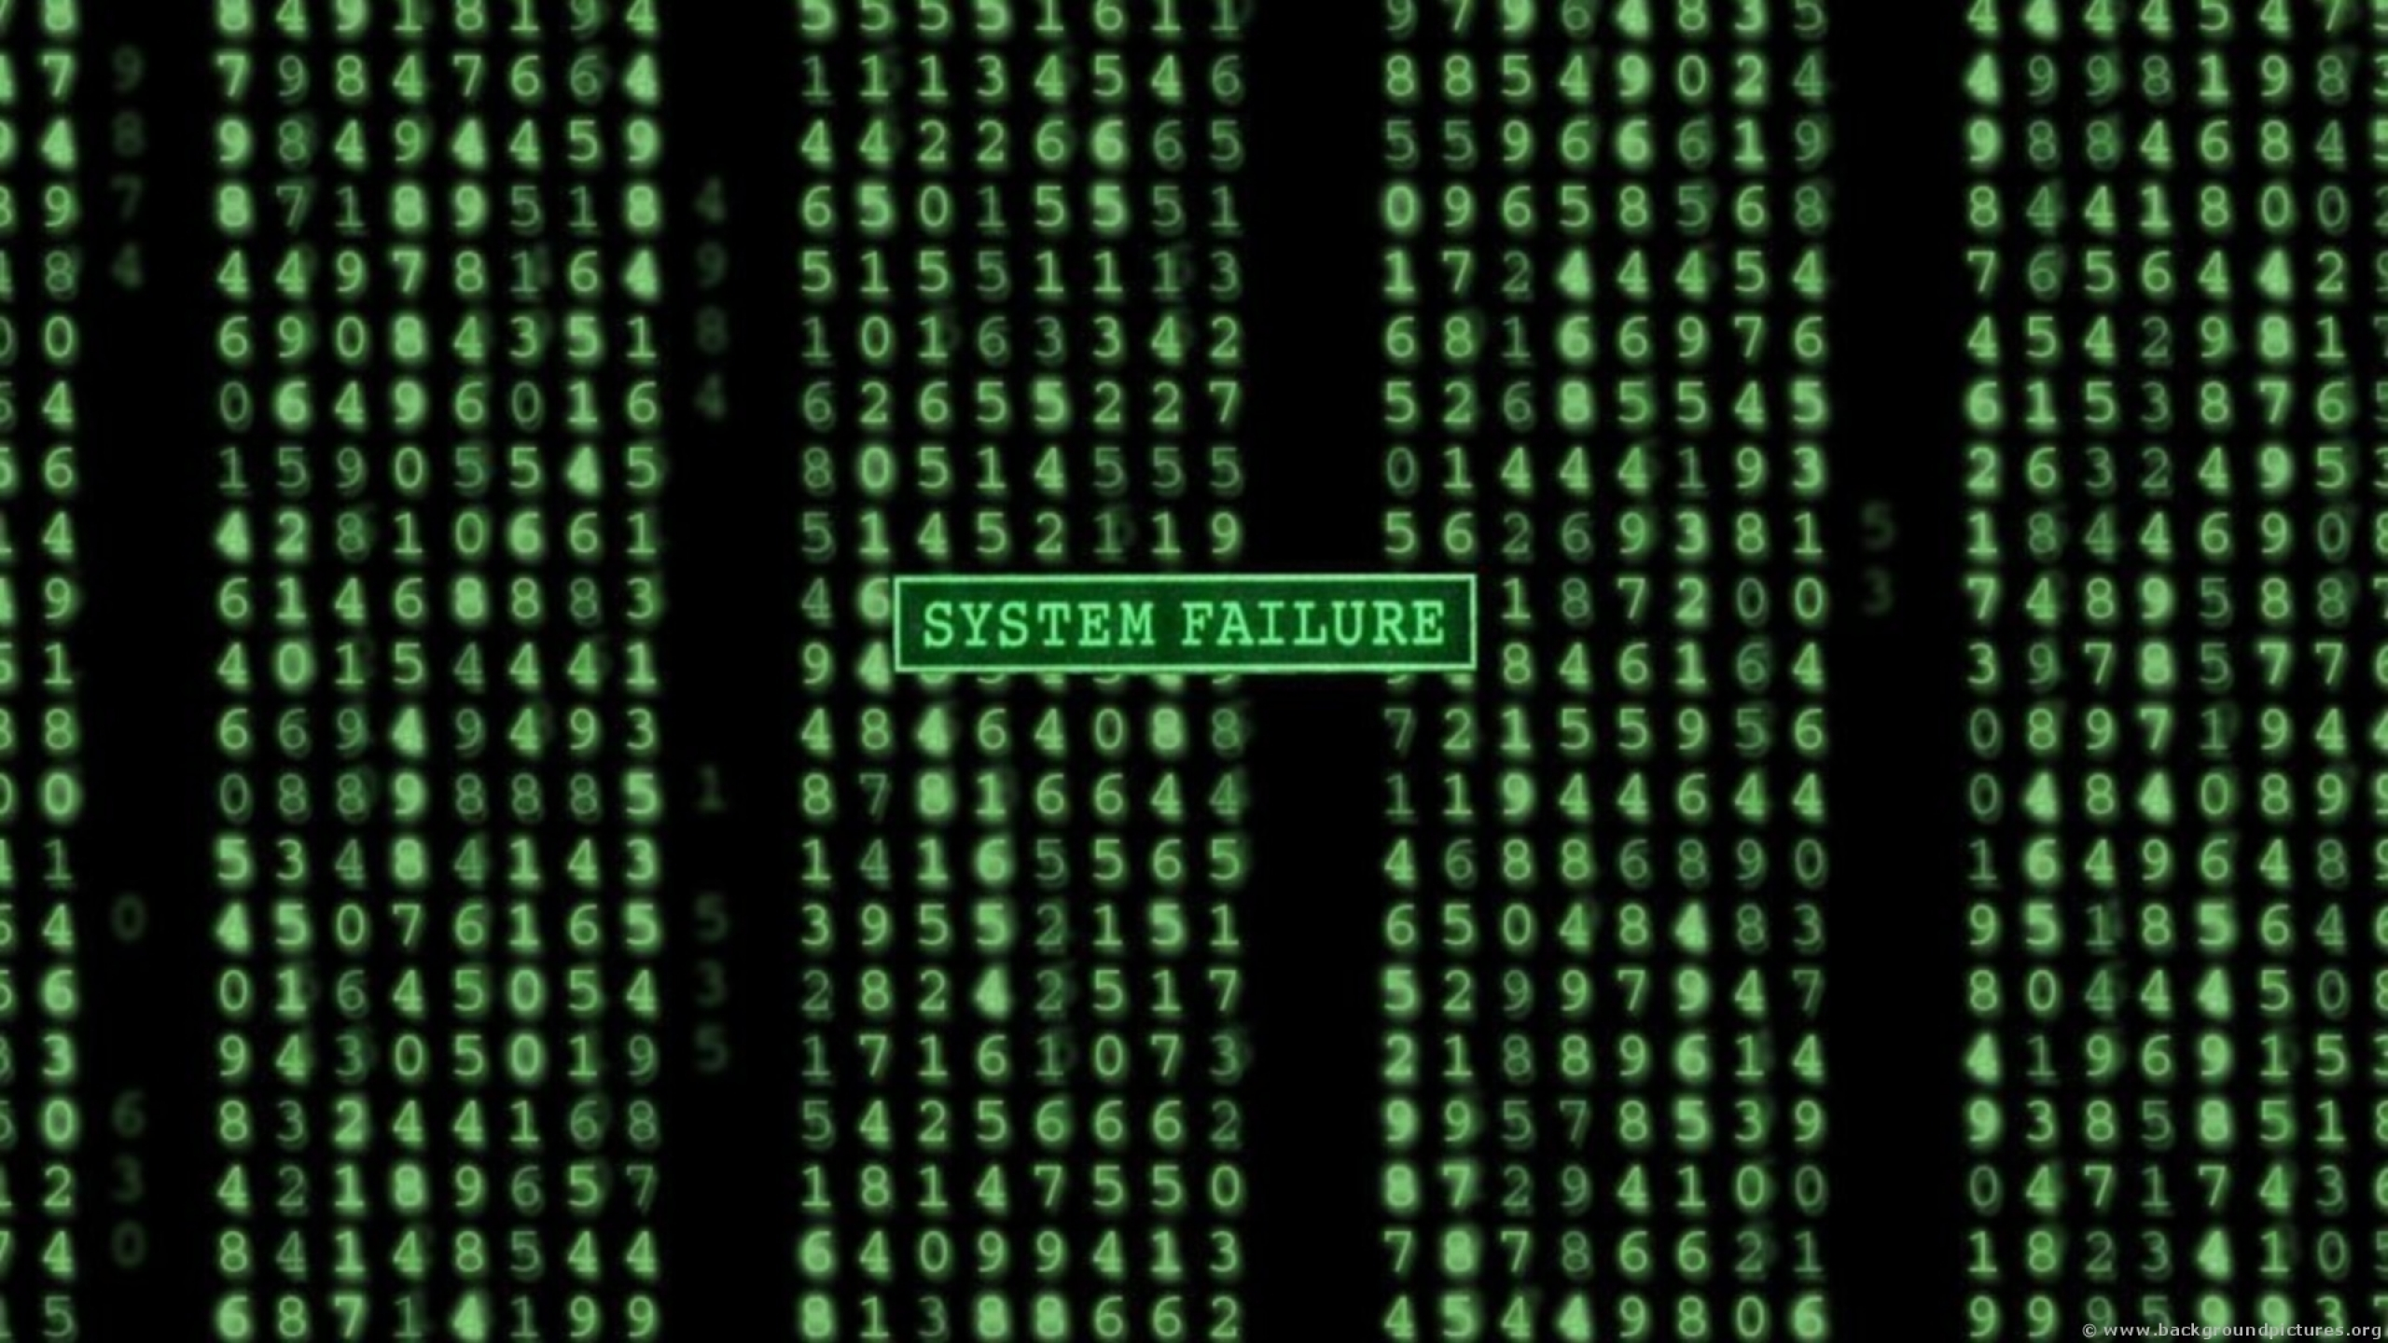

Developer-Module Networks & Failure Prediction
Can They Really Be Valid Defect Predictors?
Bryan J Muscedere
Rafi Turas

Slide 2
Introduction
As we’ve seen in the course, they are many advantages to early defect prediction.
Many studies have been published looking at whether internal metrics can be used as failure predictors.
Studies have looked at:
Code measures
People and organizational metrics
Social networks

Slide 3
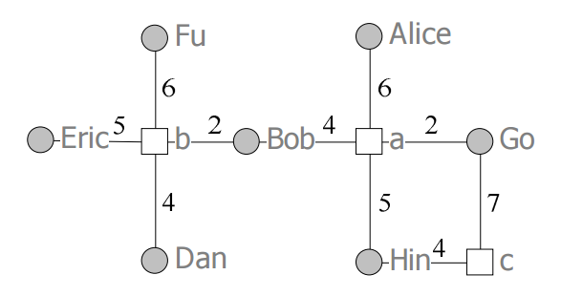
Developer-Module Networks
Social network.
Contains actors.
Files and developers.
Contains ties.
Commits between files and developers.
Can compute social network metrics like betweenness centrality.

Slide 4


Slide 5
Can Developers-Module Networks Predict Failures?
Study of Windows Vista.
Looked at whether the developer-module network for Windows Vista could predict failure-prone binaries.
Hypothesized that
Found that, with

Slide 6
Our Project
Windows Vista is a massive software project with thousands of developers and binaries.

Slide 7
Our Project

Slide 8
The Boa Project
Project that aims to develop a high-level language for mining code version repositories.
Comprised of two elements:
Domain specific language for mining code repositories.
Large online dataset from GitHub and Surgeforge (September 2013)
Has an Eclipse plugin and Java API.

Slide 9
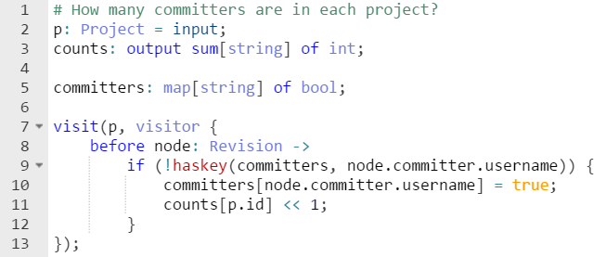
Example of Boa: Number of Committers

Slide 10
Software Tool
An extra component that we started working on is a software tool.
In the future, we will look at additional data sources.

Slide 11
Thanks For Listening
Any Questions?

