Slide 2
Android and iOS Development with JAX-RS, WebSocket and Java EE 7
Reza Rahman, Oracle
Balaji Muthuvarathan, CapTech
Ryan Cuprak, Dassault Systemès

Slide 3
Program Agenda
Mobile Landscape
Java EE
iOS
Android
Java EE + Mobile Demo
Best Practices/Summary
Q&A

Slide 4
Mobile Platform Overview
Dominated by Google’s Android and Apple’s iOS platforms.
  Android’s US market share is about 52% against iOS’s 42%
Windows Phone is at a distance 3rd place with about 4% share
Globally, Android’s market share is even higher

Slide 5
Mobile Development Models
Native App
  Built for a specific platform
  Downloadable app
  Objective-C/xCode, Java/Eclipse etc.
Mobile Web App
  Service side apps that run in the device’s web browser
  HTML 5, CSS3, JavaScript
  jQuery Mobile, Sencha Touch
  Responsive and Adaptive Web Designs
Hybrid App
  Developed mostly using Mobile Web App technologies, but are executed like a native app in a native (wrapper) container
  PhoneGap, ADF Mobile, IBM Worklight, AeroGear, Appcelerator

Slide 6
Mobile Development Models (cont.)
Native App
  Best user experience
  Access all device/hardware capabilities
  But, development/maintenance will have to be done for every target mobile platform
Mobile Web App
  Target multiple platforms from a singe code base
  Low barrier to entry – low learning curve, nothing to download for users
  But, evolving HTML 5 standards and inconsistent adoption/support could impact user experience and timelines
  Access to device capabilities (such as accelerometer) is limited as well
Hyrbid
  Allows to target multiple platforms with a single code base, while maintaining access to device capabilities
  But, native development may still be needed and performance may also suffer slightly

Slide 7
Client/Server Connectivity
Two main types – RESTful services and WebSockets
RESTful Services
  Client/server communication from mobile applications commonly happens over HTTP, more often using REST style services
  Stateless, lightweight, scalable
  Typically JSON over HTTP/HTTPS. XML could be used as well
  Client initiates the request
  Commonly supported HTTP verbs include GET, POST, PUT, and DELETE
  Uses existing web technologies and security standards
  Fully supported by Java EE and GlassFish Server

Slide 8
Client/Server Connectivity (cont.)
WebSockets
  Offers true bi-directional (full-duplex) communication over a single TCP connection
  Initial hand-shake over HTTP, but subsequent conversations over WebSockets
  Supports asynchronous, extremely low-lag communication
  Perfect for applications like chat and game
  Uses existing web technologies and security standards
  Supported by Java EE and GlassFish

Slide 9
Java EE/Mobile
Mobile Device
JAX-RS
Java API for
WebSocket
Java API for
JSON
JAXB
Bean Validation
Servlet
EJB 3
CDI
JPA
JMS
JTA
JCA

Slide 10
JAX-RS
REST development API for Java
Server and client
Annotation based, declarative
  @Path, @GET, @POST, @PUT, @DELETE, @PathParam, @QueryParam, @Produces, @Consumes
Pluggable and extensible
  Providers, filters, interceptors

Slide 11
JAX-RS Example
@Path("/atm/{cardId}")
public class AtmService {
@GET
@Path("/balance")
@Produces("text/plain")
public String balance(
@PathParam("cardId") String card,
@QueryParam("pin") String pin) {
return Double.toString(getBalance(card, pin));
}
...
Notes:
Use @Path to define web resources
Use other annotations to map requests to methods
Use method return value as response
MBR and MBW help us behind the scenes

Slide 12
JAX-RS Example
...
@POST
@Path("/withdrawal")
@Consumes("text/plain")
@Produces("application/json")
public Money withdraw(
@PathParam("card") String card,
@QueryParam("pin") String pin,
String amount) {
return getMoney(card, pin, amount);
}
}
Notes:
MBR and MBW can be user defined too

Slide 13
Java API for WebSocket
High level declarative API for WebSocket
Both client and server-side
Small, powerful API
  @ServerEndpoint, @OnOpen, @OnClose, @OnMessage, @OnError, Session, Remote
Pluggable and extensible
  Encoders, decoders, sub-protocols

Slide 14
WebSocket Sample
@ServerEndpoint("/chat")
public class ChatBean {
Set<Session> peers = Collections.synchronizedSet(…);
@OnOpen
public void onOpen(Session peer) {
peers.add(peer);
}
@OnClose
public void onClose(Session peer) {
peers.remove(peer);
}
...

Slide 15
WebSocket Sample (Continued)
...
@OnMessage
public void message(String message, Session client) {
for (Session peer : peers) {
peer.getRemote().sendObject(message);
}
}
}

Slide 16
iOS
Overview
iOS provides built-in support for REST and JSON.
  Functionality can be augmented with external libraries like RestKit.
iOS has no built-in WebSocket support.
  External library required such as SocketRocket.
SSL supported for both REST and WebSockets.

Slide 17

iOS and REST
Reskit
RestKit: http://restkit.org
Apache License
Core Data Support
Object Mapping
Pluggable Parser
Support MIME types, multi-part submissions

Slide 18
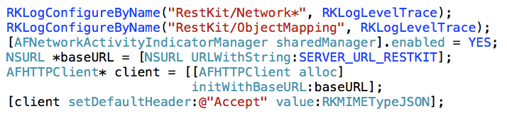
iOS and REST
RestKit – Configuration

Slide 19
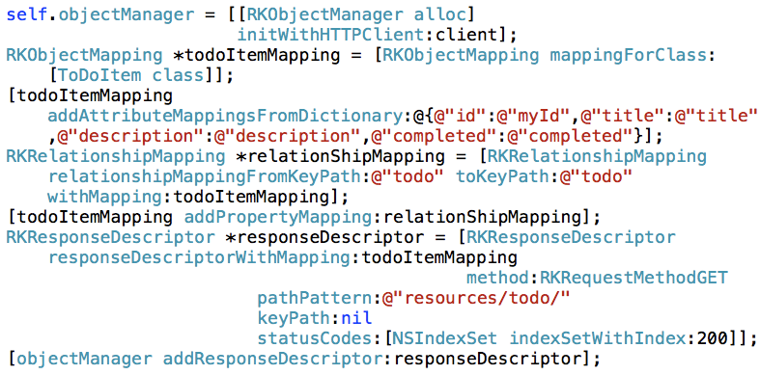
iOS and REST
RestKit – Object Mapping Setup

Slide 20
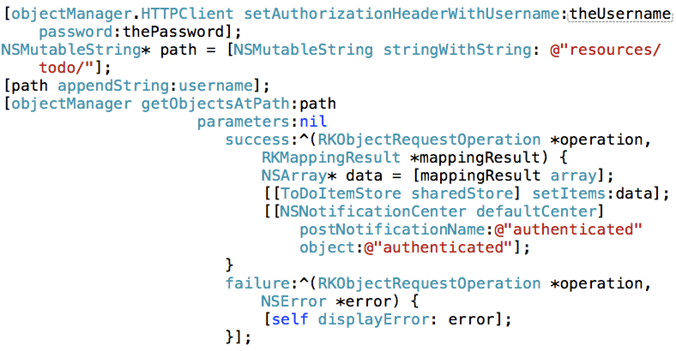
iOS and REST
RestKit – Invoking Service

Slide 21
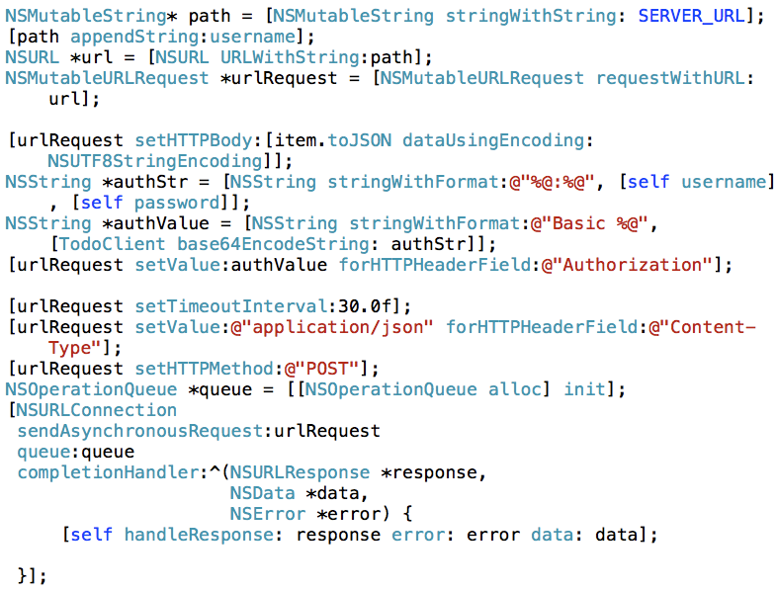
iOS and REST
NSURL Approach

Slide 22
iOS and WebSocket
SocketRocket
Open source library WebSocket library for iOS.
http://github.com/square/SocketRocket
Apache 2.0 License.
Comprehensive regression suite.
Supports secure WebSockets.
Implement proxy SRWebSocketDelegate.
Simple project integration.

Slide 23
iOS and WebSocket
Delegate Methods
Message Message Callback
-(void)webSocket:(SRWebSocket*)webSocket
didReceiveMessage:(id)message;
WebSocket Open Operation
(void)webSocketDidOpen:(SRWebSocket*)webSocket;
WebSocket Connection Failed
(void)webSocket:(SRWebSocket*)webSocket
didFailWithError:(NSError*)error;
WebSocket Failed
(void)webSocket:(SRWebSocket*)webSocket
didCloseWithCode:(NSInteger)code
reason:(NSString*)reason wasClean:(BOOL)wasClean;

Slide 24
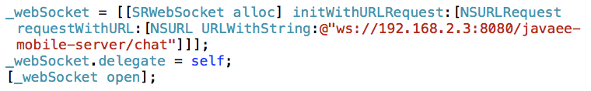
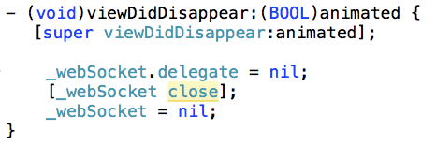
iOS and WebSocket
Open WebSocket Connection
Open Connection
Close Connection

Slide 25
Android
Overview
Comes bundled with Apache HTTPClient
Comes bundled with a rudimentary JSON library from json.org
  Jackson
  GSON
No out-of-box REST support
  Spring Android RestTemplate
  RESTDroid
  JAX-RS/Jersey Client APIs on Android?
No out-of-box WebSockets support
  Autobahn Android
  Android WebSockets from CodeButler
  WebSocket/Tyrus Client APIs on Android?

Slide 26
Spring Android RestTemplate
  RestTemplate restTemplate = new RestTemplate();
  restTemplate.getMessageConverters().add(new
  MappingJacksonHttpMessageConverter());
  restTemplate.getMessageConverters().add(new StringHttpMessageConverter());
  ResponseEntity<ToDoResponse> response = ResponseEntityrestTemplate.exchange(
  urlStr,
  HttpMethod.POST,
  new HttpEntity<ToDoItem>(todoItem, httpHeaders),
  ToDoResponse.class
  );

Slide 27
Android – HTTP Basic Authentication
import org.springframework.http.HttpAuthentication;
  import org.springframework.http.HttpBasicAuthentication;
  import org.springframework.http.HttpHeaders;
...
HttpAuthentication authHeader =
new HttpBasicAuthentication(username, password);
defaultHeaders = new HttpHeaders();
defaultHeaders.setAuthorization(authHeader);

Slide 28
Autobahn Android WebSockets Client
private final WebSocketConnection mConnection = new
WebSocketConnection();
...
mConnection.connect(wsuri, new WebSocketHandler() {
  @Override
  public void onOpen() {
  mConnection.sendTextMessage("Hello, world!");
  }
  @Override
  public void onTextMessage(String payload) {
  Log.d(TAG, "Got echo: " + payload);
  }
  @Override
  public void onClose(int code, String reason) {
  Log.d(TAG, "Connection lost.");
  }
  });

Slide 29
Android – SSL certs and Self-signed certs
Using SSL certificates from established CAs requires no additional work
Using self-signed SSL certs (during development or otherwise) requires some tedious setup
  Export the cert from the server
  Save the cert as an asset in the Android application
  Load the cert into a CertificateFactory within the application
  Create Trust Manager with the self-signed CA
  Create an SSL Context that uses the Trust Manager
  Set the SSLContext as the default context
  Spring RestTemplate will automatically use this new default SSLContext when communicating with HTTPS resources

Slide 30

Java EE + Android/iOS Demo
https://github.com/m-reza-rahman/javaee-mobile

Slide 31
Some Best Practices
REST vs. WebSocket
  REST for the most part, WebSocket only for full-duplex, bidirectional
JSON vs. XML
  JSON hands down
Where to store state
  Mostly on the client, synchronize/persist on the server
API design
  Coarse grained, stateless, general purpose
Security
  TLS, federated (OAuth), avoid sensitive data on client
Development model
  Native -> Hybrid -> HTML 5?

Slide 32
Some Best Practices
Testing
  Be-aware of data conversion issues: encoding, data precision, etc
  Write unit tests for all target platforms.
  Use Java for baseline unit testing.

Slide 33
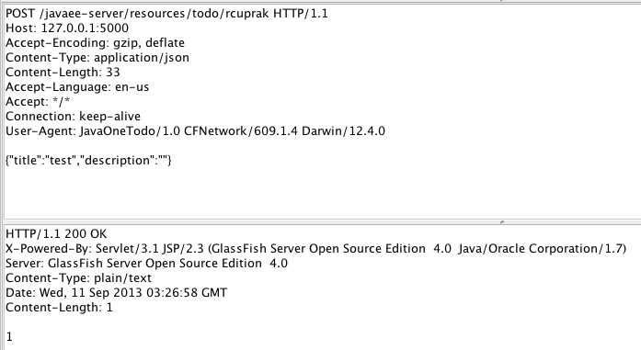
Best Practices
Tcpmon Troubleshooting

Slide 34
Summary
Mobile space dominated by Android, iOS native development
The mobile client development model is still evolving, perhaps towards HTML 5
Communication to server side happens via REST and WebSocket
Java EE well positioned as a mobile backend, especially with JAX-RS and the Java API for WebSocket
You can use our demo code as a starting point
There are some best practices to be aware of
Most importantly, have fun!

Slide 35
Resources
Mobile Development Models
  http://www.captechconsulting.com/sites/default/files/MobileWebinar_CageMatch_V7.pdf
Mobile Market Share
  http://www.networkworld.com/news/2013/070813-iphone6-ios-marketshare-apple-android-271583.html
Java EE
  http://oracle.com/javaee
Java EE Tutorial
  http://docs.oracle.com/javaee/7/tutorial/doc/home.htm
Reference Implementation
  http://glassfish.org
  http://java.net/projects/tyrus
  http://jersey.java.net

Slide 36
Resources
RestKit
  http://restkit.org/
SocketRocket
  http://corner.squareup.com/2012/02/socketrocket-websockets.html
Autobahn Android
  http://autobahn.ws/android
Spring Android RestTemplate
  http://projects.spring.io/spring-android/
CapTech Mobile Practice
  http://www.captechconsulting.com/services/systems-integration/mobile-technologies

