Slide 1
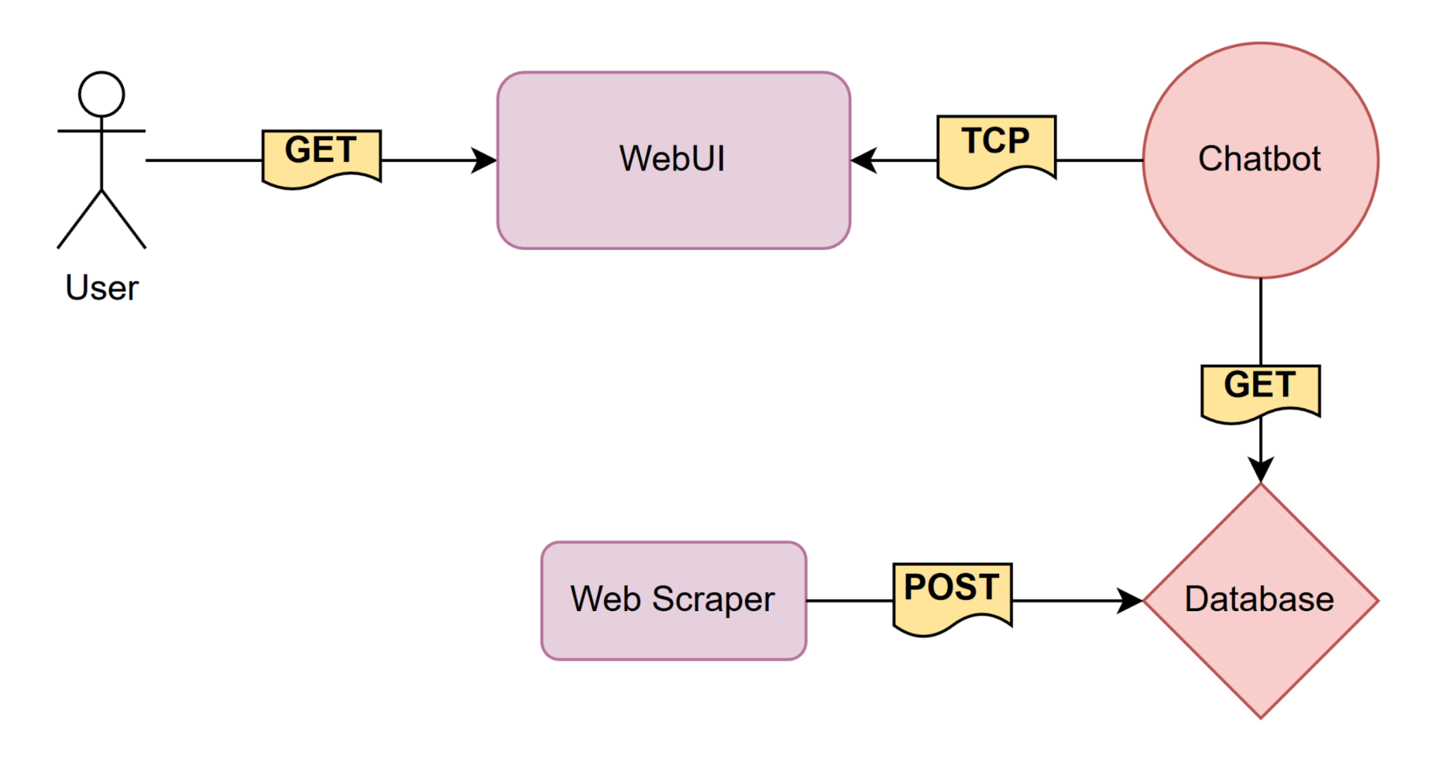
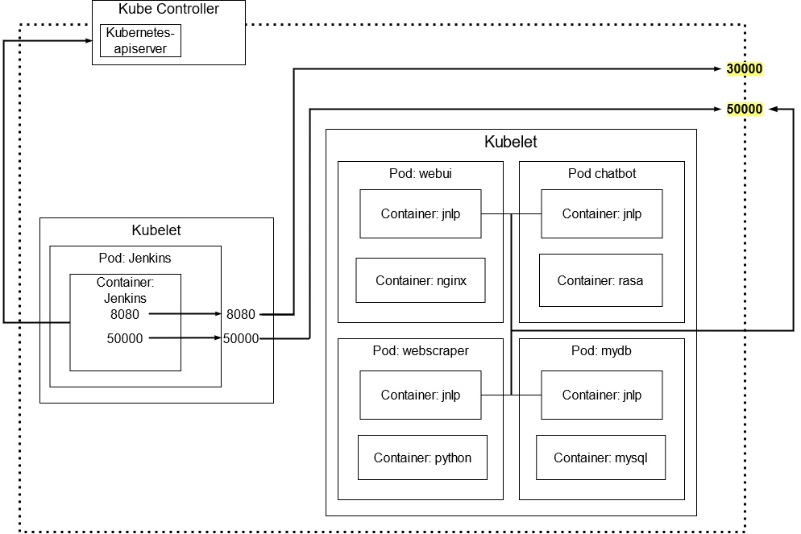
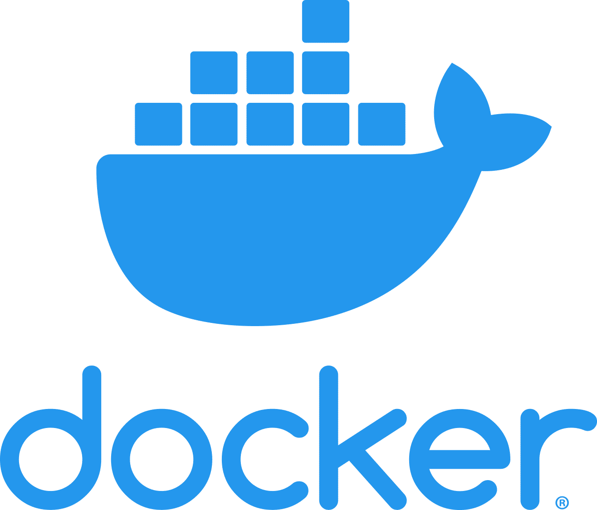


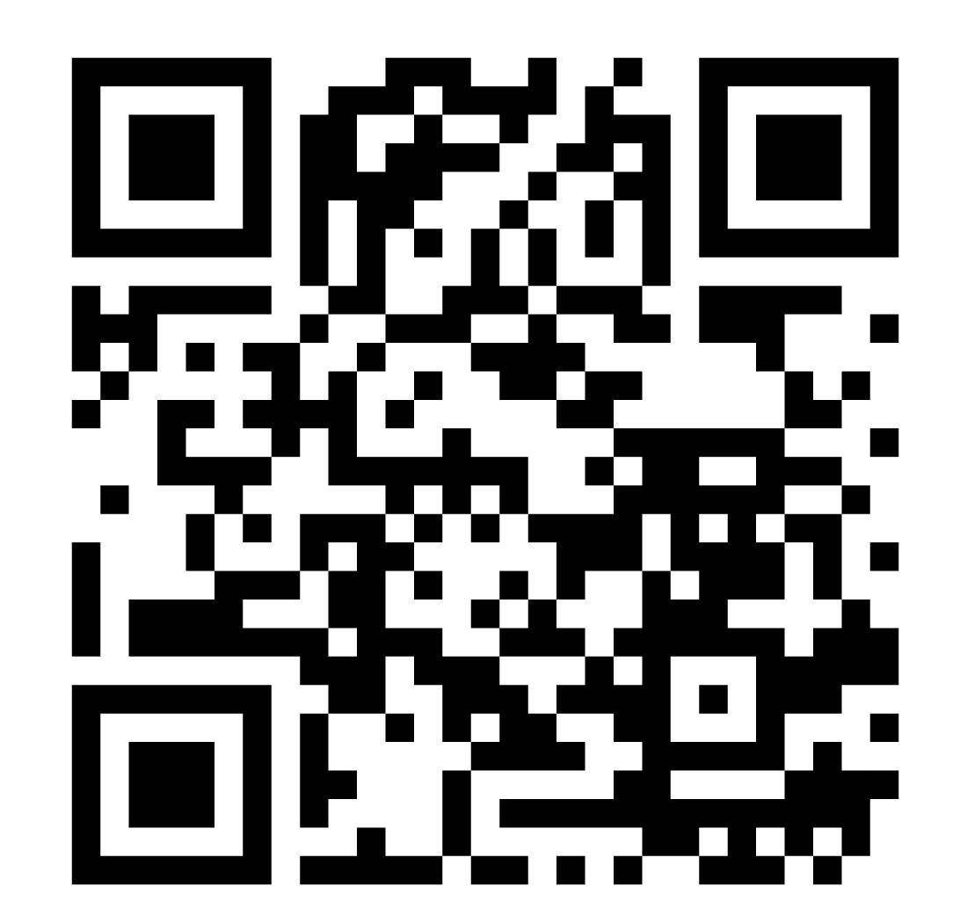
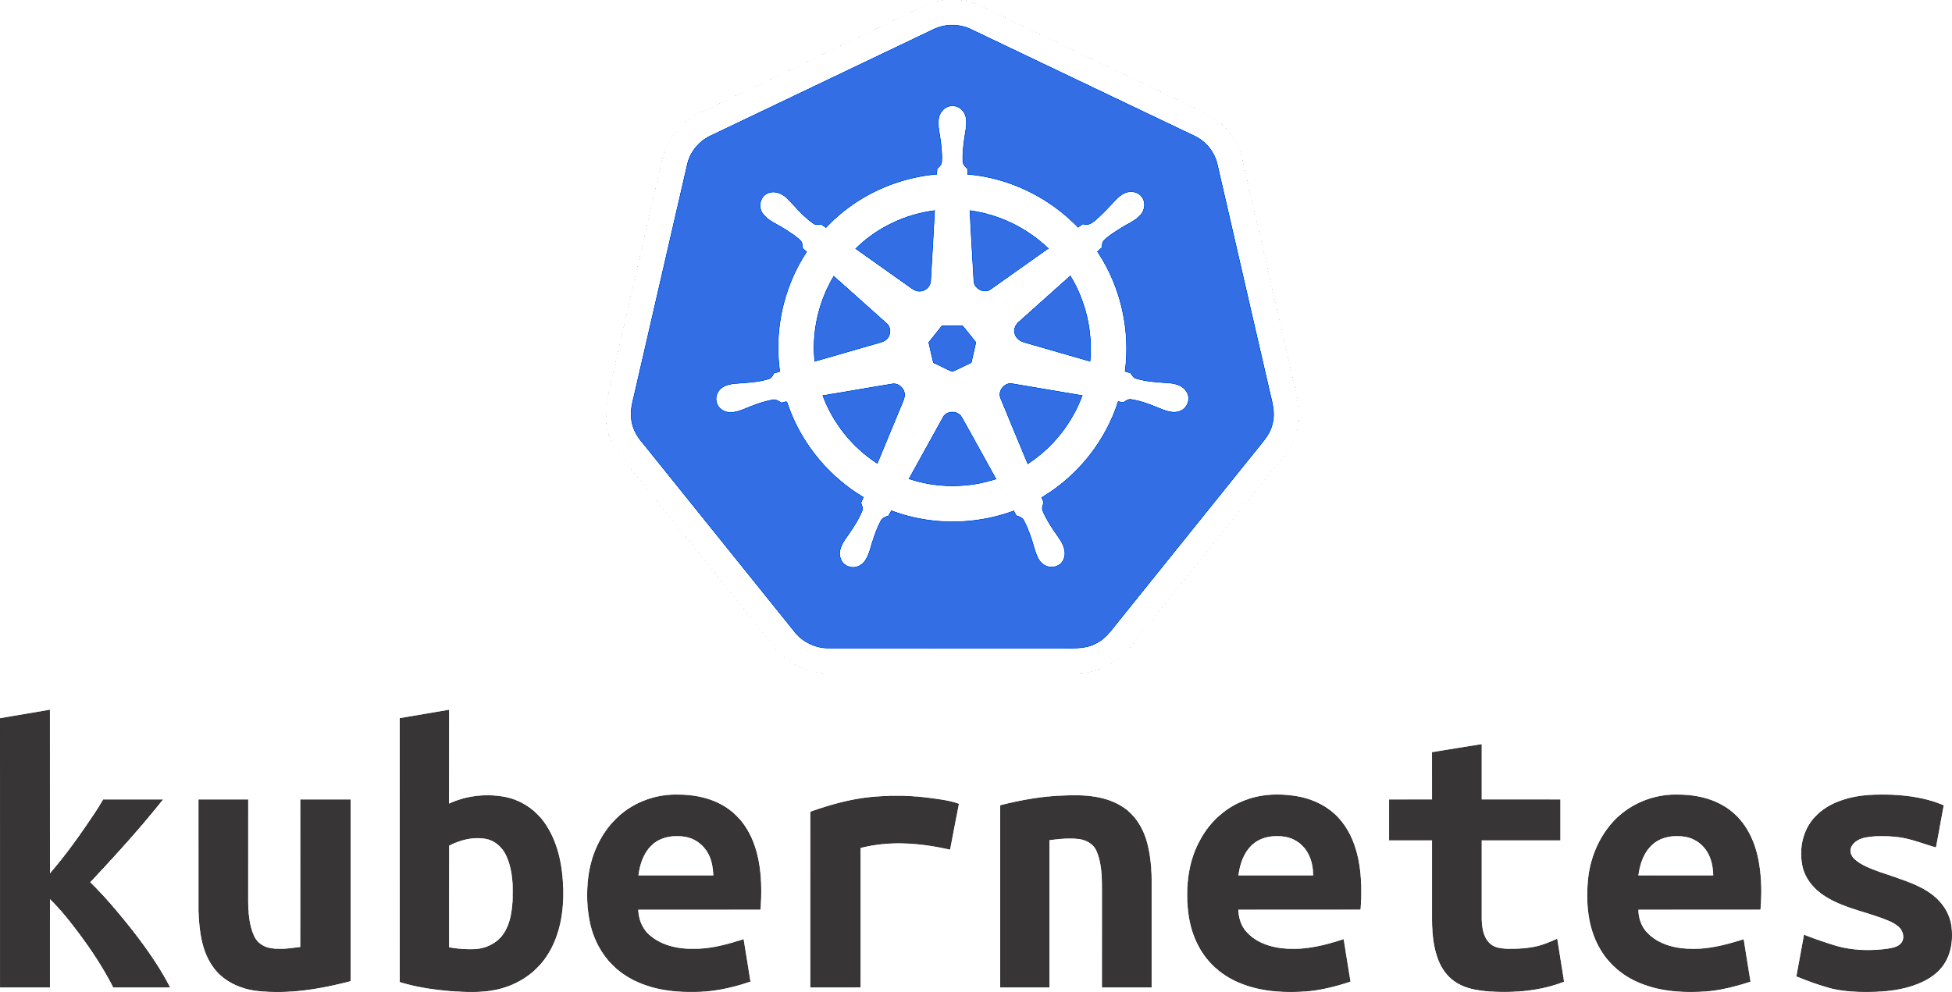
University ChatBot
Nicholas Hines, Jared Miller,
Brian Montecinos-Velazquez,
Dominic Pisano, Tyler Profitt
Summary
Provides an interface to make specific queries about campus events
Development with cloud-infrastructure, containerization, CI/CD pipline
Used Docker, Docker-Compose, Kubernetes, and Jenkins
Components
Description
WebUI
Themed after wcupa.edu
Designed to mimic standard messaging application
Hosted by nginx container
ChatBot
Reads and responds to text
Queries database according to user input
Uses Rasa framework for natural language processing
Isolated as Kubernetes pod
WebScraper
Gathers event data from university website
Inputs into database
Written in Python using: Beautiful Soup 4, Pandas, and SqlAlchemy.
Database
MySql server hosted on pod
Stores all university- related data from webscraper
Kubernetes Cluster
CI/CD Pipeline
https://github.com/bmv0161/csc468-final

