Slide 1


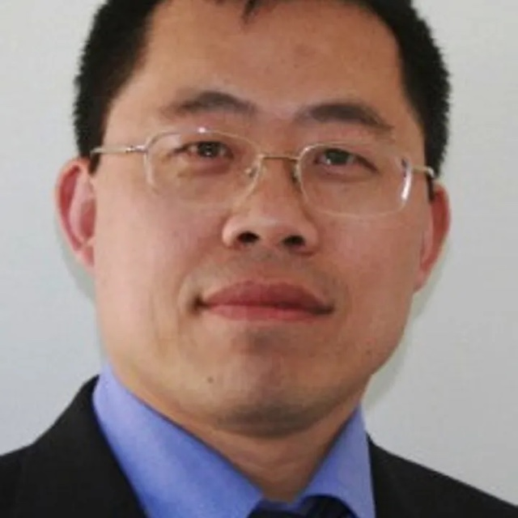
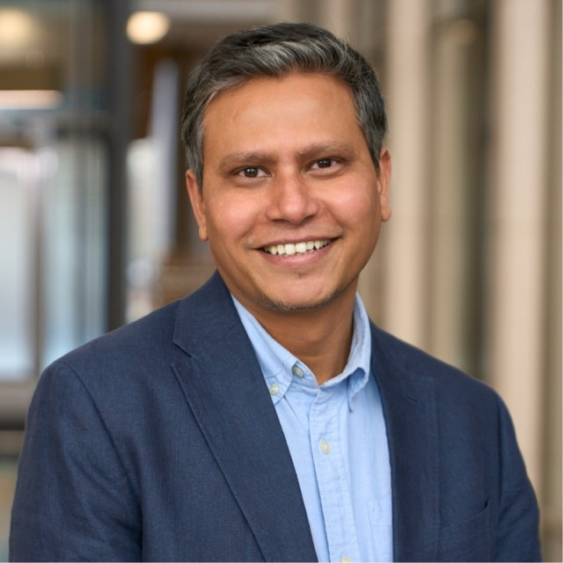
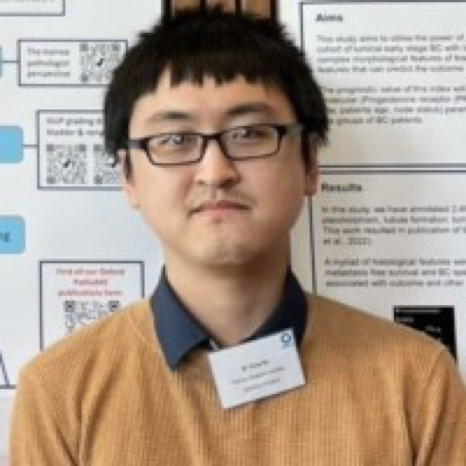
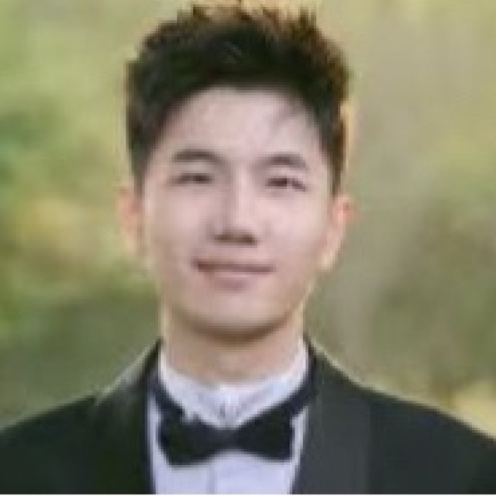
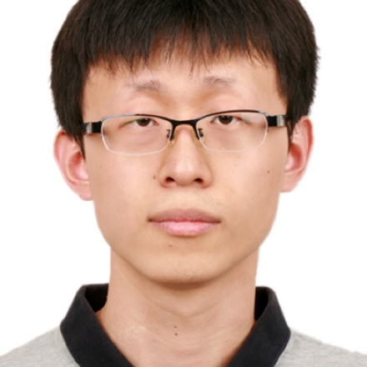
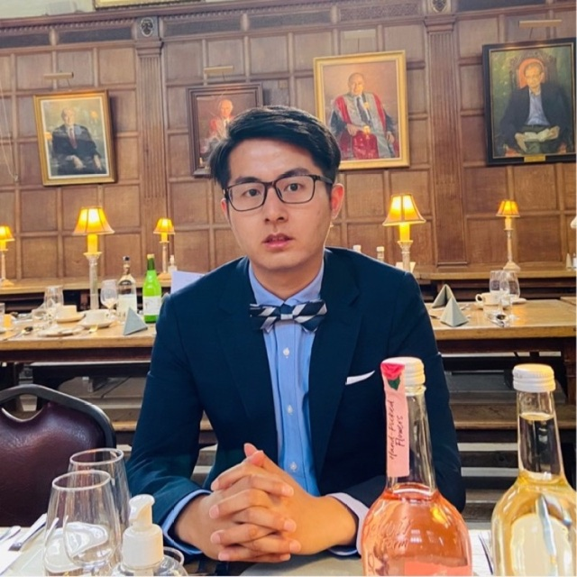
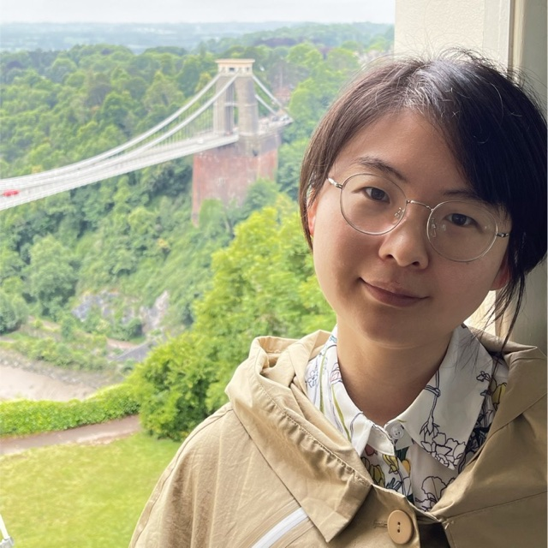
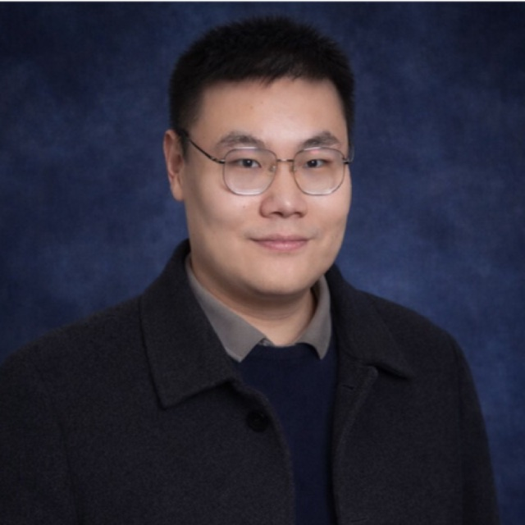
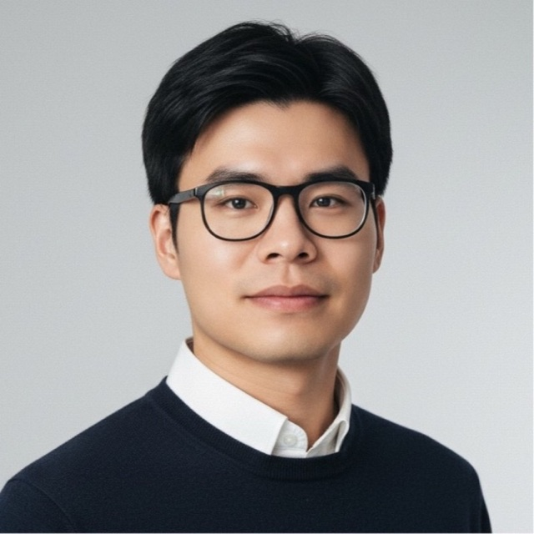
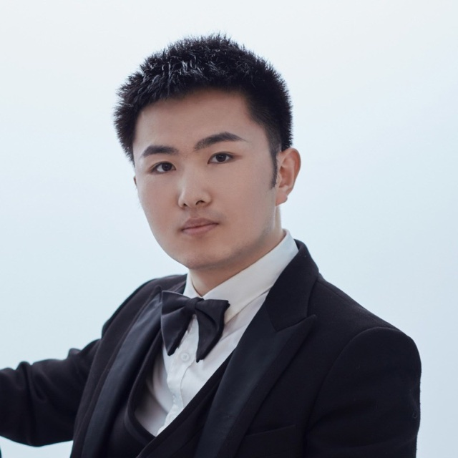
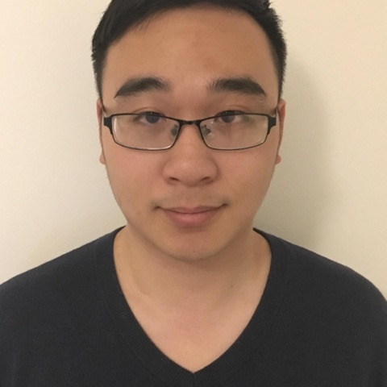










BD-MedVis
37TH BRITISH MACHINE VISION CONFERENCE
BMVC 2026 WORKSHOP
BMVC 2026 WORKSHOP
Biomarker-Driven
Medical Vision
Intelligence
From pixels to clinically credible biomarkers.
BD-MedVis brings together computer vision, medical imaging and clinical AI to create image-derived biomarkers that are biologically grounded, reproducible and clinically meaningful. Join researchers across radiology, pathology and multimodal medicine to advance trustworthy methods for precision care.
DISCOVER · VALIDATE · TRANSLATE
WORKSHOP DATE
VENUE
ONLINE
26 November 2026
Lancaster Town Hall · UK
bmvc-bdmedvis.github.io
WHY THIS WORKSHOP
Medical vision is moving beyond prediction toward evidence linked to biology, clinical endpoints and patient outcomes. BD-MedVis brings together vision, pathology, radiology and multimodal AI to discover, validate and translate trustworthy imaging biomarkers.
BIOLOGICAL GROUNDING
CLINICAL CREDIBILITY
RELIABLE & INTERPRETABLE
RESPONSIBLE TRANSLATION
CALL FOR PAPERS
INVITED SPEAKERS
Share work that makes medical vision matter.
Professor Yalin Zheng
We welcome original research, methods, benchmarks and clinical perspectives that connect medical images to robust biomarkers and meaningful evidence.
University of Liverpool
AI in healthcare & ophthalmic imaging
Imaging biomarkers
Computational pathology
Radiogenomics
Multimodal biomedical AI
Reliability & interpretability
Clinical translation
SUBMISSIONS OPEN
INTENT TO SUBMIT
FULL PAPER
Dr Sharib Ali
3 Aug 2026
28 Aug 2026
4 Sep 2026
University of Leeds
Medical & surgical image analysis
NOTIFICATION
CAMERA-READY
DEADLINE TIME
Two translational perspectives. One shared question: what makes an image-derived biomarker clinically credible?
25 Sep 2026
16 Oct 2026
23:59 AoE
ORGANIZING COMMITTEE
An interdisciplinary team spanning medical imaging, biomedical AI and clinical translation.
Dr Yang Hu
Dr Tianyang Zhang
Dr He Zhao
University of Leicester
Oxford / Birmingham
University of Liverpool
Dr Jian Chen
Dr Dan Dai
Dr Yakun Ju
University of Cambridge
Aston University
University of Leicester
Dr Le Zhang
Dr Shangqi Gao
Dr Zheheng Jiang
University of Birmingham
University of Cambridge
University of Leicester
ORGANISING INSTITUTIONS
PARTNERS & SUPPORTERS
In association with BMVC 2026 and the Lancaster host community
26 NOVEMBER 2026 · LANCASTER TOWN HALL · LANCASTER, UK
bmvc-bdmedvis.github.io
hy208@leicester.ac.uk
Notes:
[Sources]
- /Users/huyang/Workspace/bmvc-bdmedvis.github.io/index.html (workshop title, speakers, organizers, venue, public copy; accessed 2026-08-01)
- /Users/huyang/Workspace/bmvc-bdmedvis.github.io/WORKSHOP_SCHEDULE.md (confirmed public dates; accessed 2026-08-01)
- /Users/huyang/Workspace/bmvc-bdmedvis.github.io/assets/hero-front-page.jpg (workshop illustration)
- /Users/huyang/Workspace/bmvc-bdmedvis.github.io/assets/bmvc-2026-logo.png (BMVC 2026 logo)
- /Users/huyang/Workspace/bmvc-bdmedvis.github.io/assets/speakers/yalin-zheng.jpg and sharib-ali.jpg (speaker photos)
- /Users/huyang/Workspace/bmvc-bdmedvis.github.io/assets/universities (organising institution marks)
- /Users/huyang/Library/CloudStorage/OneDrive-UniversityofLeicester/2025-2026 Leicester-connecting/2026.5 BMVC workshop/BMVC-BDMVI 2026 2.pdf (visual reference and Lancaster/ICVL marks)
- /Users/huyang/Workspace/bmvc-bdmedvis.github.io/assets/organizers (nine organizer portraits; accessed 2026-08-01)
[/Sources]

