Slide 1
Finding Data

Slide 2
Ways to Find Data
Build your own corpus.
Use an archive.
API

Slide 3
Build a Corpus
Pros
You have control over everything
Select your own texts
Particular to your interests
Cons
Super slow
Super duper slow
Might not be possible

Slide 4
Use an Archive
Pros
Benefit from the work of others
Work is in context
Quicker
Cons
Work might not be available in the form you want
If you ask for a grocery list and they give you in one written in Martian, that doesn’t help.

Slide 5
API
Application Programming Interface (API) – a way of interacting with all the different functions and data offered by a product/company/service
Pros
Lots of data that you might not otherwise have access to
Can often get whatever form you want
Cons
Need a way to interact with it

Slide 6


Slide 7
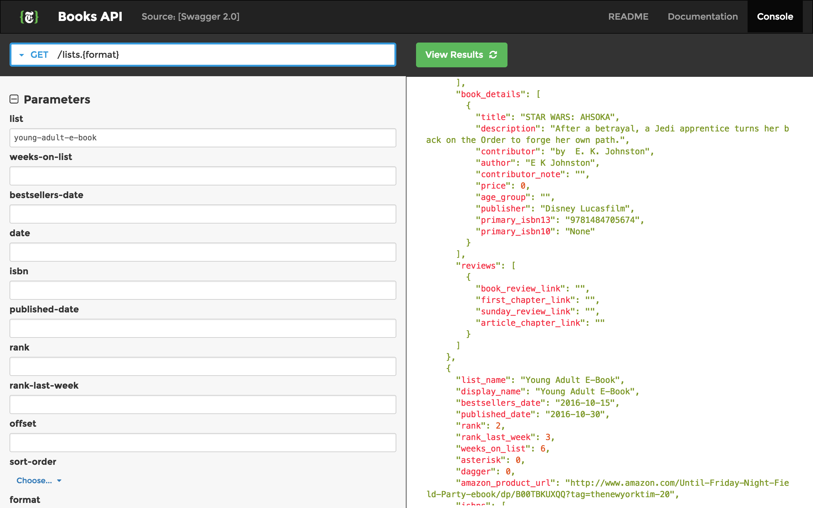

Slide 8
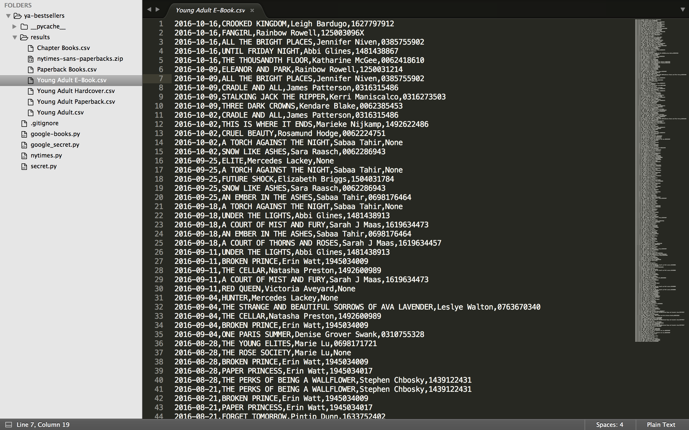

Slide 9
Twitter API
Let’s you search and work with tweets pertaining to a particular topic.
But you need a way to interact with all that data.
A programming language is one way.
Another…

Slide 10
TwxPlorer
Sign up for a Twitter Account
Go to twxplorer.knightlab.com
App that interacts with the Twitter API to let you read text.
Go play. Come back to discuss.

