Slide 1
Hist 211
(Now with Computers)

Slide 2
Digital Humanities
Using humanities skills to think critically about technology.
Using technology to address humanities questions.
“A vague interest in technology” – Ted Underwood

Slide 3
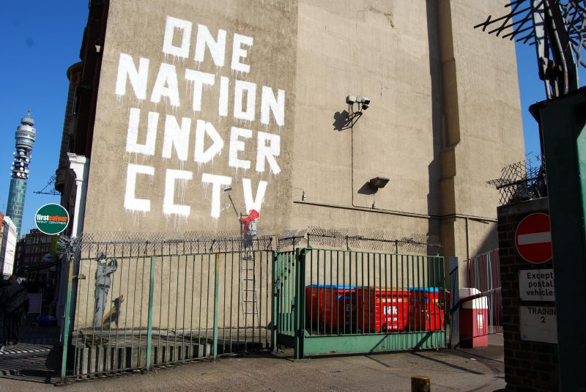
Source: https://www.flickr.com/photos/35972505@N00/2416377899
Notes:
Explain who Banksy is – critically about technology

Slide 4
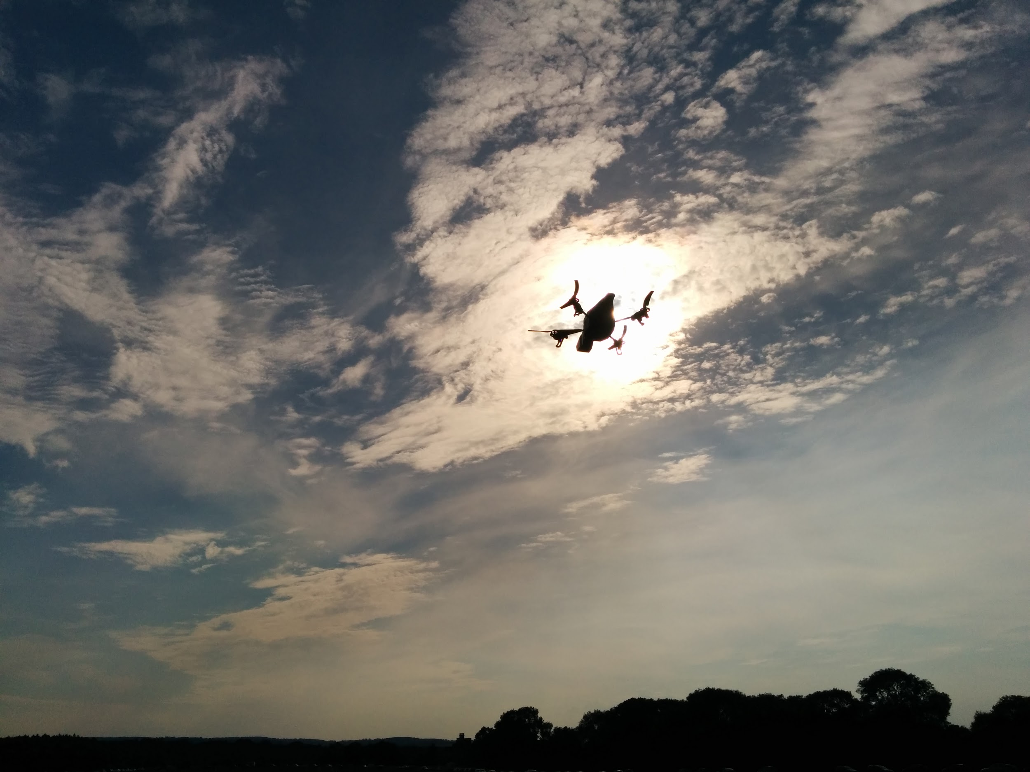
https://flic.kr/p/o6Vuqi
Notes:
Drone photography – thinking critically about tech

Slide 5

Notes:
The particular type of work that we’re talking about in this course is text analysis

Slide 6
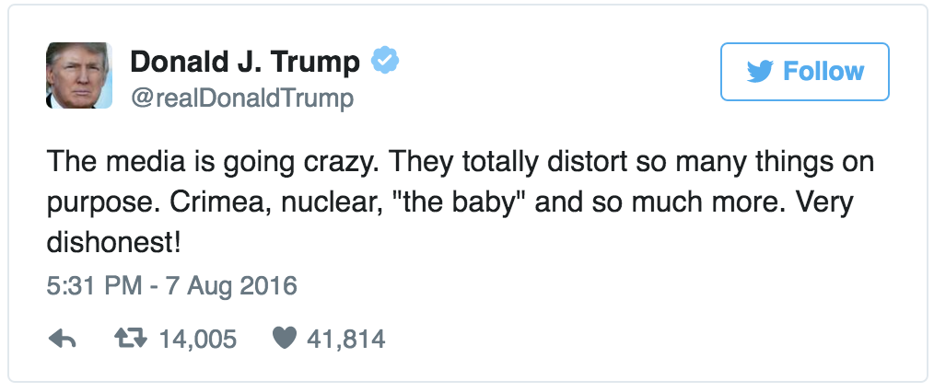

Slide 7
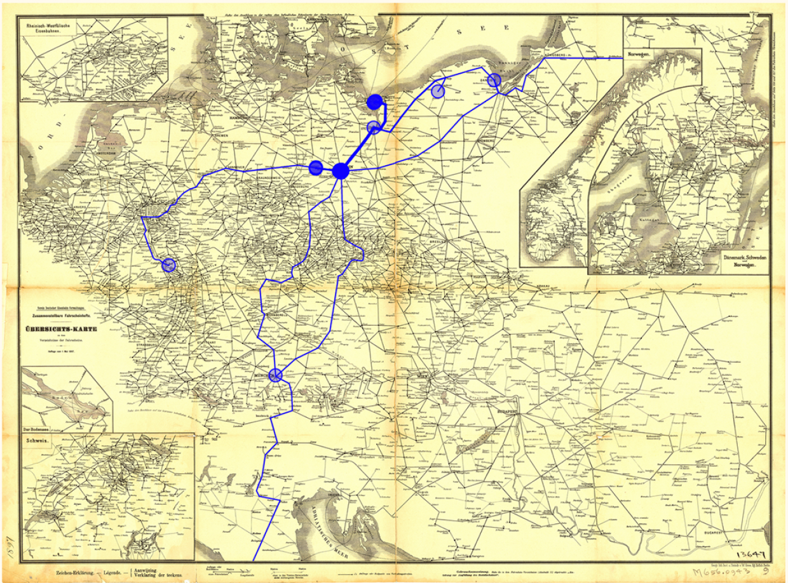
Mapping the Literary Railway Youngman

Slide 8

DH @ W&L

Slide 9
DH @ W&L
Undergraduate fellowships
(independent or faculty)
Student-run conferences > unrh.org
Summer research opportunities
Access to the Digital Humanities Action Team

Slide 10
Text Analysis

Slide 11
Computers and Reading
We all do it
Going to go beyond screen reading/print reading
Reading through computers
vs.
Reading with computers

Slide 12
Topics
Individual vs. Group Reading
Reading hundreds of thousands of texts at once
Cleaning, encoding, and archiving texts
Distilling underlying themes in a body of texts
Graphing sentiment in texts
Identifying unknown authors based on representative texts of known ones

Slide 13
Reading with Computers
Fundamentally changes the way we see things
Going to think a lot about what computers are good at and what they’re not.
About what humans can get out of reading and what they can’t

Slide 14
Google Ngram Viewer
Go to books.google.com/ngrams
Do a search for Victorian, Edwardian
What do you make of the results?
Any questions that you can ask?

Slide 15
Activity
Get in groups of two
Experiment
Look up terms based on a preconceived notion you have about the nineteenth century. (or the twentieth century if you don’t think you know much about the nineteenth)
What kinds of trends do you see that map onto things you know about history?

Slide 16
Reading Like This
Can process SO MUCH TEXT
But what is lost?
What is gained?

Slide 17
Three Things to Keep in Mind
Corpus
Methodology
Interpretation

