Slide 1
Dallas Crime
By Nimisha Pachory, Viswanathan Subramanian, Jon Patterson, Brandon Wepking, Jay Streff

Slide 2
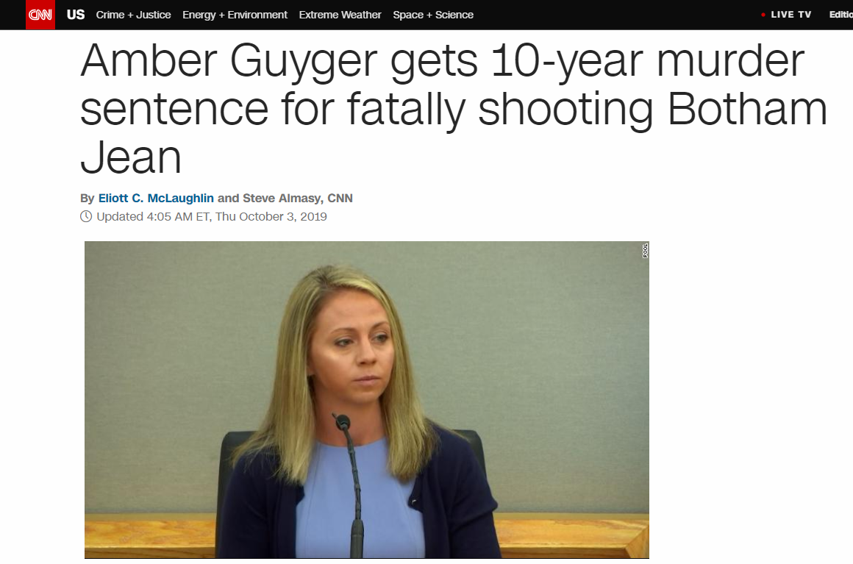
Story
2017 There was Dallas murder that sparked interest in looking at Dallas crime data.

Slide 3
Ideas
Heat map, crime intensity
Rates of crimes over time(any amount of time)

