Slide 1
GIT

Slide 2
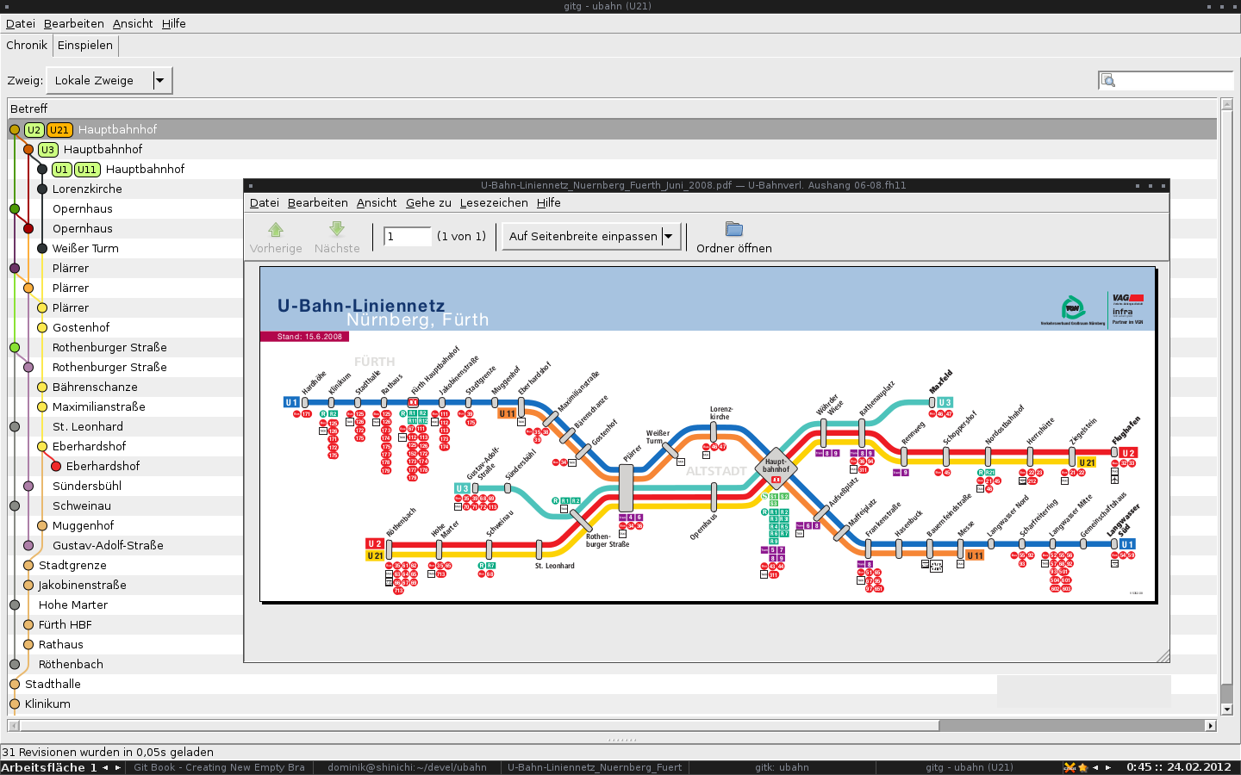
How to code your own subway map

Slide 3
What is git
A Distributed Version Control System
DVCS

Slide 4
Why is git
When hardware evolves
we need to adapt the kernel
When community and
development processes evolve
we need to adapt
the development tools

Slide 5
Why is git better
Very Fast
Tamper-proof (accidental or malicious)
Easy merges
Hard to learn
Easy to learn if give it a chance

Slide 6
How is git
Strong support for non-linear development
Distributed development
Compatibility with existing systems/protocols
Efficient handling of large projects
Cryptographic authentication of history
Toolkit-based design
Configurable

Slide 7
How is git different from svn
The Git working directory is a repository
Commits are created local
push and fetch sync with other repos
SHA1 sum instead of incremental revision number
Only one top-level .git directory
Branches are real branches (not just folders)

Slide 8

Live Demo

Slide 9
