Slide 1
Bespoke Bio: current pipeline
Personalized protein sequences and computational binder candidates
01
02
03
Evidence to proteins
Target structures
Binder design
Resolve supported alleles from variant evidence. Translate complete protein sequences and retain donor / transcript provenance.
Reuse exact matching structures or predict each unique sequence with Boltz-2, ESMFold or OpenFold.
BoltzGen generates candidate binders, predicts complexes and evaluates folding and interface quality.
Output: protein JSON + FASTA
Output: structures + confidence
Output: sequences + ranked models
Live shortcut: protein JSON can enter the binder API directly, without a separate folding job.
Verified: HG002 protein export and public-target binder runs. Raw-read qualification and variant selectivity remain open.
Notes:
Reviewed GitHub main 086484a and binder branch 95507e6 on 2026-10-17. Stage 1 precomputed HG002 export and independent replay are reported in main README and docs/stage-one.md. Raw DNA/RNA workflow adapters remain unqualified for full cases. Stage 2 implements exact-sequence lookup and folding adapters; do not claim every backend was run here. Current direct protein intake bypasses the CDS-based Step 2 API and accepts full sequences without automatic signal peptide trimming. BoltzGen supports sequence and structure inputs, with no specified epitope. The public PD-L1 runs establish pipeline execution, not measured binding. Uniqueness refers to deduplicated protein sequences, not experimentally established variant-specific binders. Selectivity against reference proteins or other targets is not established. No new binder run was performed for the supplied CCL26 JSON.
Sources:
https://github.com/bmwoolf/bespoke-bio/blob/086484a/README.md
https://github.com/bmwoolf/bespoke-bio/blob/086484a/docs/stage-one.md
https://github.com/bmwoolf/bespoke-bio/blob/086484a/src/bespoke_bio/api.py
https://github.com/bmwoolf/bespoke-bio/blob/95507e6/docs/STATUS.md
https://github.com/bmwoolf/bespoke-bio/blob/95507e6/src/biocad/service.py

Slide 2
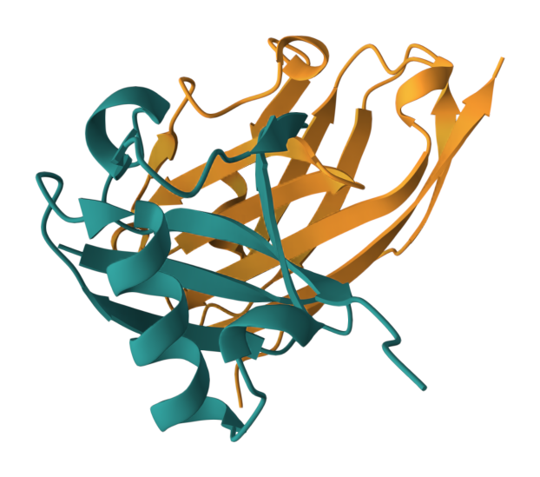
PD-L1 binder tests: results so far
Three completed BoltzGen GPU runs, four candidate binders
What worked
All seven pipeline stages completed. The shared API also downloaded results and deleted its GPU worker.
What passed / failed
3 of 4 passed native filters. One refolded too far from its design: RMSD 2.61 Å (limit 2.5 Å).
What remains unproven
PD-L1 target
Designed binder
Interface confidence was low to modest (ipTM 0.20–0.41). Binding, affinity and variant selectivity need validation.
Predicted complex from the sequence-only test
Notes:
These are small pipeline smoke tests, not an estimate of binder hit rate. Structure-input run: 2 candidates, 1 passed, ipTM 0.3046 and 0.2925. Rejected candidate failed filter_rmsd at 2.6117 Å against the configured 2.5 Å threshold. Sequence-only HTTP run shown: 1 candidate, passed, complex recovery RMSD 0.8308 Å, binder-alone recovery 1.3318 Å, ipTM 0.4104, ESMFold2 minimum ipSAE 0.172. Managed shared-service run: 1 candidate, passed, ipTM 0.2009, ESMFold2 minimum ipSAE 0.0148; verified result download and worker deletion. Counts total 4 generated candidates and 3 native filter passes across 3 completed runs. Failed startup attempts are not included. No measured affinity, binding assay, reference-vs-variant specificity or off-target panel is available. CCL26 integration preparation did not perform inference. The image uses actual refolded predicted coordinates from binder_5c7000a0e62fb0de/complex.cif, rendered with Mol*: chain A 75 residues teal, chain B 115 residues orange. Geometry recovery tests whether refolding reproduces the design, not whether the proteins bind in a laboratory.
Sources: https://github.com/bmwoolf/bespoke-bio/blob/95507e6/examples/boltzgen_results/summary.json
https://github.com/bmwoolf/bespoke-bio/blob/95507e6/examples/boltzgen_api_results/summary.json
https://github.com/bmwoolf/bespoke-bio/blob/95507e6/examples/shared_service_smoke/summary.json
https://github.com/bmwoolf/bespoke-bio/blob/95507e6/examples/boltzgen_api_results/bundle/binder_5c7000a0e62fb0de/complex.cif

Slide 3
Vision: field care loop
Sense
Soldier
Analyze
On-the-fly
bespoke synthesis
Deliver + reassess
Synthesize in field
Concept
Notes:
User-proposed future concept: the entire loop operates in the field. A soldier or medic provides a sample; edge omics sensing sends a compact reference-linked report to local field computing; analysis informs bespoke peptide synthesis or formulation in a portable field lab; delivery to the medic enables treatment and reassessment, feeding back into the loop. On-the-fly bespoke synthesis is the intended capability, not a demonstrated current clinical capability. New treatments require efficacy, safety, clinical review and manufacturing quality validation. The current project has demonstrated computational pipeline operation, not this field medical system. Figure is a conceptual diagram, not actual equipment. Foldseek omitted.

