Slide 1
OS Project2. WRR Schedular Team 4
Kim Jihoon
Seol Jaewan
Choi Yoonseo

Slide 2
Contents
Implementing a WRR scheduler
1. Change default policy
2. Defining of related members
3. Othrer Requirements
4. Implementing wrr.c
5. Implementing System calls
Investigating schedular
Demo Video
Possible improvements
Lessons learned
Notes:
저희는 스케줄러를 구현하기 위해 커널에 구현되어 있는 기존의 스케줄러, 그중에서도 rt.c를 중심으로 코드를 읽고 이것이 어떤 방식으로 작동하는지 이해하고 새로운 스케줄러를 구현하기 위해 어떤 일들을 해야하는가 알아보았습니다. 그 결과 여기 적혀있는 일들을 해야했습니다. 그리고 그 뒤에 이어지는 내용은 여기 적힌대로입니다.

Slide 3
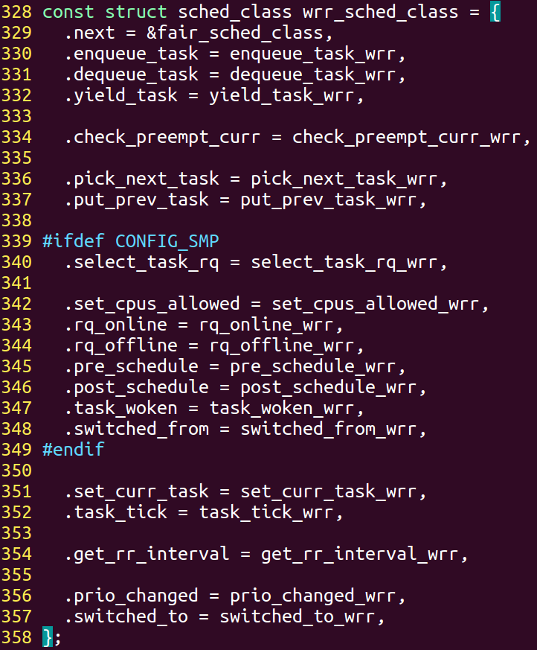
Implementing WRR schedular
Implementing Schedular?
= Defining a Scheduling Class and its Functions
ddd
Requirements?
1. Changing tasks’s default policy and
sched_class members
-> to apply our scheduler
2. Declaration of related members
(1) wrr_rq inside run queue
(2) sched_entity inside task_struct
3, Other requirements
(1) defining policy SCHED_WRR = 6
(2) setting policy priority
(3) external declarations
(4) updating Makefile
Notes:
스케줄러를 구현한다는 것은, 스케줄러의 클래스와 그에 종속된 함수들을 구현하는 것입니다. 이 함수들을 core.c에서 필요한 위치에서 불리게 되어 동작하게 됩니다.

Slide 4
(1)Changing default policy
Steps | At Where?
1. Swapper’s default policy | /include/linux/init_task.h #define INIT_TASK(tsk)
2. Kthread’s default policy | /kernel/kthread.c Kthread_create_on_node(…)
3. Policy checking parts | /kernel/sched/core.c __sched_setscheduer(…)
4. Default sched_class | /kernel/sched/core.c, setsch __setschedular(…)
5. Defining policy SCHED_WRR | /include/uapi/linux/sched.h #define SCHED_WRR 6
Notes:
초기에 생성되는 프로세스가 저희의 저책을 따르도록, init_task.h와 kthread.c의 디폴트 스케줄링 폴리시를 SCHED_WRR로 바꿔주었습니다. 그리고 SCHED_WRR은 sched.h에 정의해 줍니다.

Slide 5
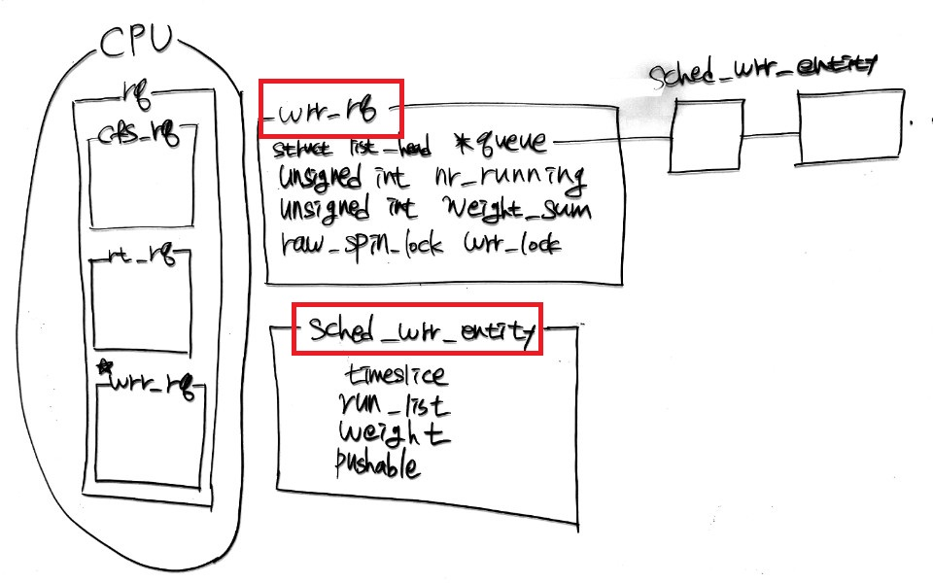
(2)Declaration of Related Members
Notes:
저희가 코드를 커널 코드를 분석한 결과, CPU마다 런큐를 가지고 있고, 이 런큐 다시 각 스케줄링 정책을 따르는 런큐로 이루어져 있습니다. 그리고 sched_entity는 스케줄링되는 단위를 의미합니다. 이 sched_entity는 task_struct 구조체의 멤버이며, run queue에 들어가는 단위가 됩니다. 저희는 스케줄러를 구현하기 위해 wrr_rq와 wrr_entity를 만들었습니다. Queue는 entity들을 연결리스트로 연결한 것이고, nr_runiing은 해당 런큐에 있는 entity의 수입니다. 그리고 weight_sum은 런큐에 있는 enity들의 weight 합이고, wrr_lock은 wrr_rq의 멤버에 접근할때 쓰이는 락입니다.

Slide 6
(2)Declaration of Related Members
Steps
At Where?
wrr_rq | Run queue of entities with wrr sched policy
sched_wrr_entity | Unit of scheduling in wrr policy
Member | Steps | At Where?
wrr_rq | 1. Definition | /kernel/sched/sched.h
 | 2. Including wrr_rq as member of rq | /kernel/sched/sched.h
 | 3. Initializing wrr_rq | init_wrr_rq() in wrr.c -> Later!
wrr_entity | 1. Definition | /include/linux/sched.h
 | 2. Including wrr_entity as member of task_struct | /include/linux/sched.h
 | 3. Initializing wrr_entity | /include/linux/init_task.h 자연스럽게 weight을 상속!

Slide 7
(3) Other requirements
1. #define SCHED_WRR 6
-> /include/uapi/linux/sched.h
2. Setting Policy Priority
(1). rt_sched_class -> .next = &wrr_sched_class
(2). wrr_sched_class -> .next = &fair_sched_class
(3). fair_sched_class -> .next = &idle_sched_class
3. External Declarations (/kernel/sched/sched.h)
(1). extern const struct sched_class wrr_sched_class
(2). extern init_wrr_rt_class(void);
(3). extern init_wrr_rq(~)
Notes:
Development Environment

Slide 8
(3) Other requirements
4. Updating Makefile
-> Include wrr.o at /kernel/Makefile
5. Call init_wrr_rq(~) from sched_init(void)
-> initializing wrr_rq
function | location | What does it do?
sched_init(void) | /kernel/sched/core.c | Initializing scheduler
Init_wrr_rq(~) | /kernel/sched/wrr.c | Initializing wrr run queue
Notes:
Development Environment

Slide 9

(4) Implementing wrr.c
<SPECs>
1. No group scheduling policy
2. No priority issue among same wrr run queue
3. Each entity is enqueued with timeslice -> enqueue_task_wrr(~) Timeslice = weight * timeQuantum (10ms)
4. Supporing SMP (1) task decides to select lowest weighted CPU’s run queue -> select_task_rq_wrr(~) (2) Load Balancing is provided among CPU run queues
5. When weight changes, current running task finishes its timeslice determined before the change
6. Load Balancing -> Next Next Slide!

Slide 10
(4) Implementing wrr.c
<IMPLEMENTATIONS>
Functions | What does it do?
init_wrr_rq | wrr_rq 초기화
enqueue_task_wrr | wrr run queue에 wrr_entity 추가 weight_sum update
dequeue_task_wrr | wrr run queue에서 wrr_entity 제거 weight_sum update
pick_next_task_wrr | wrr run queue에서 맨앞의 entity를 return pushable = 0 (don’t migrate)
task_tick_wrr | Task가 timeslice를 마쳤다면, 새로운 timeslice를 부여 Call requeue_task_wrr()

Slide 11
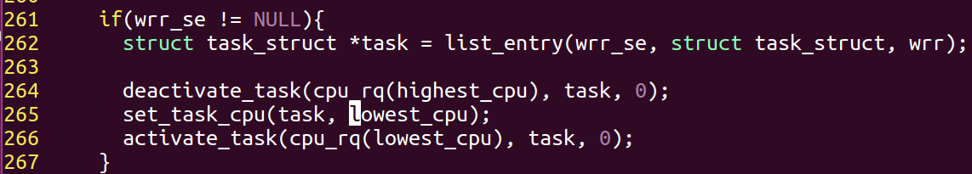
<LOAD BALANCING>
static enum hrtimer_restart_wrr_load_balance(~)
<Logics>
(At every 2000ms,) 1. Find Highest, Lowest Run Queue …….. (CPU1) (CPU2) (CPU3) (CPU8) 2. Find entity with highest weight not exceeding Max_movable_weight && pushable==1 Max_movable_weight = (HRQ_weight – LRQ_weight) / 2 3. If entity is found, move entity from HRQ to LRQ
HRQ
entity
LRQ
Notes:
Core.c의 sched_init 함수에서
hrtimer_init(&wrr_loadbalance_timer, …)
wrr_loadbalance_timer.function = wrr_load_balance;
Sched_init_smp 함수에서
hrtimer_start(&wrr_loadbalance_timer, ktime, HRTIMER_MODE_REL)

Slide 12
(5) Implementing System Calls
Steps | At Where?
1. Sys call func. implementation | /kernel/sched/core.c
2. Sys call number register | /arch/arm/include/asm/unstd.h /arch/arm/include/uapi/asm/unistd.h
3. Sys call table register | /arch/arm/kernel/calls.S
4. Sys call func. declaration | /include/linux/syscalls.h
Notes:
Development Environment

Slide 13
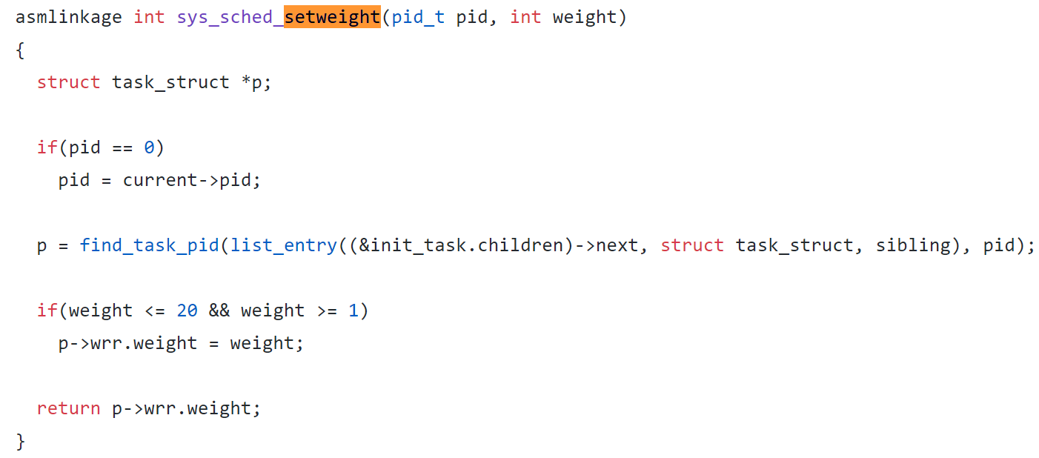
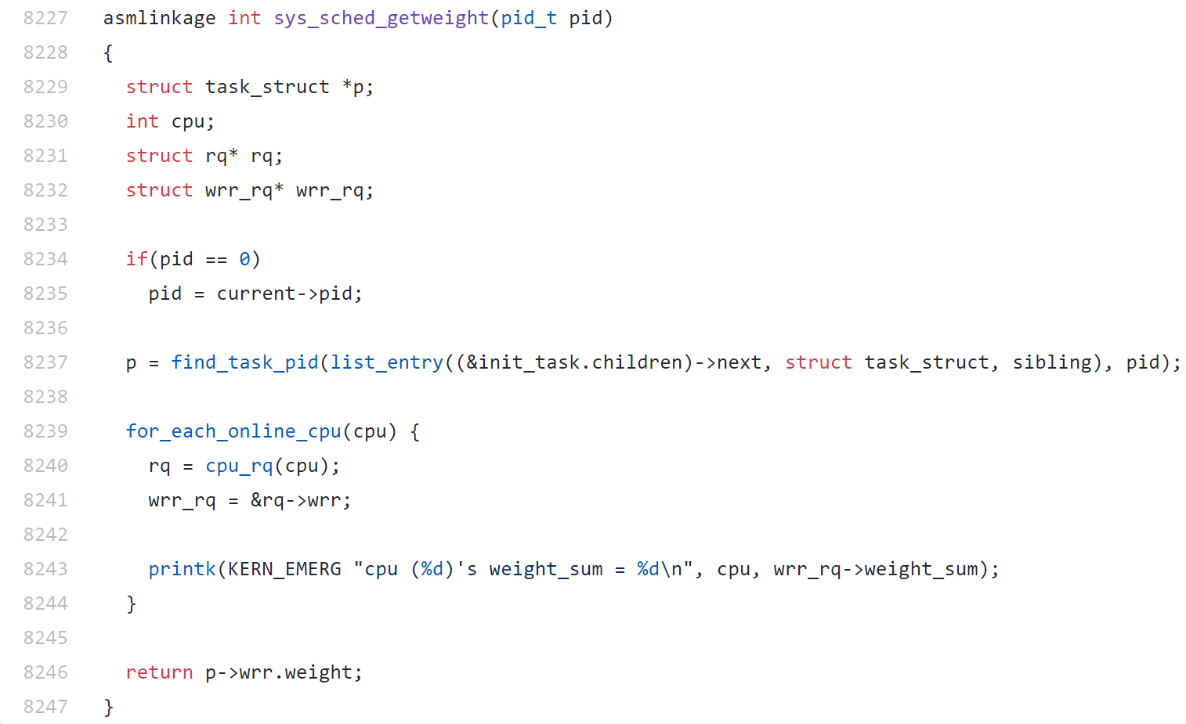
sched_setweight, getweight

Slide 14
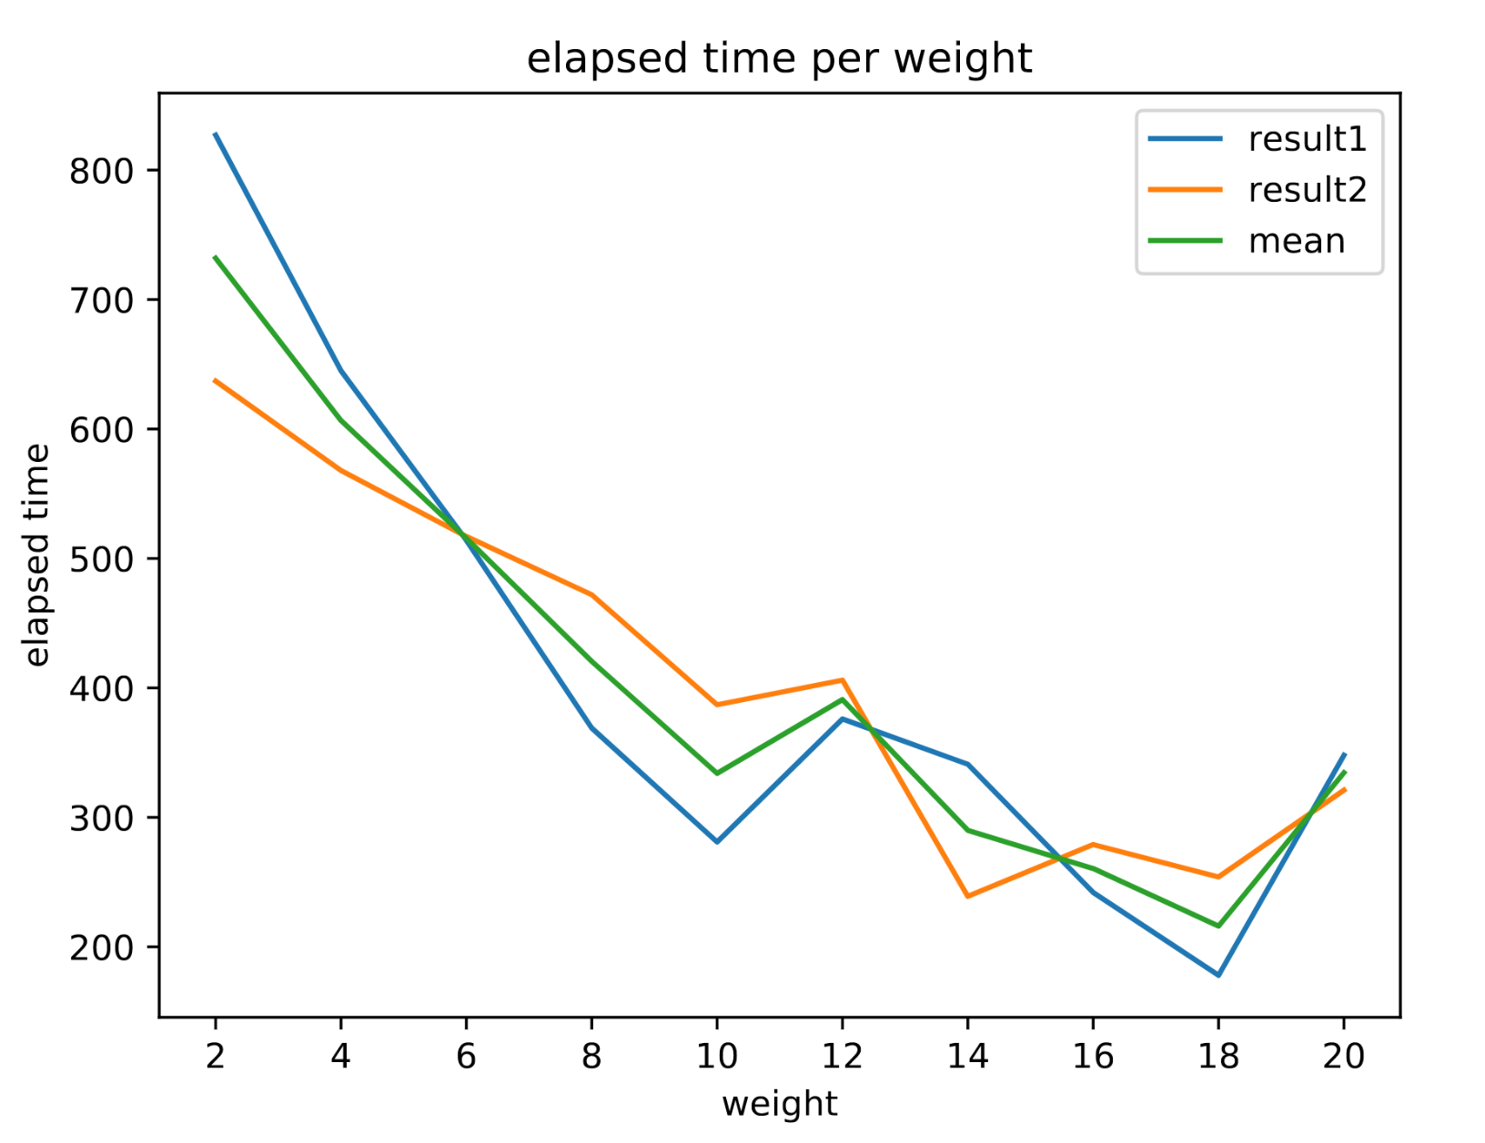
Investigating Schedular

Slide 15
Possible Improvements
“Ageing”
Current Schedular -> weight is changed by only system calls.
Age = (Current Time - Execution start time)
Timeslice = Age x weight x timeQuantum.

Slide 16
Demo Video
Youtube link
1. Task goes to Lowest CPU
https://www.youtube.com/watch?v=cnO_m5T7clY
2. Load Balancing
https://www.youtube.com/watch?v=YzKfvCeSE0c

Slide 17
Lessons learned
1. Analyzing massive code lines using cscope, ctags
2. Understanding how Linux Real Time scheduler is implemented
3. Importance of Cooler
- keeps shutting down….. Too hot!

Slide 18
Thank You!

