Slide 1
OS Project3. Rotation Lock Team 4
Kim Jihoon
Seol Jaewan
Choi Yoonseo
Notes:
안녕하세요, 저희는 Team4입니다. 저희 조원은 김지훈, 설재완, 그리고 저 최윤서입니다.

Slide 2
Contents
Data Structure Used
Functions implemented
Demo Video
Possible improvements
Lessons learned

Slide 3
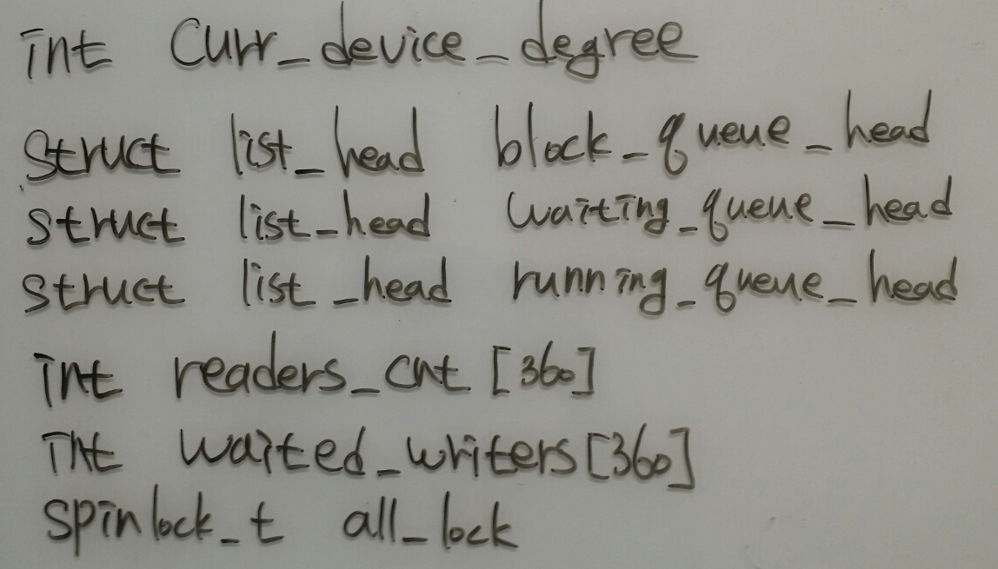
Data Structure Used

Slide 4
Data Structure Used
curr_device_degree : current device degree
block_queue_head : queue of locks that are blocked
running_queue_head : queue of locks that grap lock
waiting_queue_head : queue of locks that are waiting to grap lock
readers_cnt[360] : # of readers(if >= 0) or writer(if -1) that grap lock in particular degree
waited_writers[360] : # of writers waiting

Slide 5
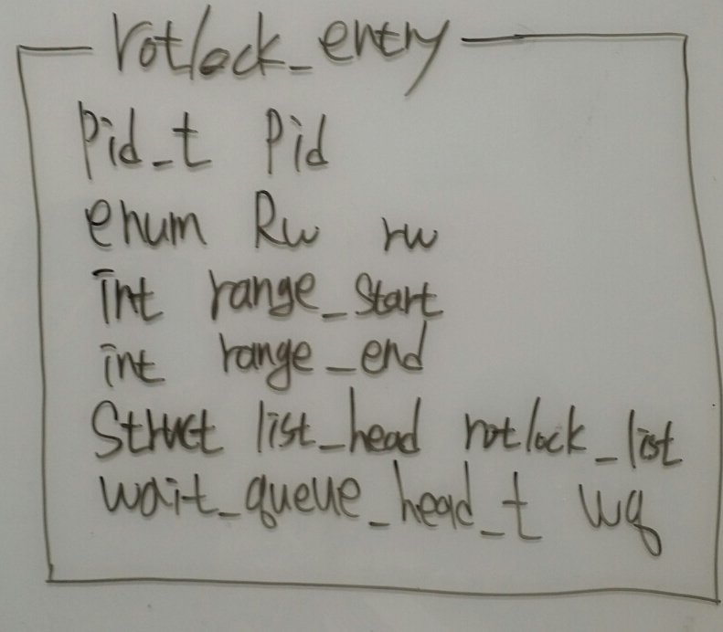
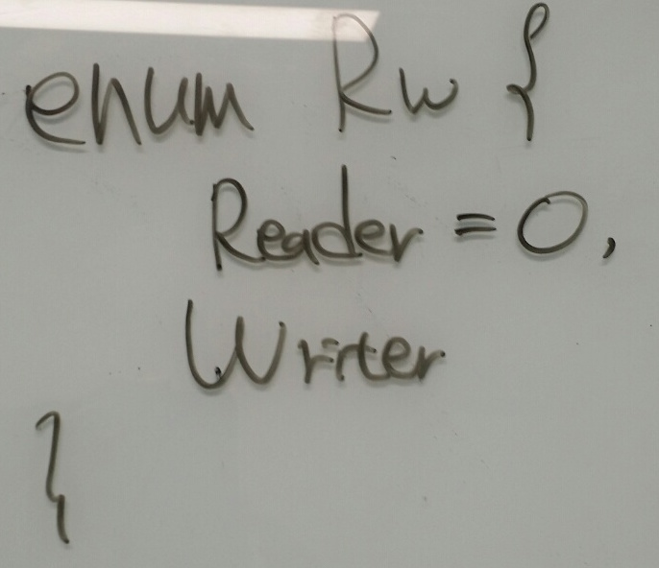
Data Structure Used

Slide 6
Data Structure Used
rotlock_entry : describe each lock
RW : whether lock is writer or reader

Slide 7
Functions Implemented
int set_rotation
1. change curr_device_degree
2. wake up “only” processes in block_queue that can grap lock right after wake up

Slide 8
Functions Implemented
int rotlock_read
1. if degree or range are wrong, return -EINVAL
2. if curr_device_degree out of range, sleep
3. if cannot grap lock, sleep(can grap lock only if there are no writer locked and no writers waiting)
int rotunlock_read
1. if degree or range are wrong, return -EINVAL
2. dequeue read_lock that can be removed using pid, range_start, range_end iterating over running_queue

Slide 9
Functions Implemented
int rotlock_write
1. if degree or range are wrong, return -EINVAL
2. if curr_device_degree out of range, sleep
3. if cannot grap lock, sleep(can grap lock only if there are no writer locked and no writers waiting and no readers locked)
int rotunlock_write
1. if degree or range are wrong, return -EINVAL
2. dequeue read_lock that can be removed using pid, range_start, range_end iterating over running_queue

Slide 10
Functions Implemented
force_to_release_rotlock
1. implemented in kernel/exit.c, do_exit
2. when exit, dequeue rotlock_entry from block_queue, waiting_queue, running_queue

Slide 11
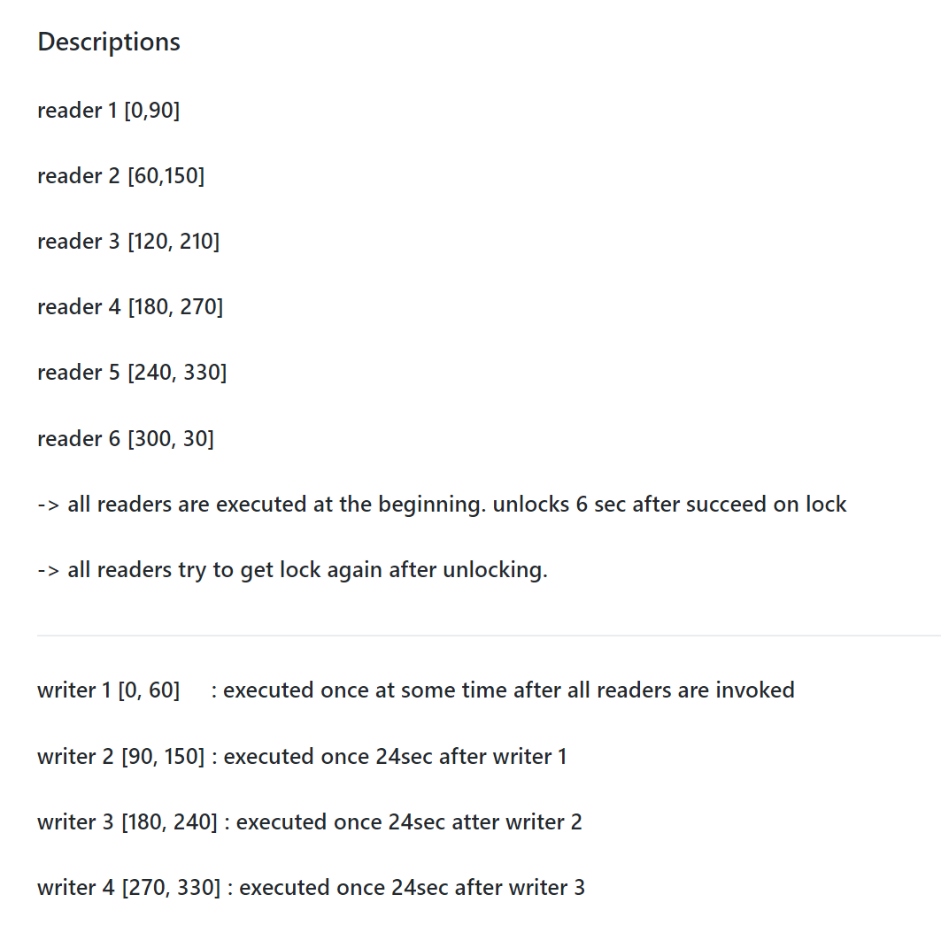
Descriptions on Demo Video

Slide 12
Demo Video
Youtube link
https://youtu.be/nfGormD-Zz0

Slide 13
Lessons learned
Importance of initializing(especially before using lock, init_lock!!!)
Avoiding deadlock
Hard to understand kernel(result can be different but hard to find the reason because very very complex relation between modules in kernel and we cannot know every relation)

Slide 14
Thank You!

