Slide 1
OS Project4. Geo-Tagged File System Team 4
Kim Jihoon
Seol Jaewan
Choi Yoonseo
Notes:
안녕하세요, 저희는 Team4입니다. 저희 조원은 김지훈, 설재완, 그리고 저 최윤서입니다.

Slide 2
Contents
1. Tracking Device Location
2. Add GPS-related operations to inode
3. Update loc info for files
4. User-space testing for loc info
5. Location-based file access
6. Symbolic Links and Directories
Demo Video
Lessons learned

Slide 3
1. Tracking Device Location
Steps | At Where?
1. Declaration of struct gps_location | /include/linux/gps.h
2. Increment Sys Call Table # & Sys Call Table Register | /arch/arm/include/asm/unistd.h /arch/arm/include/uapi/asm/unistd.h
3. Updating assembly instructions for system call. | /arch/arm/kernel/calls.S
4. Function declaration | /include/linux/syscalls.h
5. Function Implementation | /kernel/gps.c

Slide 4
1. Tracking Dev Loc - function impl
Where? | /kernel/gps.c
implementations | What to do
struct gps_location curr_gps = {0, 0, 0, 0, 0} | External declaration of gps_location variable
sys_set_gps_location | Set curr_gps by user input
sys_get_gps_location | Get _gps_location at inode pointing at file and save it.

Slide 5
2. Add GPS-related operations to inode
Steps | At Where?
1. add member functions to struct inode_operations | /include/linux/fs.h
2. Implement member functions. | fs/ext2/inode.c
3. Add gps members to struct ext2_inode | fs/ext2/ext2.h
4. Add gps members to struct ext2_inode_info | fs/ext2/ext2.h
Notes:
Development Environment

Slide 6
3. Update location info for files
※ set_gps_location
→ called when file created or file modified
1. fs/inode.c, struct ext2_inode
2. fs/splice.c, generic_file_splice_write()
Whenever “update_time” is called to change S_CTIME or S_MTIME
If normally performed, call set_gps_location
Notes:
Development Environment

Slide 7
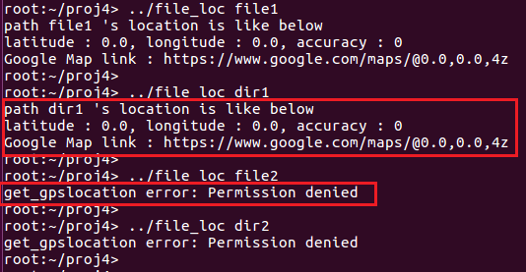

(4) User-space testing for location info

Slide 8
5. Location-based file access
(1) save table of
“1 longitude value for every latitude value”
(2) Using value in (1),
compute distance file loc <-> user loc
(3) check distance < accuracy
(4) details in kernel/gps.c check_permission()
!! check overflow between calculations.

Slide 9
6. For symbolic Links and Dirs
(1) Symbolic Links
- Not Implemented
- But, reading file path goes along with file loc.
(2) Directories
- Directory's location is saved when it is created. -
- Command like 'ls' cannot be used
if location does not match.

Slide 10
Demo Video
Youtube link
https://www.youtube.com/watch?v=ycw9Np0YU24&feature=youtu.be

Slide 11
Lessons learned
1. How file system works in kernel.
- structures of inodes, how functions are called…
2. Calculating without using floats and doubles
- learned that they cannot be used in kernel.

Slide 12
Thank You!

