Slide 1
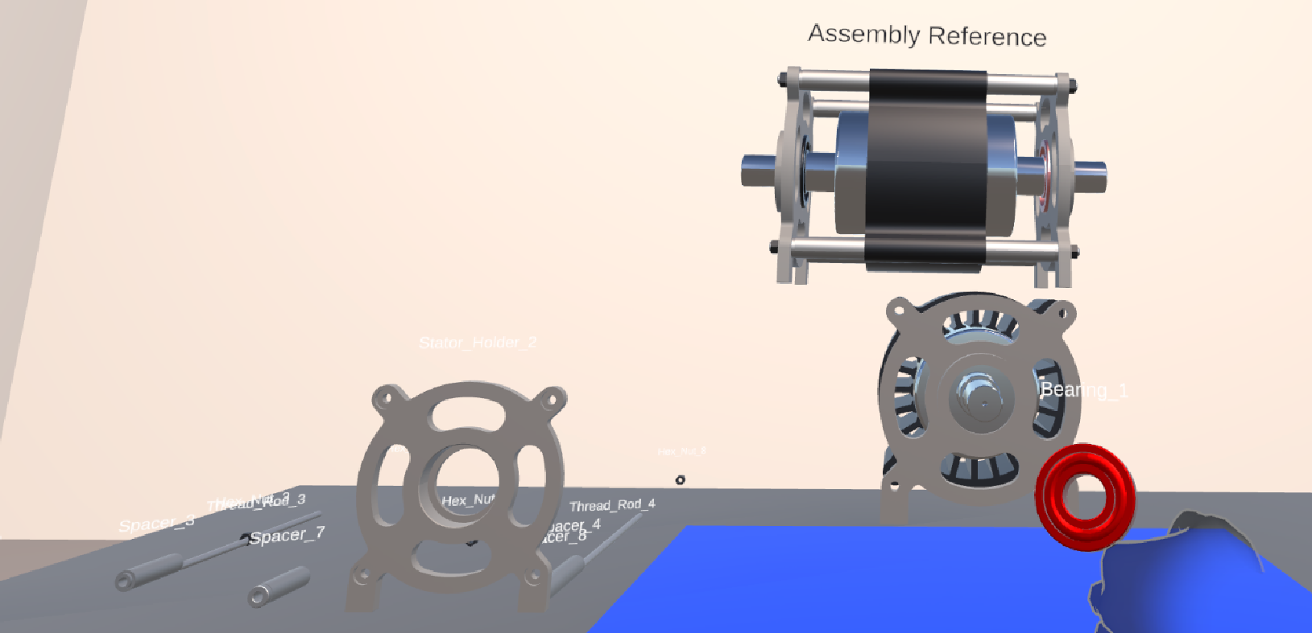
SYSTEM A · IMPLEMENTATION
Guided assembly of a 26-component electric motor
Placement-validation pipeline
1
Record the pose of every component while the motor is still assembled → these become the placement targets
2
Parts are scattered; the trainee grasps and releases one
?
Check: right component for this step AND within 0.15 m of its stored pose?
Both hold
Snaps to exact pose and locks
Either fails
Rejected — the part stays free
Fig. 1 Active component highlighted, with the 3D target-state display above the workspace
3
Guidance — 3 concurrent channels
Matters later: the 8 fasten steps resolve through this placement path — no fastening is simulated, and no assessment data is recorded.
Workspace spotlight · continuous 3D target-state display · progress panel
26
components
(only 2 unique)
52
JSON steps
(assembly + disassembly)
4
action classes
place · insert · fasten · remove
2,422
lines of code
across 10 files

