Slide 1
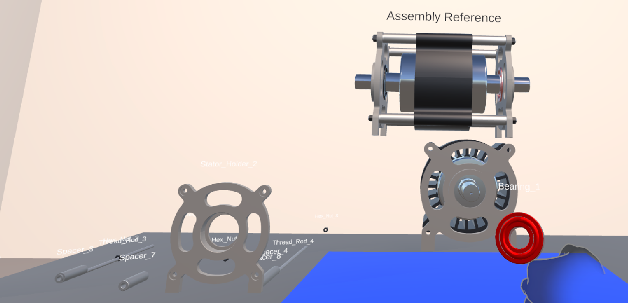
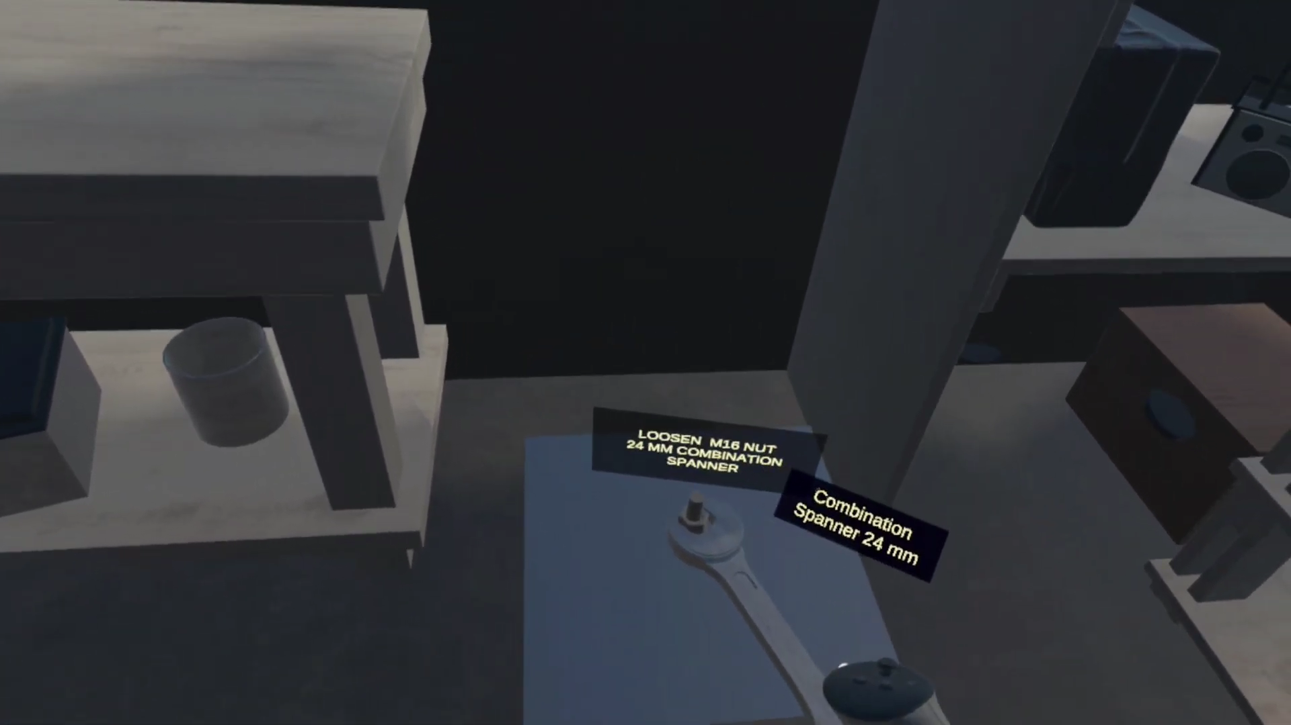
6th IEOM India International Conference · Bangalore, India · 5–7 November 2026
Design and Implementation of Two Virtual Reality Competency Trainers for Manual Assembly and Hand-Tool Selection on a Common Extended Reality Platform
A
Guided motor assembly
Prof. V Vasu¹ · Binet N B¹ · Mula Hruthik²
¹ Department of Mechanical Engineering, National Institute of Technology Warangal, Telangana, India
² Independent AR/VR developer, Warangal, Telangana, India
B
Hand-tool selection
Notes:
[0:00–0:20 | ~20 s]
Good morning. I am Binet N B from NIT Warangal, presenting joint work with Professor V Vasu and Mula Hruthik.
We built two virtual reality trainers on the same platform — one for assembling an electric motor, one for choosing the right hand tool — and we ask a simple question: what does it actually take to turn a VR scene into a trainer?
→ Transition: First, why this matters for manufacturing.

Slide 2



Interaction is now cheap — competency trainers are not
BACKGROUND & MOTIVATION
Manual assembly remains skill dependent
Commercial interaction framework supplies (configured)
It absorbs part-to-part variation, handles compliant components and supports low-volume, high-mix work without retooling — so quality is bound to operator competence.
Grasping
Ray pointing
UI pointing
Hand-pose authoring
Locomotion
VR is an established training medium
→ an object that can be picked up
No material use, no hazard exposure, unlimited repetition, direct instrumentation of trainee behaviour (Boud et al. 1999; Carlson et al. 2015).
A competency trainer also needs (must be written)
A representation of the task
Validation of what the trainee did against it
Guidance that advances with progress
Recording of performance, where scored
Standalone headsets removed the cost barrier
Inside-out tracking and bare-hand recognition: immersive training no longer needs a specialist facility.
The path from a working grasp system to a working trainer is not well documented.
Notes:
[0:20–1:05 | ~45 s]
Manual assembly is still skill dependent. It handles part variation and low-volume, high-mix work, so product quality depends on the operator. VR is an established way to train this: no material use, no hazard, unlimited repetition. And standalone headsets have removed the cost barrier.
(Point right.) Today a commercial framework gives you grasping, ray pointing, hand poses and locomotion by configuration — an object you can pick up. But a trainer needs more: a task, a check of what the trainee did, guidance, and a record of performance. The framework gives none of that.
→ Transition: What does the literature say about that missing layer?

Slide 3
Prior work shows VR training works — not what it takes to build
LITERATURE & RESEARCH GAP
Study | Scope | What it establishes
Daling & Schlittmeier (2024) | Scoping review: AR/VR/MR for manual assembly | Effects on objective and subjective measures; protocol structure explains much outcome variation
Di Pasquale et al. (2024) | Systematic review: VR assembly & disassembly | Structured assessment remains uncommon
Yang et al. (2023) | VR in manufacturing education | Effectiveness reviewed across disciplines and environments
Wang et al. (2022) | VR engine-assembly trainer (Unity, Quest 2) | Competency in fewer attempts than video demonstration
Alfaro-Viquez et al. (2025) | Meta Quest 3 welding trainer — closest system | User evaluation: reduced execution time, fewer positioning errors
Lin et al. (2024); Eswaran et al. (2024) | AR instruction authoring | Task specification derived as data from the product/CAD model
This paper | Two Quest trainers, one platform | What is built above the framework, and its cost (5,186 lines); decisions compared
None of these reports what must be built above a commercial interaction framework to obtain a competency trainer — nor how much effort that layer represents.
GAP
Notes:
[1:05–1:55 | ~50 s]
Three recent reviews — Daling and Schlittmeier, Di Pasquale, and Yang — confirm that immersive training works, and Di Pasquale notes that structured assessment is still rare. Wang et al. reached competency in fewer attempts than video. The closest system to ours, Alfaro-Viquez 2025, is a Quest 3 welding trainer evaluated with users. Lin et al. and Eswaran et al. derive the task specification from the product model — remember that.
(Point to dark box.) The gap: no one reports what must be built above the framework to get a trainer, or what that costs.
→ Transition: That gap sets our objectives.

Slide 4
Objectives and contributions
OBJECTIVES & CONTRIBUTIONS
Objectives
Contributions
1
Describe two VR competency trainers for different industrial tasks, built on one XR platform
Boundary made explicit
Framework vs. custom application layer, quantified: 5,186 lines of code across 21 source files
2
Identify what a commercial interaction framework supplies and what must be developed — and quantify that effort
Design decisions isolated
Two independent builds on one platform as parallel cases → one shared principle: derive the task specification from the scene
3
Compare task specification, validation and guidance strategies; identify the common design principle
Device-free verification
4
Report verification methods usable when interaction cannot be exercised outside the headset
Programmatic scene checks and seeded, headless simulation of session logic
Scope: an account of implementation — not a new interaction technique, not a training algorithm, and not a claim of instructional effectiveness.
Notes:
[1:55–2:35 | ~40 s]
Four objectives: describe both trainers; separate what the framework supplies from what we had to write, and measure it; compare the design strategies; and report how to verify a trainer without a headset.
Three contributions: the boundary made explicit — 5,186 lines of custom code; one shared design principle found by comparing two independent builds; and device-free verification methods.
(Bottom line.) To be clear on scope: this is an implementation account. We make no claim about learning outcomes.
→ Transition: Here is how the comparison was set up.

Slide 5
Two trainers analysed as parallel cases on one platform
RESEARCH APPROACH
Parallel cases
Shared platform (Table 1)
1
Property | System A | System B
Engine | Unity 6000.0.43f1 | Unity 6000.3.10f1
Render pipeline | URP 17.0.4 | URP 17.3
Interaction framework | Meta Interaction SDK 201.0.0 | Meta Interaction SDK 203.0.0
XR backend | OpenXR 1.14.3 | OpenXR 1.16.1
Target hardware | Meta Quest 3, standalone | Meta Quest 3 and 3S, standalone
Task model | Authored sequence, 26 steps | Seeded generation from scene scan
Two trainers built independently by the authors for different tasks; never merged
2
Characterise each system
Task model · validation rule · guidance strategy · assessment behaviour
3
Locate the framework boundary
Census of interaction components; custom code counted in lines and files
Why comparable: same engine family, framework, device and build method → differences reflect design decisions, not platform.
Qualification: different authors, so only structural decisions traceable to each task's requirements are compared.
4
Verify without a device
Programmatic scene checks; seeded headless session simulation (System B)
Notes:
[2:35–3:15 | ~40 s]
We treat the two trainers as parallel cases — built independently, for different tasks, never merged. For each, we describe the task model, validation rule, guidance and assessment; we locate the framework boundary by counting components and code; and we report verification.
(Point to table.) The comparison is fair because both use Unity 6, the same render pipeline, the Meta Interaction SDK, OpenXR and the Quest 3 — only minor versions differ. One qualification: different developers. So we compare only structural decisions linked to task requirements, not coding style.
→ Transition: System A first.

Slide 6
System A — guided assembly of a 26-component electric motor
SYSTEM A · IMPLEMENTATION
Placement validation
Scene start: record the world pose of every component while the motor is still assembled → placement targets
Parts scattered; trainee grasps and releases one
Check: is it the component this step requires — and within 0.15 m of its stored pose? (tolerance configurable)
Both hold: snaps to exact pose and locks
Either fails: rejected, part stays free
Fig. 1 Workspace with the highlighted active component and the 3D target-state display
26
26 × 2
4
2,422
Guidance — 3 concurrent channels: workspace highlight · continuous 3D target-state display · progress panel (informational)
Matters later: the 8 “fasten” steps resolve through the placement path, and no assessment data is recorded.
components — only 2 unique
JSON steps: assembly + disassembly
action classes: place · insert · fasten · remove
lines / 10 files (state machine 772)
Notes:
[3:15–4:15 | ~60 s]
System A trains assembly of a 26-component electric motor. Only 2 parts are unique; the other 24 come in identical groups such as spacers and hex nuts.
The sequence is not in the code. It sits in a JSON file — 26 steps for assembly and 26 for disassembly — so it can be changed without recompiling.
(Point right.) At start-up, while the motor is still assembled, the system records the pose of every part. Those poses become the targets. When the trainee releases a part, it checks two things: is it the right part for this step, and is it within 0.15 metres of its target? If yes, it snaps and locks; if not, it stays free.
Guidance uses three channels — the highlight and 3D target you see in Figure 1, plus a progress panel. Two points for later: the 8 fasten steps are treated as placement, and no assessment data is recorded.
→ Transition: System B is very different.

Slide 7
System B — hand-tool selection from a rack of 88 industrial tools
SYSTEM B · IMPLEMENTATION
Deliberate gaps (no 31 mm spanner, no 20 mm socket) → legal sizes come from a scan of the rack at session start
Fig. 2 Job label and a 24 mm combination spanner seated on the fastener by its working end
Score per job (100 points)
Observe
Guided
Assessed
90 s · no task · unscored
required tool is named
tool not named · scored
Selection 60
Procedure 20
Exec. 10
Eff. 10
Accepted only if type, size (within tolerance) and, where applicable, set torque all match. Rejected → fastener does not turn; tool retained for the debrief. 2,764 lines / 11 files.
Notes:
[4:15–5:15 | ~60 s]
System B trains tool selection. The trainee sees a fastener and must pick the right tool from a rack of 88 (point to chart) — spanners from 6 to 32 mm, sockets, hex keys, four torque instruments — then fit it and turn it. Figure 2 shows a 24 mm spanner on a nut.
The rack has deliberate gaps — no 31 mm spanner, no 20 mm socket — so the generator scans the rack at the start instead of using a fixed size table.
A tool is accepted only if type, size and, where needed, torque match. A wrong tool simply doesn't turn the fastener, and it is recorded for the debrief.
(Bottom left.) Three stages: 90 seconds of free observation, a guided stage, and a scored assessment. Selection carries 60 of 100 points; efficiency only 10, because rewarding speed on torque work would teach the wrong habit.
→ Transition: Now the first result.

Slide 8
Interaction was configured — the training layer was written
RESULT 1 · FRAMEWORK BOUNDARY
Training layer — written by the authors
5,186
Task representation
Object identity, type and size
Validation of trainee action
lines of custom application code across 21 source files
Fastener engagement and driving
Guidance that advances with progress
Performance recording and scoring
A
2,422 lines · 10 files
Framework boundary
B
2,764 lines · 11 files
Interaction framework — obtained by configuration (Meta Interaction SDK)
Grasp by tracked hand and controller
Ray selection and UI pointing
Authored hand poses
Framework side, System B:
183 ray interactables · 94 grabbables · 4 rotation transformers · 5 pointable canvases — with no interaction code written.
Constrained single-axis rotation
Locomotion and comfort vignette
Adapted from Fig. 3 and Table 3 of the paper
Notes:
[5:15–6:10 | ~55 s]
This is the central finding. Everything below the dashed line came from the Meta SDK by configuration — grasping, ray selection, hand poses, constrained rotation, locomotion. In System B that is 183 ray interactables and 94 grabbables, with no interaction code written.
Everything above the line had to be written. The framework has no idea of a task, a correct object, a fastener, a tool size, or a score.
That layer cost 5,186 lines across 21 files — about 2,400 in System A and 2,800 in System B.
In one line: the framework solves handling objects; the trainer is left to the developer.
→ Transition: How did the two systems build that layer differently?

Slide 9
Same problems, different decisions — one shared principle
RESULT 2 · DESIGN DECISIONS
Design problem | A · Guided assembly | B · Tool selection
Task specification | Authored sequence in an external JSON file; 26 steps, 4 action classes | Generated at session start from a rack scan, under coverage, interleaving and exclusion constraints
Source of ground truth | Component poses captured from the product model at scene start | Tool types and sizes enumerated from the tagged rack
Validation of trainee action | Correct component for the step, placed within 0.15 m of the captured pose | Correct type, size within tolerance and, where applicable, set torque within tolerance
Guidance strategy | Three concurrent channels: highlight, 3D target state, progress panel | Staged: 90 s observation → jobs naming the tool → jobs that do not
Failure behaviour | Placement rejected; component remains free | Fastener does not turn; rejected tool retained for the debrief
SHARED PRINCIPLE · REACHED INDEPENDENTLY
A
Poses captured from the product model → a revised model needs no re-targeting
Derive the task specification from the scene — don’t author it in code
B
Rack scanned each session → tools that are not on the wall are never requested
Otherwise a stale specification is scored as a trainee error (cf. Lin et al. 2024)
Notes:
[6:10–7:15 | ~65 s]
(Walk the table quickly.) A authors its sequence in a file; B generates jobs at session start. A validates by part identity and a 0.15-metre tolerance; B by tool type, size and torque. A guides with three simultaneous channels; B removes support in stages. On failure, A rejects the placement; B refuses to turn the fastener.
(Point to dark box.) But one decision is shared, and it was reached independently: neither system keeps its task specification in code — both derive it from the scene. A captures targets from the product model, so a revised model needs no re-targeting. B scans the rack, so it never asks for a tool that is not there.
The reason is the same: a hard-coded specification goes stale, and the error is then blamed on the trainee. This matches Lin et al. 2024.
→ Transition: How do we know the systems work as specified?

Slide 10
Verification without a headset: seeded, headless sweeps
RESULT 3 · SOFTWARE VERIFICATION
Tracked hands are unavailable outside the headset, so System B’s session logic is driven headlessly; because generation is seeded, every generated job can be inspected without a device.
685
0
0.060
0
15 / 15
torque jobs generated (200 seeds × 8 jobs per session) and checked
defects: missing instrument, unreachable target, or undialable target
N·m per degree, identical on all 4 torque instruments
sizes shared between training and assessment sets
generated torque labels fit the plate
Property (Table 5) | Method | Result
Rotation progress retention | Numeric simulation | 360° forward, then 180° reverse → retains 360°
Torque accumulation past wrap | 12 stops to 500° handle travel | Reads 54.99 N·m; monotonic past the wrap point
Session determinism | Seed 777 vs. seed 12345 | 1 of 10 slots identical
Shows
System B behaves as specified; System A verified by enumeration against its component manifest
Does not show
Learning outcome (no user data), or that no unknown class of defect exists
Notes:
[7:15–8:10 | ~55 s]
Hand tracking only works in the headset, so System B adds a headless layer that runs the session logic directly. Because generation is seeded, we can inspect any number of sessions.
We ran 200 seeds at 8 jobs per session — 685 torque jobs — and checked each for three defects: no instrument, a target outside the instrument's range, or a target it cannot dial. Zero defects.
All four torque instruments respond at 0.060 newton-metres per degree. Training and assessment share no sizes, so assessment tests the rule, not memory.
(Point right.) This proves software correctness — not learning. System A was checked by enumeration against its parts list.
→ Transition: The comparison also suggests how to combine the two.

Slide 11
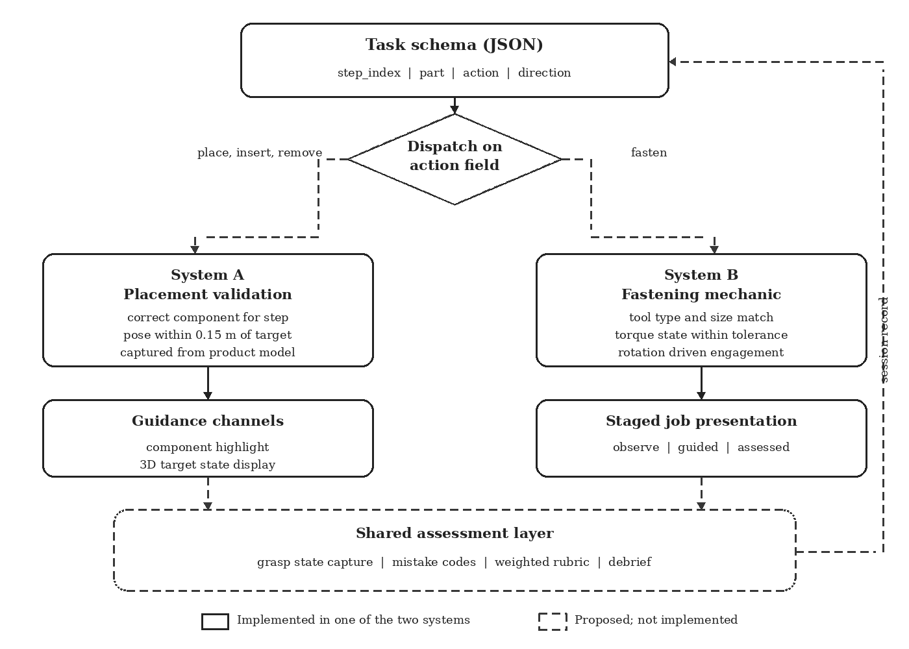
Each system implements what the other omits
DISCUSSION · PROPOSED INTEGRATION
PROPOSAL — NOT IMPLEMENTED
A
Names “fasten” (8 steps) in its schema, but resolves it as placement
B
Simulates fastening (tool, size, torque), but each fastener has no assembly context
1 · Dispatch on the action field
place / insert / remove → A’s validation; fasten → B’s mechanic. One task definition = a complete work instruction.
2 · Shared assessment layer
Extend B’s grasp-state capture to A’s placement errors, which A currently discards.
Both already broadcast state through event interfaces — no change to A’s assembly logic needed.
Fig. 4 Solid = implemented in one of the two systems; dashed = proposed, not implemented
Notes:
[8:10–9:00 | ~50 s]
The two systems complement each other. System A names fastening in its schema but treats it as placement. System B simulates fastening in detail but without any assembly around it.
(Point to the red tag and dashed boxes.) We propose — and these are proposals only — two steps. First, dispatch on the action field: place, insert and remove go to A's validation; fasten goes to B's fastening mechanic. One task file would then describe a full work instruction. Second, a shared assessment layer: extend B's capture of wrong pickups to A's placement errors, which A currently throws away.
Both systems already communicate through events, so this is technically coherent.
→ Transition: What does this mean, and where does it stop?

Slide 12



What this work contributes — and where it stops
CONTRIBUTIONS · IMPLICATIONS · LIMITATIONS
Contributions
Practical implications
Limitations
The framework boundary, made explicit and quantified: 5,186 lines, 21 files
A side-by-side comparison of design decisions taken independently on one platform
Verification methods for when interaction cannot be exercised off-device
Plan for the training layer: task, validation, guidance and assessment are written, not configured
Derive the task specification from the scene, so product revisions and rack changes do not become false trainee errors
Seeded generation lets every session be checked without a headset
No user study: no claim on learning outcome, skill acquisition or transfer
Evidence from two systems, two developers, one platform
The integration is a proposal only; System A records no assessment data
Notes:
[9:00–9:45 | ~45 s]
Contributions: the framework boundary, made explicit and measured; a comparison of independent design decisions; and verification methods without a device.
For practitioners: interaction is the cheap part — budget for the training layer. Derive the task specification from the scene, so product or rack changes don't become false trainee errors. And seed your generator, so every session can be checked automatically.
(Point right.) Limitations, stated plainly: no user study, so no claim on learning or transfer; two systems by two developers on one platform; and the integration is a proposal.
→ Transition: To conclude.

Slide 13
Conclusion and future work
CONCLUSION & FUTURE WORK
All four objectives addressed
Next steps (from the stated proposals and limitations)
1
Both trainers described by task model, validation, guidance and assessment (Sec. 3.2–3.3)
Implement action-field dispatch: one work instruction spanning placement and fastening
Extend grasp-state assessment to System A’s placement errors
User study to measure learning outcome and transfer
2
Framework supplies interaction; the training layer took 5,186 lines in 21 files (Sec. 3.4)
3
Shared principle: derive the task specification from the scene (Sec. 5.1)
4
Device-free verification: 685 generated jobs checked headlessly (Sec. 3.6, 5.4)
Interaction can now be configured. The competency trainer — task, validation, guidance, assessment — still has to be written.
Notes:
[9:45–10:15 | ~30 s]
All four objectives are met: both trainers described; the boundary measured at 5,186 lines; one shared principle — derive the task specification from the scene; and 685 jobs verified without a headset.
Next: implement the dispatch, extend assessment to System A, and run a user study.
(Read the bottom line.) Interaction can now be configured; the competency trainer still has to be written.

Slide 14
Thank you — Questions?
Acknowledgement
The authors thank the ASEAN collaborative project between the Department of Mechanical Engineering, National Institute of Technology Warangal, and Universiti Malaysia Pahang Al-Sultan Abdullah, under which part of this work was undertaken.
A
B
Contact
vasu@nitw.ac.in · bn25mem3r03@student.nitw.ac.in · mulahruthik2000@gmail.com
Notes:
[10:15–10:30 | ~15 s]
Part of this work was done under the ASEAN collaborative project between NIT Warangal and Universiti Malaysia Pahang Al-Sultan Abdullah. Thank you — I am happy to take questions.
(About 1:30 of buffer remains in the 12-minute slot. For questions on verification or task generation, jump to slides 15–16.)

Slide 15
How the reported numbers were obtained
BACKUP · VERIFICATION & DATA PROVENANCE
System B verification gate (Sec. 3.6)
Data provenance (Sec. 4)
Structural assertions
System A counts are exact: enumerated from the component verification list and cross-checked against the task configuration file
Rack composition enumerated from the tagged tool set in the deployed scene
Interaction component counts: census over every object in the scene, including inactive objects
System B scene: 458 mesh instances, 2,106,767 triangles, 63 materials (1,172,734 triangles in the 88 tools)
No human participant data collected; all results are properties of the software
1
Programmatic checks over the scene graph
2
Clean play-mode console
Any error or warning fails the gate (hard gate)
3
Headless session layer
Drives session logic through reflection: generates and steps through complete sessions so labels, task sequences, scoring and text layout are verified in bulk
Notes:
BACKUP — use only if asked how verification was done, where the numbers come from, or about scene complexity / performance.
Three-layer gate in System B: structural assertions over the scene graph; a clean play-mode console as a hard gate; then headless simulation through reflection. All counts were enumerated, not sampled. Scene: 458 mesh instances, about 2.1 million triangles, 63 materials. The paper does not report frame rate — if asked, say so honestly.

Slide 16
Component manifest and task-generation rules
BACKUP · TASK MODELS IN DETAIL
System B job generation (seeded)
Coverage: every playable family appears at least once
Interleaving: identical neighbouring families separated after shuffling
No recurrence of a size within a fixed number of jobs
Assessment list uses the training list as an exclusion set
Same seed → same session, so an instructor can reissue it
Assessment capture
Grasp state of every tool polled for a rising edge → one event per pickup
Weights 60 / 20 / 10 / 10: efficiency smallest, since rewarding speed on a torque operation would reinforce the wrong behaviour
JSON step entry: step index · part name · action (place / insert / fasten / remove) · insertion direction. 24 of 26 parts belong to groups of geometrically identical members.
Notes:
BACKUP — use if asked about System A's part list, the JSON schema, how System B generates jobs, or the scoring weights.
26 parts; only the stator and rotor are unique. Generation enforces coverage, interleaving, a no-repeat window, and an exclusion set between training and assessment; it is seeded, so sessions can be reissued. Wrong selections are captured by polling grasp state for a rising edge — one event per pickup.

