Slide 1
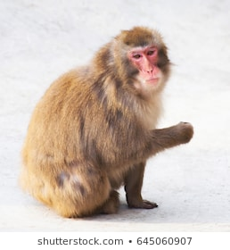
(R : 226 , G : 227, B : 231)
1 pixel : 3차원 vector
(R , G, B) * Pixel 개수
1 image : 3차원 Vector의 묶음
64 x 64 Image

Slide 2
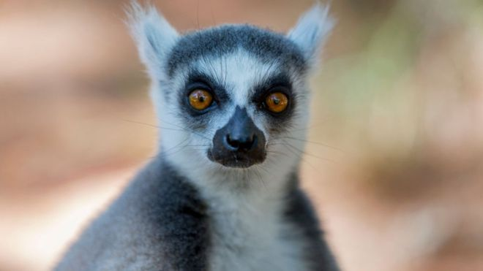
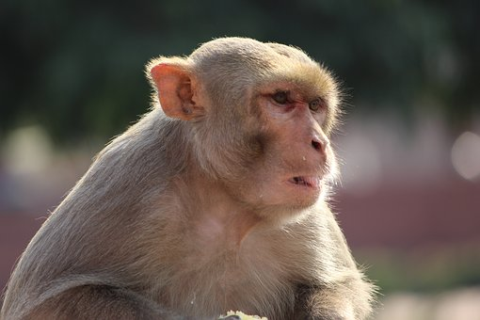
(R , G, B, Image_number) * Pixel 개수
(R , G, B, Pixel_index) * Image 개수
여러 개의 64 x 64 Image
여러 개의 image : 4차원 Vector의 묶음

Slide 3
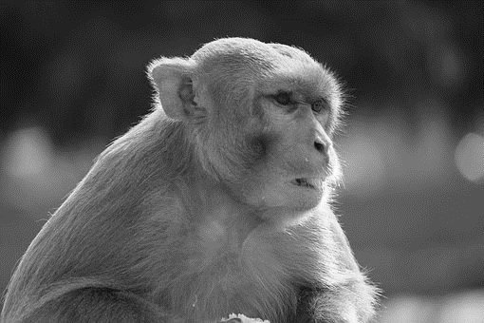
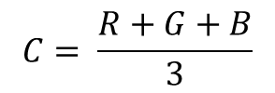
$$C= \frac{R+G+B}{3}$$
RGB Image
GrayScale Image
3차원 Vector의 묶음 : (R,G,B)
1차원 Vector의 묶음 : (C)

Slide 4

Blur 처리

Slide 5
Input
Filter / Kernel
Output
1/16 | 1/8 | 1/16
1/8 | ¼ | 1/8
1/16 | 1/8 | 1/16
2 | 3 | 5 | 1 | 7 | 8 | 2
2 | 2 | 23 | 25 | 27 | 2 | 1
4 | 4 | 32 | 34 | 25 | 1 | 2
3 | 24 | 25 | 23 | 24 | 2 | 1
3 | 26 | 28 | 24 | 26 | 4 | 5
3 | 24 | 12 | 43 | 26 | 6 | 7
36 | 37 | 34 | 23 | 57 | 7 | 8
2 | 3 | 5 | 1 | 7 | 8 | 2
2 | 2 | 23 | 25 | 27 | 2 | 1
4 | 4 | 32 | 34 | 25 | 1 | 2
3 | 24 | 25 | 23 | 24 | 2 | 1
3 | 26 | 28 | 24 | 26 | 4 | 5
3 | 24 | 12 | 43 | 26 | 6 | 7
36 | 37 | 34 | 23 | 57 | 7 | 8
1/16 | 1/8 | 1/16
1/8 | ¼ | 1/8
1/16 | 1/8 | 1/16

Slide 6
Input
Filter / Kernel
Output
1/16 | 1/8 | 1/16
1/8 | ¼ | 1/8
1/16 | 1/8 | 1/16
2 | 3 | 5 | 1 | 7 | 8 | 2
2 | 2 | 23 | 25 | 27 | 2 | 1
4 | 4 | 32 | 34 | 25 | 1 | 2
3 | 24 | 25 | 23 | 24 | 2 | 1
3 | 26 | 28 | 24 | 26 | 4 | 5
3 | 24 | 12 | 43 | 26 | 6 | 7
36 | 37 | 34 | 23 | 57 | 7 | 8
2 | 3 | 5 | 1 | 7 | 8 | 2
2 | 2 | 23 | 25 | 27 | 2 | 1
4 | 4 | 32 | 34 | 25 | 1 | 2
3 | 24 | 25 | 23 | 24 | 2 | 1
3 | 26 | 28 | 24 | 26 | 4 | 5
3 | 24 | 12 | 43 | 26 | 6 | 7
36 | 37 | 34 | 23 | 57 | 7 | 8
1/16 | 1/8 | 1/16
1/8 | ¼ | 1/8
1/16 | 1/8 | 1/16

Slide 7
2 | 3 | 5 | 1 | 7 | 8 | 2
2 | 2 | 23 | 25 | 27 | 2 | 1
4 | 4 | 32 | 34 | 25 | 1 | 2
3 | 24 | 25 | 23 | 24 | 2 | 1
3 | 26 | 28 | 24 | 26 | 4 | 5
3 | 24 | 12 | 43 | 26 | 6 | 7
36 | 37 | 34 | 23 | 57 | 7 | 8
2 | 3 | 5 | 1 | 7 | 8 | 2
2 | 2 | 23 | 25 | 27 | 2 | 1
4 | 4 | 32 | 34 | 25 | 1 | 2
3 | 24 | 25 | 23 | 24 | 2 | 1
3 | 26 | 28 | 24 | 26 | 4 | 5
3 | 24 | 12 | 43 | 26 | 6 | 7
36 | 37 | 34 | 23 | 57 | 7 | 8
1/16 | 1/8 | 1/16
1/8 | ¼ | 1/8
1/16 | 1/8 | 1/16

Slide 8
1/16 | 1/8 | 1/16
1/8 | ¼ | 1/8
1/16 | 1/8 | 1/16
2 | 23 | 25
4 | 32 | 34
24 | 25 | 23
 | 23.375
$$2\left(\frac{1}{16}\right)+23\left(\frac{1}{8}\right)+25\left(\frac{1}{16}\right)+4\left(\frac{1}{8}\right)+32\left(\frac{1}{4}\right)+34\left(\frac{1}{8}\right)+24\left(\frac{1}{16}\right)+25\left(\frac{1}{8}\right)+23\left(\frac{1}{16}\right)=\text{23.375}$$

Slide 9
2 | 3 | 5 | 1 | 7 | 8 | 2
2 | 2 | 23 | 25 | 27 | 2 | 1
4 | 4 | 32 | 34 | 25 | 1 | 2
3 | 24 | 25 | 23 | 24 | 2 | 1
3 | 26 | 28 | 24 | 26 | 4 | 5
3 | 24 | 12 | 43 | 26 | 6 | 7
36 | 37 | 34 | 23 | 57 | 7 | 8
2 | 3 | 5 | 1 | 7 | 8 | 2
2 | 2 | 23 | 25 | 27 | 2 | 1
4 | 4 | 32 | 34 | 25 | 1 | 2
3 | 24 | 25 | 23 | 24 | 2 | 1
3 | 26 | 28 | 24 | 26 | 4 | 5
3 | 24 | 12 | 43 | 26 | 6 | 7
36 | 37 | 34 | 23 | 57 | 7 | 8
모든 Pixel에 Filtering

Slide 10

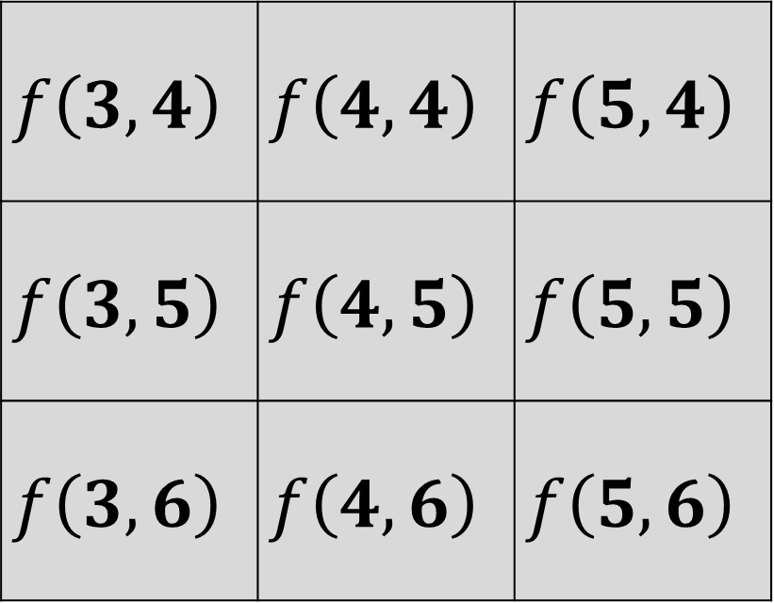




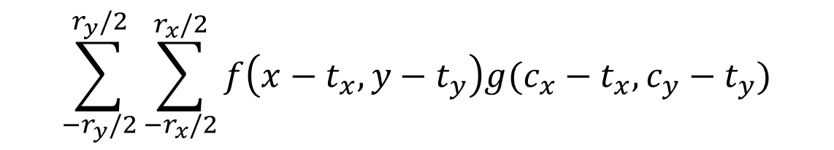
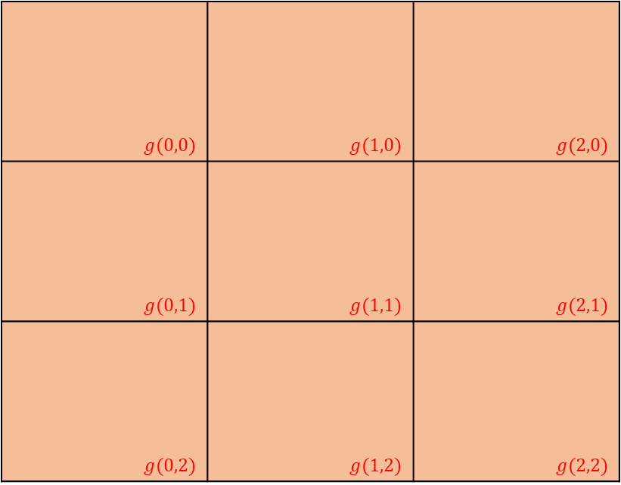

$f\left(x,y\right) : 원$래 image의 fixel 값
$$g(0,0)$$ | $$g(1,0)$$ | $$g(2,0)$$
$$g(0,1)$$ | $$g(1,1)$$ | $$g(2,1)$$
$$g(0,2)$$ | $$g(1,2)$$ | $$g(2,2)$$
$$f\left(3,4\right)$$ | $$f\left(4,4\right)$$ | $$f\left(5,4\right)$$
$$f\left(3,5\right)$$ | $$f\left(4,5\right)$$ | $$f\left(5,5\right)$$
$$f\left(3,6\right)$$ | $$f\left(4,6\right)$$ | $$f\left(5,6\right)$$
$g\left(x,y\right) :filter matrix의$ 값
$c_{x} :filter matrix의$ 중앙 x값
$c_{y} :filter matrix의$ 중앙 y값
$r_{x} :filter matrix의$ 너비
$r_{y} :filter matrix의$ 높이
$$\sum_{−r_{y}/2}^{r_{y}/2}{\sum_{−r_{x}/2}^{r_{x}/2}{f\left(x−t_{x},y−t_{y}\right)g(c_{x}−t_{x},c_{y}−t_{y})}}$$

Slide 11
2 | 3 | 5 | 1
2 | 2 | 23 | 25
4 | 4 | 32 | 34
3 | 24 | 25 | 23
2 | 3 | 5 | 1
2 | 2 | 23 | 25
4 | 4 | 32 | 34
3 | 24 | 25 | 23
2 | 3 | 5 | 1
2 | 2 | 23 | 25
4 | 4 | 32 | 34
3 | 24 | 25 | 23
Feature Map
2 | 3 | 5 | 1
2 | 2 | 23 | 25
4 | 4 | 32 | 34
3 | 24 | 25 | 23

Slide 12
2 | 3 | 5 | 1
2 | 2 | 23 | 25
4 | 4 | 32 | 34
3 | 24 | 25 | 23
2 | 3 | 5 | 1
2 | 2 | 23 | 25
4 | 4 | 32 | 34
3 | 24 | 25 | 23
Feature Map
0 | 0 | 0 | 0
0 |  |  | 0
0 |  |  | 0
0 | 0 | 0 | 0
Padding

Slide 13
Max pooling
3 | 25
24 | 34
2 | 3 | 5 | 1
2 | 2 | 23 | 25
4 | 4 | 32 | 34
3 | 24 | 25 | 23
Average pooling
2 | 18
11 | 28
Min pooling
2 | 1
3 | 23

Slide 14
Convolution
Layer
Convolution
Layer
Max pooling
Layer
Max pooling
Layer
이미지 특징 추출
Data Size 감소
이미지 특징 강화
Data Size 감소
이미지 특징 추출
Data Size 감소
이미지 특징 강화
Data Size 감소

Slide 15
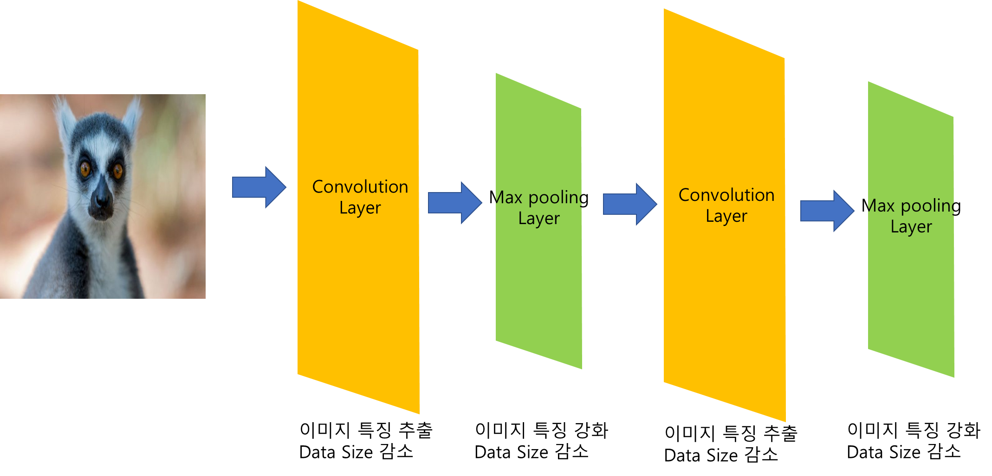

Slide 16
Pixel 개수
Image :
Input Layer
Hidden Layer 1
Hidden Layer 2
Output Layer 2

Slide 17




$$f(t)$$
$$g(t)$$
$$g(−t)$$
$$f(t)$$

Slide 18





$$f(t)$$
$$g(τ−t)$$
$$f(t)$$
$$g(τ−t)$$
$$\int_{−∞}^{∞}{f(t)}g(τ−t)$$

Slide 19


$$f(t)$$
$$g(τ −t)$$

